Slide 1

News
28/06/24
Actual programming
This is the before last CC session before the summer holidays.
I’ve decided to make you guys code a small little game…
Next week we’ll do a kahoot/blooket on the theme of computers
There will be a form for you to fill in as to what you want included…

Slide 2
The Game
28/06/24
News
This is the before last CC session before the summer holidays.
I’ve decided to make you guys code a small little game…
Next week we’ll do a kahoot/blooket on the theme of computers
There will be a form for you to fill in as to what you want included…
Actual programming
Make
Make the computer generate a random number
Input
Input a guess for the computer to compare against
Compare
Compare the guess to the computer generate number
Repeat
Repeat until the player gets the number correct
Add
Extension: add consequences for wrong numbers
Input
Input a string to convert to binary
Write
Write the binary message to a file
Read
Read the binary message from the file
Convert
Convert the binary message back to a string
Extension:
Make it repeatable endlessly unless specified otherwise
28/06/24

Slide 3
This is the before last CC session before the summer holidays.
I’ve decided to make you guys code a small little game…
Next week we’ll do a kahoot/blooket on the theme of computers
There will be a form for you to fill in as to what you want included…
News
Extra Help – Code snippets not in actual order
The Game
Easy - Guess the number/ Russian Roulette
Harder – Binary message encoder and decoder
Make
Make the computer generate a random number
Input
Input a guess for the computer to compare against
Compare
Compare the guess to the computer generate number
Repeat
Repeat until the player gets the number correct
Add
Extension: add consequences for wrong numbers
Input
Input a string to convert to binary
Write
Write the binary message to a file
Read
Read the binary message from the file
Convert
Convert the binary message back to a string
Extension:
Make it repeatable endlessly unless specified otherwise
import random # Import name
comp_num = random.randint(1,10) # The computer generated number
if guess < comp_num: # If else statement giving you hints
print("Too low!")
elif guess > comp_num:
print("Too high!")
while guess != comp_num: # While loop with condition
binary_message = ' '.join(format(ord(char), '08b') for char in user_input)
# changes string to binary
binary_data = bytearray(int(b, 2) for b in binary_message.split())
file.write(binary_data) # adds the binary data to a file (you need to open the file first (not shown in code snippet)
binary_data = file.read() # gets the binary data from file
binary_message = ' '.join(format(byte, '08b') for byte in binary_data)
message = ''.join(chr(int(binary, 2)) for binary in binary_message.split())
# Converts the binary data back to a string

Slide 4
Extra Help – Code snippets not in actual order
The Game
import random # Import name
comp_num = random.randint(1,10) # The computer generated number
if guess < comp_num: # If else statement giving you hints
print("Too low!")
elif guess > comp_num:
print("Too high!")
while guess != comp_num: # While loop with condition
binary_message = ' '.join(format(ord(char), '08b') for char in user_input)
# changes string to binary
binary_data = bytearray(int(b, 2) for b in binary_message.split())
file.write(binary_data) # adds the binary data to a file (you need to open the file first (not shown in code snippet)
binary_data = file.read() # gets the binary data from file
binary_message = ' '.join(format(byte, '08b') for byte in binary_data)
message = ''.join(chr(int(binary, 2)) for binary in binary_message.split())
# Converts the binary data back to a string
Make
Make the computer generate a random number
Input
Input a guess for the computer to compare against
Compare
Compare the guess to the computer generate number
Repeat
Repeat until the player gets the number correct
Add
Extension: add consequences for wrong numbers
Input
Input a string to convert to binary
Write
Write the binary message to a file
Read
Read the binary message from the file
Convert
Convert the binary message back to a string
Extension:
Make it repeatable endlessly unless specified otherwise

Slide 5

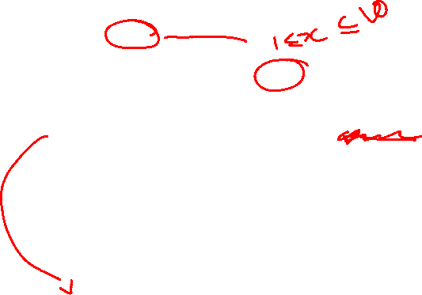
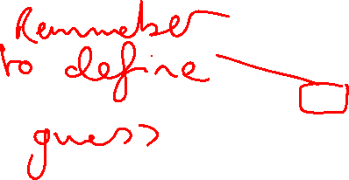
Extra Help – Code snippets not in actual order
The Game
import random # Import name
comp_num = random.randint(1,10) # The computer generated number
if guess < comp_num: # If else statement giving you hints
print("Too low!")
elif guess > comp_num:
print("Too high!")
while guess != comp_num: # While loop with condition
Make
Make the computer generate a random number
Input
Input a guess for the computer to compare against
Compare
Compare the guess to the computer generate number
Repeat
Repeat until the player gets the number correct
Add
Extension: add consequences for wrong numbers
Input
Input a string to convert to binary
Write
Write the binary message to a file
Read
Read the binary message from the file
Convert
Convert the binary message back to a string
Extension:
Make it repeatable endlessly unless specified otherwise
binary_message = ' '.join(format(ord(char), '08b') for char in user_input)
# changes string to binary
binary_data = bytearray(int(b, 2) for b in binary_message.split())
file.write(binary_data) # adds the binary data to a file (you need to open the file first (not shown in code snippet)
binary_data = file.read() # gets the binary data from file
binary_message = ' '.join(format(byte, '08b') for byte in binary_data)
message = ''.join(chr(int(binary, 2)) for binary in binary_message.split())
# Converts the binary data back to a string

