Slide 1
ErgoCompass
Posture Monitoring System
TECHIN514A — Winter 2026
Felix Du
GitHub: https://github.com/Felix-Jr056/TECHIN514A-Wi26

Slide 2
The Problem
Poor sitting posture is a silent epidemic
• 80% of adults experience back pain at some point — poor posture is a leading cause
• Office workers sit 8+ hours/day, often unaware of their posture degradation
• Existing solutions are expensive, bulky, or require constant phone interaction
• No real-time, ambient feedback system exists for desk workers
• Posture problems develop gradually — by the time you feel pain, damage is done

Slide 3
Proposed Solution
ErgoCompass — A two-device wireless posture monitoring system
Sensor Device (Chair Pad)
Fabric pad attached to chair back
3× FSR 406 pressure sensors (top / mid / bottom)
ADS1115 16-bit ADC for precise readings
XIAO ESP32-C3 microcontroller
BLE server — transmits at 5 Hz
500 mAh LiPo battery
Display Device (Desk Unit)
X27 stepper motor gauge needle (posture score)
3× NeoPixel LEDs (per-sensor feedback)
Green = good posture, Red = bad posture
One-button calibration for personalization
XIAO ESP32-C3 as BLE client
Ambient feedback — no phone needed

Slide 4
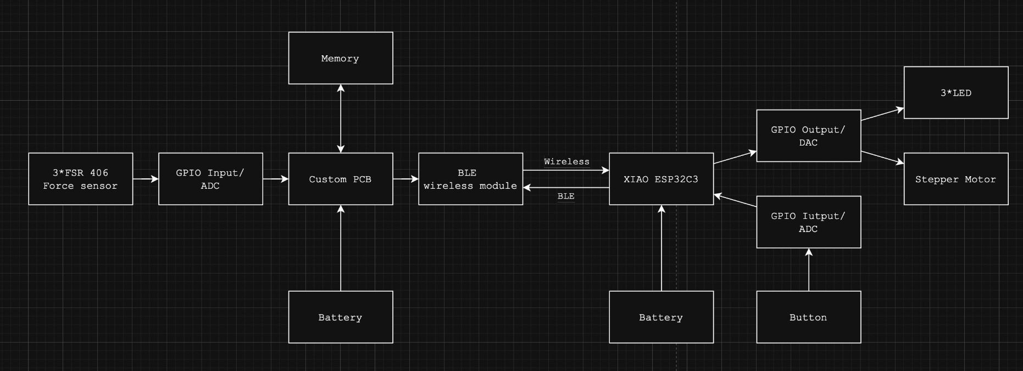
System Architecture

Slide 5
Critical Components
[ Sensor PCB — Insert Photo ]
[ Display PCB — Insert Photo ]
[ Assembled Sensor Pad — Insert Photo ]
[ Assembled Display Unit — Insert Photo ]
[ FSR 406 Sensors — Insert Photo ]

Slide 6
Signal Processing & Algorithm
1. Sensor-Side: ADC + Filtering
ADS1115 (±2.048V, 16-bit resolution)
Baseline subtraction at boot (10-sample average, no pressure)
Noise floor: readings < 200 clamped to 0
EMA filter: α=0.1 (heavy smoothing for slow posture changes)
Output: 3× int16 values at 5 Hz over BLE
2. Display-Side: Posture Scoring
Ideal values: Top=28000, Mid=15000, Bot=0
Per-channel deviation normalized to 0–1
Weighted combination: 35% top + 40% mid + 25% bot
Score 0.0 (good) → needle 300° | Score 1.0 (bad) → needle 240°
LED: green at ideal, linear gradient to red at deviation
3. Accuracy & Performance
FSR response: ~0–30000 ADC range under typical sitting pressure
Baseline calibration eliminates per-sensor DC offset
EMA smoothing removes >90% of high-frequency noise while preserving posture transitions
LED + motor update rate: real-time on each BLE notification (5 Hz)

Slide 7
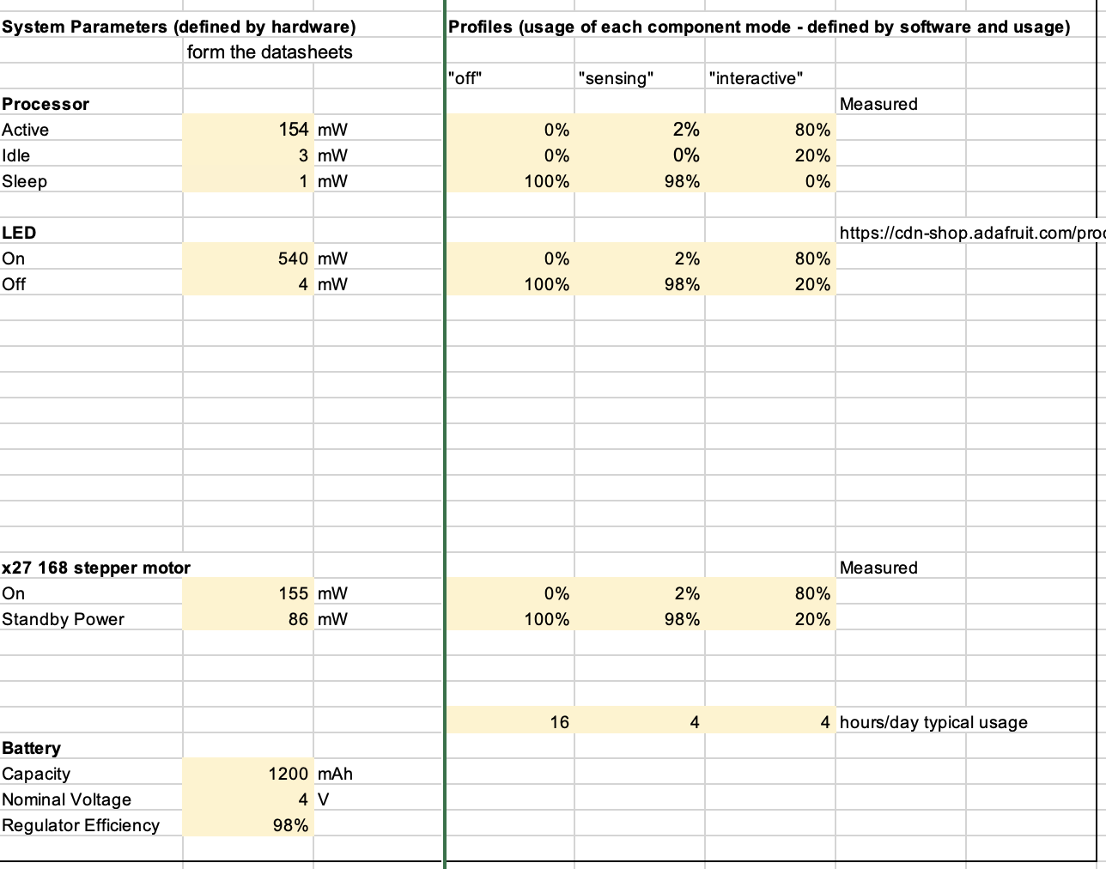
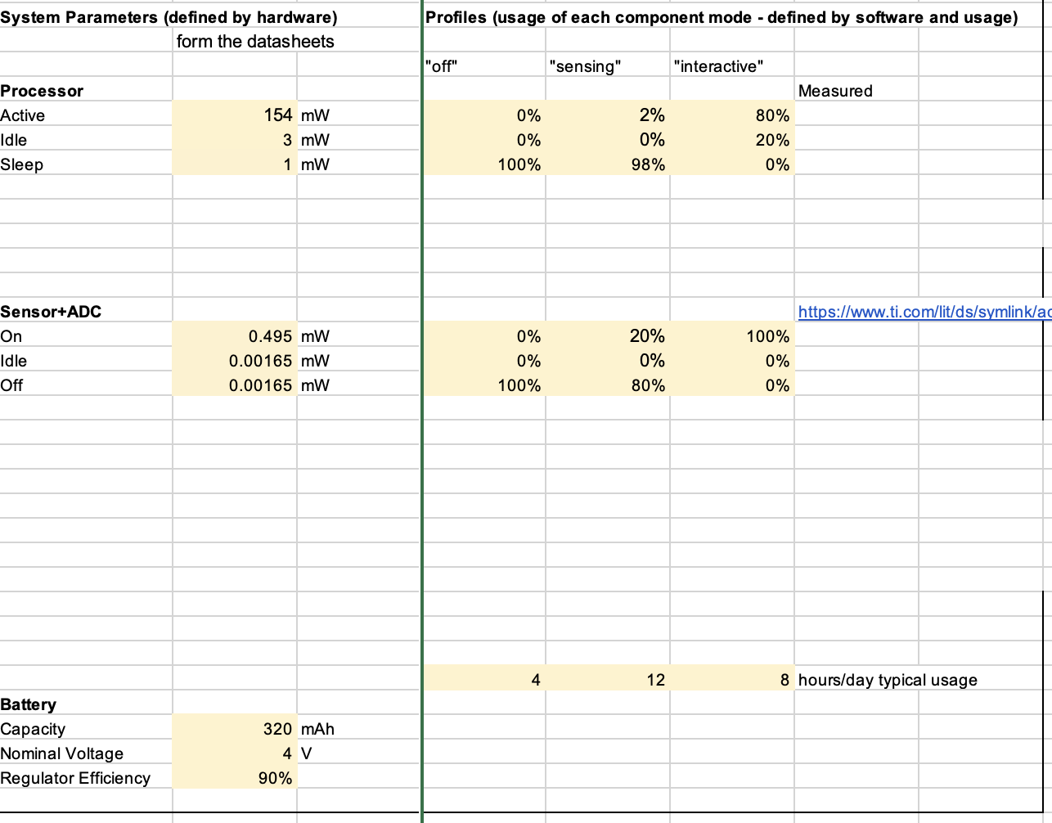
Battery Considerations
Sensor
Battery: 3.7V 800mAh LiPo
Usage: 4/12/8 h per day
Display
Battery: 3.7V 1200mAh LiPo
Usage: 16/4/4 h per day
Estimated Battery Life
Sensor: 24.5 hours continuous use
Display: 22.39 hours continuous use
Extreme Using scenario: 8 hours

Slide 8
Budget Summary
Component | Model | Qty | Est. Cost
Microcontroller | XIAO ESP32-C3 | 2 | $10.00
ADC | TI ADS1115IDGS | 1 | $3.00
Pressure Sensors | Interlink FSR 406 | 3 | $28.00
Stepper Motor | X27 | 1 | Makerspace
NeoPixel LEDs | 1655 | 10 | $5.00
Button |  | 1 | Makerspace
LiPo Batteries |  | 2 | $10.00
Custom PCBs |  | 2 | Makerspace
Misc (resistors, connectors) | 0805 / headers | — | Makerspace
 |  | TOTAL | $56

Slide 9
Future Work
▸ More integrated design
Mergeging seamlessly with office chairs
▸ Mobile App Integration
Companion app for posture history, trends, and configurable alerts
▸ Machine Learning
On-device posture classification (good/slouch/lean) trained on collected FSR data
▸ Haptic Feedback
Add vibration motor to sensor pad for immediate tactile posture correction alerts

Slide 10
Video

