Slide 1
Introduction to Mushroom Learning
Machine Learing in mushroom context
by Victoria Szabo, Cornelia Gruber, Andreas Klaß and Felix Langer
LMU – Introduction to Machine Learning – students project – SoSe 2020

Slide 2
Structure
1.) Goals
2.) Data set
3.) Method Decisions
4.) Implementation with mlr3
5.) Results

Slide 3
Goals
Classification of mushrooms: edible or poisnous
Using Machine Learing methods
Using mlr3-Package

Slide 4

Data set
8124 observations
Binary target variable (edible or poisonous)
22 nominal features (characteristics of each mushroom)

Slide 5
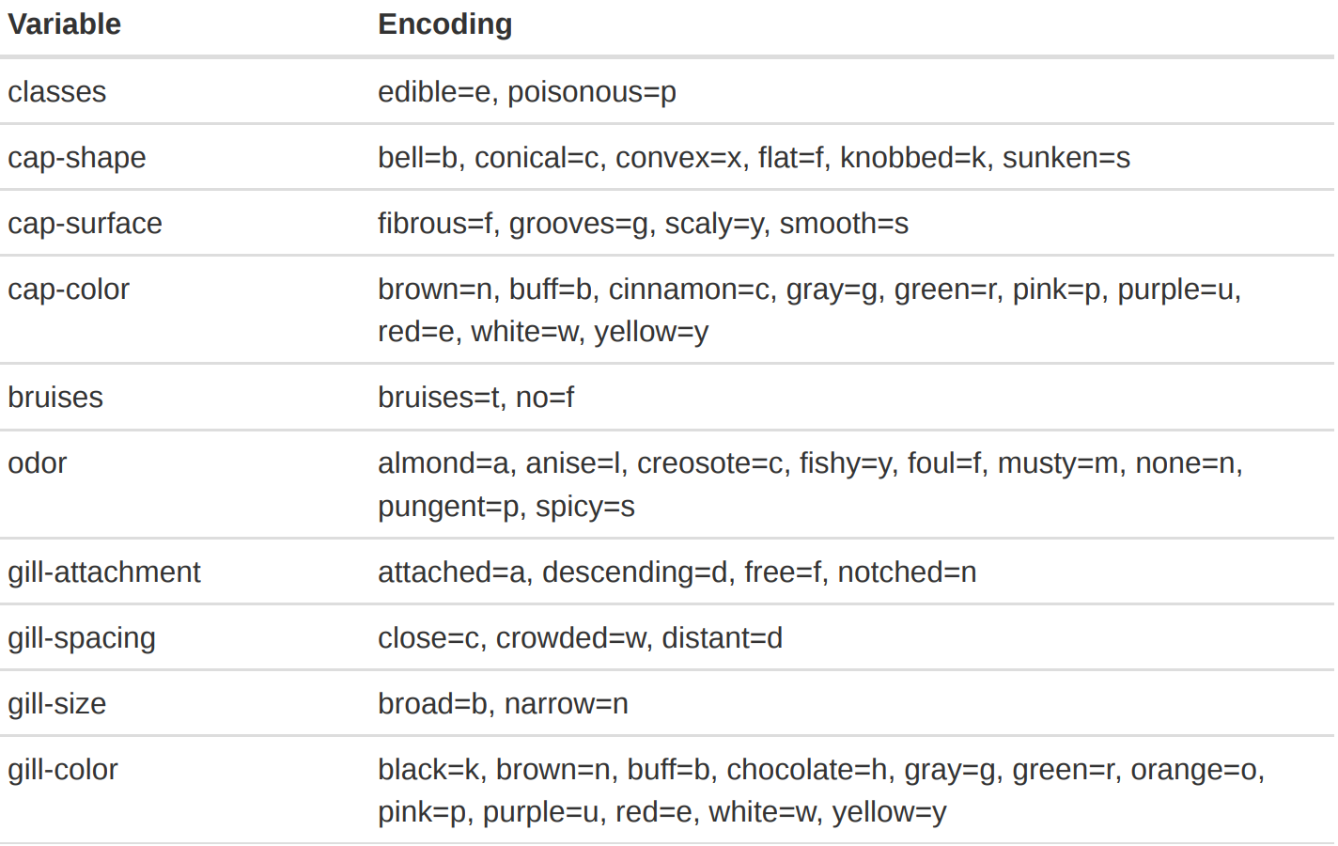
Data set
...

Slide 6
Method decisions
6 classification methods:
  Featureless
  Naive Bayes
  LDA/QDA
  Decision Tree
  Random Forest
  KNN
  Logistic Regression

Slide 7
Method decisions
6 classification methods:
  Featureless
  Naive Bayes
  LDA/QDA
  Decision Tree
  Random Forest → + Tuning mtry
  KNN → + Tuning k
  Logistic Regression

Slide 8
Method decisions
Generalisation Error & Hyperparameter tuning
  Nested Resampling
    Inner loop: 5-fold CV (Hyperparameter tuning)
    Outer loop: 10-fold CV (final GE)
  Optimization criteria: AUC
  Further measures: False Positive Rate

Slide 9
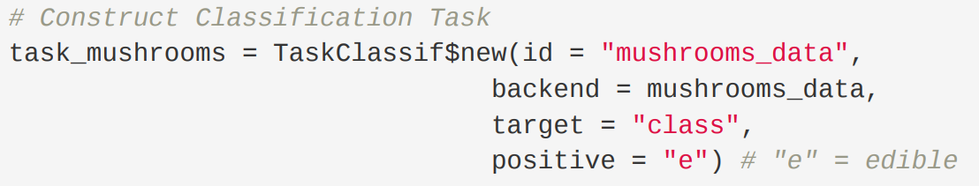
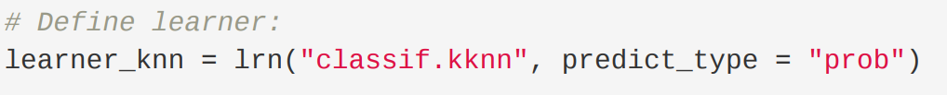
Implementation with mlr3
Task
Learner

Slide 10
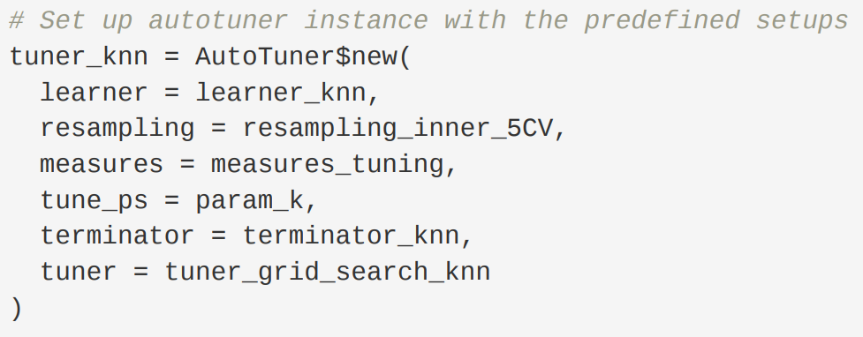
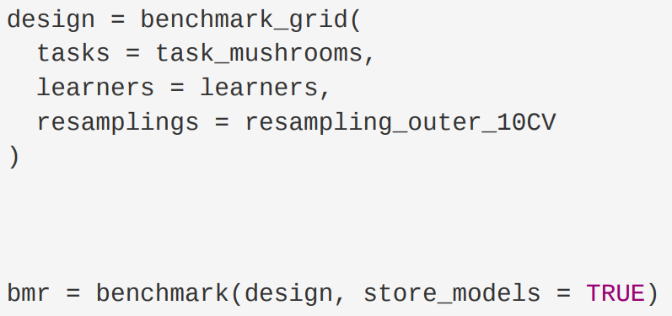
Implementation with mlr3
Tuner
Benchmark

Slide 11
Results
Warning messages with logistic regression
Performance measures:
Method | AUC | FPR
Featureless | 0.5000 | 1.000
Naive Bayes | 0.9960 | 0.1156
Dicision Tree | 0.9939 | 0.0122
Random Forest | 1.0000 | 0.0000
KNN | 1.0000 | 0.0003
Logistic Regression | 1.0000 | 0.0000

Slide 12
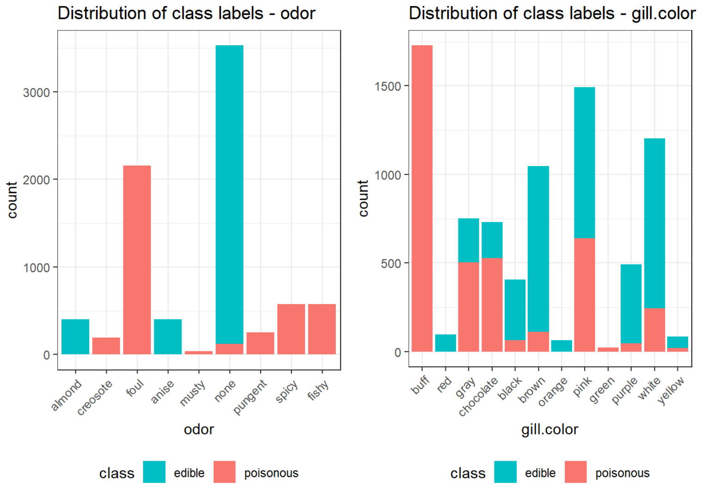
Results

Slide 13
Results
Warning messages with logistic regression
Performance measures:
Method | AUC | FPR
Featureless | 0.5000 | 1.000
Naive Bayes | 0.9960 | 0.1156
Dicision Tree | 0.9939 | 0.0122
Random Forest | 1.0000 | 0.0000
KNN | 1.0000 | 0.0003
Logistic Regression | 1.0000 | 0.0000

Slide 14
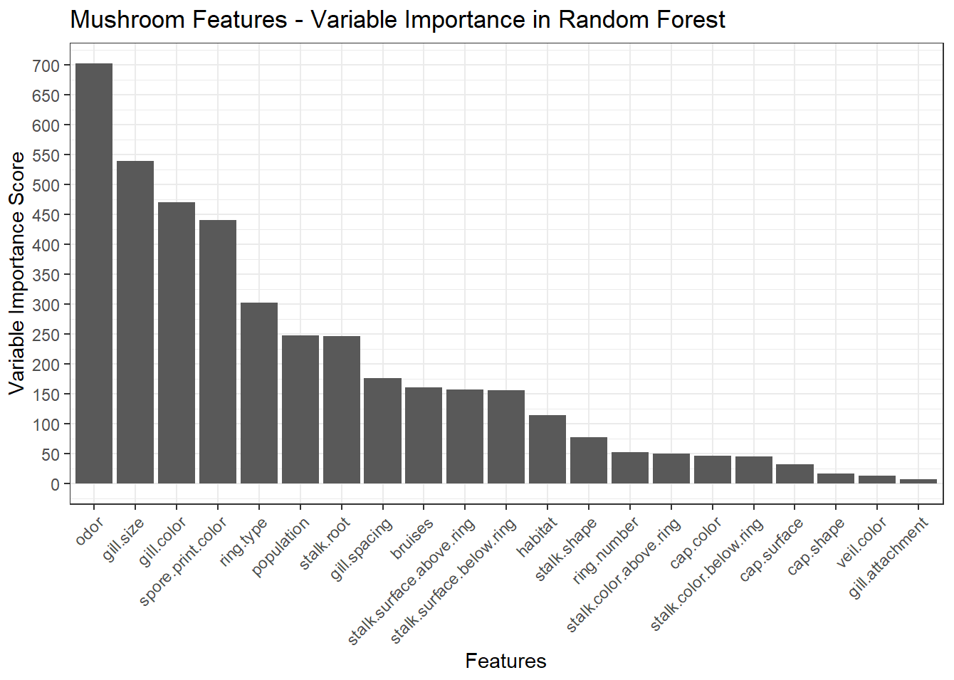
Results

Slide 15
Thank you!!!

Slide 16
Notes
Erwähnen:
  Default parameters for other methods:
    Only: complexity parameter?
  Grid search since discrete
  Welches Maß für Variable Importance?
  QUELLEN!!!!

