Slide 1


Slide 2

US SME Security Breaches
Felix Oppenheimer

Slide 3

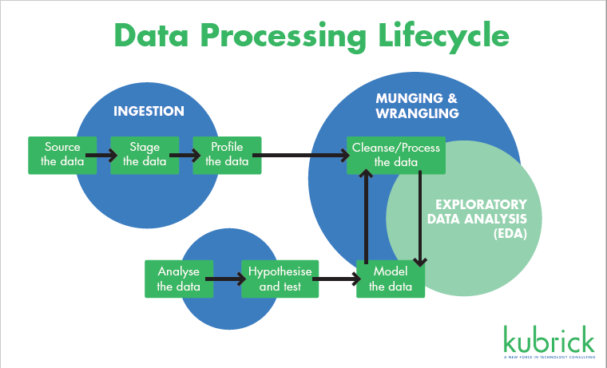
Planning
What questions am I trying to answer?
How many breaches?
How often?
What type or breach/ company?
What impact does a breach have?
Sourcing the data
Profile the data
Gain insights

Slide 4
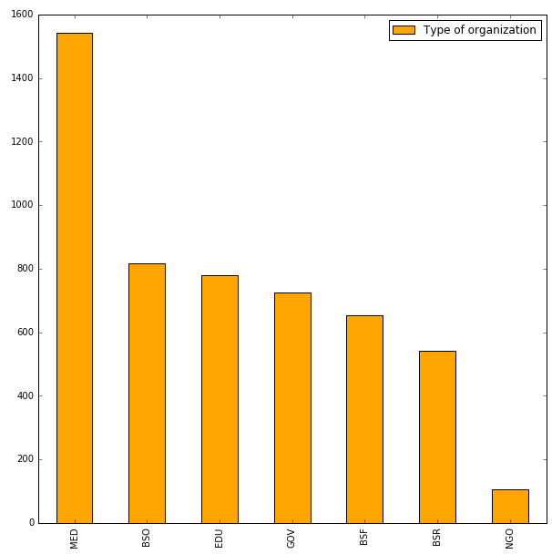
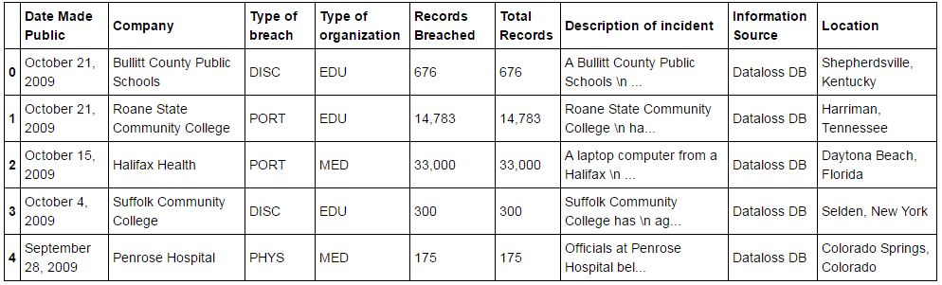
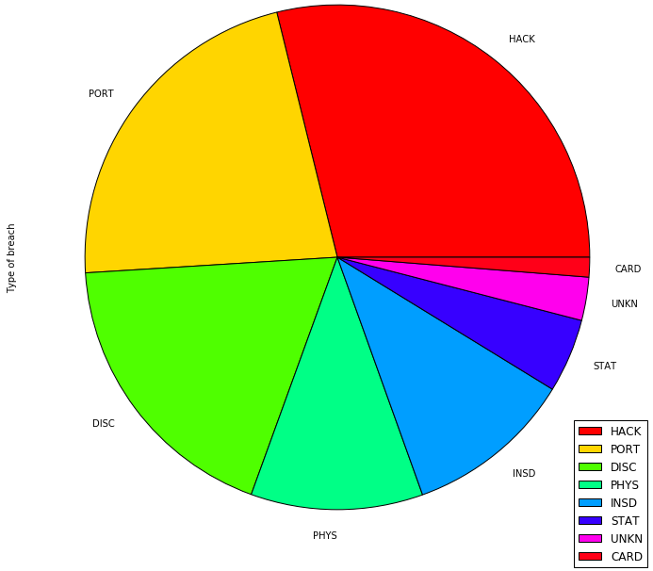
The Data
Data csv collected from - https://www.privacyrights.org/data-breaches
Profile:
5280 rows , 9 columns
8 Types of breach
7 Types of organization

Slide 5
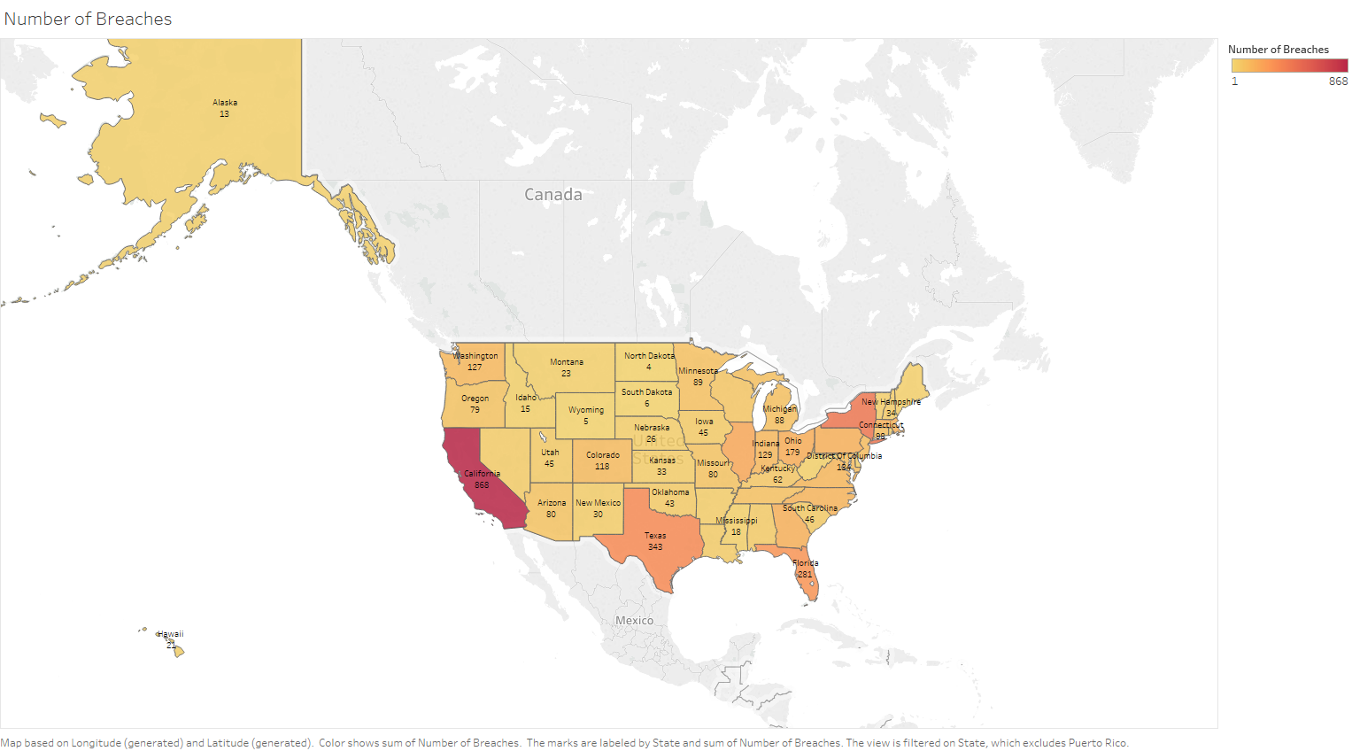
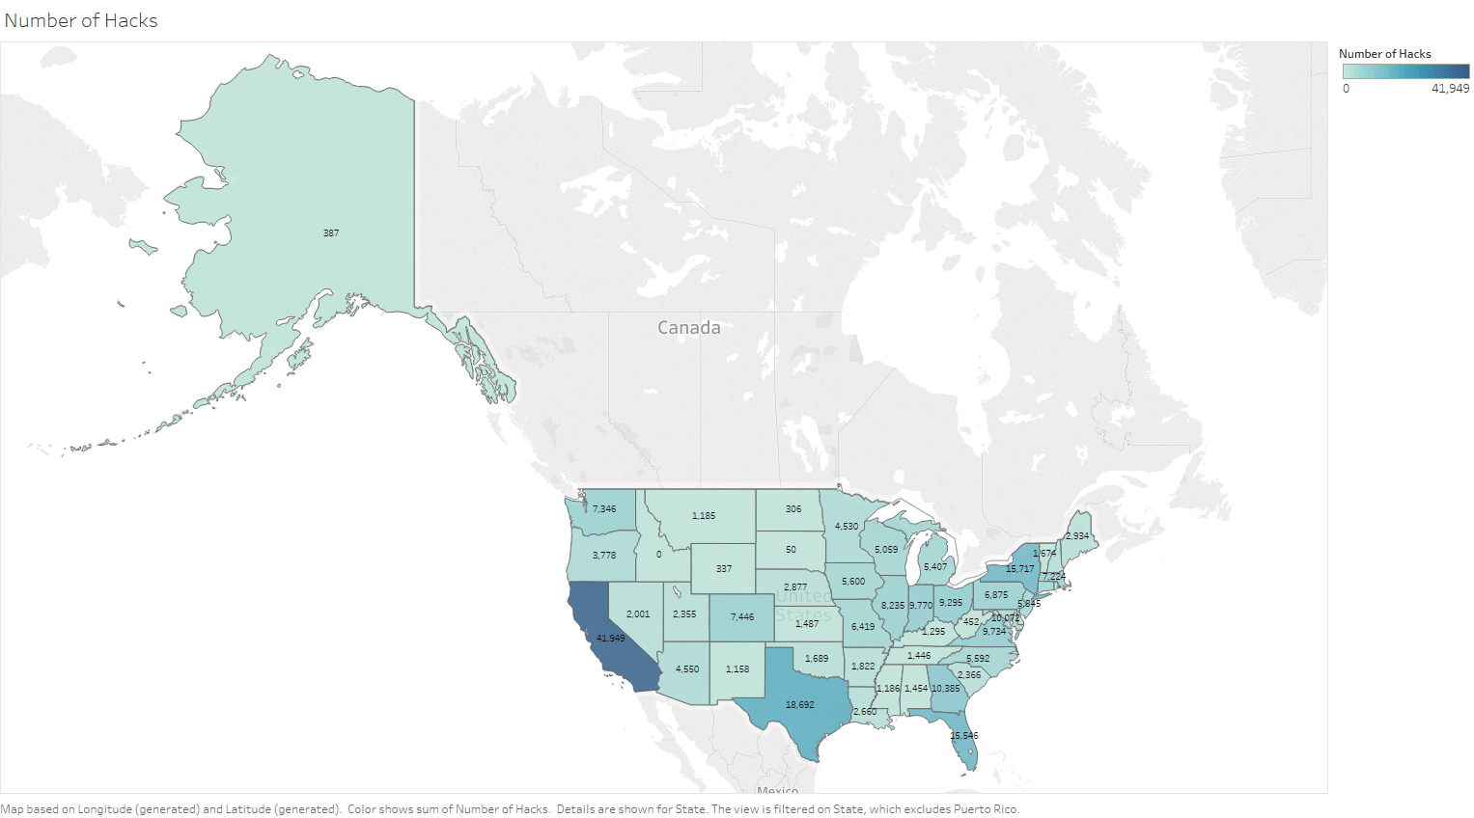
Findings

Slide 6
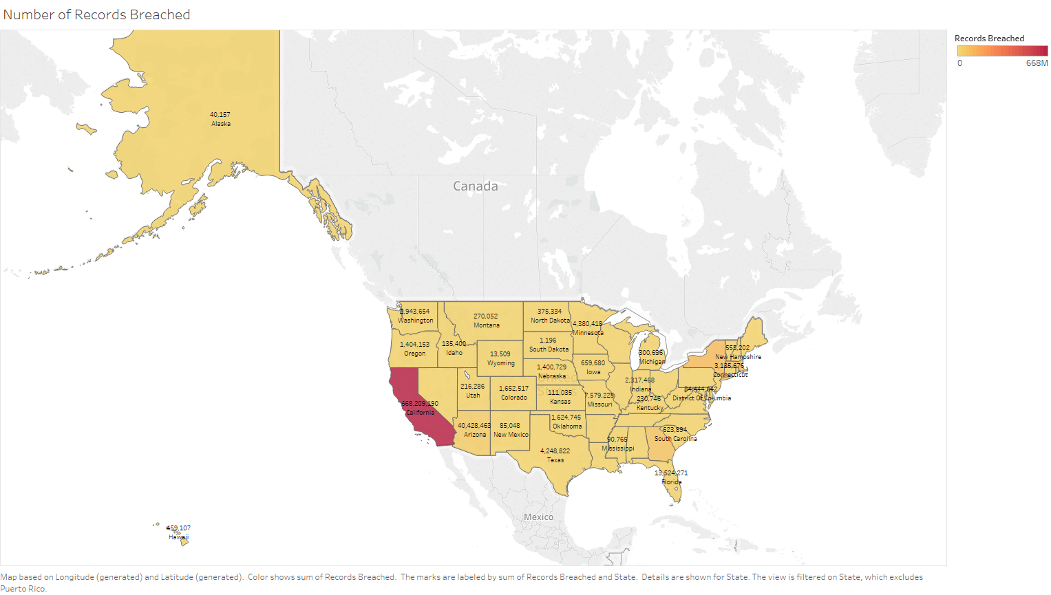
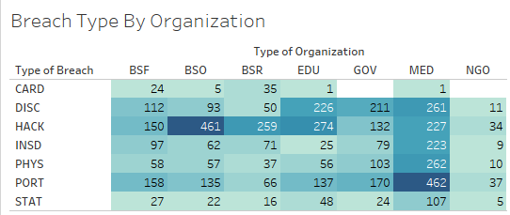
Findings

Slide 7
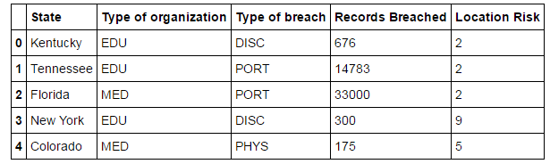
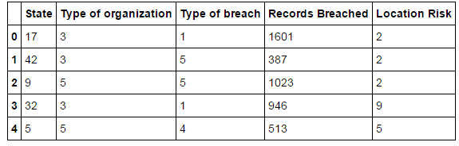
Risk Model
OWASP Risk Rating Methodology
Added Location Risk
Used sklearn Pre-processing
Added Risk Level: Type of breach + Type of organization+
Records Breached + Location Risk / 4
Added Threat Level: High, Medium, Low
Pre-processed

Slide 8
Thank you!

