Slide 2
Step 1
Determine what dates of GT data we have, which also means the pre-processed data we need;
Complete the workflow of pre-processing
Deal with LiDAR first.

Slide 3
Step 1
Determine what dates of GT data we have, which also means the pre-processed data we need;
2019 | 2020
08/16 (only Venture)
08/20 (6 cultivars) | 08/24
08/22 (6 cultivars) | 08/26
yield unit: kg/ha
plant count: plants per acre
Question: Were the GT yield data collected on the same date as the predicted data?
Answer: No. In Li et al. (2022), they tested data on Flowering and Grain Filling stages, and they found that the data from Grain Filling was better for prediction. In You et al. (2017), they learned a model of CNN and a model of LSTM from a sequence of multispectral images. Feng et al. (2020) used features from multispectral images collected 9 days ahead of the harvest date. Yang et al. (2019) used data from multiple dates ahead of harvest.

Slide 4
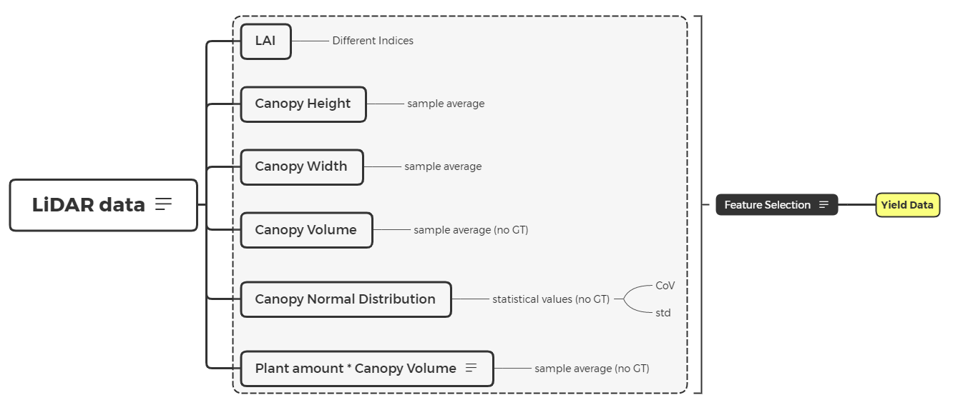
Pipeline

Slide 5
Strategies
do yield estimation from all the stages separately and compare the results to find the stage which provides the most accurate estimation;
Build up time sequence data and apply LSTM, as in You et al. (2017); however, it’s not clear if we have enough data points.

Slide 6
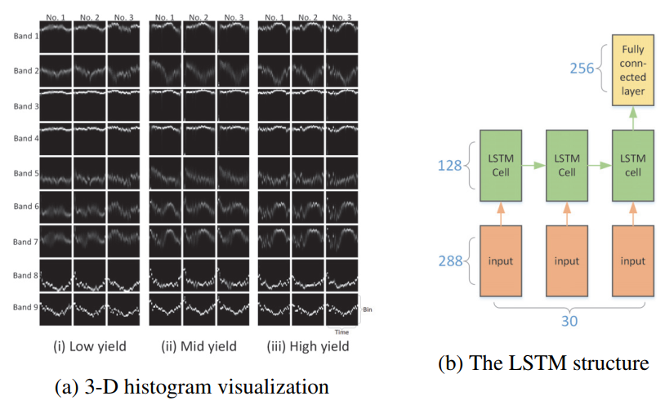
Strategies
Input: 32*9*30; output: yield; Number of data points: 8945.

Slide 7
Strategies
LAI
CH
CW
CV
N
#P
Input: 32*6*5; output: yield; Number of data points: (48+36)*n.

Slide 8
different intervals between two seasons
one for each season and one combines both with intervals corresponding ma

Slide 9
Multivariate regression on each day
LiDAR
MSI
LiDAR & MSI
h_90pct
VI1
h_90pct
sumZ
VI2
sumZ
num
VI3
num
cumInt
Yield
VI4
Yield
cumInt
topArea
VI5
topArea
poissonVol
VI6
poissonVol
VolRatio
VI7
VolRatio
Yield
VI1
VI2
VI3
VI4
VI5
VI6
VI7

Slide 10
LSTM model for predicting yield
LiDAR
MSI
LiDAR & MSI
Day 1
Day n
Day 1
Day n
Day 1
Day n
h_90pct
h_90pct
VI1
VI1
h_90pct
h_90pct
sumZ
sumZ
VI2
VI2
sumZ
sumZ
num
num
VI3
VI3
num
num
cumInt
…
cumInt
Yield
VI4
VI4
Yield
cumInt
cumInt
…
topArea
topArea
VI5
VI5
topArea
topArea
poissonVol
poissonVol
VI6
VI6
poissonVol
poissonVol
VolRatio
VolRatio
VI7
VI7
VolRatio
VolRatio
Yield
VI1
VI1
…
VI2
VI2
VI3
VI3
VI4
VI4
VI5
VI5
VI6
VI6
VI7
VI7

