Slide 1
Conditional value at risk, CVaR
Mar. 1, 2014, Hung-Hsin Chen

Slide 2
Reference
[1] N. Topaloglou, H. Vladimirou, and S. A. Zenios, "CVaR models with selective hedging for international asset allocation," Journal of Banking & Finance, vol. 26, pp. 1535-1561, 2002.
[2] N. Topaloglou, H. Vladimirou, and S. A. Zenios, "A dynamic stochastic programming model for international portfolio management," European Journal of Operational Research, vol. 185, pp. 1501-1524, 3/16/ 2008.

Slide 3
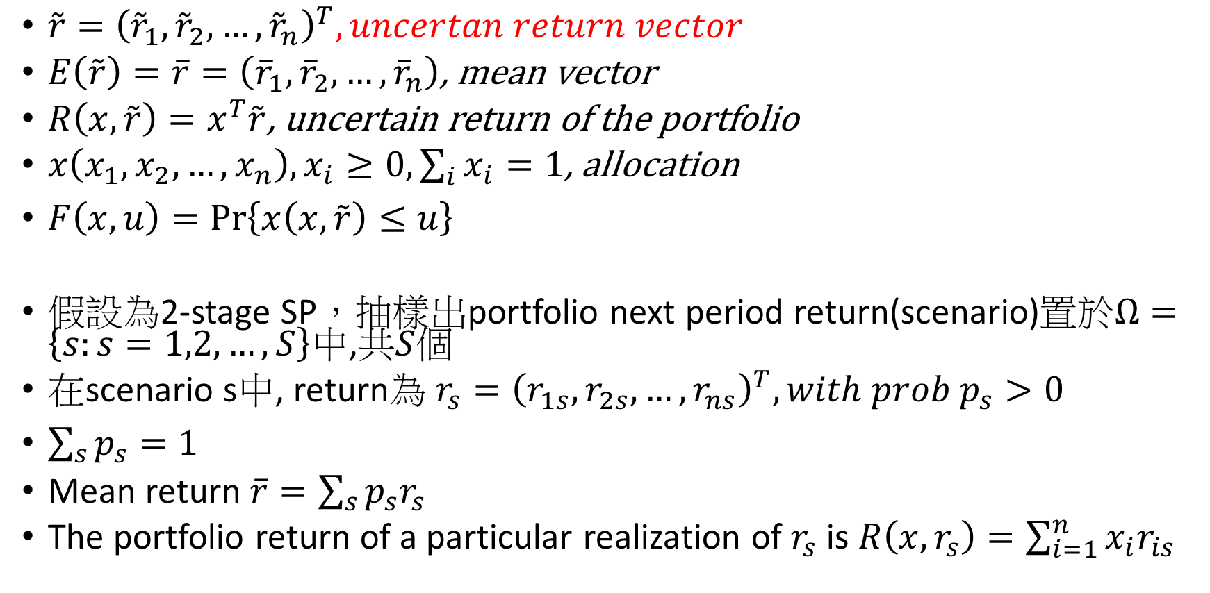
Definition
$\tilde{r}={\left({\tilde{r}}_{1},{\tilde{r}}_{2},…,{\tilde{r}}_{n}\right)}^{T}, uncertan return vector$
$E\left(\tilde{r}\right)=\overline{r}=\left({\overline{r}}_{1},{\overline{r}}_{2},…,{\overline{r}}_{n}\right)$, mean vector
$R\left(x,\tilde{r}\right)=x^{T}\tilde{r}$, uncertain return of the portfolio
$x\left(x_{1},x_{2},…,x_{n}\right), x_{i}≥0, \sum_{i}{x_{i}=1}$, allocation
$F\left(x,u\right)=\operatorname{Pr}\left\{x\left(x,\tilde{r}\right)≤u\right\}$
假設為2-stage SP，抽樣出portfolio next period return(scenario)置於$Ω=\left\{s:s=1,2,…,S\right\}$中,共$S$個
在scenario s中, return為 $r_{s}={\left(r_{1s},r_{2s},…,r_{ns}\right)}^{T}, with prob p_{s}>0$
$\sum_{s}{p_{s}=1 }$
Mean return $\overline{r}=\sum_{s}{p_{s}r_{s}}$
The portfolio return of a particular realization of $r_{s}$ is $R\left(x, r_{s}\right)=\sum_{i=1}^{n}{x_{i}r_{is}}$

Slide 4
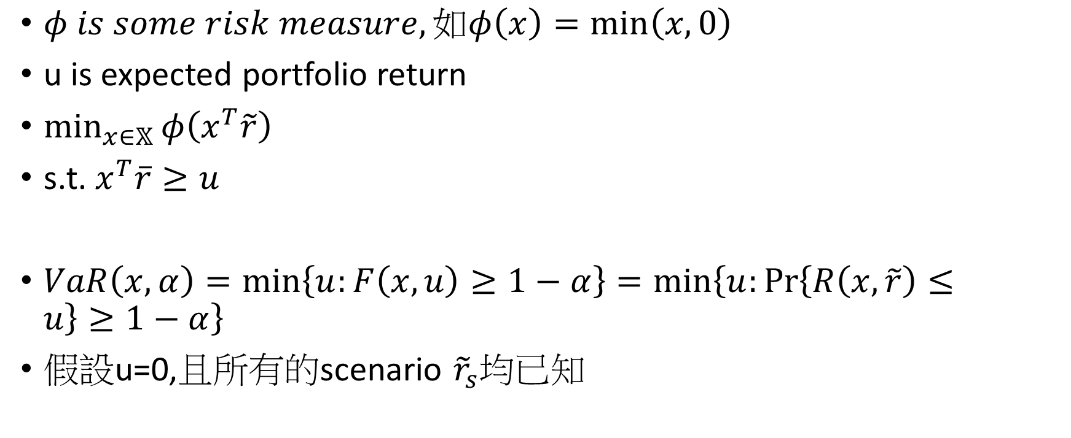
VaR
$φ is some risk measure, 如φ\left(x\right)=\min\left(x, 0\right)$
u is expected portfolio return
$\min_{x∈𝕏}{φ\left(x^{T}\tilde{r}\right)}$
s.t. $x^{T}\overline{r}≥u$
$VaR\left(x,α\right)=\min\left\{u:F\left(x,u\right)≥1−α\right\}=\min\left\{u:\operatorname{Pr}\left\{R\left(x,\tilde{r}\right)≤u\right\}≥1−α\right\}$
假設u=0,且所有的scenario ${\tilde{r}}_{s}$均已知

Slide 5

CVaR of continuous random variable
$CVaR\left(x, α\right)=E\left[R\left(x,\tilde{r}\right)|R\left(x,\tilde{r}\right)≤VaR\left(x,α\right)\right]$
CVaR為小於等於VaR的期望值，或解釋為損失超過VaR的期望值
可得知$CVaR≤VaR$, 即CVaR為VaR之lower bound

Slide 6

CVaR of discrete r.v.
$CVaR\left(x,α\right)=\left(1−\frac{\sum_{\left\{s∈Ω|R\left(x,r_{s}\right)≤z\right\}}{p_{s}}}{1−α}\right)z+\frac{1}{1−α}\sum_{\left\{s∈Ω|R\left(x,r_{s}\right)≤z\right\}}{p_{s}\left(x,r_{s}\right)},$
Where $z=VaR\left(x,α\right)$

Slide 7
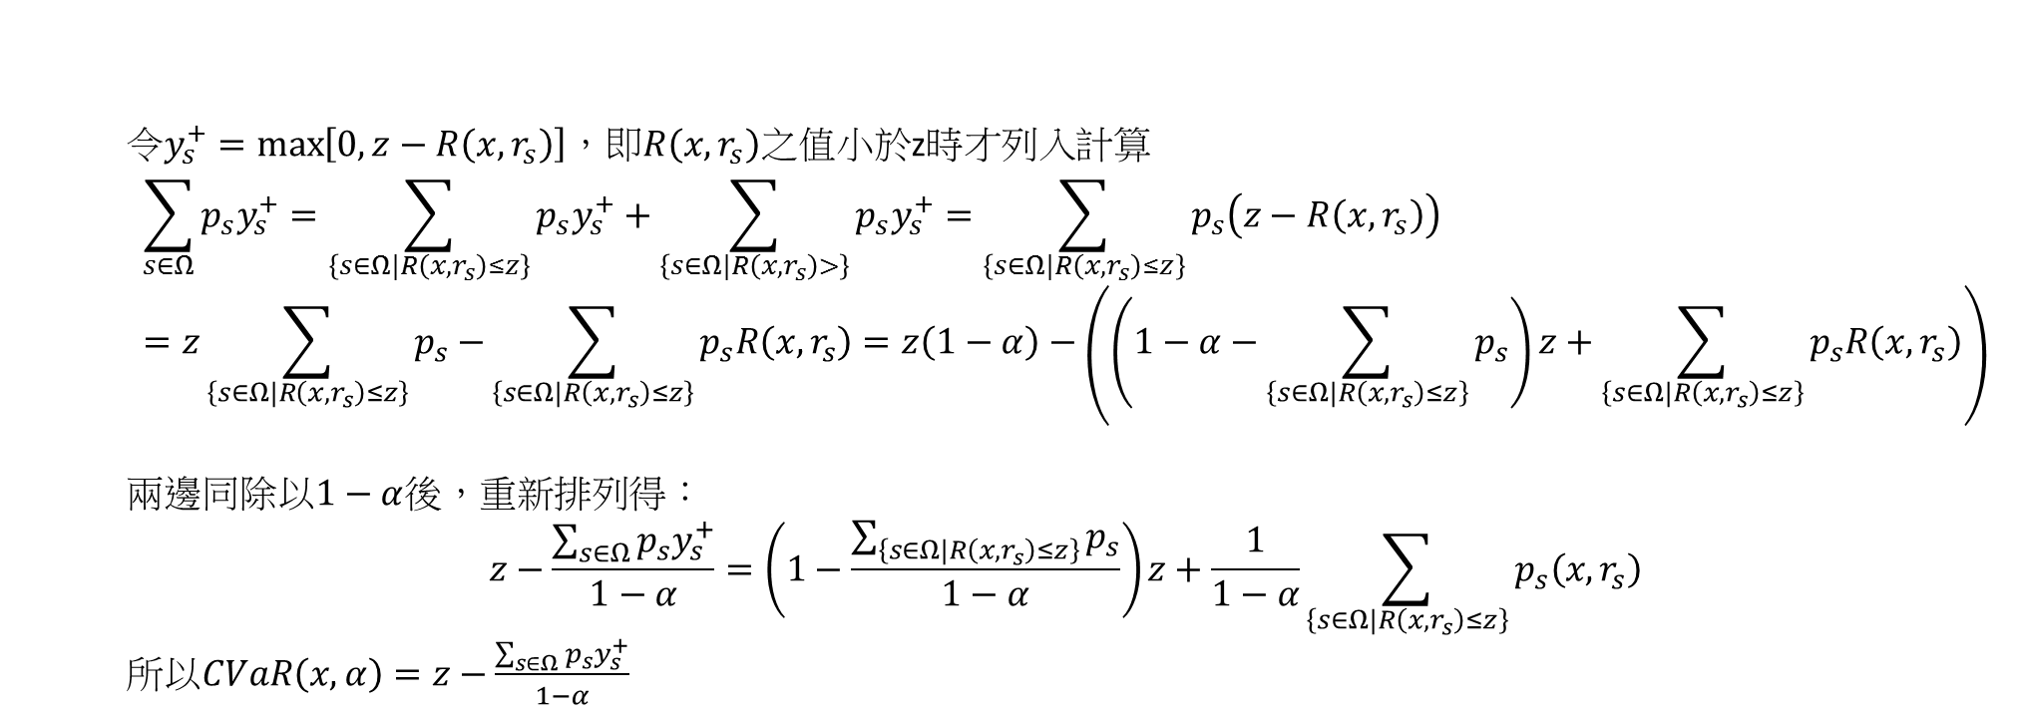
令$y_{s}^{+}=\max\left[0, z−R\left(x, r_{s}\right)\right]$，即$R\left(x, r_{s}\right)$之值小於z時才列入計算
$$\sum_{s∈Ω}{p_{s}y_{s}^{+}}=\sum_{\left\{s∈Ω|R\left(x,r_{s}\right)≤z\right\}}{p_{s}y_{s}^{+}}+\sum_{\left\{s∈Ω|R\left(x,r_{s}\right)>\right\}}{p_{s}y_{s}^{+}}=\sum_{\left\{s∈Ω|R\left(x,r_{s}\right)≤z\right\}}{p_{s}\left(z−R\left(x, r_{s}\right)\right)}=z\sum_{\left\{s∈Ω|R\left(x,r_{s}\right)≤z\right\}}{p_{s}−}\sum_{\left\{s∈Ω|R\left(x,r_{s}\right)≤z\right\}}{p_{s}R\left(x, r_{s}\right)}=z\left(1−α\right)−\left(\left(1−α−\sum_{\left\{s∈Ω|R\left(x,r_{s}\right)≤z\right\}}{p_{s}}\right)z+\sum_{\left\{s∈Ω|R\left(x,r_{s}\right)≤z\right\}}{p_{s}R\left(x, r_{s}\right)}\right)$$
兩邊同除以$1−α$後，重新排列得：
$$z−\frac{\sum_{s∈Ω}{p_{s}y_{s}^{+}}}{1−α}=\left(1−\frac{\sum_{\left\{s∈Ω|R\left(x,r_{s}\right)≤z\right\}}{p_{s}}}{1−α}\right)z+\frac{1}{1−α}\sum_{\left\{s∈Ω|R\left(x,r_{s}\right)≤z\right\}}{p_{s}\left(x,r_{s}\right)}$$
所以$CVaR\left(x,α\right)=z−\frac{\sum_{s∈Ω}{p_{s}y_{s}^{+}}}{1−α}$

