Slide 1
Google Adwords Report 10/13/2017

Slide 2
Recent Activities:
Setting alert for form submissions
Form submissions
Weekly cost and cost per click
Sitelink Edit
Ads pop-ups
Search terms of this week
New negative keywords:

Slide 3
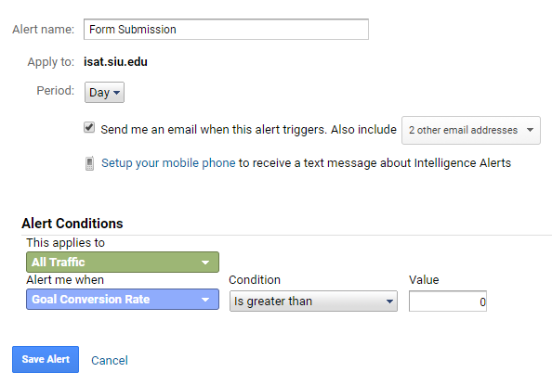
Setting alert for form submissions
It is possible to track submissions one by one using alert system

Slide 4
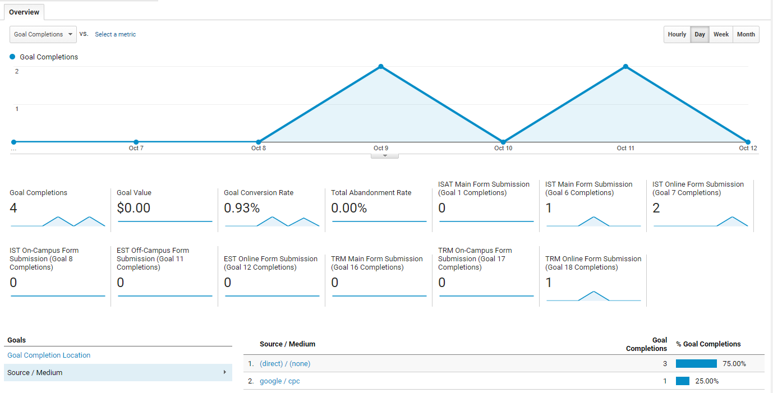
Form submissions

Slide 5
Weekly cost and cost per click
Clicks | 189
Impressions | 33826
CTR | 0.56%
Avg. CPC | 1.95
Cost | 368.65
Avg. position | 1.6
Conversions | 4
Cost / conv. | 92.16
Conv. rate | 2.12%

Slide 6
Keywords Status
Display keyword | Clicks | Status
ms in information security | 1,351 | Inactive
it degree | 1,283 | Active
it degree program | 708 | Active
degree in it | 673 | Active
information technology degree | 546 | Active
online IS degree | 319 | Active
degree of it | 306 | Active
Software developer | 248 | Inactive
online it degree programs | 201 | Active
is degree | 194 | Inactive
it degree | 169 | Active
online degree in IT | 141 | Active
it degree program | 129 | Active
information technology courses | 100 | Active
information technology | 84 | Inactive
information technology | 66 | Inactive
is degree | 49 | Inactive
online degree in IT | 34 | Active
IS degrees online | 28 | Active
degree program | 26 | Inactive
information technology degree | 26 | Active
data analytics | 23 | Inactive
university undergraduate degree | 20 | Inactive

Slide 7
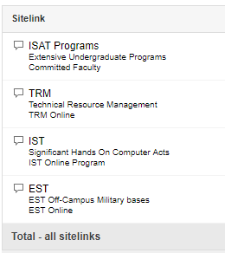
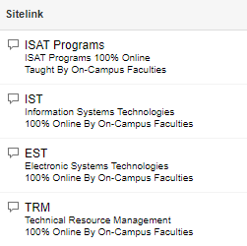
Sitelink

Slide 8
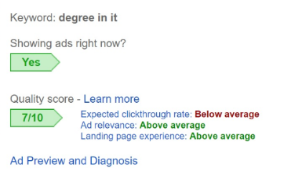
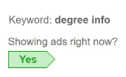
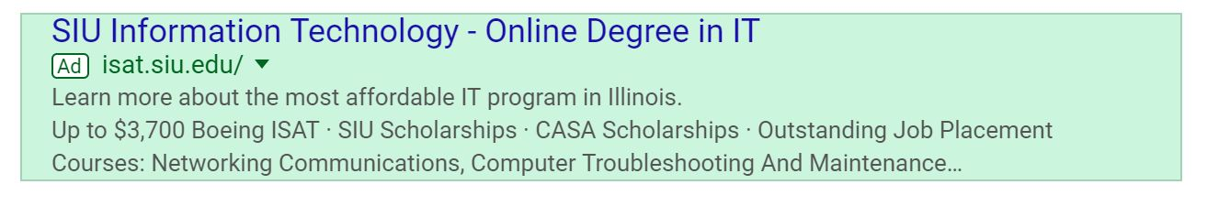
Ads pop-ups

Slide 9
Search terms of this week
infonstion technolgy siu
online colleges in memphis tn
siu bachelor's degrees
online colleges in tn
siu majors
online university
siu online degree
online colleges in illinois

Slide 10
New negative keywords:
walden
turf
psg
kinesiology
meteorology
welding
animation
theater
cooking
chef
ranking
address
associate
athletic
automotive
bba
contact
control
edwardsville
infonstion
medical
radiology
sullivan
technician

Slide 11
Thank You!

