Slide 1
Google Adwords Report 10/06/2017

Slide 2
Recent Activities:
Implementation of Analytic tools
Better search terms
Changing match type from broad match to phrase match
Definition of negative keywords
Checking site link and call extensions
Running Google Search Console

Slide 3
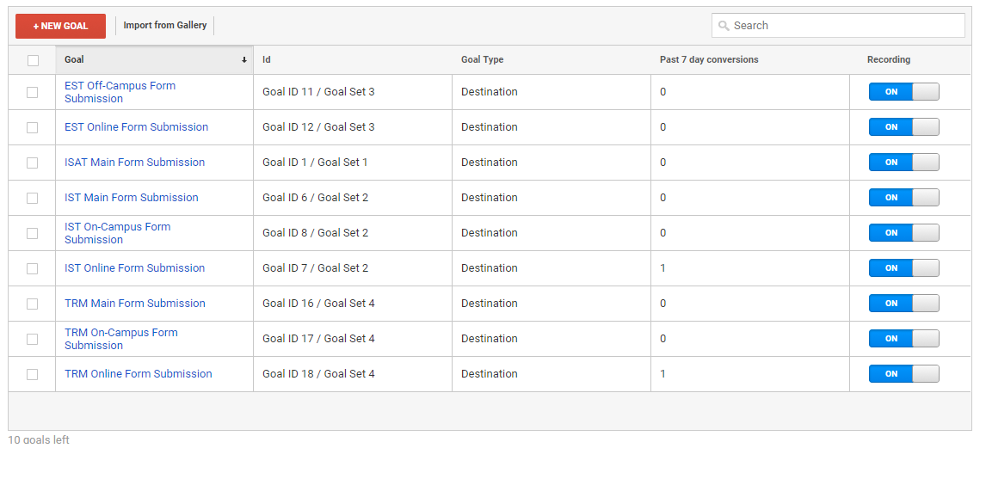
Implementation of Analytic tools
Definition of 9 URL goals

Slide 4
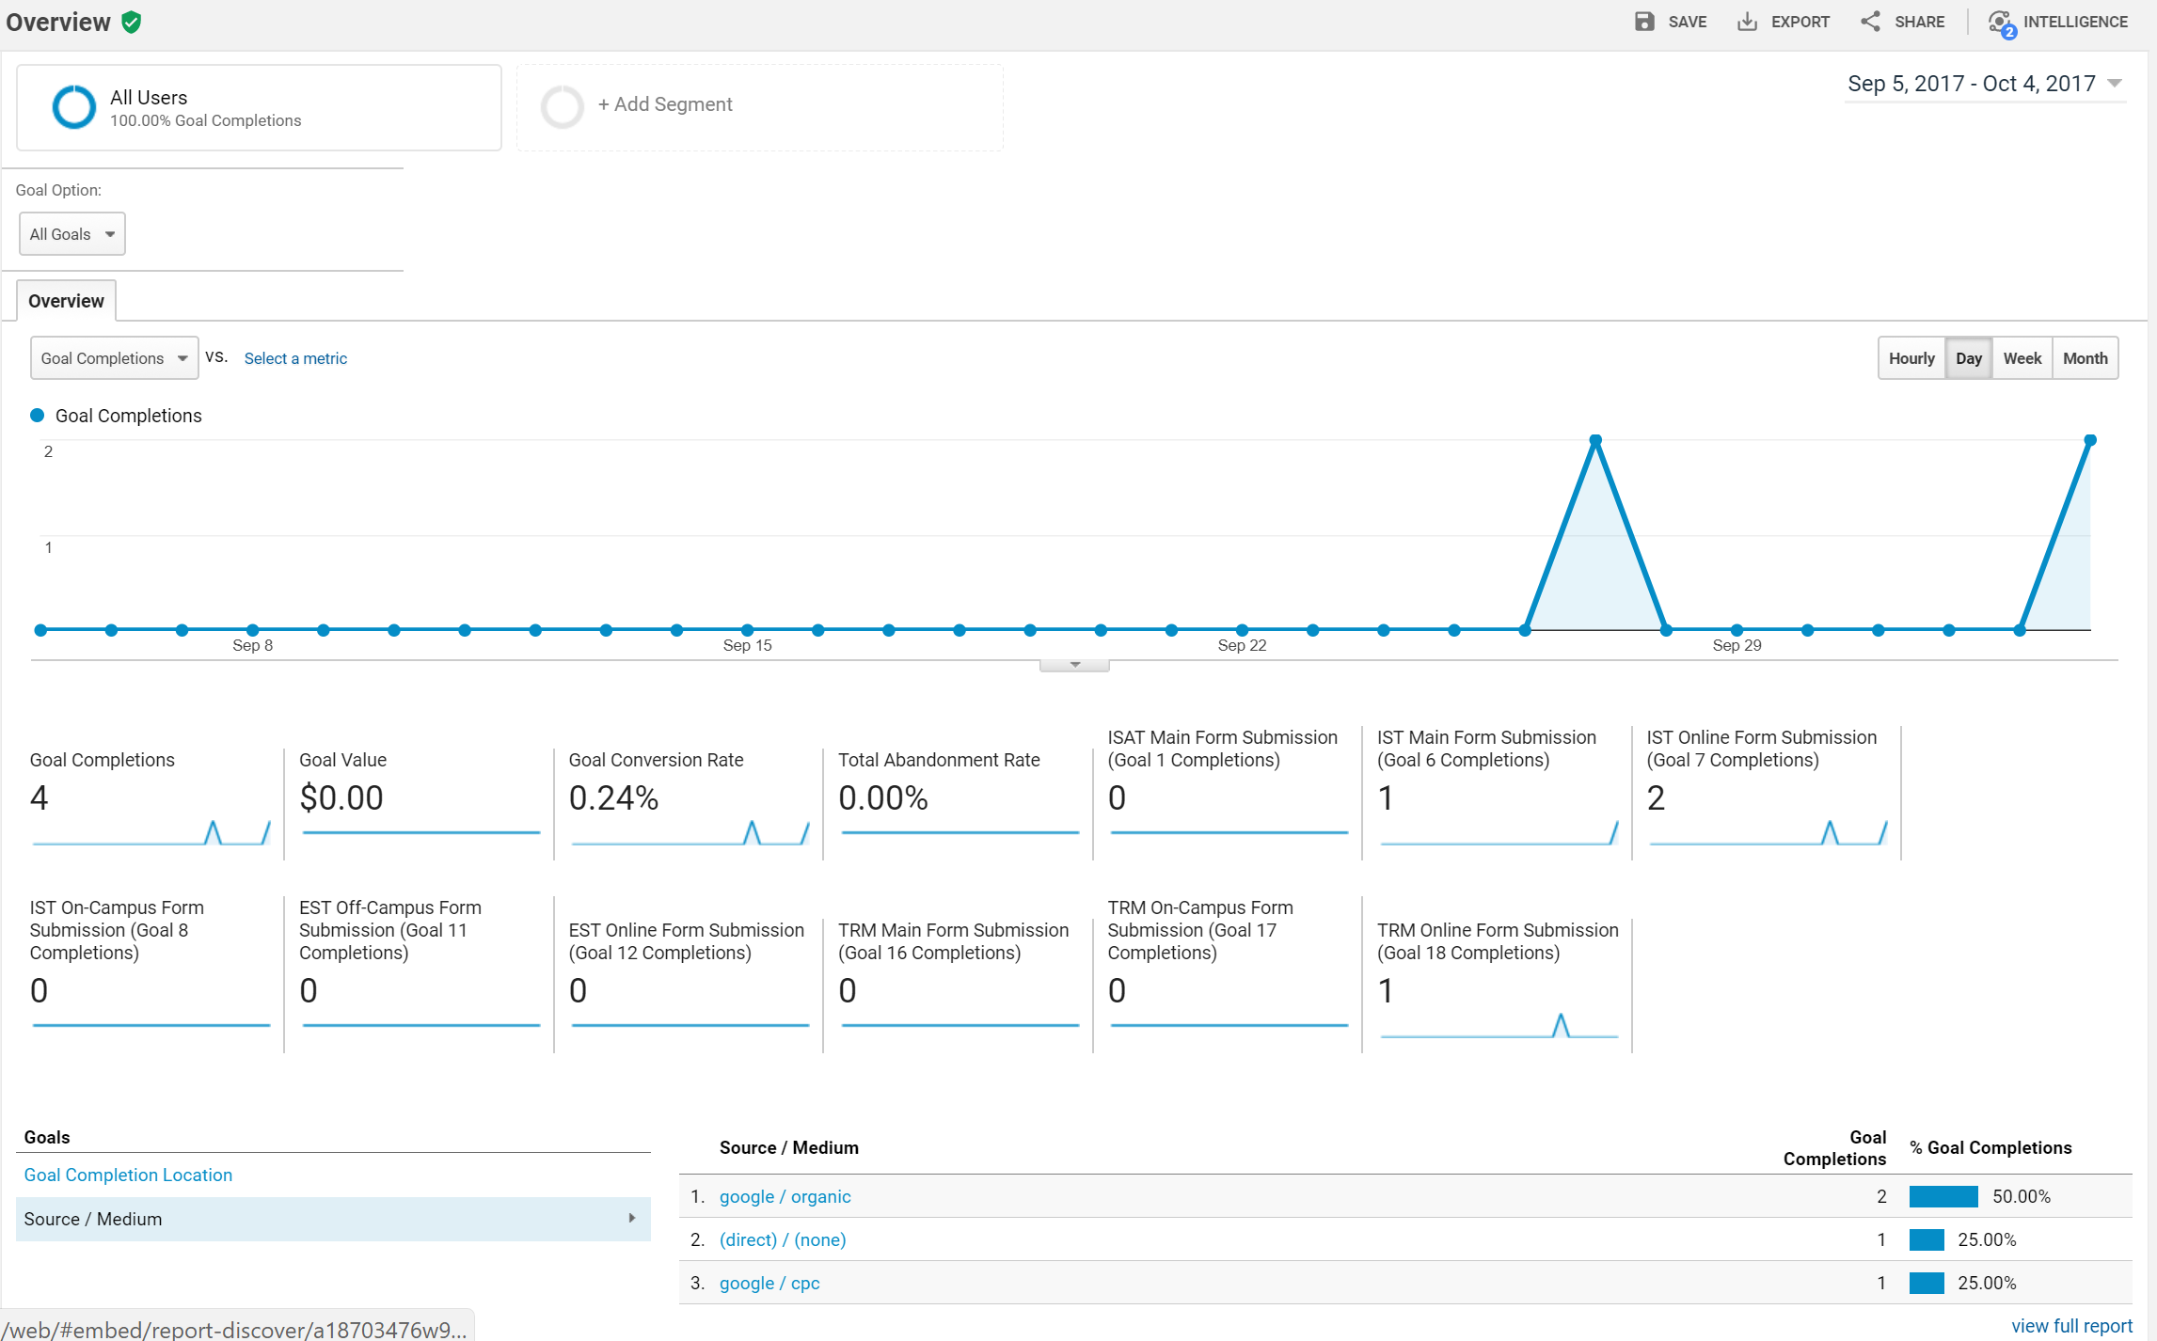
Implementation of Analytic tools

Slide 5
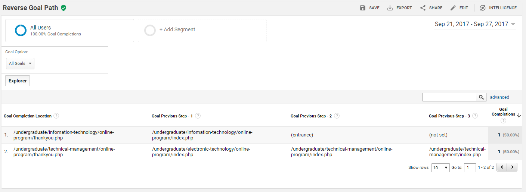
Implement Analytic tools
Tracking conversions to the goals

Slide 6
Better search terms this week
online courses in usa
siu ist courses
online universities in illinois
computer information technology vocational certificate
computer science bachelor's Illinois
information technology coursesillinois state university
online colleges in Illinois
online universities undergraduate

Slide 7
Implement Analytic tools
Definition of negative keywords based on search terms
architecture
meteorology
salary
cosmetology
sonography
nutrition
purdue
aiu
sport
master
masters
master's
dental
hygienist
marine
zoology
poultry
animal
Biology
free
graphic
agriculture
architecture
art
physics
forestry
doctor
law
devry
park
lpn
rn
niche
phd
uic
diploma
ultrasound
bradley
intercontinental
language
interpretation
mechanical
engineering
paramedic
computer science
walden
turf
psg
kinesiology
meteorology
welding
animation
theater
cooking
chef
ranking

Slide 8
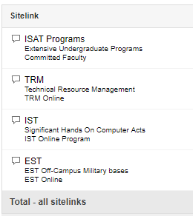
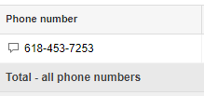
Checking site link and call extensions
Site link extensions
Call extension

Slide 9
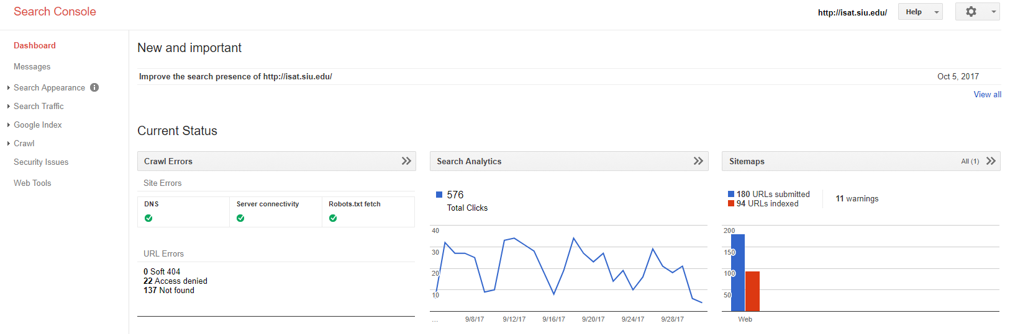
Running Google Search Console
Submit and check a sitemap.
Check and set the crawl rate, and view
List internal and external pages that link to the site
See what keyword searches on Google led to the
Highlight to Google Search elements of structured data which are used to enrich search hit
Provide access to an API to add, change and delete listings
Rich Cards a new section added, for better mobile user experience

Slide 10
Thank You!

