Slide 1
Google Adwords Report 10/13/2017

Slide 2
Recent Activities:
Setting alert for form submissions
Form submissions
Weekly cost and cost per click
Sitelink Edit
Ads pop-ups
Search terms of this week
New negative keywords:

Slide 3
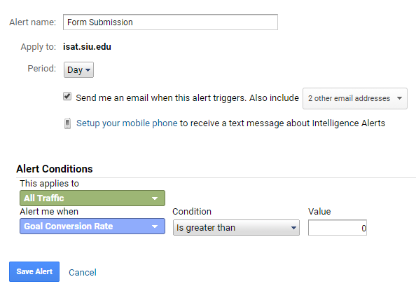
Setting alert for form submissions
It is possible to track submissions one by one using alert system

Slide 4
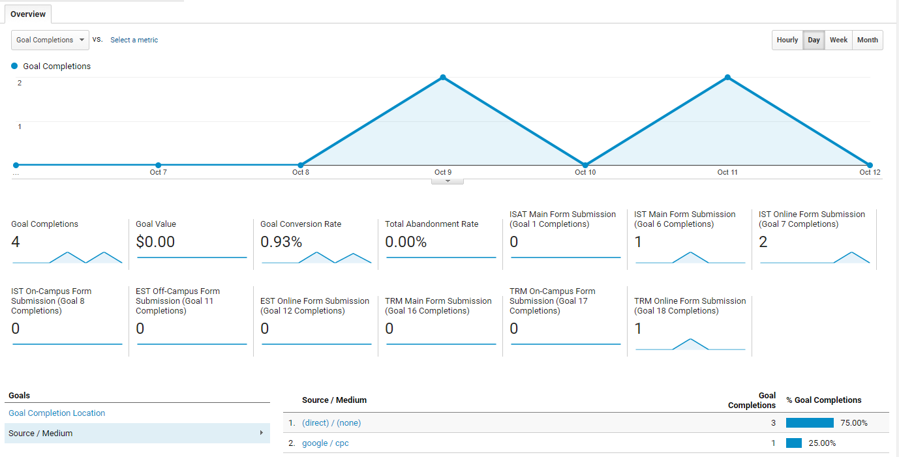
Form submissions

Slide 5
Weekly cost and cost per click
Clicks | 189
Impressions | 33826
CTR | 0.56%
Avg. CPC | 1.95
Cost | 368.65
Avg. position | 1.6
Conversions | 4
Cost / conv. | 92.16
Conv. rate | 2.12%

Slide 6
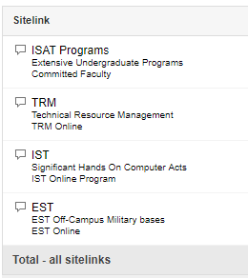
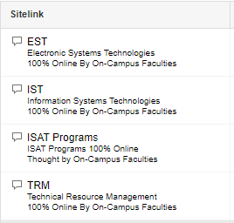
Sitelink edit

Slide 7
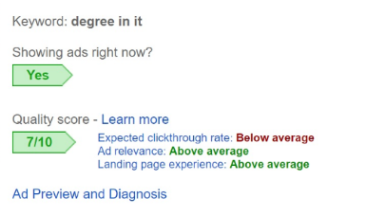
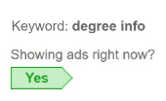
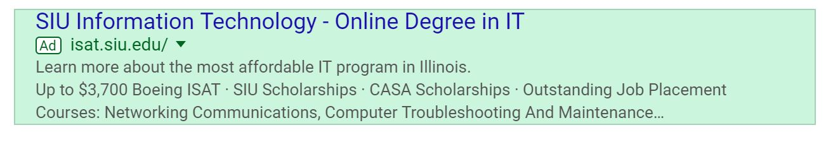
Ads pop-ups

Slide 8
Search terms of this week
infonstion technolgy siu
online colleges in memphis tn
siu bachelor's degrees
online colleges in tn
siu majors
online university
siu online degree
online colleges in illinois

Slide 9
New negative keywords:
walden
turf
psg
kinesiology
meteorology
welding
animation
theater
cooking
chef
ranking
address
associate
athletic
automotive
bba
contact
control
edwardsville
infonstion
medical
radiology
sullivan
technician

Slide 10
Thank You!

