Slide 1
Google Adwords Report 09/22/2017

Slide 2
Recent Activities:
Change of ads’ headline and description
Pause keywords with unrelated search terms
Checking of match type performance
Checking search terms for creating new keywords
Linking Adwords and Analytics

Slide 3

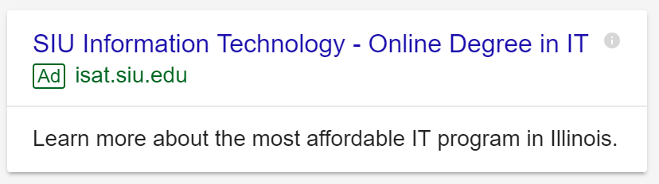
Change of ads’ headline and description

Slide 4
Pause keywords with unrelated search terms
We have payed $7920 for all keywords for the first day
$6717 for those are now paused
$1203 for those that are still active

Slide 5
Checking of match type performance
We have payed $7920 from the first day
$5065 for broad match searches
$1938 for phrase match searches
$148 for exact match searches

Slide 6
Checking search terms for creating new keywords
Broad Match Search Term
advance it course in usa
associates in information technology prerequisites
bachelor degree computer network management online
bachelor degree online
bachelor degree online free
bachelor in cyber security in chicago
bachelor information technology information systems illinois
bachelor of science degree online
bachelor of science in information security
bachelor of science in information technology
bachelor of science in information technology online
best college courses to get a job
best colleges in illinois for information technology
best computer programming colleges
best it colleges in illinois
bs information technology subjects
bsc it colleges in usa
certificate programs
certificate programs in chicago
certificates in information technology
cheap bachelor in information management universities in america
chicago it courses
cilago ilinois all information tecnology university in mca acadamic cource
colleges for computer it
colleges in illinois with health information technology
computer information systems major in usa
computer science online university of illinois
computer technician online courses
Phrase Match Search Term
siu information technology
siu information technology
information technology requirements
southern illinois university information technology
information technology siu
information technology at siu
cyber security bachelor's degree
it courses near me
siu cyber security
information technology for dummies
information technologhy siu carbondale
information technology southern illinois
siu it degree
information technology in chicago
aiu carbondale information technology
degree information systems management
schools that offer cyber security in illinois
illinois state university information technology
siue information technology phone number
southern illinois university information technology management
siu information systems technology
siu c information technology demographics
how to get into information technology with no experience
how to get into information technology with no experience
information system technology siu
information technology full time illinois
Exact Match Search Term
information technology courses
technical resource management

Slide 7
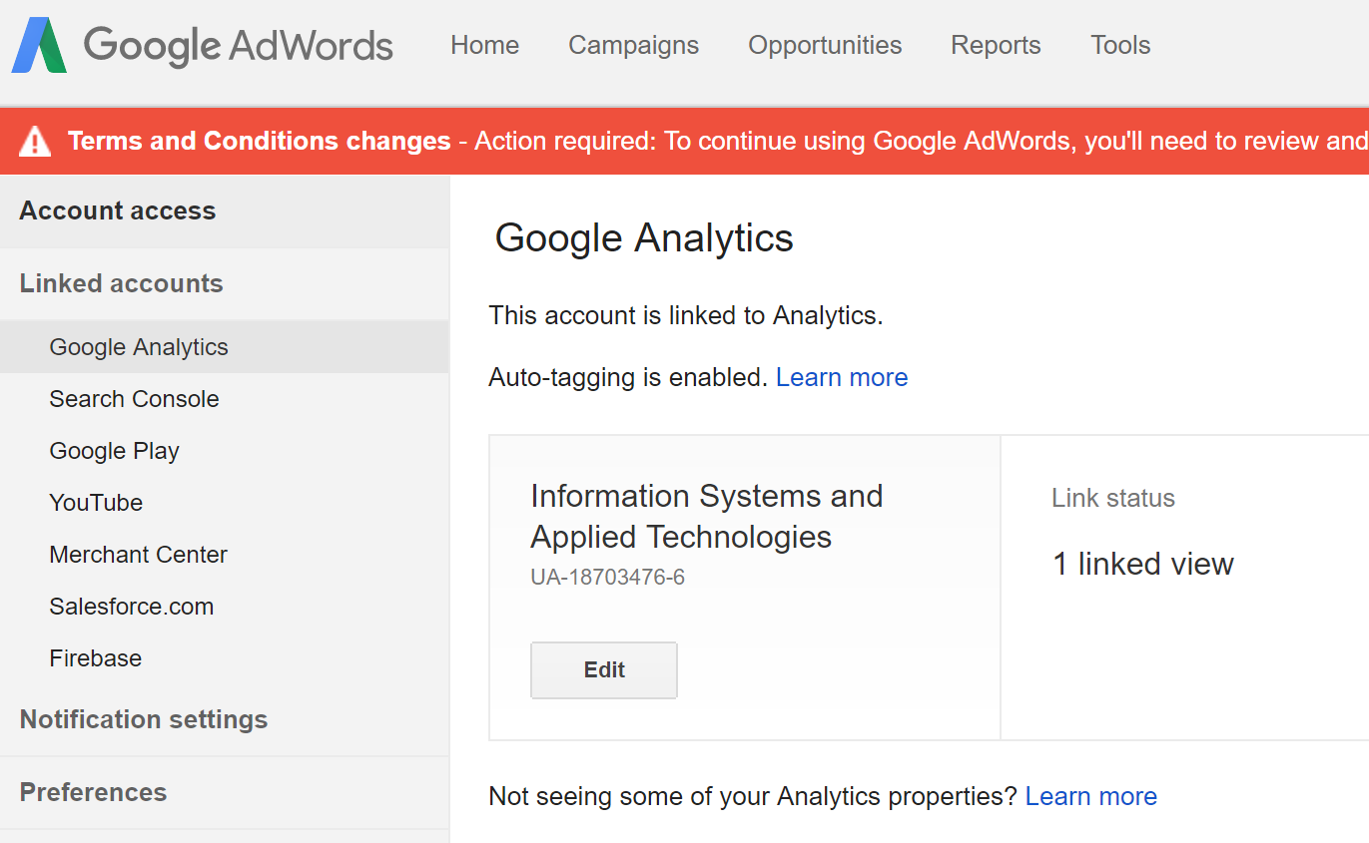
Linking Adwords and Analytics

Slide 8
Thank You!

