Slide 1
Weekly Report
7/11/2017
Alireza Khamesipour

Slide 2
Outline
SIU-ODIRS(Online-Degree Information Request System)
E-mail Auto-response
Text message Auto-response
How to choose the 3rd party company
Web Server Management
Website Speed
Indication
How to improve

Slide 3
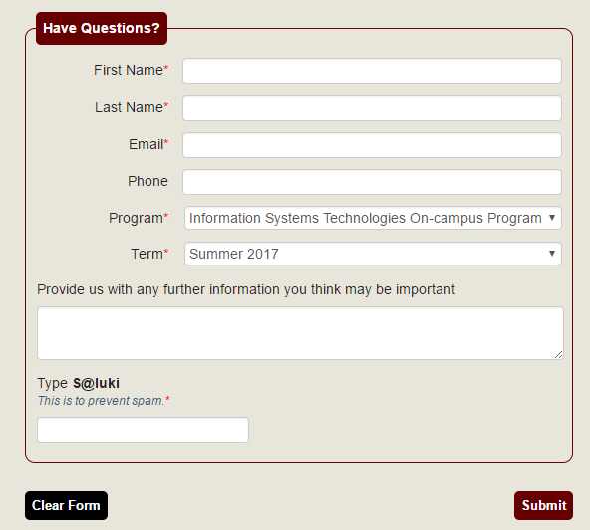
SIU - ODIRS
Information stored into our database
Academic Student Advisor contacts students individually

Slide 4
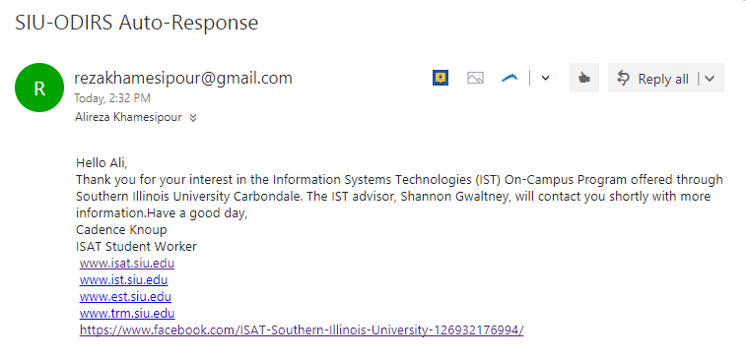
E-mail Auto-response
Save work load
Contact student while the Student advisor contacts
Provide student with some helpful information

Slide 5
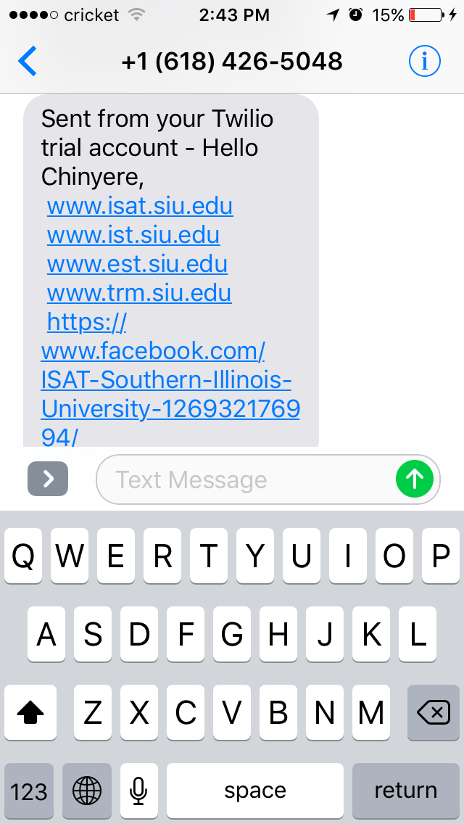
Text-message Auto-response
Provide student with some helpful information
Introduce our social media channels

Slide 6
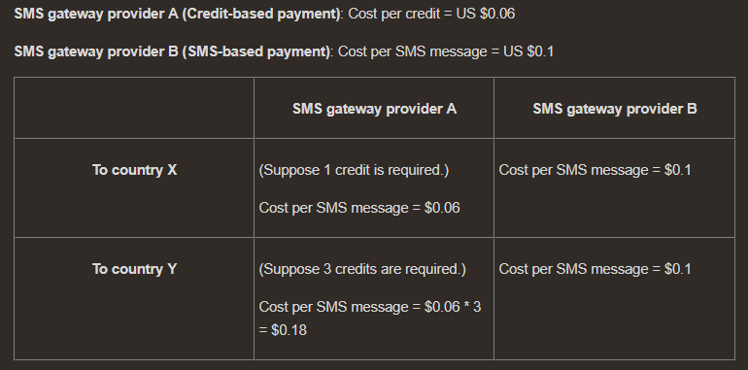
Choosing the right 3rd party company
The proper programming language
Twilio,
https://youtu.be/7vXkY-134R0
The cost
Credit-based
SMS-based

Slide 7
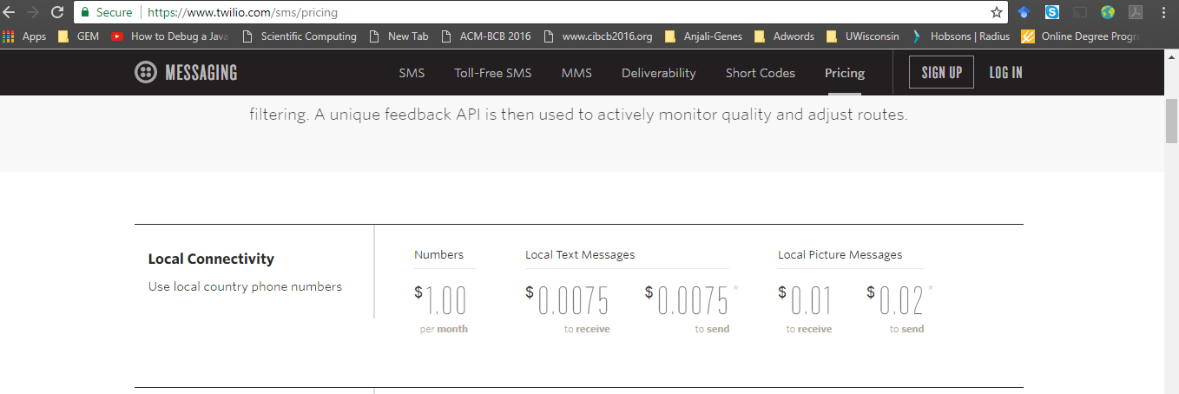
Programmable SMS pricing

Slide 8
Web Server Management
MEAN web App
MongoDB – Database
MongoDB Atlas → cloud database solution
Express
Angular
Node.js

Slide 9
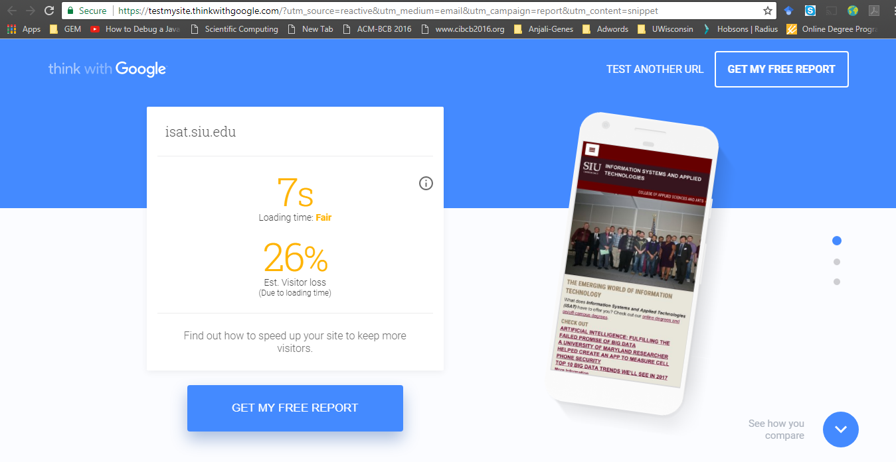
Our Website speed

Slide 10
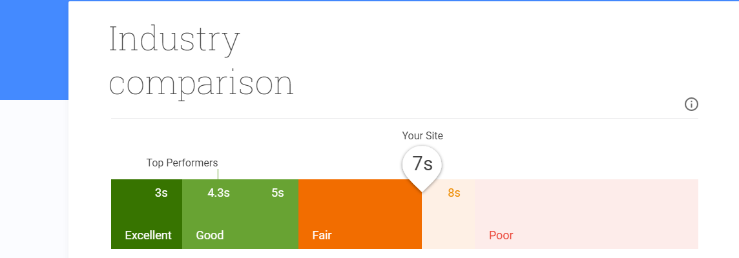

Slide 11
Improving website speed:
Reduce page weight
Compress images
Compress resource with GZIP
Minify resources
Reduce number of requests
Leverage browser caching
Eliminate render-blocking JavaScript and CSS in above-the-fold content
Avoid landing page redirects
Make a quick first impression
Load visible content before CSS and JS files
Reduce server response time o Make your page lightning fast with AMP

