Slide 1
SEM Report
Alireza Khamesipour

Slide 2
Google Adwords Changes
Callout Extension
Sitelinks Extensions
Structured Snippets Extensions
Implement and Grow ETA
Website Conversion Tracking
ANALYTICS linking
https://saluki-my.sharepoint.com/personal/samchung_siu_edu/_layouts/15/WopiFrame.aspx?sourcedoc=%7BE568B615-26BC-4023-825E-10126CFC5F68%7D&file=7-7-2017%20Google%20Adwords%20Report.docx&action=default

Slide 3
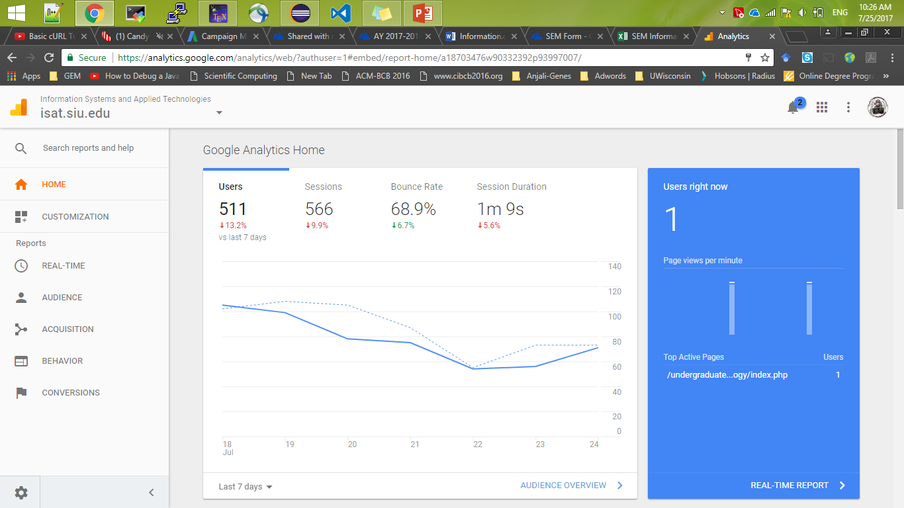
Google Analytics

Slide 4
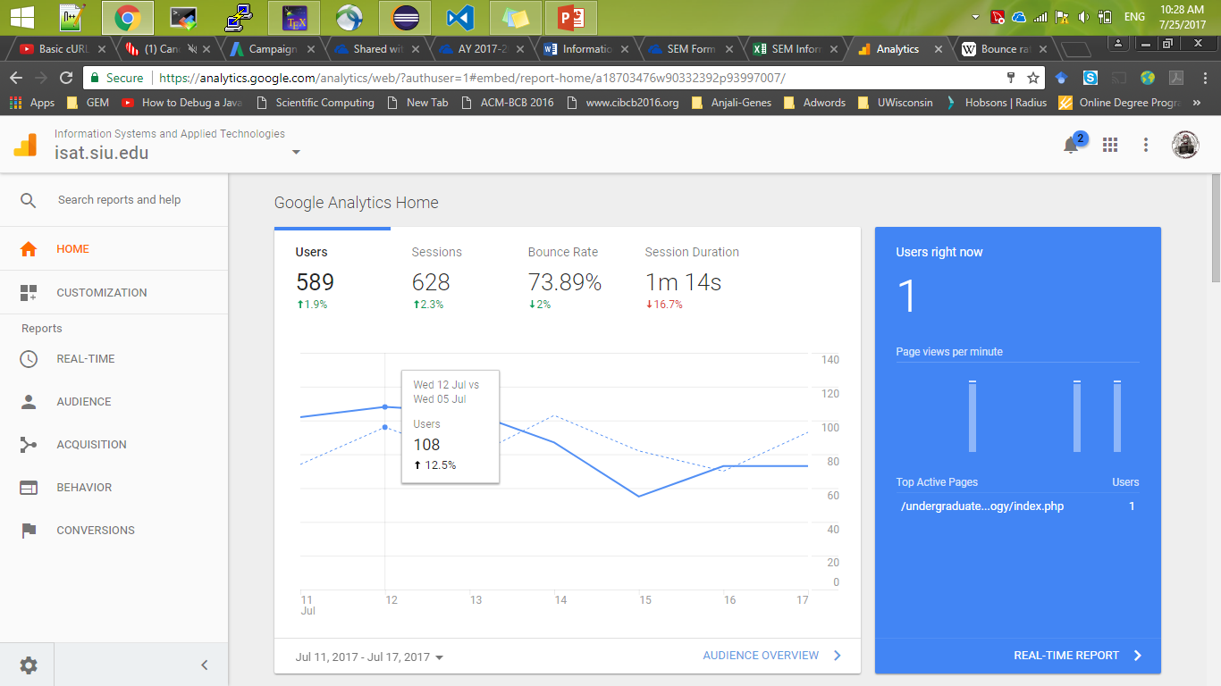

Slide 5


Slide 6
Bounce rate : the percentage of visitors who enter the site and then leave ("bounce") rather than continuing to view other pages within the same site.

Slide 7
Once we are sure that we have targeted the right audience, we can start “Remarketing” the users who have visited our website.

Slide 8
Number of student contacts/month

Slide 9
Student contacts/program

