Slide 1
Google Adwords Report 10/27/2017

Slide 2
Recent Activities:
Creating new ad group Illinois
Setting up new alerts
Creating submission tracking form
Weekly cost and cost per click
Search terms of this week
New negative keywords

Slide 3
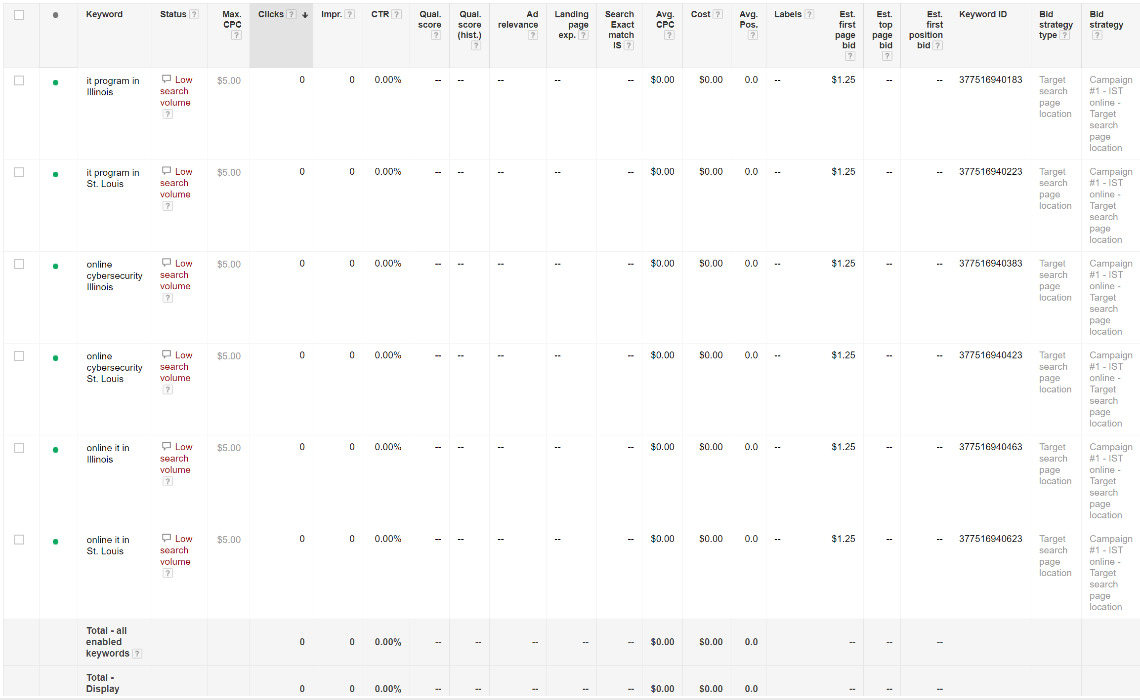
Creating new ad group Illinois

Slide 4
Keywords Status (Oct 12 to Oct 25)
Search keyword | Campaign | Clicks | Impressions | Cost | CTR | Avg. CPC | Form Submission | Status
Online Programs | Campaign #1 - IST online | 9 | 1,882 | $127.90 | 0.48% | $14.21 | 0 | Paused
degrees offered | Campaign #1 - IST online | 7 | 67 | $25.03 | 10.45% | $3.58 | 0 | Paused
it degree | Campaign #1 - IST online | 3 | 187 | $22.99 | 1.60% | $7.66 | 0 | Active
Online IT Degree | Campaign #1 - IST online | 1 | 31 | $22.40 | 3.23% | $22.40 | 0 | Active
ba in information technology | Campaign #1 - IST online | 2 | 20 | $11.80 | 10.00% | $5.90 | 0 | Active
science degree programs | Campaign #1 - IST online | 1 | 22 | $7.38 | 4.55% | $7.38 | 0 | Active
degree in information security | Campaign #1 - IST online | 1 | 1 | $2.16 | 100.00% | $2.16 | 0 | Active
technical resource management | Campaign #3 - TRM Online | 2 | 4 | $2.12 | 50.00% | $1.06 | 0 | Active
project management | Campaign #3 - TRM Online | 1 | 26 | $1.19 | 3.85% | $1.19 | 0 | Active
Total |  | 27 | 2,240 | $222.97 | 1.21% | $8.26 | 1 | -

Slide 5
Search terms of this week
siu it degree
majors and degrees offered at unc chapel hill
alabama a&m degrees offered
number of degrees offered at ohio state university
umkc college prowler science degree programs
degree in information security
indiana university bloomington different degrees offered
vet tech online programs
online programs
online programs
how can a ged have an it degree
degrees offered at ivy tech bloomington
siu online programs
online programs in computer programming

Slide 6
New negative keywords:
chapel hill
alabama
ohio
broadcasting
news
radiology

Slide 7
Thank You!

