Slide 1
Google Adwords Report 11/10/2017

Slide 2
Recent Activities:
Google Adwords
Ads Changes
Performance of paid search
Content update
Job table
Weekly Analysis
Cost and Cost per Click (CPC)
Search terms
New negative keywords

Slide 3
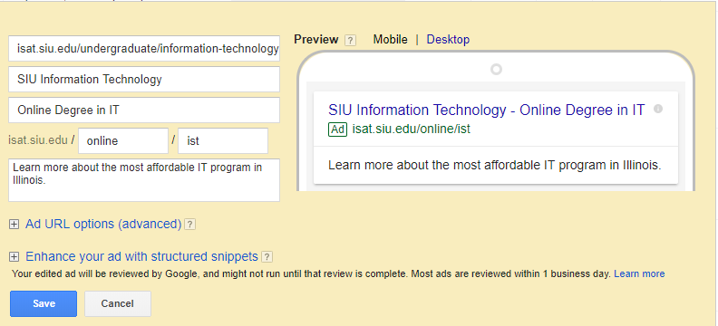
Ads Changes

Slide 4
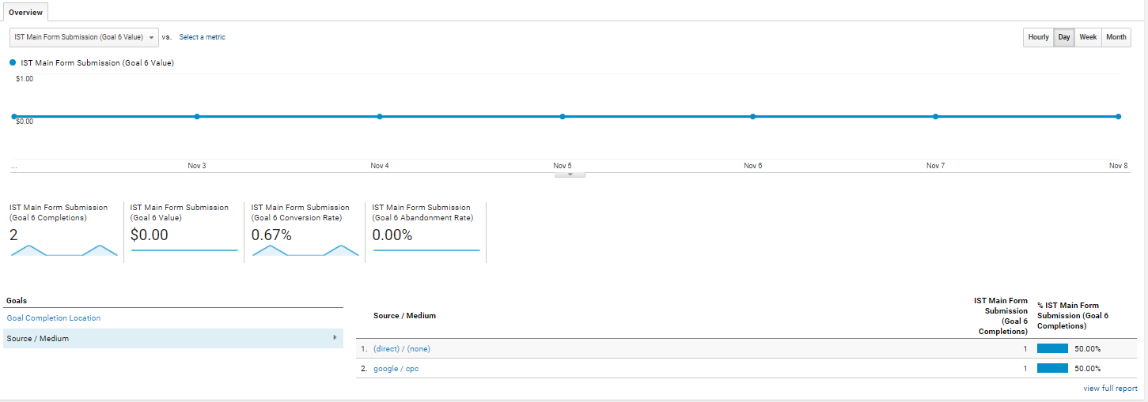
Performance of paid search
Three form submissions
One from paid search
Two direct

Slide 5
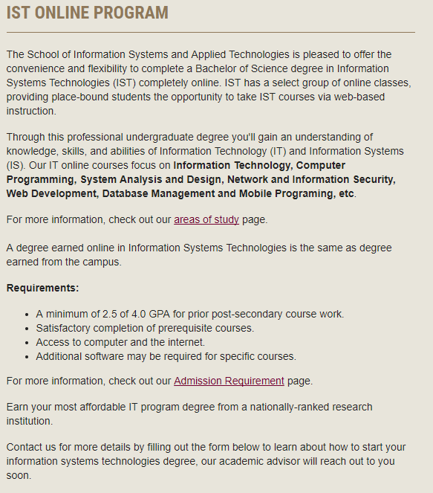
Content Changes

Slide 6
Job table
Area of Study | Related Job | 2016 Median Pay |  | Typical Entry-Level Education | Work Experience in a Related Occupation | On-the-job Training | Number of Jobs, 2016 | Job Outlook, 2016-26 | Employment Change, 2016-26
Cybersecurity Specialization | Information Security Analysts | $92,600 per year | $44.52 per hour | Bachelor's degree | Less than 5 years | None | 100,000 | 28% (Much faster than average) | 28,400
Network & System Administration | Network and Computer Systems Administrators | $79,700 per year | $38.32 per hour | Bachelor's degree | None | None | 391,300 | 6% (As fast as average) | 23,900
Web Development Specialization | Web Developers | $66,130 per year | $31.79 per hour | Associate's degree | None | None | 162,900 | 13% (Faster than average) | 21,300
Mobile App Development | Software Developers | $102,280 per year | $49.17 per hour | Bachelor's degree | None | None | 1,256,200 | 24% (Much faster than average) | 299,500
IT/IS Management | Computer and Information Systems Managers | $135,800 per year | $65.29 per hour | Bachelor's degree | 5 years or more | None | 367,600 | 12% (Faster than average) | 43,800
Data Management | Database Administrators | $84,950 per year | $40.84 per hour | Bachelor's degree | None | None | 119,500 | 11% (Faster than average) | 13,700

Slide 7
Weekly Analysis Cost and Cost per Click (CPC) (Nov 2 to Nov 8)
Search keyword | Campaign | Clicks | Impressions | Cost | CTR | Avg. CPC
Online IT Degree | Campaign #1 - IST online | 4 | 31 | $108.71 | 12.90% | $27.18
it degree | Campaign #1 - IST online | 2 | 289 | $22.82 | 0.69% | $11.41
data interpretation | Campaign #3 - TRM Online | 2 | 6 | $2.12 | 33.33% | $1.06
information security online degree | Campaign #1 - IST online | 2 | 2 | $52.34 | 100.00% | $26.17
IT degrees online | Campaign #1 - IST online | 1 | 35 | $18.74 | 2.86% | $18.74
science degree programs | Campaign #1 - IST online | 1 | 26 | $22.19 | 3.85% | $22.19
technical resource management | Campaign #3 - TRM Online | 1 | 3 | $1.45 | 33.33% | $1.45
information technology degree | Campaign #1 - IST online | 0 | 213 | $0.00 | 0.00% | $0.00
project management | Campaign #3 - TRM Online | 0 | 60 | $0.00 | 0.00% | $0.00
computer programming degree | Campaign #1 - IST online | 0 | 48 | $0.00 | 0.00% | $0.00
programmer degree | Campaign #1 - IST online | 0 | 46 | $0.00 | 0.00% | $0.00
degrees available | Campaign #1 - IST online | 0 | 31 | $0.00 | 0.00% | $0.00
quick degrees | Campaign #1 - IST online | 0 | 23 | $0.00 | 0.00% | $0.00
security degrees | Campaign #1 - IST online | 0 | 22 | $0.00 | 0.00% | $0.00
professionalism | Campaign #3 - TRM Online | 0 | 22 | $0.00 | 0.00% | $0.00
telecommunication | Campaign #2 EST | 0 | 20 | $0.00 | 0.00% | $0.00
degree curriculum | Campaign #1 - IST online | 0 | 18 | $0.00 | 0.00% | $0.00
quality management | Campaign #3 - TRM Online | 0 | 17 | $0.00 | 0.00% | $0.00
cit degree | Campaign #1 - IST online | 0 | 13 | $0.00 | 0.00% | $0.00
technical bachelor's degree | Campaign #1 - IST online | 0 | 10 | $0.00 | 0.00% | $0.00
EST | Campaign #2 EST | 0 | 10 | $0.00 | 0.00% | $0.00
degrees in science | Campaign #1 - IST online | 0 | 10 | $0.00 | 0.00% | $0.00
Total |  | 13 | 955 | $228.37 | 1.36% | $17.57

Slide 8
Weekly Analysis Search terms (Nov 2 to Nov 8)
Search term | Keyword | Match type | Campaign | Clicks | Impressions | CTR | Avg. CPC | Cost | Avg. position
technical resource management siuc | "technical resource management" | phrase | Campaign #3 - TRM Online | 1 | 1 | 100.00% | 1.45 | 1.45 | 1
information security online degree | "information security online degree" | exact | Campaign #1 - IST online | 2 | 2 | 100.00% | 26.17 | 52.34 | 2
how much to get an it degree | "it degree" | phrase | Campaign #1 - IST online | 1 | 1 | 100.00% | 7.83 | 7.83 | 4
online it degrees st louis mo | "Online IT Degree" | phrase (close variant) | Campaign #1 - IST online | 1 | 1 | 100.00% | 21.52 | 21.52 | 3
computer programmer degree | "computer programming degree" | exact (close variant) | Campaign #1 - IST online | 0 | 6 | 0.00% | 0 | 0 | 3.5
online information technology degree | "Online IT Degree" | exact (close variant) | Campaign #1 - IST online | 0 | 4 | 0.00% | 0 | 0 | 2.5
need an it degree | "it degree" | phrase | Campaign #1 - IST online | 1 | 1 | 100.00% | 14.99 | 14.99 | 3
it degree requirements | "it degree" | phrase | Campaign #1 - IST online | 0 | 1 | 0.00% | 0 | 0 | 7
it degrees online | "IT degrees online" | exact | Campaign #1 - IST online | 1 | 3 | 33.33% | 18.74 | 18.74 | 5
data interpretation | "data interpretation" | exact | Campaign #3 - TRM Online | 1 | 1 | 100.00% | 1.1 | 1.1 | 1
online it degree | "Online IT Degree" | exact | Campaign #1 - IST online | 3 | 8 | 37.50% | 29.06 | 87.19 | 4.9
question of data interpretation | "data interpretation" | phrase | Campaign #3 - TRM Online | 1 | 1 | 100.00% | 1.02 | 1.02 | 1
data scientist degree programs | "science degree programs" | phrase (close variant) | Campaign #1 - IST online | 1 | 1 | 100.00% | 22.19 | 22.19 | 4
-- | -- | Total | -- | 13 | 31 | 41.94% | 17.57 | 228.37 | 3.6

Slide 9
Weekly Analysis New negative keywords (Nov 2 to Nov 8)
No negative keyword!

Slide 10
Thank You!

