Slide 1
Google Adwords Report 11/03/2017

Slide 2
Recent Activities:
Google Adwords
Network Changes
New ad group
Content Changes
Weekly Analysis
Cost and Cost per Click (CPC)
Search terms
New negative keywords

Slide 3
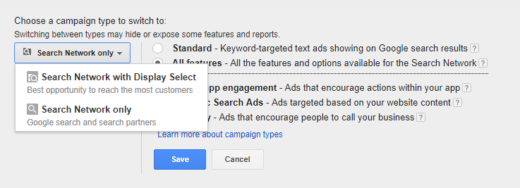
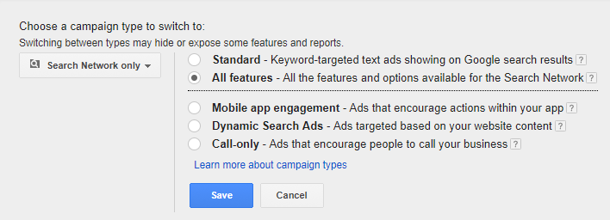
Network Changes

Slide 4
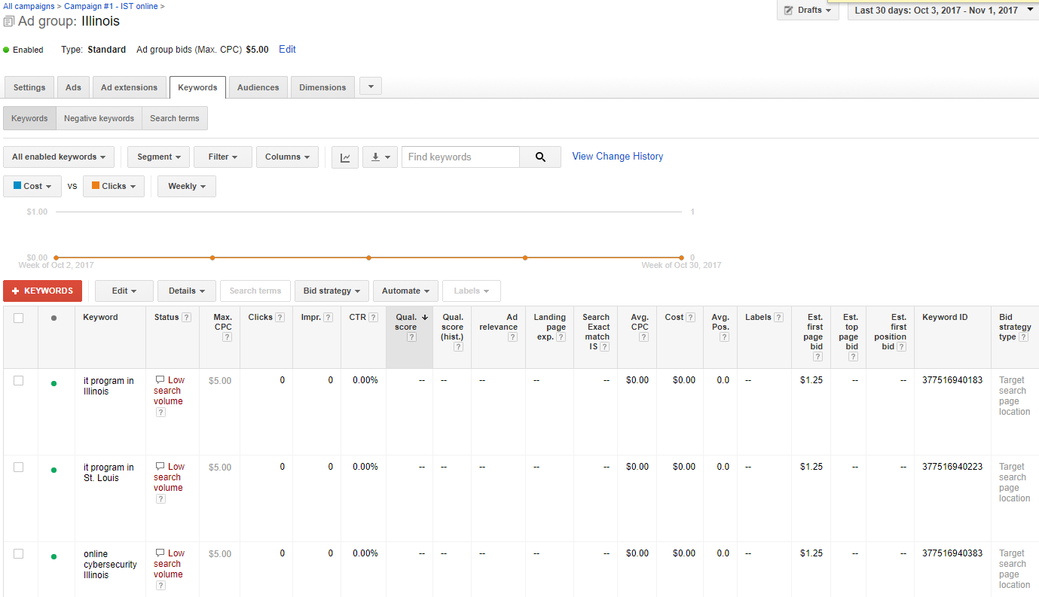
New ad group

Slide 5
Content Changes
The School of Information Systems and Applied Technologies is pleased to offer the convenience and flexibility to complete a Bachelor of Science degree in Information Systems Technologies completely online. IST has a select group of online classes, providing place-bound students the opportunity to take IST courses via web-based instruction.
Through this professional undergraduate certificate you'll gain an understanding of the techniques and necessary tools to design, code, run and test computer programs and information systems using the newest development and programming technologies.
A degree earned online from the School of Information Systems and Applied Technologies is the same as degree earned from the campus.
Our IT online courses focus on:
Information Technology
Computer Programming
System Analysis and Design
Network and Information Security
Web Development
Database management
Mobile Programing
For more information, check out our areas of study page.
Requirements:
A minimum of 2.5 of 4.0 GPA for prior post-secondary course work.
Satisfactory completion of prerequisite courses.
Access to computer and the internet.
Additional software may be required for specific courses.
For more information, check out our Admission Requirement page.
Earn your most affordable IT program degree from a nationally-ranked research institution.
Contact us for more details by filling out the form below to learn about how to start your information systems technologies, our academic advisor will reach out to you soon.

Slide 6
Weekly Analysis Cost and Cost per Click (CPC) (Oct 12 to Oct 25)
Search keyword | Campaign | Clicks | Impressions | Cost | CTR | Avg. CPC | Form Submission
it degree | Campaign #1 - IST online | 3 | 273 | $40.88 | 1.10% | $13.63 | 0
information technology degree | Campaign #1 - IST online | 0 | 226 | $0.00 | 0.00% | $0.00 | 0
security degrees | Campaign #1 - IST online | 1 | 69 | $23.55 | 1.45% | $23.55 | 0
Online IT Degree | Campaign #1 - IST online | 1 | 58 | $34.84 | 1.72% | $34.84 | 0
programmer degree | Campaign #1 - IST online | 0 | 35 | $0.00 | 0.00% | $0.00 | 0
computer programming degree | Campaign #1 - IST online | 2 | 33 | $20.84 | 6.06% | $10.42 | 2
degree curriculum | Campaign #1 - IST online | 1 | 29 | $7.79 | 3.45% | $7.79 | 0
degrees available | Campaign #1 - IST online | 0 | 29 | $0.00 | 0.00% | $0.00 | 0
science degree programs | Campaign #1 - IST online | 0 | 27 | $0.00 | 0.00% | $0.00 | 0
IT degrees online | Campaign #1 - IST online | 0 | 25 | $0.00 | 0.00% | $0.00 | 0
ba in information technology | Campaign #1 - IST online | 0 | 13 | $0.00 | 0.00% | $0.00 | 0
quality management | Campaign #3 - TRM Online | 0 | 13 | $0.00 | 0.00% | $0.00 | 0
degrees in science | Campaign #1 - IST online | 0 | 12 | $0.00 | 0.00% | $0.00 | 0
professionalism | Campaign #3 - TRM Online | 0 | 12 | $0.00 | 0.00% | $0.00 | 0
fastest degree | Campaign #1 - IST online | 0 | 11 | $0.00 | 0.00% | $0.00 | 0
technical bachelor's degree | Campaign #1 - IST online | 0 | 10 | $0.00 | 0.00% | $0.00 | 0
Google Display Network |  | 0 | 0 | 0 | 0 | 0 | 6
Total |  | 8 | 875 | $127.90 | 0.91% | $15.99 | 8

Slide 7
Weekly Analysis Search terms (Oct 26to Nov 1)
depaul it degree transfer degree
siu technical resource management
chemistry degree curriculum
online information technology degree
computer programmer degree
homeland security degree siu
it degree requirements
siue it degree

Slide 8
Weekly Analysis New negative keywords (Oct 12 to Oct 25)
depaul
transfer
chemistry
homeland
requirements

Slide 9
Thank You!

