Slide 1
Google Adwords Report 10/27/2017

Slide 2
Recent Activities:
Process Overview
Statistics
Linking Google Adwords and Analytics
Setting up new goals
Setting up new alerts
Tracking page visits
Weekly Analysis
Cost and Cost per Click (CPC)
Search terms
New negative keywords

Slide 3
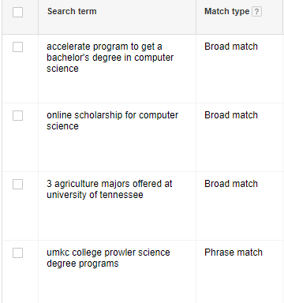
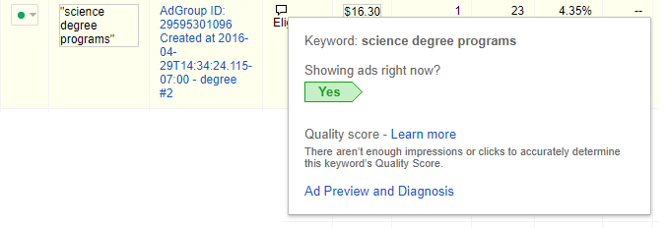
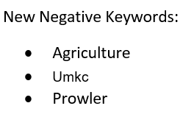
Process
Starting new ads with new keywords
Tracking keywords performance using search terms
Defining new negative keywords based on search terms
Making change in price and match type of keywords
Making decision about keeping or deletion of keyword

Slide 4
Statistics
Year | Clicks | Impressions | CTR | Avg. CPC | Cost | Form Submission
May 21 - Jun 21 | 1,021 | 89,620 | 1.14% | $1.23 | $1,252 | 14
Jun 21 - Jul 21 | 1,351 | 128,041 | 1.06% | $1.36 | $1,836 | 27
Jul 21 - Aug 21 | 2,392 | 236,254 | 1.01% | $0.74 | $1,781 | 18
Aug 21 - Sep 21 | 560 | 66,645 | 0.84% | $3.59 | $2,011 | 14
Sep 21 - Oct 21 | 598 | 89,316 | 0.67% | $2.89 | $1,727 | 21
Keword Changes (Aug21 – Oct 21)
Max Bid Increased | Max Bid Decreased | Keyword Paused | Negative keywords added
116 | 51 | 97 | 77
Example:
Keyword: | Online Programs
First Max Bid | $ 0.67
First Match type: | Broad
Match Type Changed | Phrase
Max CPC increased | $ 15.00
Max CPC increased | $ 20.00
Keyword Paused | -

Slide 5
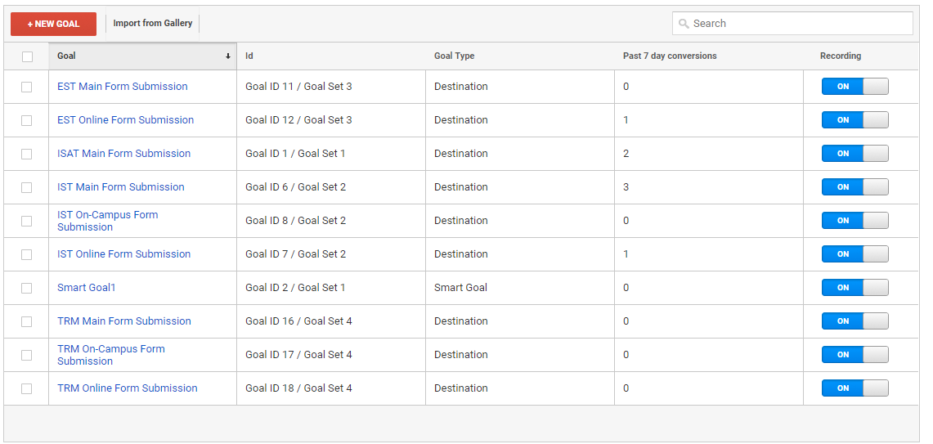
Linking Google Adwords and Analytics Setting up goals

Slide 6
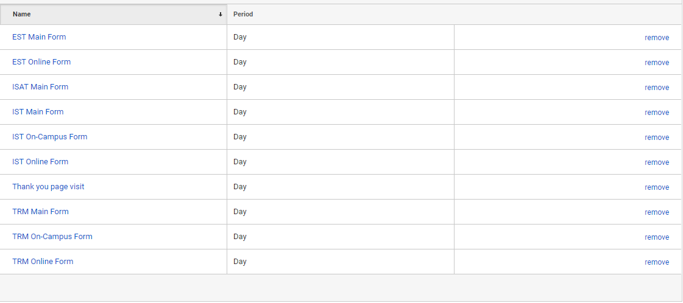
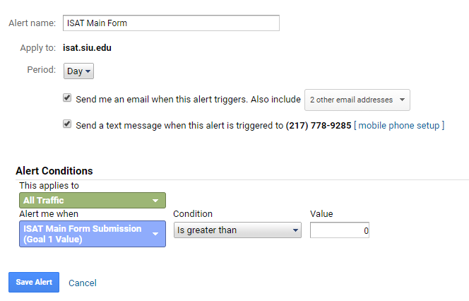
Linking Google Adwords and Analytics Setting up alerts

Slide 7
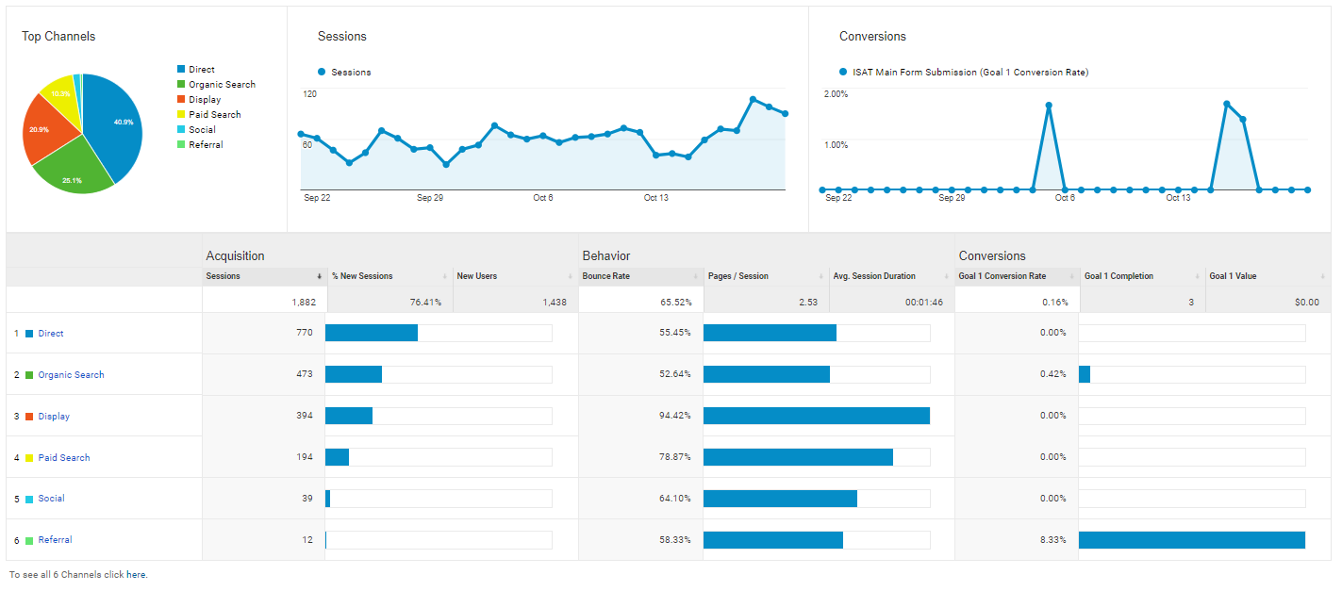
Linking Google Adwords and Analytics Tracking page visits

Slide 8
Weekly Analysis Cost and Cost per Click (CPC) (Oct 12 to Oct 25)
Search keyword | Campaign | Clicks | Impressions | Cost | CTR | Avg. CPC | Form Submission | Status
Online Programs | Campaign #1 - IST online | 9 | 1,882 | $127.90 | 0.48% | $14.21 | 0 | Paused
degrees offered | Campaign #1 - IST online | 7 | 67 | $25.03 | 10.45% | $3.58 | 0 | Paused
it degree | Campaign #1 - IST online | 3 | 187 | $22.99 | 1.60% | $7.66 | 0 | Active
Online IT Degree | Campaign #1 - IST online | 1 | 31 | $22.40 | 3.23% | $22.40 | 0 | Active
ba in information technology | Campaign #1 - IST online | 2 | 20 | $11.80 | 10.00% | $5.90 | 0 | Active
science degree programs | Campaign #1 - IST online | 1 | 22 | $7.38 | 4.55% | $7.38 | 0 | Active
degree in information security | Campaign #1 - IST online | 1 | 1 | $2.16 | 100.00% | $2.16 | 0 | Active
technical resource management | Campaign #3 - TRM Online | 2 | 4 | $2.12 | 50.00% | $1.06 | 0 | Active
project management | Campaign #3 - TRM Online | 1 | 26 | $1.19 | 3.85% | $1.19 | 0 | Active
Total |  | 27 | 2,240 | $222.97 | 1.21% | $8.26 | 1 | -

Slide 9
Weekly Analysis Search terms (Oct 12 to Oct 25)
siu it degree
majors and degrees offered at unc chapel hill
alabama a&m degrees offered
number of degrees offered at ohio state university
umkc college prowler science degree programs
degree in information security
indiana university bloomington different degrees offered
vet tech online programs
online programs
online programs
how can a ged have an it degree
degrees offered at ivy tech bloomington
siu online programs
online programs in computer programming

Slide 10
Weekly Analysis New negative keywords (Oct 12 to Oct 25)
chapel hill
alabama
ohio
broadcasting
news
radiology

Slide 11
Thank You!

