Slide 1

Zelula
Group E
Felix Akkermans, Niels Doekemeijer, Albert ten Napel, Thomas van Helden, Jan Pieter Waagmeester

Slide 2
Contents
Project description
Plan
Result
Future implementation
Demo

Slide 3
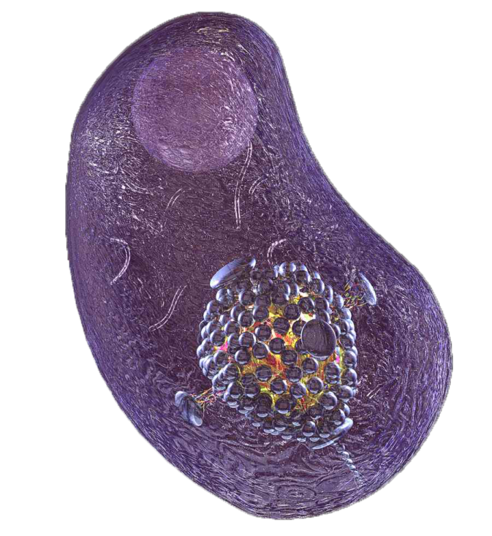
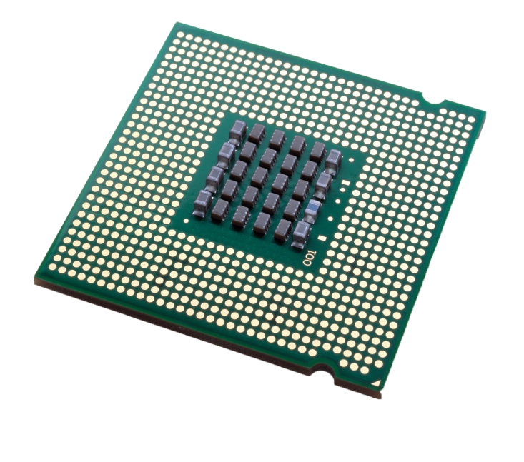
Project description

Slide 4
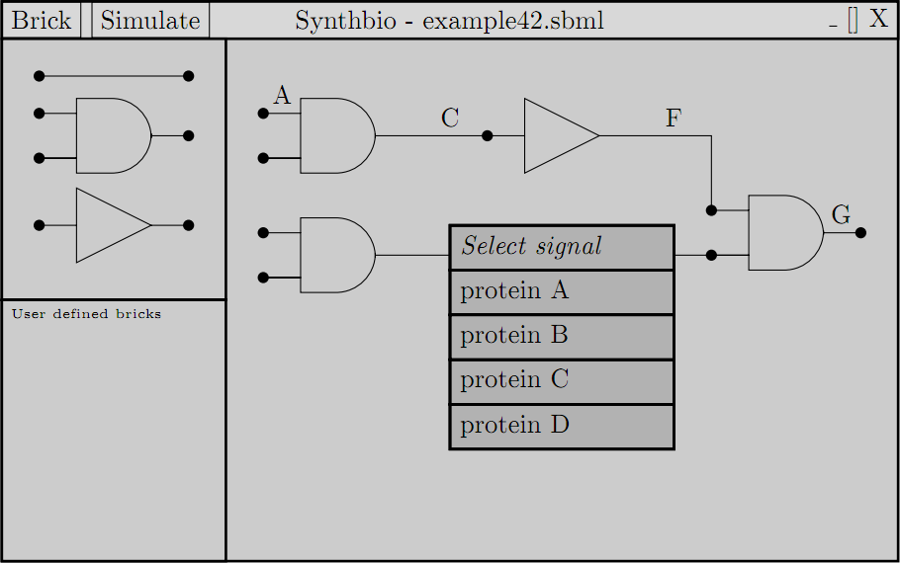
Plan

Slide 5
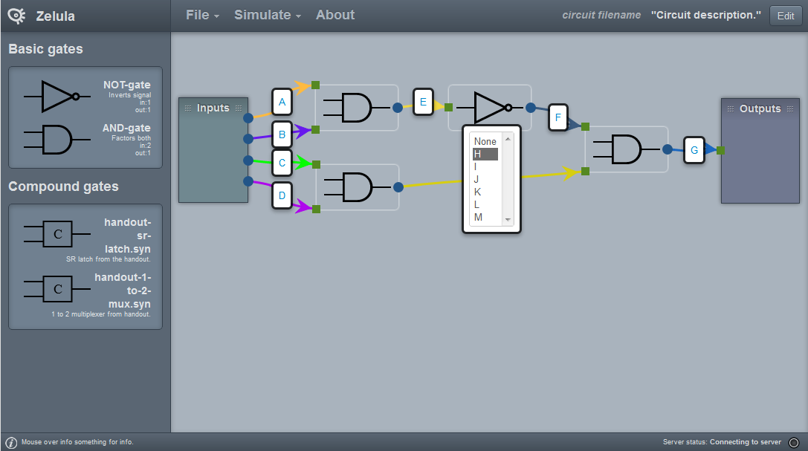
Result

Slide 6
Future implementation
Displaying compound gates different
Advanced zooming
Simulation results in separate screen

Slide 7
Demo

