Slide 1

Zelula
Group E
Felix Akkermans, Niels Doekemeijer, Albert ten Napel, Thomas van Helden, Jan Pieter Waagmeester

Slide 2
Contents
Project description
Plan
Result
Future implementation
Demo

Slide 3
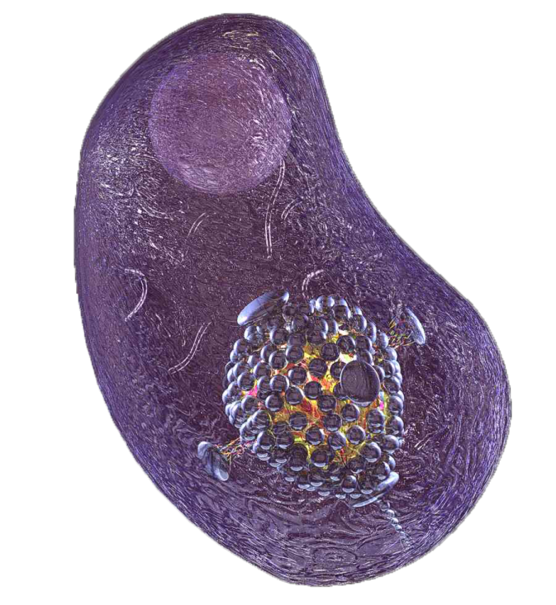
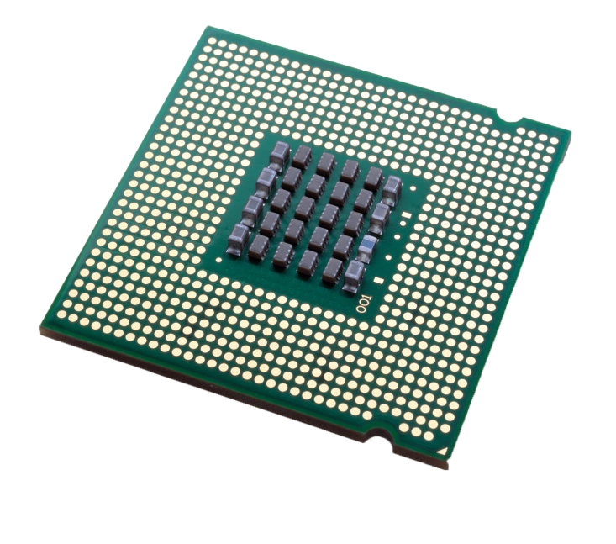
Project description

Slide 4
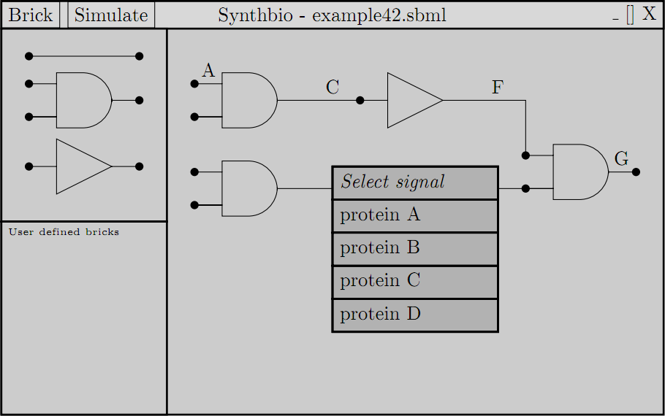
Plan

Slide 5
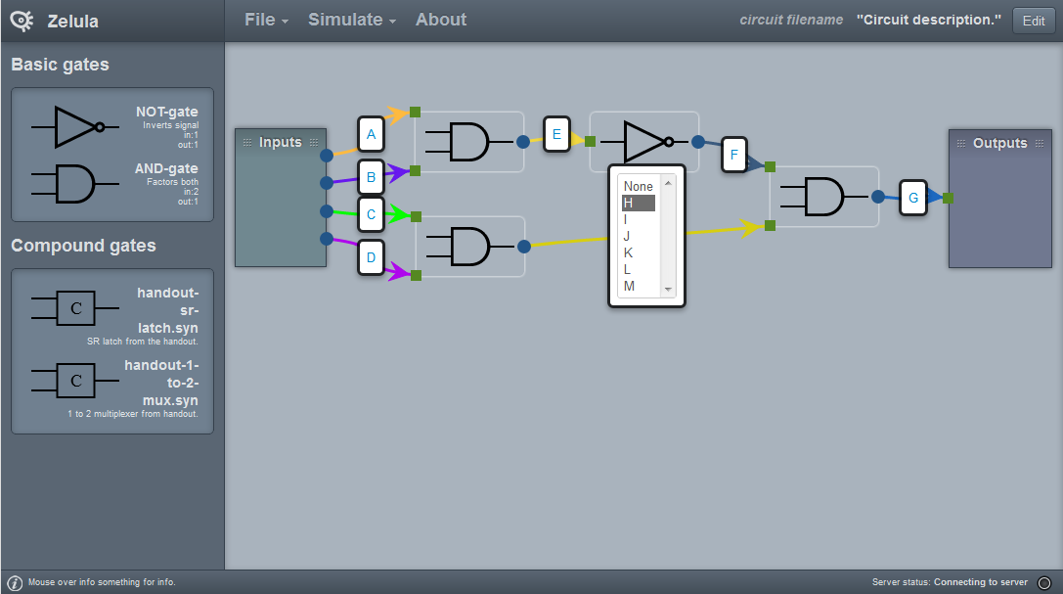
Result

Slide 6
Future implementation
Displaying compound gates different
Advanced zooming
Simulation results in separate screen

Slide 7
Demo

Slide 9
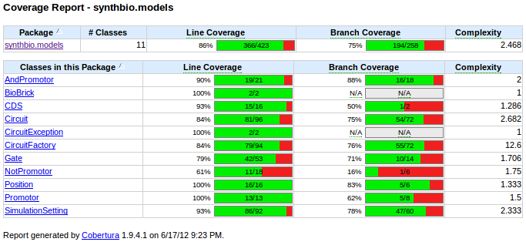
Test coverage Java models

Slide 10
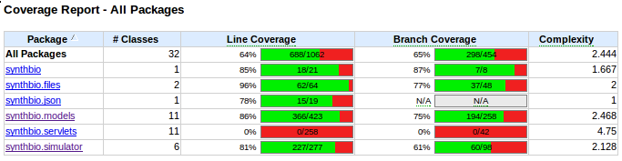
Test coverage Java packages

Slide 11
Future implementation part 2
Acceptance test results
Groupings
Green dot
Display open wires
Highlighting problems
Compound normal gate distinction

Slide 12
Libraries etc
jsPlumb
Less
Ant
HighChart
JQuery
QUnit
JUnit
SBML Solvers
Bootstrap

