Slide 1
100 resources to product management
https://www.sachinrekhi.com/top-resources-for-product-managers

Slide 2
01 - Good Product Manager/Bad Product Manager
https://a16z.com/2012/06/15/good-product-managerbad-product-manager/
Good Product Manager | Bad Product Manager
Knows market, product, product line, competition Measures by success of product and revenue | have lots of excuses. Not enough funding, the engineering manager is an idiot, Microsoft has 10 times engineers working on it, I’m overworked, I don’t get enough direction
They are not part of the product team; they manage the product team Good product managers are the marketing counterpart of the engineering manager
Good product managers crisply define the target, the “what” (as opposed to the how) and manage the delivery of the “what.” | Bad product managers feel best about themselves when they figure out “how”
Good product managers communicate crisply to engineering in writing as well as verbally. Good product managers don’t give direction informally. Good product managers gather information informally.
Good product managers create leveragable collateral, FAQs, presentations, white papers | Bad product managers complain that they spend all day answering questions for the sales force and are swamped.
Good product managers take written positions on important issues (competitive silver bullets, tough architectural choices, tough product decisions, markets to attack or yield). | Bad product managers voice their opinion verbally and lament that the “powers that be” won’t let it happen
Good product managers focus the team on revenue and customers | Bad product managers focus team on how many features Microsoft is building
Good product managers think in terms of delivering superior value to the market place during inbound planning and achieving market share and revenue goals during outbound | Bad product managers get very confused about the differences amongst delivering value, matching competitive features, pricing, and ubiquity
Good product managers think about the story they want written by the press. | Bad product managers think about covering every feature and being really technically accurate with the press
Good product managers ask the press questions. | Bad product managers answer any press question
Good product managers send their status reports in on time every week, because they are disciplined. | Bad product managers forget to send in their status reports on time, because they don’t value discipline.

Slide 3
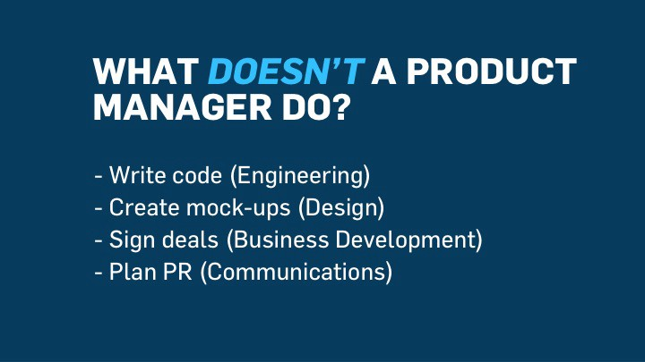
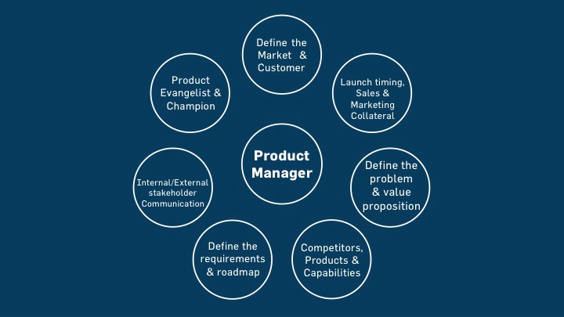

02 - Let’s talk about Product Management
https://news.greylock.com/let-s-talk-about-product-management-d7bc5606e0c4#.pssfrgp3i

Slide 4
02 - Let’s talk about Product Management
https://news.greylock.com/let-s-talk-about-product-management-d7bc5606e0c4#.pssfrgp3i
Your role on the team
Set the cadence
Build the roadmap with brainstorm meetings (quarterly)
Articulate the roadmap clearly and consistently
Take and share clear meeting notes
Brainstorm Effectively - Roadmap
Be open to everyone pitching ideas
Q&A where people pitch ideas
Everyone votes for their top 3
Discussion on why and revote
We have 3 roadmap plans atleast
Manage Product Operations
Gut check for features getting launched ASAP
Learnings and analysis of recent features
Feedback from testers, active users,
Criticism from non users,, Input from founders
Roadmap check in on new development
1-2 key topics for brainstorm/new ideas or guest speaker
The most important thing you do
is document decisions
Follow up notes usually take longer than the meeting itself
Help SHIP product, SHIP >> PERFECTION
Providing clear criteria for launch readiness
Make the difficult tradeoffs
Prioritize ruthlessly
Advocate for the user
Identify a core use case – which tells who should use the product and why – articulating core usecase is the hardest
Understand the challenges/issues of the user
Understand how the product can deliver the value target users want
Continuously listening to feedback (usability tests, meetings, tweets)

