Slide 1
Employee Data Insights
Visual analysis of factors affecting income and satisfaction

Slide 2
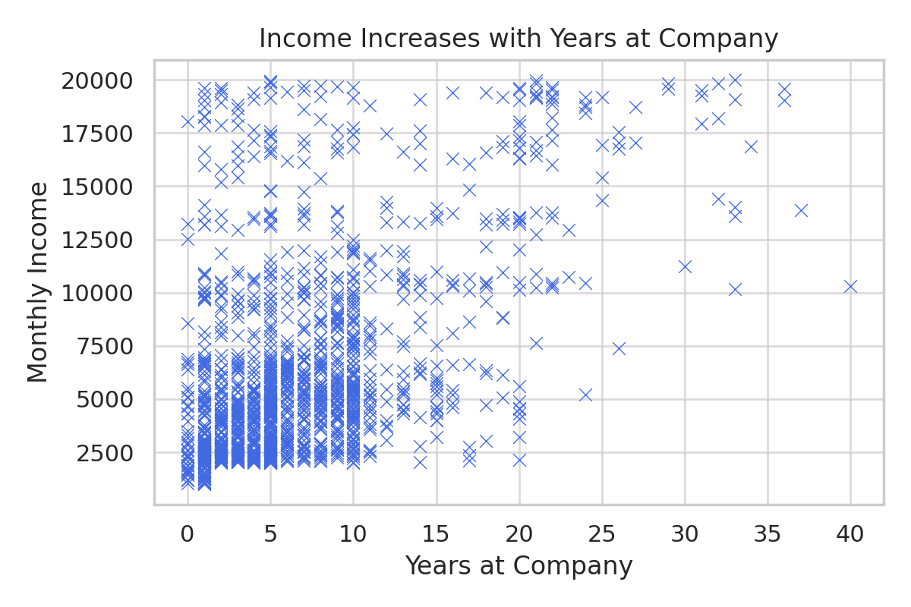
Income Increases with Years at Company

Slide 3
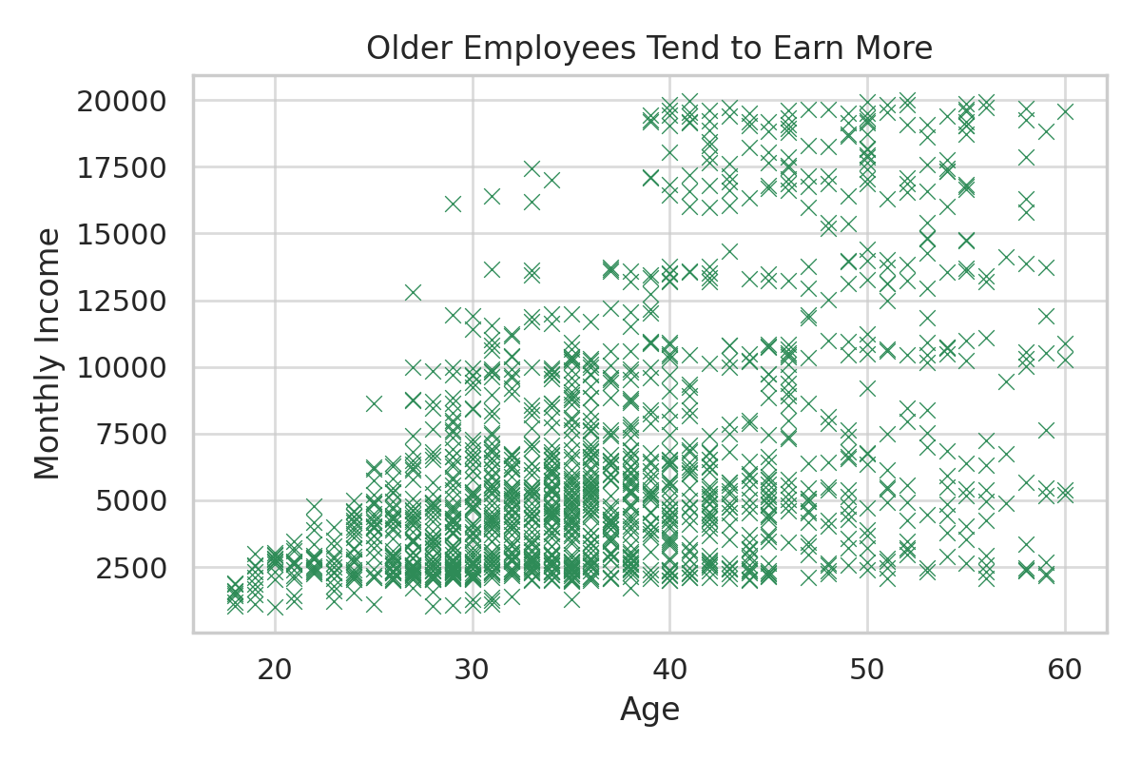
Older Employees Tend to Earn More

Slide 4
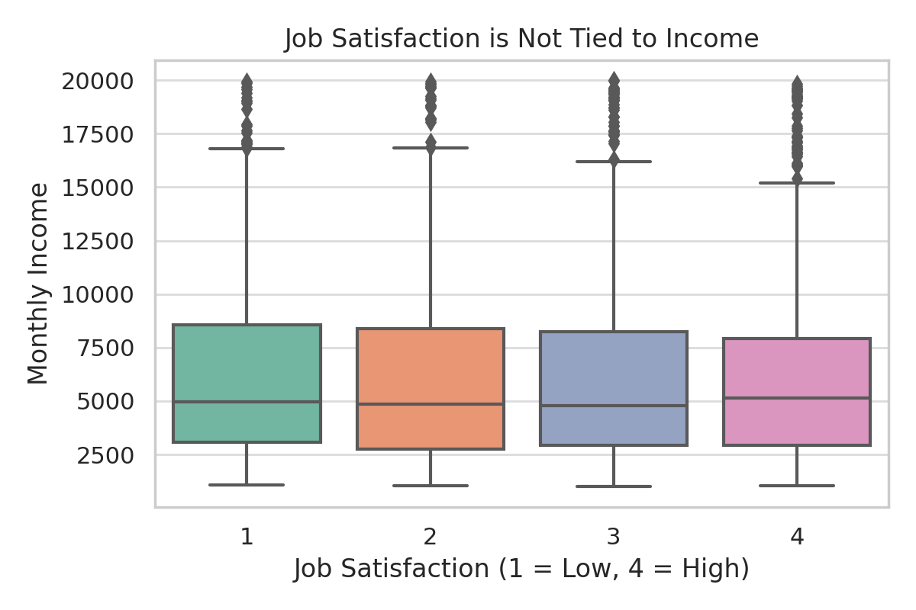
Job Satisfaction is Not Tied to Income

