Slide 1

BIM2SIM
A Concept for HVAC Processing
David Jansen

Slide 2
BIM2SIM Motivation
Generating simulation models from BIM has two main advantages:
Eliminating the error-prone process of manual modeling
Decrease time and effort for performing simulations
Ongoing and finished researches have different approaches regarding:
Export format (IFC and gbXML)
Modeling/Simulation (Modelica, EnergyPlus + DesignBuilder, IES, TRNSYS)
Level of automation
Our objecitve:
Mostly automatic generation of BES for the early phases of building construction
Analyse and optimize the usage of different energy systems
Store results of the simulations in the BIM model for further usage

Slide 3
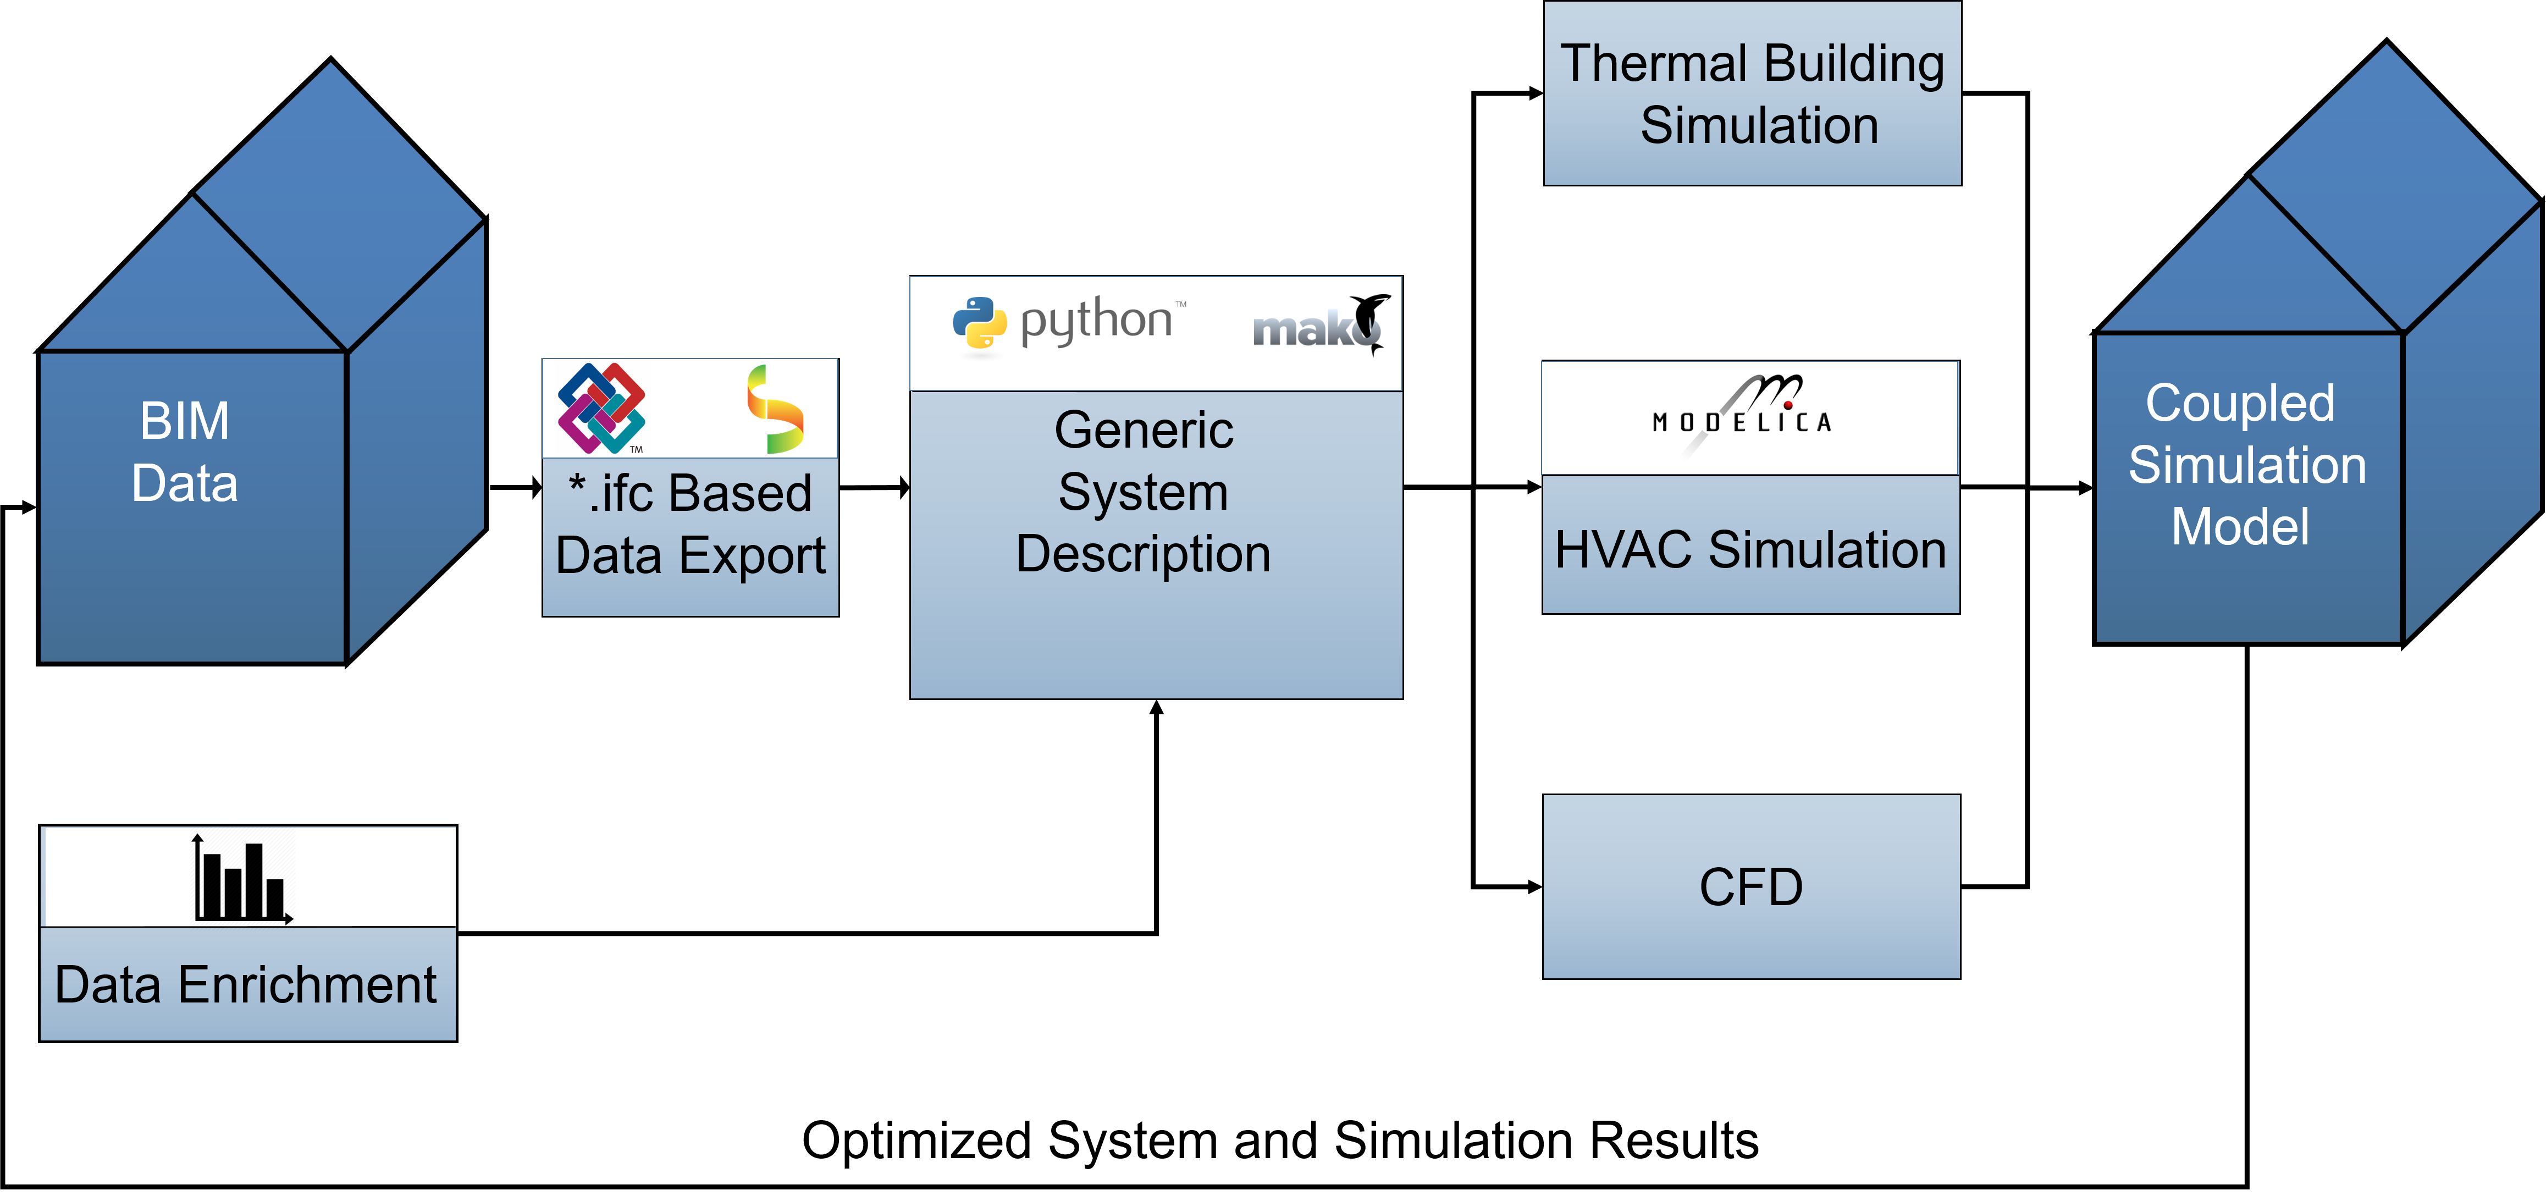
BIM2SIM Approach

Slide 4


BIM2SIM HVAC Processing – IFC
IFC Ex- and Import
Exporting as many data as possible from BIM to Ifc
Importing data to Python with IfcOpenShell
A Model check regarding completeness could either be performed
before Import (MVD)
or after Import (Creating own Model Check in Python)

Slide 5

BIM2SIM HVAC Processing – Data Enrichment
Data Enrichment
Currently BIM Models doesn’t hold all data needed for parameterization
Missing parameters have to be aggregated from external sources
These sources mainly could be:
Data sheets from manufacturers
Statistical data from literature and studies
Quality of data enrichment can have a high impact on the results

Slide 6


BIM2SIM HVAC Processing - Generic System Description
Generic System Description
Combined data from Ifc and data enrichment
Holds the basic classes:
Energy Conversion System
Air Handling Unit
Hydraulc System
Air Duct System
Controls
Stay as generic as possible to fulfill different libraries and simulation software conditions
Export will be done via Mako Templates

Slide 7

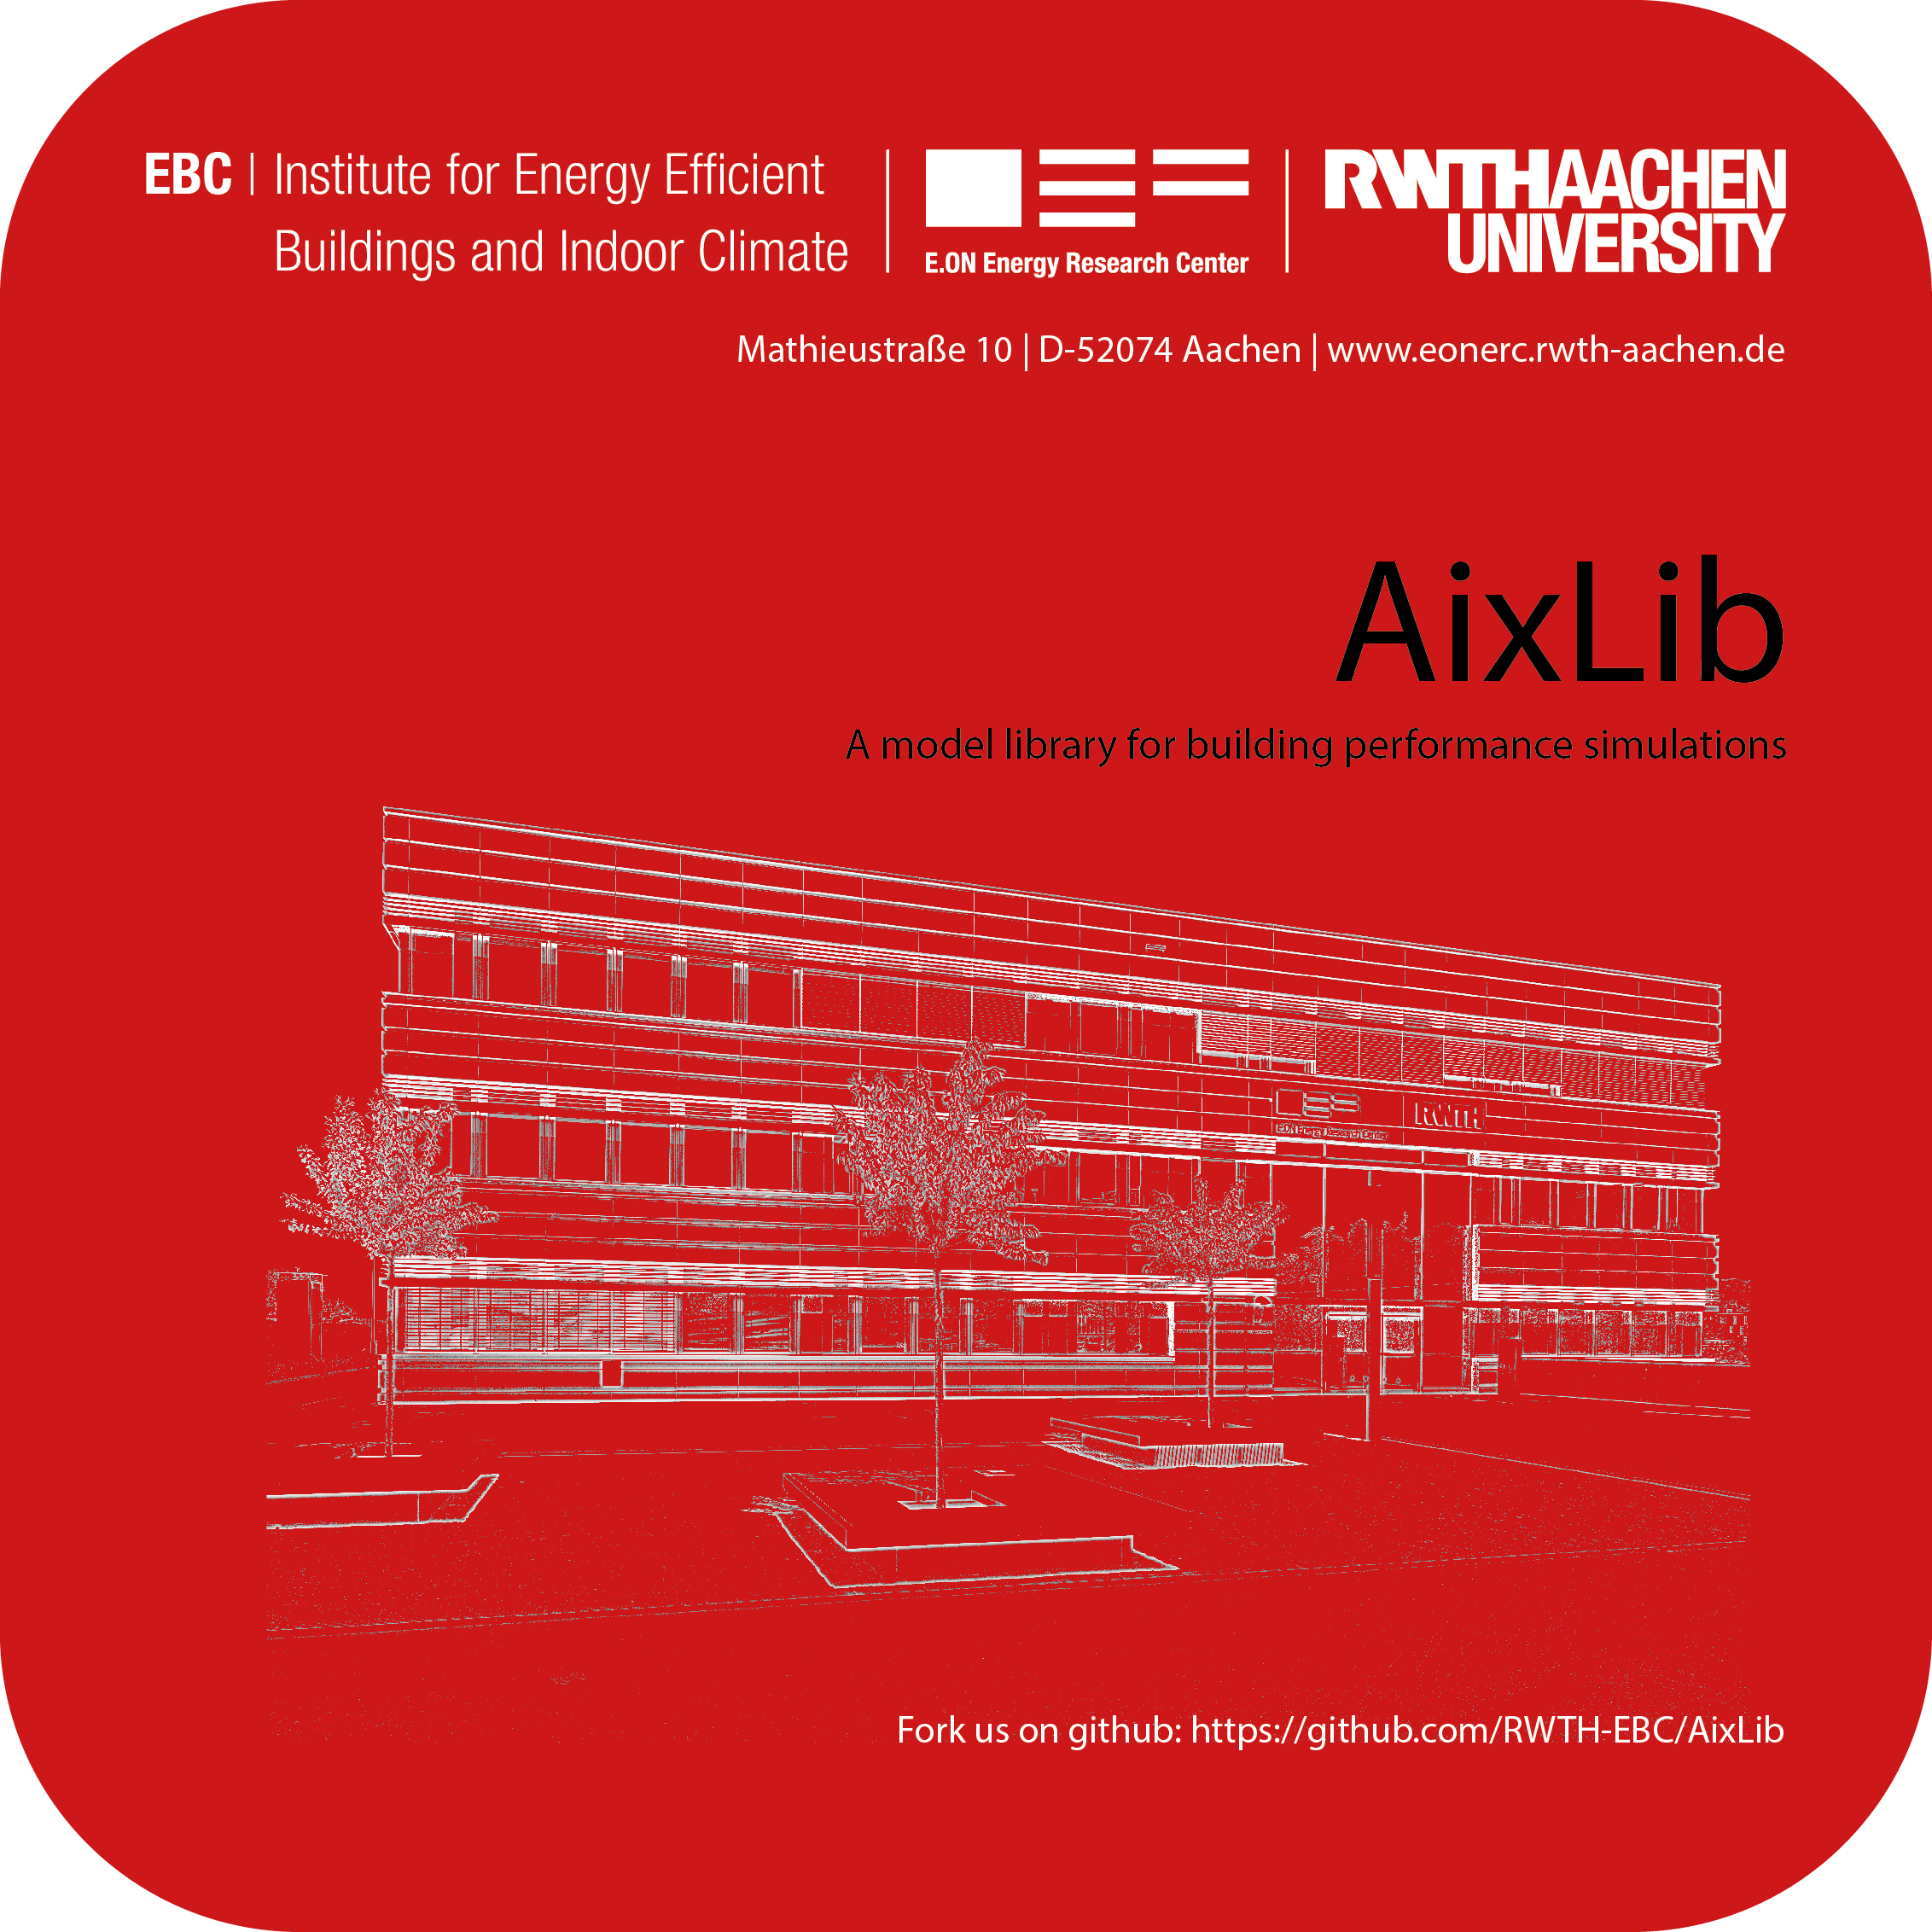
BIM2SIM HVAC Processing – Model generation
HVAC System
FastHVAC +
HVAC System will be modelled in Modelica in the first place
Library: FastHVAC
Simplified enthalpy flow based 1D-Modelling
No pressure calculation
robust
Thermal zone based distribution
Energy Conversion System & Storages & Air Handling Unit
Hydraulic & Air Distribution System
Characteristic curves/maps
rated powers
Dimensions
…
From Ifc or data enrichment
Abstracted piping system
Abstracted duct system
Zone based distribution system
From Ifc data

Slide 8
BIM2SIM Coupled Simulation
Two ways of coupled simulation could be done
1. Dynamic coupled simulation:
Direct coupling between Modelica Models (e.g. TEASER generated Building & fastHVAC HVAC Simulation)
Direct coupling with FMUs (e.g. Modelica & EnergyPlus)
2. Indirect coupled simulation:
Storing time series data from simulations back into Ifc file
Other simulation programs can then

Slide 9
BIM2SIM Current Steps and Challenges
Current steps and questions to answer:
Analyse the data situation in industry
Exporting a mostly complete Ifc file
Generating the abstracted networks for hydraulic and air duct system
How to perform the Model Check:
Use MVDs
Create Model Check in Python
Main Challenges are:
Insufficient model description in BIM data
Mapping to Ifc components depends on the used export software
Every ex- and import of BIM data leads to data loss

Slide 10
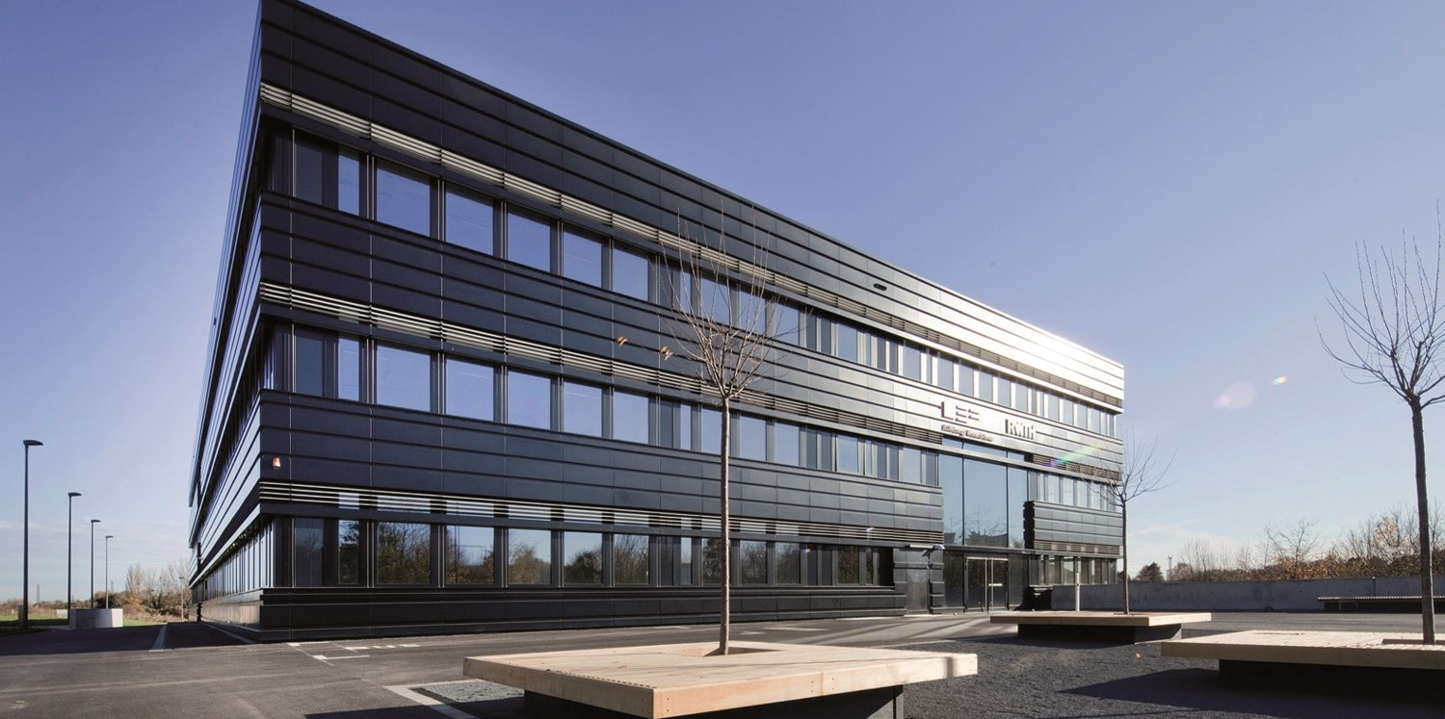
Contact
E.ON Energy Research Center
Mathieustraße 10
52074 Aachen
Germany
David Jansen
T +49 241 80 49808
F +49 241 80 49769
djansen@eonerc.rwth-aachen.de
http://www.eonerc.rwth-aachen.de

