Slide 1

深入浅出Netty
fengxue2026@qq.com

Slide 2
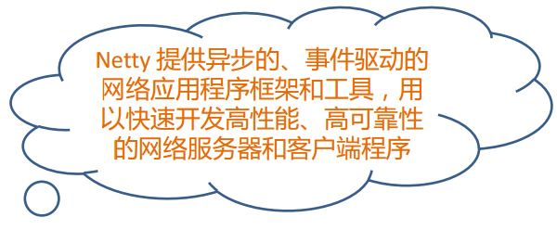
Netty是什么？

Slide 3
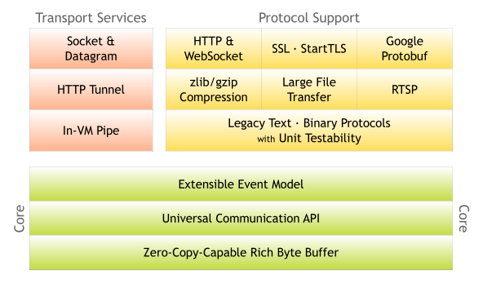
Netty的架构

Slide 4
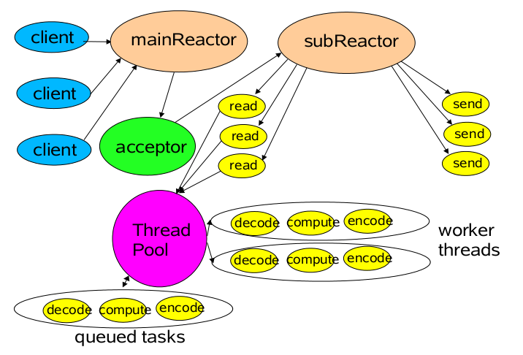
Netty Reactor网络模型

Slide 5
传统线程池+BIO
一线程管理一条Socket
Acceptor
Client
read
socket
write
Worker
Client
Worker
Client
Worker

Slide 6
Epoll 异步IO
事件驱动
System
优点:少量线程管理大量的Socket
1:accept
3:EPOLLIN
Acceptor
4: socket
2:Connect
Client
6:read
System
7:EPOLLIN Read Event
9:write
5:read
8:write
Worker
Task
Task Queue
Client
Worker
Task
Task Queue
Client
Worker
Task
Task Queue

Slide 7
Pipeline模型
I/O Request
via {@link Channel} or
{@link ChannelHandlerContext}
|
+----------------------------------------------------+-----------------+
| ChannelPipeline | |
| \|/ |
| +----------------------+ +-----------+------------+ |
| | Inbound Handler N | | Outbound Handler 1 | |
| +----------+-----------+ +-----------+------------+ |
| /|\ | |
| | \|/ |
| +----------+-----------+ +-----------+------------+ |
| | Inbound Handler N-1 | | Outbound Handler 2 | |
| +----------+-----------+ +-----------+------------+ |
| /|\ . |
| . . |
| [{@link ChannelInboundInvoker}] [{@link ChannelOutboundInvoker}()] |
| [ method call] [method call] |
| . . |
| . \|/ |
| +----------+-----------+ +-----------+------------+ |
| | Inbound Handler 2 | | Outbound Handler M-1 | |
| +----------+-----------+ +-----------+------------+ |
| /|\ | |
| | \|/ |
| +----------+-----------+ +-----------+------------+ |
| | Inbound Handler 1 | | Outbound Handler M | |
| +----------+-----------+ +-----------+------------+ |
| /|\ | |
+---------------+------------------------------------+-----------------+
| \|/
+---------------+------------------------------------+-----------------+
| | | |
| [ Socket.read() ] [ Socket.write() ] |
| |
| Netty Internal I/O Threads (Transport Implementation) |
+----------------------------------------------------------------------+

Slide 8
Pipeline模型 : HTTP 链式调用
Socket.read()
Socket.write()
byte[]
byte[]
HttpRequestDecoder
HttpResponseEncoder
HttpObject
HttpObjectAggregator
HttpResponse
HttpRequest
BusinessHandler

Slide 9
Buffer
池化 Pooled Byte Buffer
Netty Zero-Copy Buffer
基于组合模式的CompositeByteBuf
Easy To User Buffer
+-------------------+------------------+------------------+
| discardable bytes | readable bytes | writable bytes |
+-------------------+------------------+------------------+
| | | |
0 <= readerIndex <= writerIndex <= capacity

Slide 10

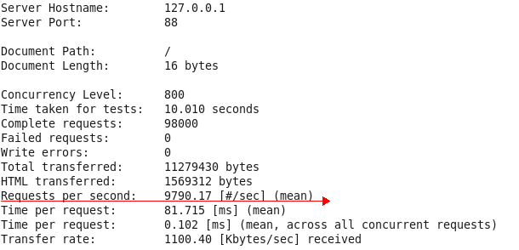
性能测试
对每一请求简单返回一个JSON的响应
Worker线程: 8个
关闭Keep-alive,进行apache bench 测试
# ab -n 98000 -c 800 http://127.0.0.1:88/
测试结果:

Slide 11
JNetty
fengxue2026@qq.com

Slide 12
JNetty是什么？
基于Netty实现的高性能Servlet/JSP服务器

Slide 13
JNetty的架构
Filter
Servlet
Filter
Servlet
Filter
Servlet
Client
Http请求
Netty
FilterChainBuilder
Http响应
HttpResponse
HttpRequest
RequestDispatcherImpl
FilterChain
dispatch
FilterChain
Filter
Filter
Servlet

Slide 14
JNetty的架构:引入Cache
Filter
Servlet
Filter
Servlet
Filter
Servlet
Client
Http请求
Netty
FilterChainBuilder
Http响应
HttpResponse
HttpRequest
RequestDispatcherImpl
FilterChainCache
FilterChain
dispatch
FilterChain
Filter
Filter
Servlet

Slide 15

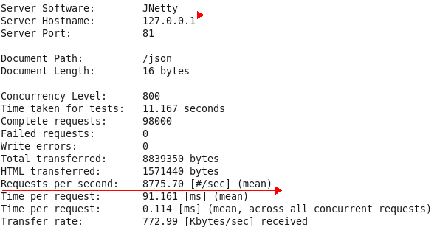
性能测试
对每一请求简单返回一个JSON的响应
Worker线程: 8个
关闭Keep-alive,进行apache bench 测试
# ab -n 98000 -c 800 http://127.0.0.1:81/json
测试结果:

