Slide 1
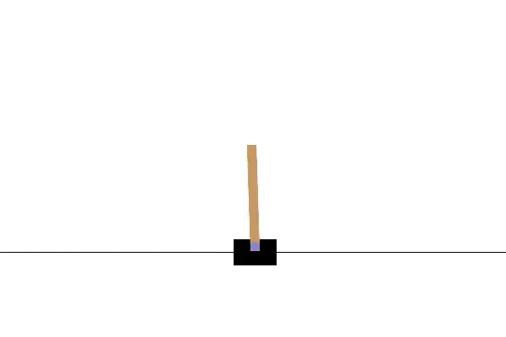
Offline-RL
On Cartpole

Slide 2

Reinforcement Learning
States $S$, Actions $A$, Probabilities $P_{a}$, Rewards $R_{a}$
Objective:
Find $π\left(s\right)$ which maps $s→a$ to maximize $E[\sum_{t=o}^{∞}{γ^{t}R_{a_{t}}(s_{t, s_{t+1}})]=Return}$
Accumulate as much reward as possible, as soon as possible.
Functions:
Policy: $π\left(s\right): s→a$
Value Function: $V\left(s\right): s→ E(Return)$

Slide 3
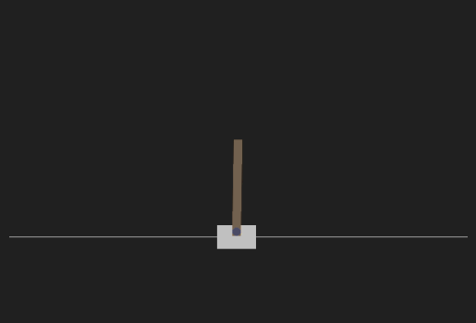
Cartpole
States:
[position, speed, pole-angle, pole-speed]
Actions:
0: Push left
1: Push right
Rewards:
+1 for every action
Termination if pole falls

Slide 4
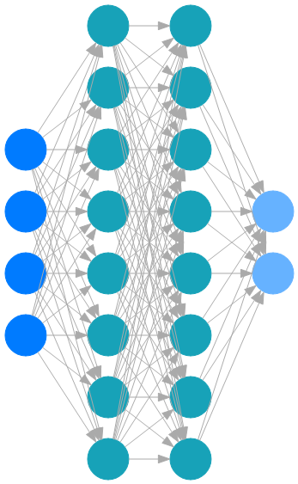

Deep Q Network
Combining Value and Policy:$Q\left(s,a\right)$
Policy: choose argmax(output)
Training: Collect tuples $t=\left(s, a, r, s^{′}, d\right)$.
Update process per t: $q=Q\left(s\right)[a]$, $q′=Q(s′)$
$$Target=r+γ ∗\max\left(q^{′}\right)∗(1−d)$$
$$Loss_{DQN}=MSE(q,Target)$$

Slide 5

Problems with offline Training
Distributional shift (Out of distribution)
Due to $\max\left(q^{′}\right)$ action-values are typically overestimated
No exploration
Data quality and Coverage
Evaluation tricky

Slide 6
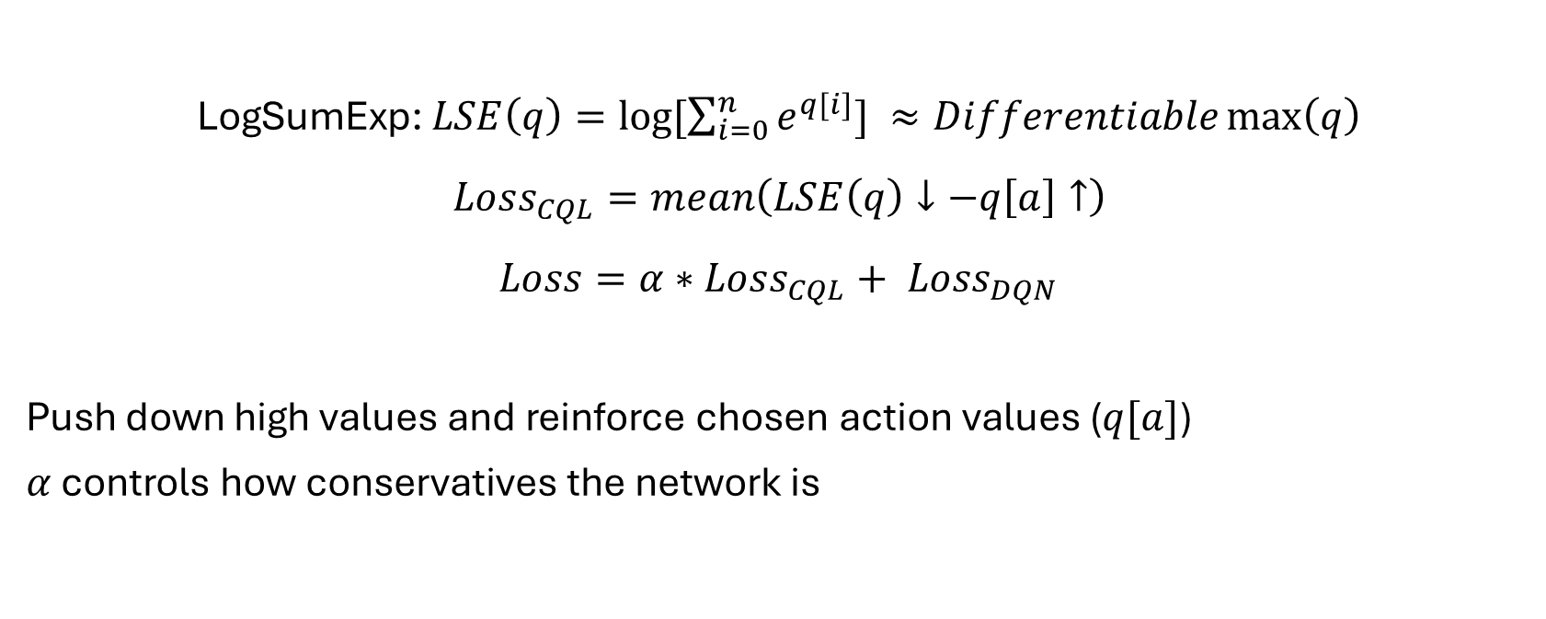
Conservative Q-Learning
LogSumExp: $LSE\left(q\right)=\log{[\sum_{i=0}^{n}{e^{q[i]}}]} ≈Differentiable\max\left(q\right)$
$$Loss_{CQL}=mean\left(LSE\left(q\right)↓−q\left[a\right]↑\right)$$
$$Loss=α∗Loss_{CQL}+ Loss_{DQN}$$
Push down high values and reinforce chosen action values ($q[a]$)
$α$ controls how conservatives the network is

Slide 7

Training
Evaluation:
Average Returns on 20+ episodes ($R)$
Dataset Generation:
3 datasets a 100k tuples from different Online-DQN policies
Random($R=$20), Mid($R=250$), Perfect($R=500$)
Training:
With different alphas and comparing Offline vs Online

Slide 8
Perfect (Return =500)

Slide 9
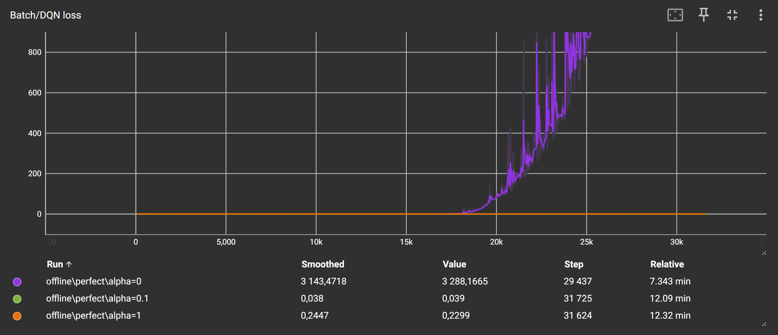
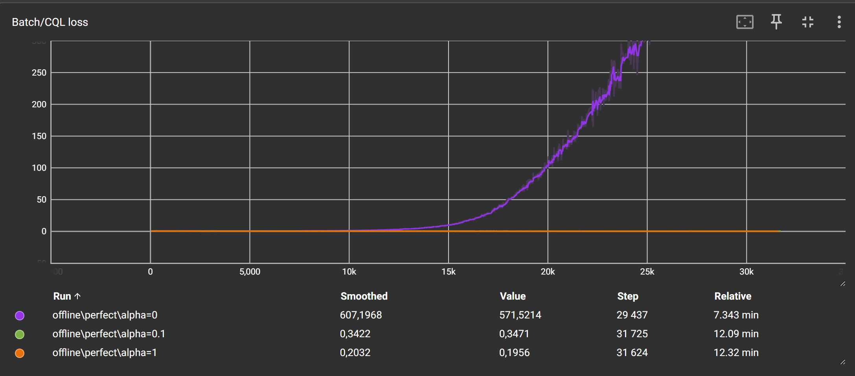

Slide 10
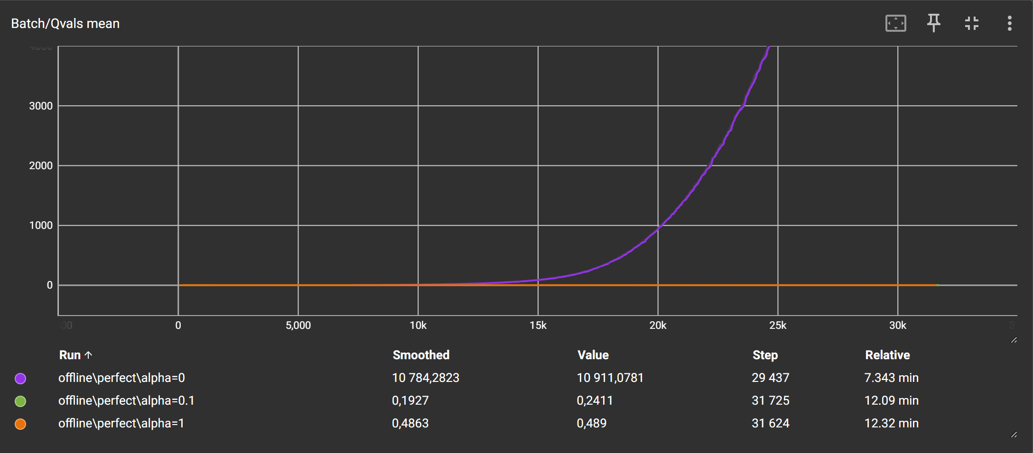
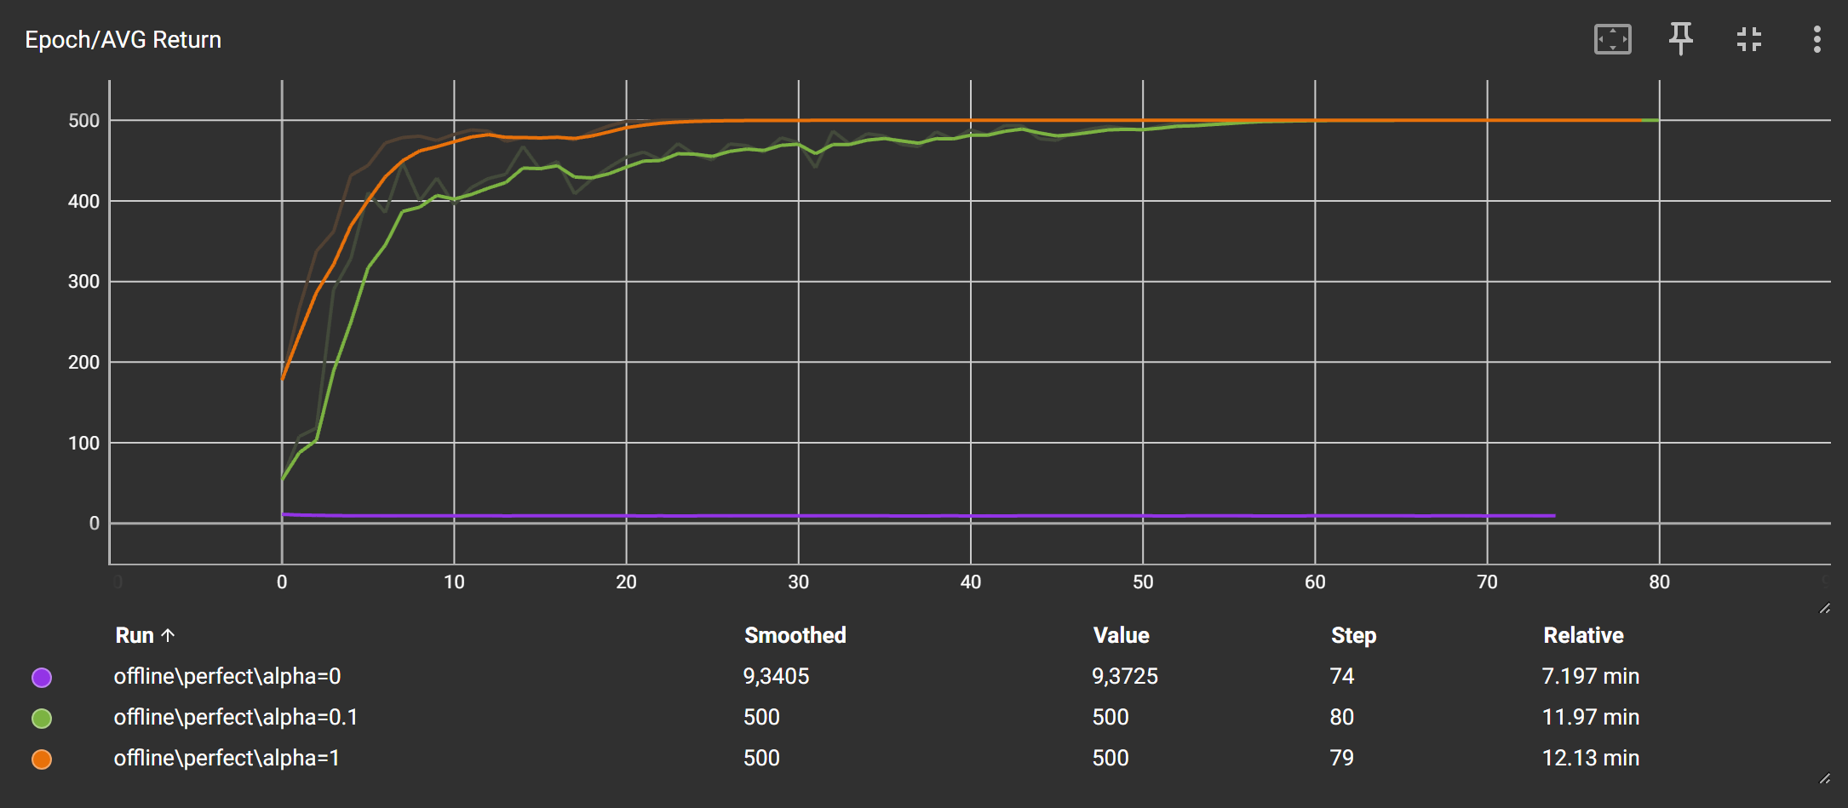

Slide 11
Mid (Return =240)

Slide 12
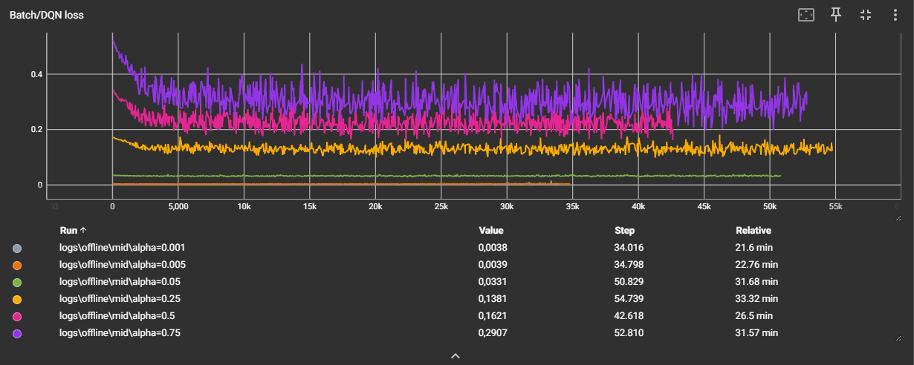
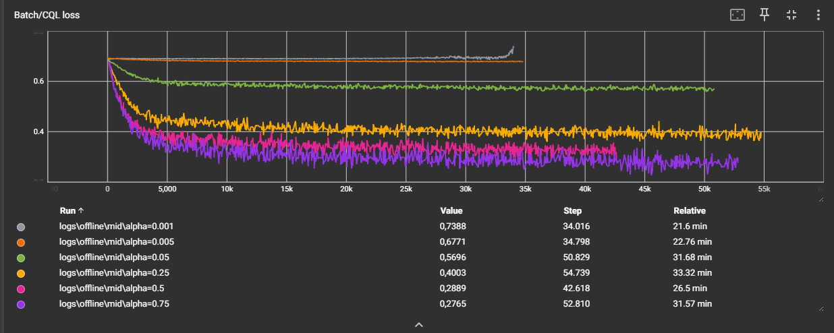

Slide 13
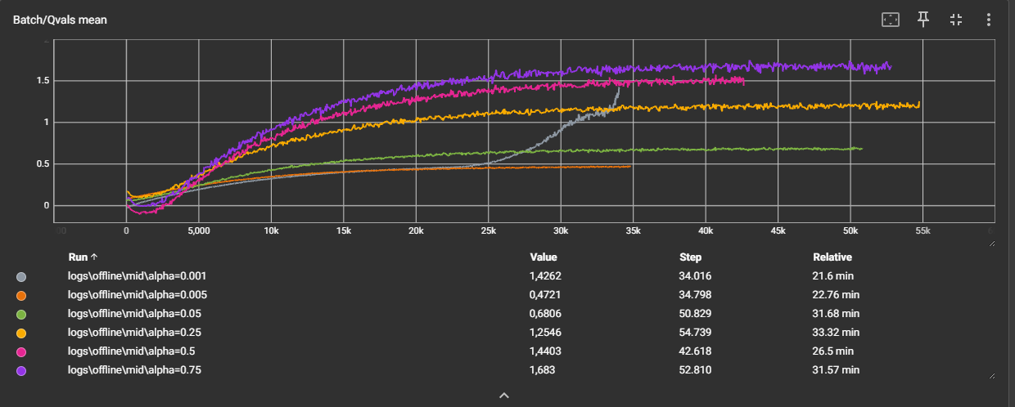
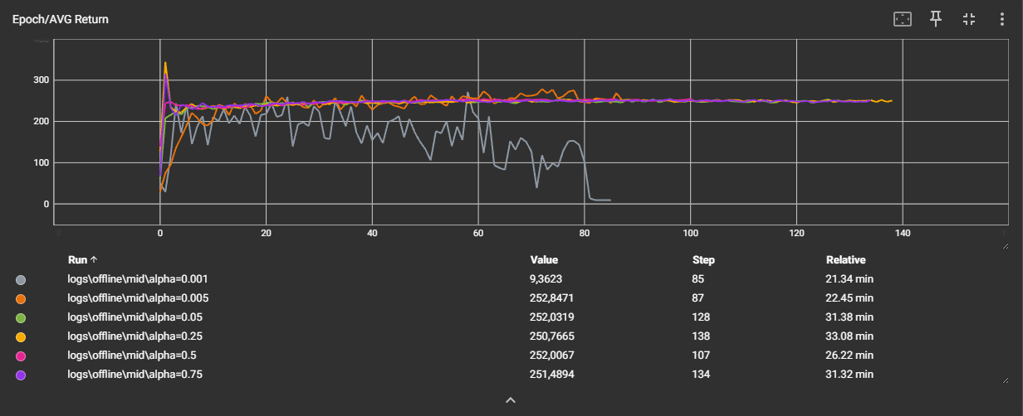

Slide 14
Random (Return =20)

Slide 15
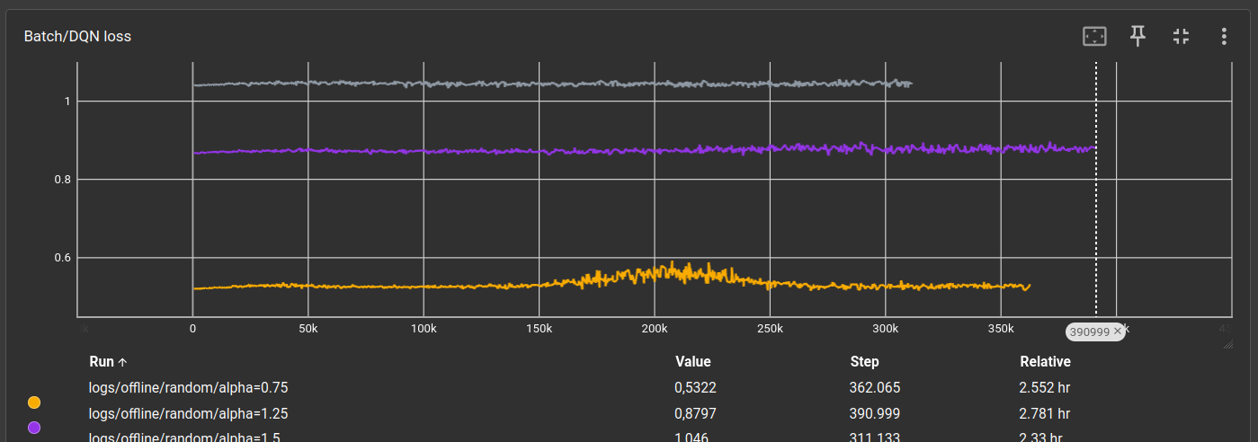
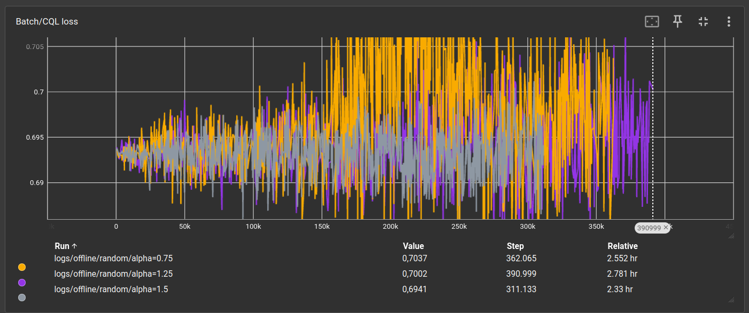

Slide 16
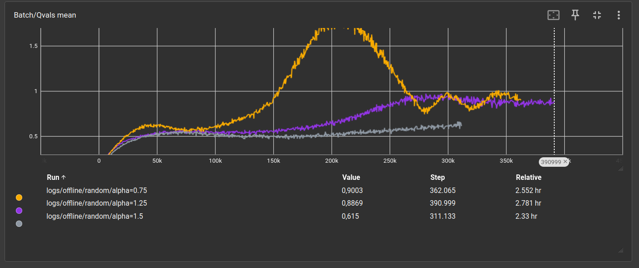
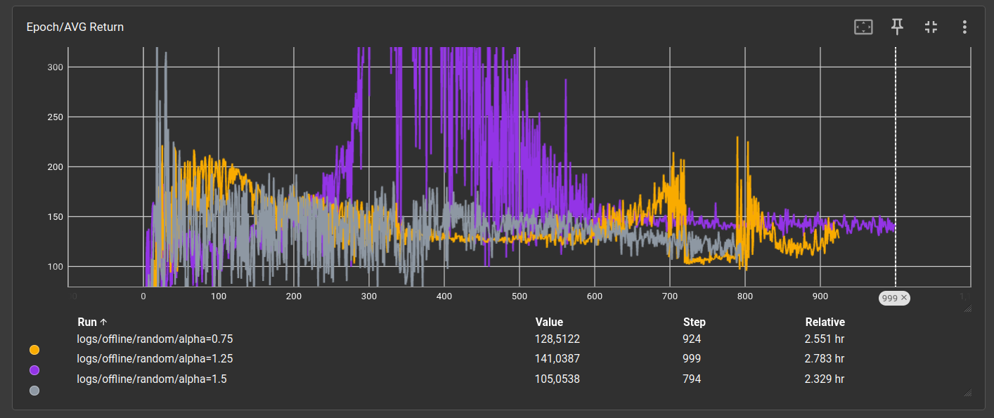

Slide 17
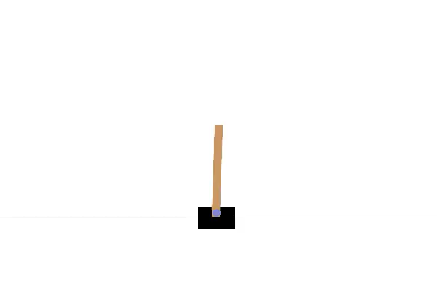

Perfect Example
Online (R=500)
Offline (R=500)

Slide 18
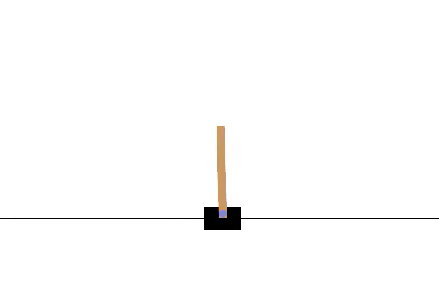

Mid Example
Online (R=227)
Offline (R=226)

Slide 19
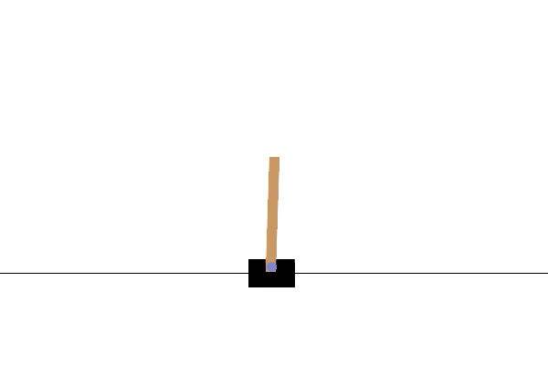

Random Example
Online (R=20)
Offline (R=122)

Slide 20
Thanks Return = Sehr gut?

