Slide 1
Analytics report
Natural Failures and Subtask-Guided Recovery in RoboCasa
pi0 composite-seen success
RLDX-1 composite-seen success
Composite-seen tasks
Composite-unseen tasks
6.1%
27.9%
16
16
Success across 16 composite-seen target tasks.
Success across 16 composite-seen target tasks.
Number of target composite tasks seen during Human300 pretraining.
Number of held-out composite tasks evaluated zero-shot.
Source: RoboCasa365 official leaderboard · Table: robocasa.ai.leaderboard · Materializes the reviewed RoboCasa365 policy-by-split leaderboard values used in this report.

Slide 2
Executive summary
Key metrics
Use RoboCasa as the primary benchmark, retain pi0 as a weak-policy baseline, and add RLDX-1 as the higher-progress policy.
Recovery demonstrations are not required for locally retryable failures when the environment remains task-valid and the base policy assigns some probability to a successful continuation.
The dataset should remain centered on natural on-policy failures, with expert-derived perturbations used as controlled augmentation rather than as the main scientific claim.
pi0 composite-seen success
RLDX-1 composite-seen success
6.1%
27.9%
Success across 16 composite-seen target tasks.
Success across 16 composite-seen target tasks.
Composite-seen tasks
Composite-unseen tasks
16
16
Number of target composite tasks seen during Human300 pretraining.
Number of held-out composite tasks evaluated zero-shot.
Source: RoboCasa365 official leaderboard · Table: robocasa.ai.leaderboard · Materializes the reviewed RoboCasa365 policy-by-split leaderboard values used in this report.

Slide 3
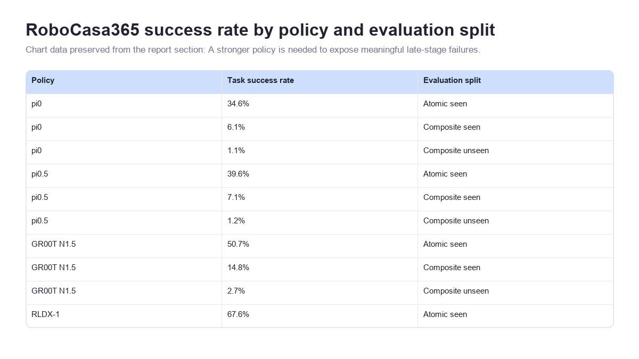
RoboCasa365 success rate by policy and evaluation split
Context
Chart data preserved from the report section: A stronger policy is needed to expose meaningful late-stage failures.
RoboCasa365 success rate by policy and evaluation split
Source: RoboCasa365 official leaderboard · Table: robocasa.ai.leaderboard · Materializes the reviewed RoboCasa365 policy-by-split leaderboard values used in this report.

Slide 4
Policy options for failure-recovery research table
Policy | Overall | Composite seen | Composite unseen | Availability | Fit for guidance research | Recommended role
Xiaomi-Robotics-1 | 57.4% | 57.1% | 32.1% | Closed; private evaluation | Not reproducible | Upper-bound context only
RLDX-1 | 36% | 27.9% | 8.5% | Open code and RoboCasa checkpoint | Flow-matching action generator | Recommended higher-progress primary policy
GR00T N1.5 | 23.9% | 14.8% | 2.7% | Open; official RoboCasa support | Higher integration/training cost | Secondary alternative
pi0.5 | 16.9% | 7.1% | 1.2% | Open | Native flow-policy fit | Do not prioritize; progress gain is small
pi0 | 14.8% | 6.1% | 1.1% | Open; current project baseline | Native flow-policy fit | Weak-policy baseline and existing natural-failure dataset
Source table extracted from the report.
Source: Policy benchmark and implementation evidence · Tables: robocasa.ai.leaderboard, reviewed_policy_implementations.availability · Materializes the reviewed policy decision table from the official leaderboard and implementation evidence.

Slide 5
Failure and recovery evidence matrix table
Method | Failure source | Corrective signal | Monitoring | Implication for this project
AFIL | Natural on-policy failures from a pretrained VLA | Dual success/failure action generators; failure as negative guidance | Guidance strength adapts during diffusion/flow sampling | Closest precedent for direct negative flow guidance
FailSafe | Injected translation, rotation, and no-op errors in expert rollouts | Motion-planned executable recovery actions with verification | External failure-reasoning VLM | Strong controlled baseline; less natural than deployment failures
FLARE | Perturbation-and-bridging augmentation plus mined OOD failures | Retry robustness and a targeted reset-skill library | Online MLLM routes retry versus reset | Supports the locally retryable versus state-breaking split
Phoenix | Expert motion labels, online intervention, and offline correction annotation | Coarse motion instruction conditions a diffusion policy | Motion correction module evaluates and revises instructions | Shows a mid-level correction interface but requires more recovery supervision
SAFE | Successful and failed on-policy rollouts | Failure likelihood from frozen VLA internal features | Multitask temporal detector with conformal calibration | Best starting point for an early failure detector
Sentinel-VLA | Automatically synthesized error-recovery trajectories | Unified status-aware reasoning and recovery training | Integrated active status sentinel | Supports on-demand reasoning but is a much larger first implementation
Source table extracted from the report.
Source: Reviewed failure and recovery literature set · Table: reviewed_primary_papers.failure_taxonomy · Materializes the paper-method taxonomy reviewed from six primary papers.

Slide 6
Minimal-to-full experimental ladder table
Phase | Intervention | Controlled comparison | Decision gate
1 | Oracle failure onset plus EEF rollback and unguided retry | No intervention; retry without rollback; full-state rollback oracle | Rollback produces retryable states without frequent prefix regression
2 | EEF rollback plus subtask-critic reranking | Same checkpoints and candidate budgets as unguided retry | Reranking improves failed-subtask completion and end-to-end success
3 | Learned temporal detector and retryable/state-breaking router | Oracle onset and simulator-timeout detection | Timely detection with acceptable clean-run false alarms
4 | Subtask-conditioned direct flow guidance | Critic reranking at matched inference budget | Guidance adds value without reducing clean-run success or safety
5 | Explicit reset skills for state-breaking failures | Retry-only system and reset oracle | Targeted reset data closes failures that resampling cannot solve
Source table extracted from the report.
Source: Current project report and research notes · Table: current_project_report.experiment_ladder · Materializes the reviewed experimental ladder from the current project report.

Slide 7
Recommended next steps
Integrate the released RLDX-1 RoboCasa checkpoint behind the existing model-agnostic policy interface.
Run a six-task pilot with matched pi0 and RLDX-1 rollouts; estimate useful-failure yield and failure-depth distributions before recollecting at scale.
Extend annotations with failure onset, last-good checkpoint, retryable/state-breaking class, completed prefix, and forked candidate outcomes.
Implement EEF rollback plus unguided retry as the minimum baseline.
Train the subtask critic and compare reranking against unguided retry from identical checkpoints.
Source: report implications section.

Slide 8
Limitations and robustness checks
Simulator privilege: EEF pose restoration must be reported separately from full environment restoration; the latter is an oracle.
Policy dependence: failure distributions shift with policy competence. Train/evaluate across pi0 and RLDX-1, or explicitly limit claims to one policy family.
Multiple valid subtask orders: condition on semantic subtask identity and the observed completed prefix, not a fixed global index.
Success is not safety: add drop, contact, spill, collision, and success-but-unsafe metrics rather than relying only on task predicates.
Critic exploitation: compare critic predictions with deterministic fork outcomes, monitor calibration, and test whether aggressive guidance degrades clean rollouts.
Source: report caveats and assumptions section.

Slide 9
Sources
Current project report and research notes duckdb · 2026-07-12T00:00:00+09:00 Materializes the reviewed experimental ladder from the current project report.
SQL query SELECT * FROM (VALUES (1, 'Oracle failure onset plus EEF rollback and unguided retry'), (2, 'EEF rollback plus subtask-critic reranking'), (3, 'Learned temporal detector and recovery router'), (4, 'Subtask-conditioned direct flow guidance'), (5, 'Explicit reset skills for...
RoboCasa365 official site and release notes
RoboCasa365 official leaderboard duckdb · 2026-07-12T00:00:00+09:00 Materializes the reviewed RoboCasa365 policy-by-split leaderboard values used in this report.
SQL query SELECT * FROM (VALUES ('pi0', 'Atomic seen', 0.346), ('pi0', 'Composite seen', 0.061), ('pi0', 'Composite unseen', 0.011), ('pi0.5', 'Atomic seen', 0.396), ('pi0.5', 'Composite seen', 0.071), ('pi0.5', 'Composite unseen', 0.012), ('GR00T N1.5', 'Atomic seen', 0.507), ('GR00T N1.5',...
RoboCasa365 multi-task learning documentation
Source: report sources and reproducibility section.

