Slide 1
D3-Robot Data-Driven Disaster Response Robot by Felix Ekwueme
D3-Robot identifies & eliminates fire hazard in a building facility by monitoring the level of detected signals for temperature, fire, smoke and humidity. The sensors detect and transmits the sensory data to the host computer (Monitored by first responders e.g: Firefighters). This information is analyzed, and according to the information received from the analysis, it creates escape routes for trapped victims based on confidence level and floor mapping. In addition, it maps entry & exit pathways with lower risk of endangerment for first responders & survivors.
Hardware:
Arduino Micro-controller as its brain.
DHT11 Temperature & Humidity Sensor.
API:
AlchemyAPI to analyze and identify survivors.
Watson Text to Speech to enable trapped victims to communicate with first responders via text . The text is transmitted to first responders via audio devices as speech, enabling them to identify and rescue victims within a shorter time.
IBM Embeddable Reporting to generate fast report sheet that can be analyzed to confirm the causes of the disaster.
Detector
Monitors room Temp. & Humidity using DHT11 Sensor.
Connected to Bluemix via Arduino Yun Micro-controller.
Stores Temp. & humidity reading on IBM Cloudant.
Responder
Identify fire location using pre-calculated floor mapping
Extinguish fire.
Constantly send temperature alert to First responders.
Create entry and exit routes for first responders based
on temperature reading and floor mapping.
Identify stable temperature
Create event report based on collected data using IBM
Embeddable Reporting to analyze number of incidents
reported and resolutions for each incident.
Temp / Humidity
>
Threshold
First Responders
Site Security
Send Critical Warning alert
Via SMS and E-mail
Activate Responder

Slide 2


Slide 3
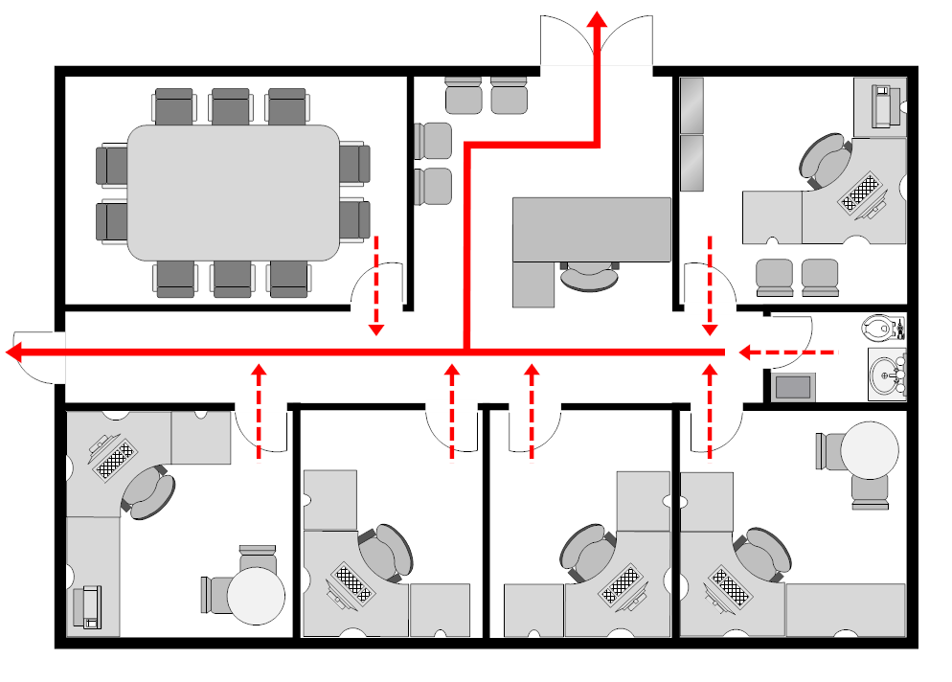





Do Not Enter
Entry & Exit

