Slide 1
Access Control Lists

Slide 2
Overview
Network administrators must figure out how to deny unwanted access to the network while allowing internal users appropriate access to necessary services.
Although security tools, such as passwords, callback equipment, and physical security devices are helpful, they often lack the flexibility of basic traffic filtering and the specific controls most administrators prefer.
For example, a network administrator may want to allow users access to the Internet, but not permit external users telnet access into the LAN.
Routers provide basic traffic filtering capabilities, such as blocking Internet traffic, with access control lists (ACLs).
An ACL is a sequential list of permit or deny statements that apply to addresses or upper-layer protocols.
This module will introduce standard and extended ACLs as a means to control network traffic, and how ACLs are used as part of a security solution.

Slide 3
Overview
In addition, this chapter includes:
  Tips, considerations, recommendations, and general guidelines on how to use ACLs,
  Commands and configurations needed to create ACLs.
  Examples of standard and extended ACLs
  How to apply ACLs to router interfaces.
Doyle:
Access Lists have become powerful tools for controlling the behavior of packets and frames.
Their uses fall into three categories.
  Security Filters protect the integrity of the router and the networks to which it is passing traffic. (CCNA)
  Traffic Filters prevent unnecessary packets from passing onto limited-bandwidth links. (CCNP)
  Other Filters such as dialer lists, route filters, route maps, and queuing lists, must be able to identify certain packets to function properly. (CCNP)

Slide 4
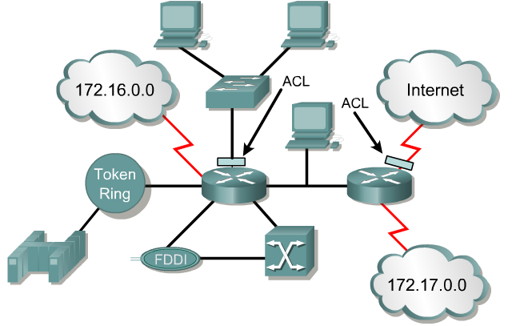
What are ACLs?
Note: Much of the beginning of this module are concepts. These concepts will become much clearer once we begin configuring ACLs.
An access list is a sequential series of commands or filters.
These lists tell the router what types of packets to:
  accept or
  deny
Acceptance and denial can be based on specified conditions.
ACLs applied on the router's interfaces.

Slide 5
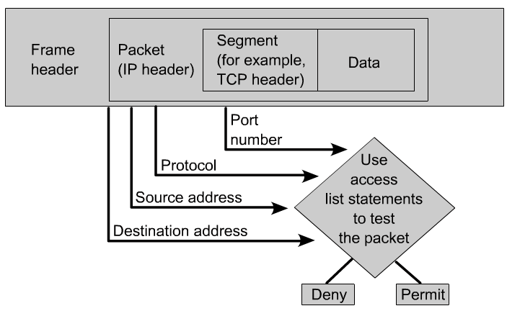
What are ACLs?
The router examines each packet to determine whether to forward or drop it, based on the conditions specified in the ACL.
Some ACL decision points are:
  IP source address
  IP destination addresses
  UDP or TCP protocols
  upper-layer (TCP/UDP) port numbers

Slide 6
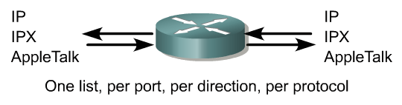

What are ACLs?
ACLs must be defined on a:
  per-protocol (IP, IPX, AppleTalk)
  per direction (in or out)
  per port (interface) basis.
ACLs control traffic in one direction at a time on an interface.
A separate ACL would need to be created for each direction, one for inbound and one for outbound traffic.
Finally every interface can have multiple protocols and directions defined.

Slide 7
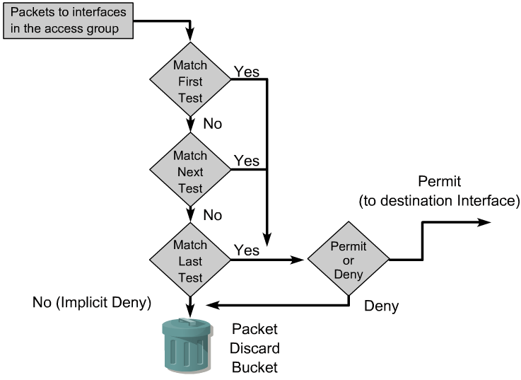
How ACLs work
An ACL is a group of statements that define whether packets are accepted or rejected coming into an interface or leaving an interface.
ACL statements operate in sequential, logical order.
If a condition match is true, the packet is permitted or denied and the rest of the ACL statements are not checked.
If all the ACL statements are unmatched, an implicit "deny any" statement is placed at the end of the list by default. (not visible)
When first learning how to create ACLs, it is a good idea to add the implicit deny at the end of ACLs to reinforce the dynamic presence of the command line..

Slide 8
How ACLs work
Access list statements operate in sequential, logical order.
They evaluate packets from the top down.
Once there is an access list statement match, the packet skips the rest of the statements.
  If a condition match is true, the packet is permitted or denied.
There can be only one access list per protocol per interface.
There is an implicit “deny any” at the end of every access list.
ACLs do not block packets that originate within the router. (ie. pings, telnets, etc.)

Slide 9
Two types of ACLs
Standard IP ACLs
  Can only filter on source IP addresses
Extended IP ACLs
  Can filter on:
    Source IP address
    Destination IP address
    Protocol (TCP, UDP)
    Port Numbers (Telnet – 23, http – 80, etc.)
    and other parameters

Slide 10
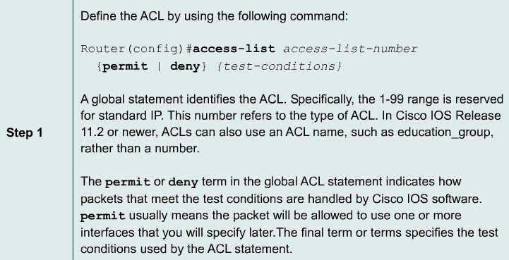
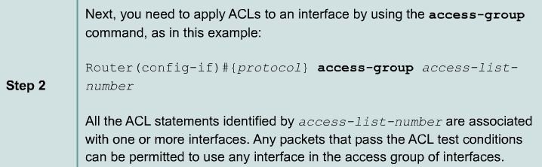
Creating Standard ACLs – 2 Steps

Slide 11
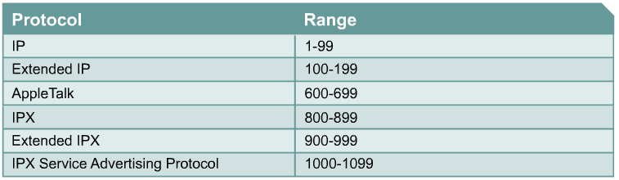
Creating ACLs – 2 Steps
(Standard IP)

Slide 12
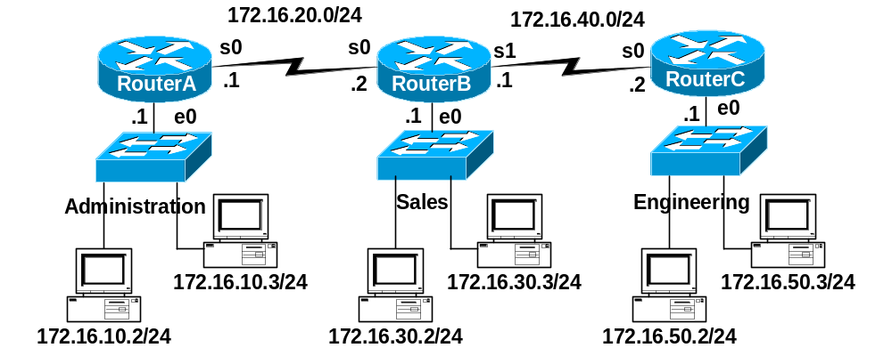
Learn by example!
Task:
  Permit only the host 172.16.30.2 from exiting the Sales network.
  Deny all other hosts on the Sales network from leaving the 172.16.30.0/24 network.

Slide 13


Learn by example!
Step 1 – ACL statements Implicit deny any, which is automatically added.
Test Condition
RouterB(config)#access-list 10 permit 172.16.30.2
Implicit “deny any” -do not need to add this, discussed later
RouterB(config)#access-list 10 deny 0.0.0.0 255.255.255.255
(Standard IP)

Slide 14
From Cisco Web Site
Applying ACLs
You can define ACLs without applying them.
However, the ACLs will have no effect until they are applied to the router's interface.
It is a good practice to apply the Standard ACLs on the interface closest to the destination of the traffic and Extended ACLs on the interface closest to the source. (coming later)
Defining In, Out, Source, and Destination
  Out - Traffic that has already been routed by the router and is leaving the interface
  In - Traffic that is arriving on the interface and which will be routed router.

Slide 15
Learn by example!
Step 2 – Apply to an interface(s)
RouterB(config)#access-list 10 permit 172.16.30.2
Implicit “deny any” -do not need to add this, discussed later
RouterB(config)#access-list 10 deny 0.0.0.0 255.255.255.255
RouterB(config)# interface e 0
RouterB(config-if)# ip access-group 10 in

Slide 16
Learn by example!
Step 2 – Or the outgoing interfaces… Which is preferable and why?
RouterB(config)#access-list 10 permit 172.16.30.2
Implicit “deny any” -do not need to add this, discussed later
RouterB(config)#access-list 10 deny 0.0.0.0 255.255.255.255
RouterB(config)# interface s 0
RouterB(config-if)# ip access-group 10 out
RouterB(config)# interface s 1
RouterB(config-if)# ip access-group 10 out

Slide 17
Learn by example!
Because of the implicit deny any, this has an adverse affect of also denying packets from Administration from reaching Engineering, and denying packets from Engineering from reaching Administration.
RouterB(config)#access-list 10 permit 172.16.30.2
Implicit “deny any” -do not need to add this, discussed later
RouterB(config)#access-list 10 deny 0.0.0.0 255.255.255.255
RouterB(config)# interface s 0
RouterB(config-if)# ip access-group 10 out
RouterB(config)# interface s 1
RouterB(config-if)# ip access-group 10 out

Slide 18
Learn by example!
Preferred, this access list will work to all existing and new interfaces on RouterB.
RouterB(config)#access-list 10 permit 172.16.30.2
Implicit “deny any” -do not need to add this, discussed later
RouterB(config)#access-list 10 deny 0.0.0.0 255.255.255.255
RouterB(config)# interface e 0
RouterB(config-if)# ip access-group 10 in

Slide 19
Example 2
Task:
  Permit only the hosts 172.16.30.2, 172.16.30.3, 172.16.30.4, 172.16.30.5 from exiting the Sales network.
  Deny all other hosts on the Sales network from leaving the 172.16.30.0/24 network.

Slide 20
Example 2
Once a condition is met, all other statements are ignored, so the implicit deny any only applies to not-matched packets.
RouterB(config)#access-list 10 permit 172.16.30.2
RouterB(config)#access-list 10 permit 172.16.30.3
RouterB(config)#access-list 10 permit 172.16.30.4
RouterB(config)#access-list 10 permit 172.16.30.5
Implicit “deny any” -do not need to add this, discussed later
RouterB(config)#access-list 10 deny 0.0.0.0 255.255.255.255
RouterB(config)# interface e 0
RouterB(config-if)# ip access-group 10 in

Slide 21
Example 2
To remove an Access List, use the no access-list command. Removing the access-group only from from the interface leaves the access list, but they are not currently being applied. Usually, best to remove it from both.
RouterB(config)#no access-list 10
RouterB(config)# interface e 0
RouterB(config-if)# no ip access-group 10 in

Slide 22
Example 3
Task:
  Deny only the host 172.16.30.2 from exiting the Sales network.
  Permit all other hosts on the Sales network to leave the 172.16.30.0/24 network.
Keyword “any” can be used to represent all IP Addresses.

Slide 23
Example 3
Order matters! What if these two statements were reversed? Does the implicit deny any ever get a match? No, the permit any will cover all other packets.
RouterB(config)#access-list 10 deny 172.16.30.2
RouterB(config)#access-list 10 permit any
Implicit “deny any” -do not need to add this, discussed later
RouterB(config)#access-list 10 deny 0.0.0.0 255.255.255.255
RouterB(config)# interface e 0
RouterB(config-if)# ip access-group 10 in

Slide 24
Example 3
Order matters! In this case all packets would be permitted, because all packets would match the first access list statement. Once a condition is met, all other statements are ignored. The second access list statement and the implicit deny any would never be used. This would not do what we want.
RouterB(config)#access-list 10 permit any
RouterB(config)#access-list 10 deny 172.16.30.2
Implicit “deny any” -do not need to add this, discussed later
RouterB(config)#access-list 10 deny 0.0.0.0 255.255.255.255
RouterB(config)# interface e 0
RouterB(config-if)# ip access-group 10 in

Slide 25
Note on inbound access lists
When an access lists applied to an inbound interface, the packets are checked against the access list before any routing table lookup process occurs.
We will see how outbound access list work in a moment, but they are applied after the forwarding decision is made, after the routing table lookup process takes place and an exit interface is determined.
Once a packet is denied by an ACL, the router sends an ICMP “Destination Unreachable” message, with the code value set to “Administratively Prohibited” to the source of the packet.
RouterB(config)#access-list 10 deny 172.16.30.2
RouterB(config)#access-list 10 permit any
Implicit “deny any” (do not need to add this, discussed later):
RouterB(config)#access-list 10 deny 0.0.0.0 255.255.255.255
RouterB(config)# interface e 0
RouterB(config-if)# ip access-group 10 in

Slide 26
Notes from www.cisco.com
Traffic coming into the router is compared to ACL entries based on the order that the entries occur in the router.
New statements are added to the end of the list.
The router keeps looking until it has a match.
If no matches are found when the router reaches the end of the list, the traffic is denied.
For this reason, you should have the frequently hit entries at the top of the list.
There is an "implied deny" for traffic that is not permitted.
A single-entry ACL with only one "deny" entry has the effect of denying all traffic.
You must have at least one "permit" statement in an ACL or all traffic will be blocked.
access-list 10 permit 10.1.1.1 0.0.0.255
access-list 10 deny ip any (implicit)

Slide 27

Time for Wildcard Masks!
A wildcard mask address:
Tells how much of the packet’s source IP address (or destination IP address) needs to match for this condition to be true.

Slide 28
Time for Wildcard Masks!
A wildcard mask is a 32-bit quantity that is divided into four octets.
A wildcard mask is paired with an IP address.
The numbers one and zero in the mask are used to identify how to treat the corresponding IP address bits.
The term wildcard masking is a nickname for the ACL mask-bit matching process and comes from of an analogy of a wildcard that matches any other card in the game of poker.
Wildcard masks have no functional relationship with subnet masks.
  They are used for different purposes and follow different rules.
Subnet masks start from the left side of an IP address and work towards the right to extend the network field by borrowing bits from the host field.
Wildcard masks are designed to filter individual or groups of IP addresses permitting or denying access to resources based on the address.

Slide 29
Wildcard Masks!
“Trying to figure out how wildcard masks work by relating them to subnet masking will only confuse the entire matter. The only similarity between a wildcard mask and a subnet mask is that they are both thirty-two bits long and use ones and zeros for the mask.”
This is not entirely true.
Although it is very important that you understand how a wildcard mask works, it can also be thought as an inverse subnet mask.
We will see examples in a moment…

Slide 30

Wildcard Masks!
Test Condition
Test Conditon
10101100.00010000.00000000.00000000
00000000.00000000.11111111.11111111
------------------------------------
10101100.00010000.any value.any value
A Match…
Matching packets will look like this…
The packet
Wildcard masking used to identify how to treat the corresponding IP address bits.
  0 - “check the corresponding bit value.”
  1 - “do not check (ignore) that corresponding bit value.”
A zero in a bit position of the access list mask indicates that the corresponding bit in the address must be checked and must match for condition to be true.
A one in a bit position of the access list mask indicates the corresponding bit in the address is not “interesting”, does not need to match, and can be ignored.

Slide 31
Wildcard Masks!
Test Condition
Test Conditon
10101100.00010000.00000000.00000000
00000000.00000000.11111111.11111111
------------------------------------
10101100.00010000.any value.any value
Must Match
No Match Necessary
A Match…
The packet
Resulting in the bits that must match or doesn’t matter.
Matching packets will look like this.
  0 - “check the corresponding bit value.”
  1 - “do not check (ignore) that corresponding bit value.”

Slide 32
Example 4 – Using Wildcard Masks
Task:
  Want RouterA to permit entire sales network and just the 172.16.50.2 station.
  Deny all other traffic from entering Administrative network.

Slide 33
Example 4 – Using Wildcard Masks
RouterA(config)#access-list 11 permit 172.16.30.0 0.0.0.255
RouterA(config)#access-list 11 permit 172.16.50.2 0.0.0.0
172.16.30.0 0.0.0.255
0 check - make sure first octet is 172
0 check - make sure second octet is 16
0 check - make sure third octet is 30
255 - don’t check (permit any fourth octet)
172.16.50.2 0.0.0.0
0 check - make sure first octet is 172
0 check - make sure second octet is 16
0 check - make sure third octet is 50
0 check - make sure fourth octet is 2

Slide 34
Example 4 – Using Wildcard Masks
RouterA(config)#access-list 11 permit 172.16.30.0 0.0.0.255
0 = check, we want this to match, 1 = don’t check (don’t care)
172.16.30.0 10101100 . 00010000 . 00011110 . 00000000
0.0.0.255 00000000 . 00000000 . 00000000 . 11111111
-----------------------------------------
172.16.30.0 10101100 . 00010000 . 00011110 . 00000000
172.16.30.1 10101100 . 00010000 . 00011110 . 00000001
... (through)
172.16.30.255 10101100 . 00010000 . 00011110 . 11111111
Test Conditon
The packet(s)

Slide 35
Example 4 – Using Wildcard Masks
RouterA(config)#access-list 11 permit 172.16.50.2 0.0.0.0
0 = check, we want this to match, 1 = don’t check (don’t care)
172.16.50.2 10101100 . 00010000 . 00110010 . 00000010
0.0.0.0 00000000 . 00000000 . 00000000 . 00000000
-----------------------------------------
172.16.50.2 10101100 . 00010000 . 00110010 . 00000010
Test Conditon
The packet(s)

Slide 36
Example 4 – Using Wildcard Masks
Don’t forget to apply the access-list to an interface.
RouterA(config)#access-list 11 permit 172.16.30.0 0.0.0.255
RouterA(config)#access-list 11 permit 172.16.50.2 0.0.0.0
RouterA(config)# interface e 0
RouterA(config-if)#ip access-group 11 out

Slide 37
Example 4 – Using Wildcard Masks
Remember that implicit deny any? It’s a good idea for beginners to include the deny any statement just as a reminder.
RouterA(config)#access-list 11 permit 172.16.30.0 0.0.0.255
RouterA(config)#access-list 11 permit 172.16.50.2 0.0.0.0
RouterA(config)#access-list 11 deny 0.0.0.0 255.255.255.255
RouterA(config)# interface e 0
RouterA(config-if)#ip access-group 11 out

Slide 38
Example 4 – Using Wildcard Masks
RouterA(config)#access-list 11 deny 0.0.0.0 255.255.255.255
0 = check, we want this to match, 1 = don’t check (don’t care)
0.0.0.0 00000000 . 00000000 . 00000000 . 00000000
255.255.255.255 11111111 . 11111111 . 11111111 . 11111111
-----------------------------------------
0.0.0.0 00000000 . 00000000 . 00000000 . 00000000
0.0.0.1 00000000 . 00000000 . 00000000 . 00000001
... (through)
255.255.255.255 11111111 . 11111111 . 11111111 . 11111111
Test Conditon
The packet(s)

Slide 39
“any” keyword
RouterA(config)#access-list 11 deny 0.0.0.0 255.255.255.255
Or
RouterA(config)#access-list 11 deny any
any = 0.0.0.0 255.255.255.255
Simply put, the any option substitutes 0.0.0.0 for the IP address and 255.255.255.255 for the wildcard mask.
This option will match any address that it is compared against.

Slide 40
“any” keyword – From Example 3
RouterB(config)#access-list 10 deny 172.16.30.2
RouterB(config)#access-list 10 permit any
or
RouterB(config)#access-list 10 permit 0.0.0.0 255.255.255.255
Previous example:
Deny only the host 172.16.30.2 from exiting the Sales network.
Permit all other hosts on the Sales network to leave the 172.16.30.0/24 network.
Keyword “any” can be used to represent all IP Addresses.

Slide 41
A note about outbound access lists
But can reach this interface
Denied
Denied
RouterA(config)#access-list 11 permit 172.16.30.0 0.0.0.255
RouterA(config)#access-list 11 permit 172.16.50.2 0.0.0.0
RouterA(config)#access-list 11 deny 0.0.0.0 255.255.255.255
RouterA(config)# interface e 0
RouterA(config-if)#ip access-group 11 out
This will deny packets from 172.16.30.0/24 from reaching all devices in the 172.16.10.0/24 Administration LAN, except RouterA’s Ethernet 0 interface, of 172.16.10.1. The access list will need to be applied on Router A’s Serial 0 interface for it to be denied on RouterA’s Ethernet 0 interface. A better soluton is to use an Extended Access list. (coming)

Slide 42
Practice
RouterB(config)#access-list 10 permit __________ ___________
Permit the following networks:
Network/Subnet Mask Address/Wildcard Mask
172.16.0.0 255.255.0.0
172.16.1.0 255.255.255.0
192.168.1.0 255.255.255.0
172.16.16.0 255.255.240.0 (hmmm . . .?)
172.16.128.0 255.255.192.0 (hmmm . . .?)
Permit the following hosts:
Network/Subnet Mask Address/Wildcard Mask
172.16.10.100
192.168.1.100
All hosts

Slide 43
Practice – Do you see a relationship?
RouterB(config)#access-list 10 permit __________ ___________
Permit the following networks:
Network/Subnet Mask Address/Wildcard Mask
172.16.0.0 255.255.0.0 172.16.0.0 0.0.255.255
172.16.1.0 255.255.255.0 172.16.1.0 0.0.0.255
192.168.1.0 255.255.255.0 192.168.1.0 0.0.0.255
172.16.32.0 255.255.240.0 172.16.32.0 0.0.15.255
172.16.128.0 255.255.192.0 172.16.128 0.0.63.255
Permit the following hosts:
Network/Subnet Mask Address/Wildcard Mask
172.16.10.100 172.16.10.100 0.0.0.0
192.168.1.100 192.168.1.100 0.0.0.0
All hosts 0.0.0.0 255.255.255.255

Slide 44
Answers Explained
172.16.0.0 0.0.255.255
RouterB(config)#access-list 10 permit 172.16.0.0 0.0.255.255
0 = check, we want this to match
1 = don’t check, this can be any value, does not need to match
172.16.0.0 10101100 . 00010000 . 00000000 . 00000000
0.0.255.255 00000000 . 00000000 . 11111111 . 11111111
-----------------------------------------
172.16.0.0 10101100 . 00010000 . 00000000 . 00000000
172.16.0.1 10101100 . 00010000 . 00000000 . 00000001
172.16.0.2 10101100 . 00010000 . 00000000 . 00000010
... (through)
172.16.255.255 10101100 . 00010000 . 11111111 . 11111111
Test Conditon
Matching packets will look like this.
The packet(s)

Slide 45
Answers Explained
D. 172.16.32.0 255.255.240.0
RouterB(config)#access-list 10 permit 172.16.32.0 0.0.15.255
0 = check, we want this to match
1 = don’t check, this can be any value, does not need to match
172.16.16.0 10101100 . 00010000 . 00100000 . 00000000
0.0.15.255 00000000 . 00000000 . 00001111 . 11111111
-----------------------------------------
172.16.16.0 10101100 . 00010000 . 00100000 . 00000000
172.16.16.1 10101100 . 00010000 . 00100000 . 00000001
172.16.16.2 10101100 . 00010000 . 00100000 . 00000010
... (through)
172.16.16.255 10101100 . 00010000 . 00101111 . 11111111
Test Conditon
The packet(s)
Packets belonging to the 172.16.32.0/20 network will match this condition because they have the same 20 bits in common.

Slide 46
There is a relationship!
Bitwise-not on the Subnet Mask
D. 172.16.32.0 255.255.240.0
RouterB(config)#access-list 10 permit 172.16.32.0 0.0.15.255
Subnet Mask: 255 . 255 . 240 . 0
Wildcard Mask: + 0 . 0 . 15 . 255
----------------------
255 . 255 . 255 . 255
So, we could calculate the Wildcard Mask by:
255 . 255 . 255 . 255
Subnet Mask: - 255 . 255 . 240 . 0
---------------------
Wildcard Mask: 0 . 0 . 15 . 255

Slide 47
255.255.255.255 – Subnet = Wildcard
RouterB(config)#access-list 10 permit __________ ___________
Permit the following networks:
255.255.255.255. - Subnet Mask = Wildcard Mask
255.255.255.255 - 255.255.0.0 = 0.0.255.255
255.255.255.255 - 255.255.255.0 = 0.0.0.255
255.255.255.255 - 255.255.255.0 = 0.0.0.255
255.255.255.255 - 255.255.240.0 = 0.0.15.255
255.255.255.255 - 255.255.192.0 = 0.0.63.255
Permit the following hosts: (host routes have a /32 mask)
255.255.255.255. - /32 Mask = Wildcard Mask
255.255.255.255 – 255.255.255.255 = 0.0.0.0
255.255.255.255 – 255.255.255.255 = 0.0.0.0

Slide 48
255.255.255.255 – Subnet = Wildcard
RouterB(config)#access-list 10 permit __________ ___________
Permit the following networks:
Network/Subnet Mask Address/Wildcard Mask
172.16.0.0 255.255.0.0 172.16.0.0 0.0.255.255
172.16.1.0 255.255.255.0 172.16.1.0 0.0.0.255
192.168.1.0 255.255.255.0 192.168.1.0 0.0.0.255
172.16.32.0 255.255.240.0 172.16.32.0 0.0.15.255
172.16.128.0 255.255.192.0 172.16.128 0.0.63.255
Permit the following hosts:
Network/Subnet Mask Address/Wildcard Mask
172.16.10.100 172.16.10.100 0.0.0.0
192.168.1.100 192.168.1.100 0.0.0.0
All hosts or “any” 0.0.0.0 255.255.255.255

Slide 49
“host” option
RouterB(config)#access-list 10 permit 192.168.1.100 0.0.0.0
RouterB(config)#access-list 10 permit host 192.168.1.100
Permit the following hosts:
Network/Subnet Mask Address/Wildcard Mask
172.16.10.100 172.16.10.100 0.0.0.0
192.168.1.100 192.168.1.100 0.0.0.0
The host option substitutes for the 0.0.0.0 mask.
This mask requires that all bits of the ACL address and the packet address match.
The host keyword precedes the IP address.
This option will match just one address.
172.16.10.100 0.0.0.0 replaced by host 172.16.10.100
192.168.1.100 0.0.0.0 replaced by host 192.168.1.100

Slide 50
Ranges with Wildcard Masks - Extra
Wildcard masks can be used to define “some” ranges of IP address.
Note:
  It is possible to get overly complicate your access lists when trying to do a range.
  Many times using multiple access lists are easier to configure, easier to understand, and you are less likely to make a mistake.
  We will do our best to understand this, but it is not imperative that you do.
  If you are with me so far, but I lose you here, don’t worry about it.
For example:
  The administrator wants to use IP wildcard masking bits to permit, match subnets 172.30.16.0 to 172.30.31.0.
  access-list 20 permit 172.30.16.0 0.0.15.255

Slide 51
Ranges with Wildcard Masks
Match subnets 172.30.16.0 to 172.30.31.0
access-list 20 permit 172.30.16.0 0.0.15.255
What’s happening (we’ll see its easier than this):
The easiest way to see how we did this is to show it in binary…

Slide 52
Ranges with Wildcard Masks
Match subnets 172.30.16.0 to 172.30.31.0
access-list 20 permit 172.30.16.0 0.0.15.255
172.30.16.0 10101100 . 00011110 . 00010000 . 00000000
0.0.15.255 00000000 . 00000000 . 00001111 . 11111111
-----------------------------------------
172.30.16.0 10101100 . 00011110 . 00010000 . 00000000
172.30.16.1 10101100 . 00011110 . 00010000 . 00000001
through . . .
172.30.31.254 10101100 . 00011110 . 00011111 . 11111110
172.30.31.255 10101100 . 00011110 . 00011111 . 11111115

Slide 53
Ranges with Wildcard Masks
Match subnets 172.30.16.0 to 172.30.31.0
access-list 20 permit 172.30.16.0 0.0.15.255
Must match
172.30.16.0 10101100 . 00011110 . 00010000 . 00000000
0.0.15.255 00000000 . 00000000 . 00001111 . 11111111
-----------------------------------------
172.30.16.0 10101100 . 00011110 . 00010000 . 00000000
172.30.16.1 10101100 . 00011110 . 00010000 . 00000001
through . . .
172.30.31.254 10101100 . 00011110 . 00011111 . 11111110
172.30.31.255 10101100 . 00011110 . 00011111 . 11111115

Slide 54
Ranges with Wildcard Masks
Match subnets 172.30.16.0 to 172.30.31.0
access-list 20 permit 172.30.16.0 0.0.15.255
Any Value
172.30.16.0 10101100 . 00011110 . 00010000 . 00000000
0.0.15.255 00000000 . 00000000 . 00001111 . 11111111
-----------------------------------------
172.30.16.0 10101100 . 00011110 . 00010000 . 00000000
172.30.16.1 10101100 . 00011110 . 00010000 . 00000001
through . . .
172.30.31.254 10101100 . 00011110 . 00011111 . 11111110
172.30.31.255 10101100 . 00011110 . 00011111 . 11111115

Slide 55
Ranges with Wildcard Masks
Match subnets 172.30.16.0 to 172.30.31.0
access-list 20 permit 172.30.16.0 0.0.15.255
Must match
Any Value
172.30.16.0 10101100 . 00011110 . 00010000 . 00000000
0.0.15.255 00000000 . 00000000 . 00001111 . 11111111
-----------------------------------------
172.30.16.0 10101100 . 00011110 . 00010000 . 00000000
172.30.16.1 10101100 . 00011110 . 00010000 . 00000001
through . . .
172.30.31.254 10101100 . 00011110 . 00011111 . 11111110
172.30.31.255 10101100 . 00011110 . 00011111 . 11111111

Slide 56
Ranges with Wildcard Masks
Match subnets 172.30.16.0 to 172.30.31.0
access-list 20 permit 172.30.16.0 0.0.15.255
Must match
Any Value
172.30.16.0 10101100 . 00011110 . 00010000 . 00000000
0.0.15.255 00000000 . 00000000 . 00001111 . 11111111
-----------------------------------------
172.30.16.0 10101100 . 00011110 . 00010000 . 00000000
through . . .
172.30.31.255 10101100 . 00011110 . 00011111 . 11111111
The subnets 172.30.16.0 through 172.30.31.0 have the subnet mask 255.255.240.0 in common.
This gives us the wildcard mask: 0.0.15.255 (255.255.255.255 – 255.255.240.).
Using the first permitted subnet, 172.30.16.0, gives us the address for our test condition.
This will not work for all ranges but does in some cases like this one.

Slide 57
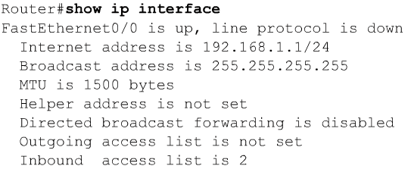
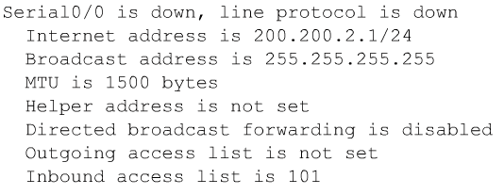
Verifying Access Lists

Slide 58
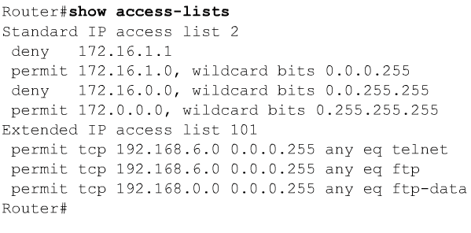
Verifying Access Lists

Slide 59

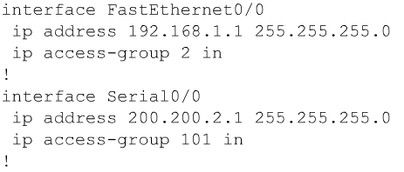
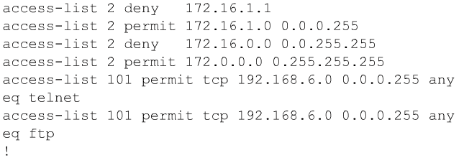
Verifying Access Lists
Note: More than one interface can use the same access-list.

Slide 60
Part 2: ACL Operations

Slide 61
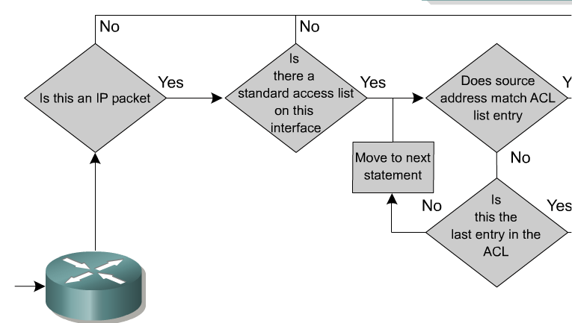
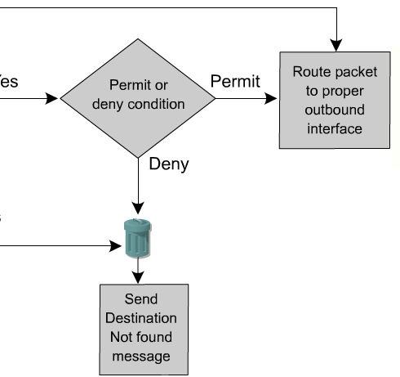
Inbound Standard Access Lists
Inbound Access Lists
RouterA(config)# interface e 0
RouterA(config-if)#ip access-group 11 in
With inbound Access Lists the IOS checks the packets before it is sent to the Routing Table Process.
With outbound Access Lists, the IOS checks the packets after it is sent to the Routing Table Process, except destined for the router’s own interface.
  This is because the output interface is not known until the forwarding decision is made.

Slide 62
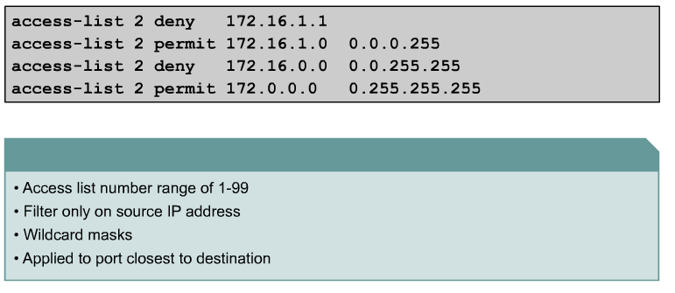
Standard ACL
We will see why in a moment.
The full syntax of the standard ACL command is:
Router(config)#access-list access-list-number {deny | permit} source [source-wildcard ] [log]
The no form of this command is used to remove a standard ACL. This is the syntax: (Deletes entire ACL!)
Router(config)#no access-list access-list-number

Slide 63
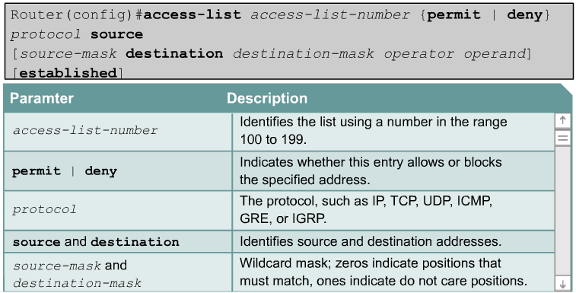
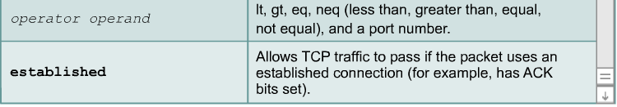
Extended Access Lists

Slide 64
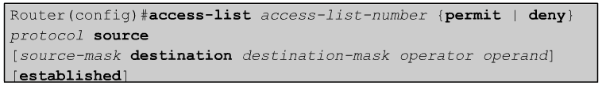
Extended Access Lists
Extended ACLs are used more often than standard ACLs because they provide a greater range of control.
Extended ACLs check the source and destination packet addresses as well as being able to check for protocols and port numbers.
This gives greater flexibility to describe what the ACL will check.
Packets can be permitted or denied access based on where the packet originated and its destination as well as protocol type and port addresses.

Slide 65
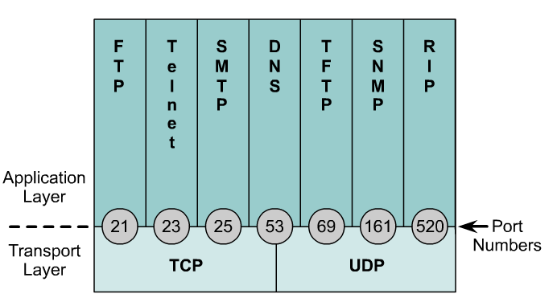
Extended Access Lists
Operator and operand can also refer to ICMP Types and Codes or whatever the protocol is being checked.
If the operator and operand follow the source address it refers to the source port
If the operator and operand follow the destination address it refers to the destination port.

Slide 66
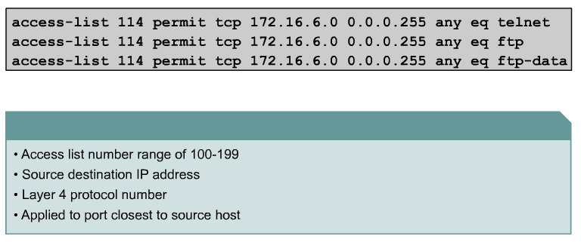
Extended Access Lists - Examples
port number or protocol name
The ip access-group command links an existing extended ACL to an interface.
Remember that only one ACL per interface, per direction, per protocol is allowed. The format of the command is:
Router(config-if)#ip access-group access-list-number {in | out}

Slide 67
Example 1
Port 80
Task
What if we wanted Router A to permit only the Engineering workstation 172.16.50.2 to be able to access the web server in Administrative network with the IP address 172.16.10.2 and port address 80.
All other traffic is denied.

Slide 68
Example 1
Port 80
RouterA(config)#access-list 110 permit tcp host 172.16.50.2 host 172.16.10.2 eq 80
RouterA(config)#inter e 0
RouterA(config-if)#ip access-group 110 out
Why is better to place the ACL on RouterA instead of RouterC?
Why is the e0 interface used instead of s0 on RouterA?
We’ll see in a moment!

Slide 69
Example 2
Port 80
Task
What if we wanted Router A to permit any workstation on the Sales network be able to access the web server in Administrative network with the IP address 172.16.10.2 and port address 80.
All other traffic is denied.

Slide 70
Example 2
Port 80
RouterA(config)#access-list 110 permit tcp 172.16.30.0 0.0.0.255 host 172.16.10.2 eq 80
RouterA(config)#inter e 0
RouterA(config-if)#ip access-group 110 out
When configuring access list statements, use the “?” to walk yourself through the command!

Slide 71
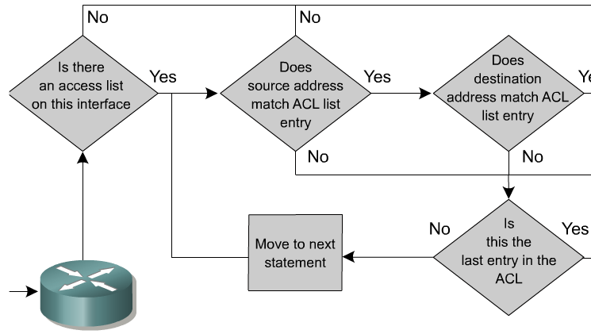
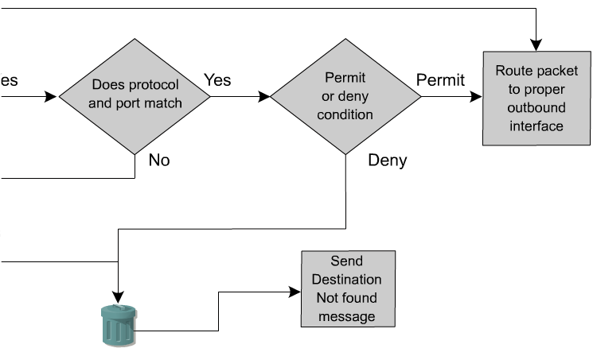
Inbound Extended Access Lists
Inbound Access Lists
RouterA(config)# interface e 0
RouterA(config-if)#ip access-group 11 in
With inbound Access Lists the IOS checks the packets before it is sent to the Routing Table Process.
With outbound Access Lists, the IOS checks the packets after it is sent to the Routing Table Process.
  This is because the output interface is not known until the forwarding decision is made.

Slide 72
Notes from www.cisco.com
In the following example, the last entry is sufficient.
You do not need the first three entries because TCP includes Telnet, and IP includes TCP, User Datagram Protocol (UDP), and Internet Control Message Protocol (ICMP).
access-list 101 permit tcp host 10.1.1.2 host 172.16.1.1 eq telnet
access-list 101 permit tcp host 10.1.1.2 host 172.16.1.1
access-list 101 permit udp host 10.1.1.2 host 172.16.1.1
access-list 101 permit ip 10.1.1.0 0.0.0.255 172.16.1.0 0.0.0.255

Slide 73
Named ACLs
IP named ACLs were introduced in Cisco IOS Software Release 11.2.
Allows standard and extended ACLs to be given names instead of numbers.
The advantages that a named access list provides are:
  Intuitively identify an ACL using an alphanumeric name.
  Eliminate the limit of 798 simple and 799 extended ACLs
  Named ACLs provide the ability to modify ACLs without deleting and then reconfiguring them.
  It is important to note that a named access list will allow the deletion of statements but will only allow for statements to be inserted at the end of a list.
  Even with named ACLs it is a good idea to use a text editor to create them.

Slide 74
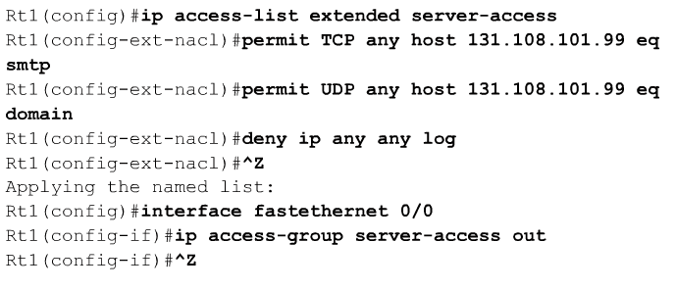
Named ACLs
A named ACL is created with the ip access-list command.
This places the user in the ACL configuration mode.

Slide 75
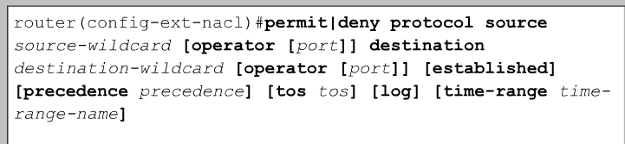
Named ACLs
In ACL configuration mode, specify one or more conditions to be permitted or denied.
This determines whether the packet is passed or dropped when the ACL statement matches.

Slide 76
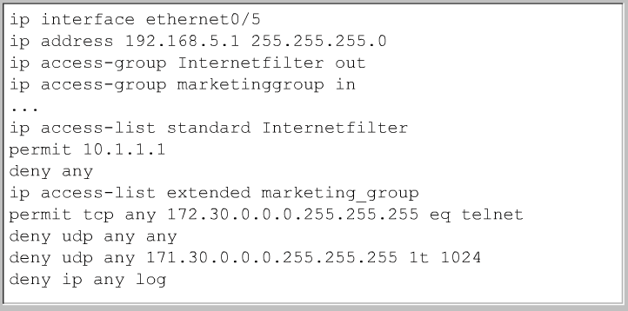

Named ACLs

Slide 77
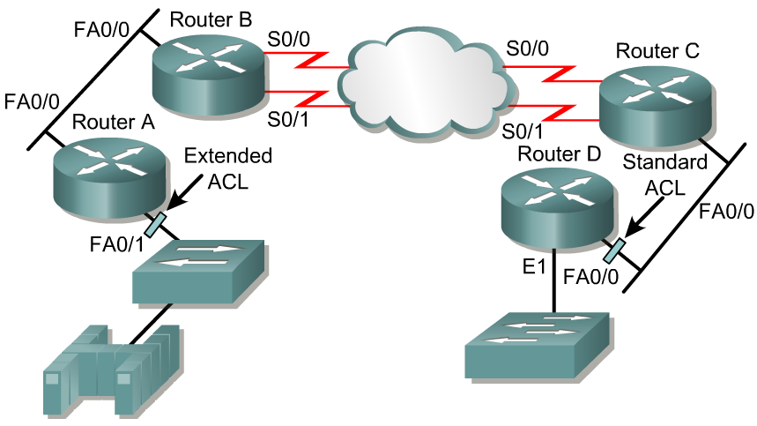
Placing ACLs
Source 10.0.0.0/8
Destination 172.16.0.0/16
The general rule:
Standard ACLs do not specify destination addresses, so they should be placed as close to the destination as possible.
Put the extended ACLs as close as possible to the source of the traffic denied.

Slide 78
Placing ACLs
Source 10.0.0.0/8
Destination 172.16.0.0/16
If the ACLs are placed in the proper location, not only can traffic be filtered, but it can make the whole network more efficient.
If traffic is going to be filtered, the ACL should be placed where it has the greatest impact on increasing efficiency.

Slide 79
Placing ACLs – Extended Example
deny telnet deny ftp permit any
Source 10.0.0.0/8
Destination 172.16.0.0/16
Policy is to deny telnet or FTP Router A LAN to Router D LAN.
All other traffic must be permitted.
Several approaches can accomplish this policy.
The recommended approach uses an extended ACL specifying both source and destination addresses.

Slide 80
Placing ACLs – Extended Example
deny telnet deny ftp permit any
Source 10.0.0.0/8
RouterA
Destination 172.16.0.0/16
interface fastethernet 0/1
access-group 101 in
access-list 101 deny tcp any 172.16.0.0 0.0.255.255 eq telnet
access-list 101 deny tcp any 172.16.0.0 0.0.255.255 eq ftp
access-list 101 permit ip any any
Place this extended ACL in Router A.
Then, packets do not cross Router A's Ethernet, do not cross the serial interfaces of Routers B and C, and do not enter Router D.
Traffic with different source and destination addresses will still be permitted.

Slide 81
Placing ACLs – Extended Example
deny telnet deny ftp permit any
Source 10.0.0.0/8
RouterA
Destination 172.16.0.0/16
interface fastethernet 0/1
access-group 101 in
access-list 101 deny tcp any 172.16.0.0 0.0.255.255 eq telnet
access-list 101 deny tcp any 172.16.0.0 0.0.255.255 eq ftp
access-list 101 permit ip any any
If the permit ip any any is not used, then no traffic is permitted.
Be sure to permit ip and not just tcp or all udp traffic will be denied.

Slide 82
Placing ACLs – Standard Example
deny 10.0.0.0 permit any
Source 10.0.0.0/8
Destination 172.16.0.0/16
interface fastethernet 0/0
access-group 10 in
access-list 10 deny 10.0.0.0 0.255.255.255
access-list 10 permit any
RouterD
Standard ACLs do not specify destination addresses, so they should be placed as close to the destination as possible.
If a standard ACL is put too close to the source, it will not only deny the intended traffic, but all other traffic to all other networks.

Slide 83
Placing ACLs – Standard Example
deny 10.0.0.0 permit any
Source 10.0.0.0
Destination 172.16.0.0/16
interface fastethernet 0/0
access-group 10 in
access-list 10 deny 10.0.0.0 0.255.255.255
access-list 10 permit any
RouterD
Better to use extended access lists, and place them close to the source, as this traffic will travel all the way to RouterD before being denied.

Slide 84
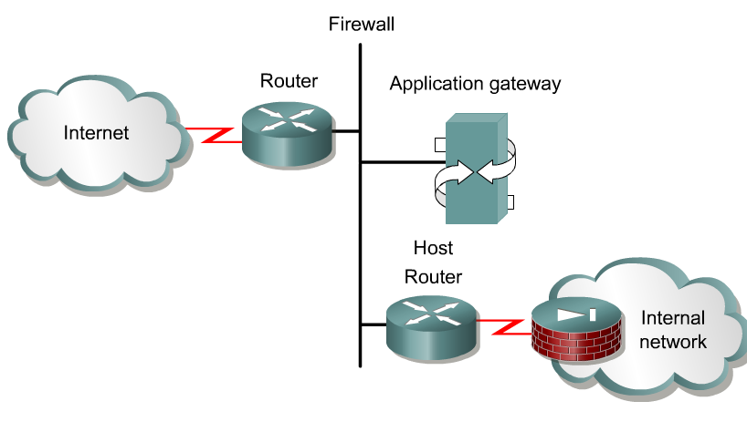
Firewalls
A firewall is an architectural structure that exists between the user and the outside world to protect the internal network from intruders.
In most circumstances, intruders come from the global Internet and the thousands of remote networks that it interconnects.
Typically, a network firewall consists of several different machines that work together to prevent unwanted and illegal access.
ACLs should be used in firewall routers, which are often positioned between the internal network and an external network, such as the Internet.
The firewall router provides a point of isolation so that the rest of the internal network structure is not affected.
ACLs can be used on a router positioned between the two parts of the network to control traffic entering or exiting a specific part of the internal network.

Slide 85
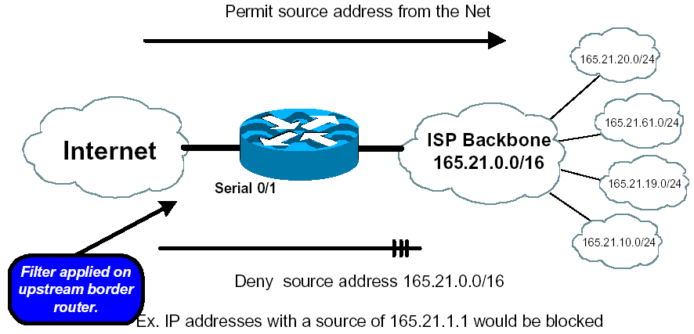
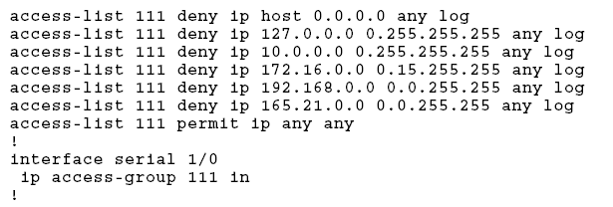
Firewalls
ISPs use ACLs to deny RFC 1918 addresses into their networks as these are non-routable Internet addresses.
IP packets coming into your network should never have a source addresses that belong to your network. (This should be applied on all network entrance routers.)
There are several other simple access lists which should be added to network entrance routers.
See Cisco IP Essentials White Paper for more information.

Slide 86
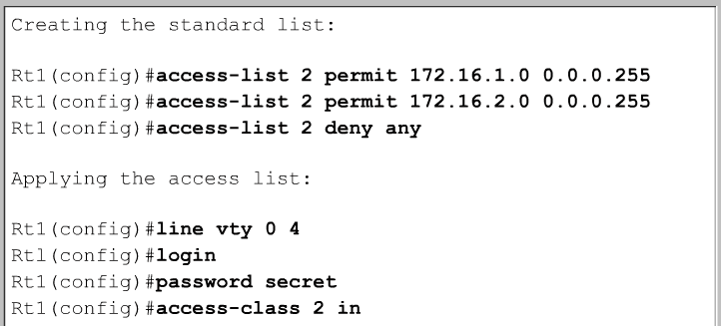
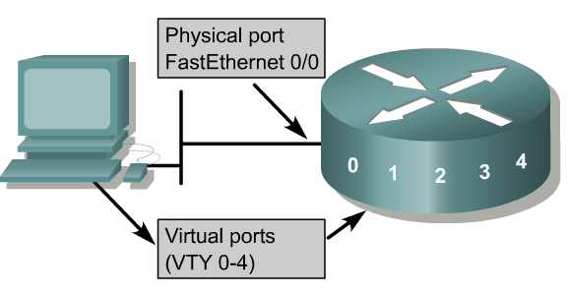
Restricting Virtual Terminal Access to a Router
Rt1(config-line)#
The purpose of restricted vty access is increased network security.
Access to vty is also accomplished using the Telnet protocol to make a nonphysical connection to the router.
As a result, there is only one type of vty access list. Identical restrictions should be placed on all vty lines as it is not possible to control which line a user will connect on.

Slide 87
Restricting Virtual Terminal Access to a Router
Rt1(config-line)#
Standard and extended access lists apply to packets traveling through a router.
ACLs do not block packets that originate within the router.
An outbound Telnet extended access list does not prevent router initiated Telnet sessions, by default.

