Slide 1
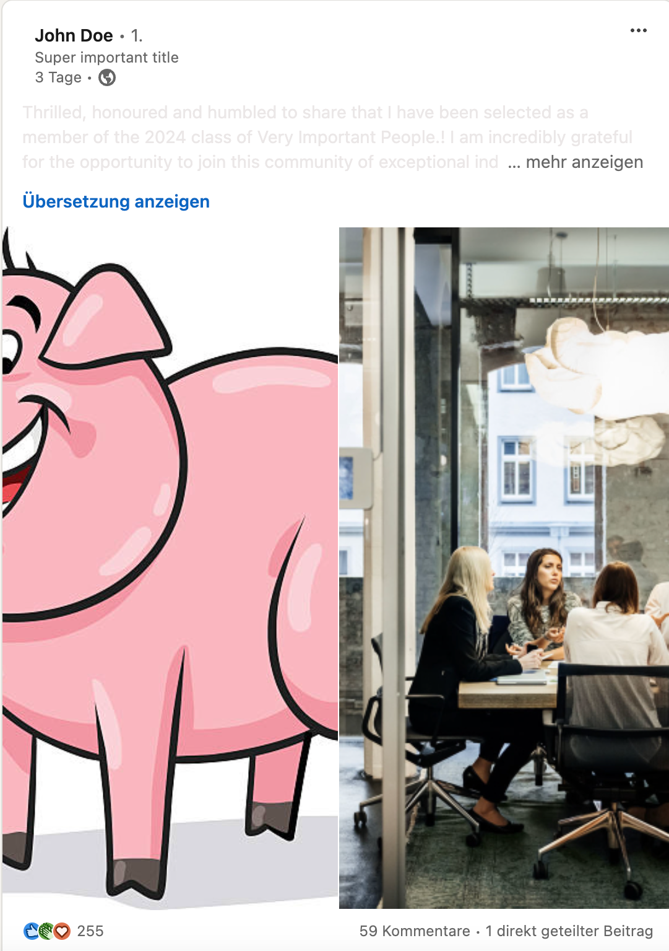
Pretentious text is greyed out
Irrelevant selfie is replaced with pig
Normal images and text remains untouched

Slide 2
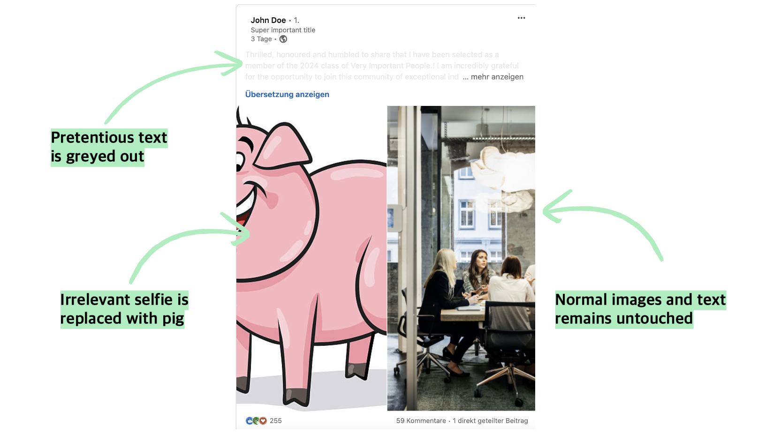

Slide 3


