Slide 1


A simple chat server
Cloud Computing
Jan-Patrick Kirchner [742143], Felix Hennig [752734], Marija Belova [752684]

Slide 2
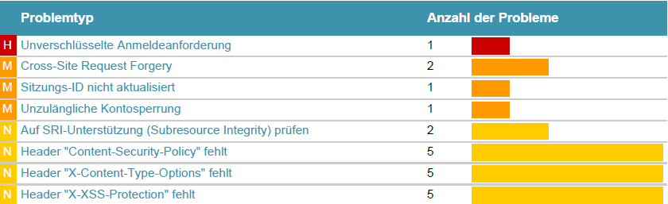
Security problems

Slide 3
Unencrypted Login Request

Slide 4
Subresource Integrity (SRI)
Subresource Integrity allows to ensure that resources hosted on third-party servers have not been tampered with.
That guarantees that a resource hasn't changed since it was hashed by a web author.
…

Slide 5
Content Security Policy
The HTTP Content-Security-Policy response header allows web site administrators to control resources the user agent is allowed to load for a given page.
That protect against malicious injection of JavaScript, CSS, plugins, and more.
To solve the security problem we added the Content-Security-Policy HTTP header to a web page and gave it values to control resources.

Slide 6
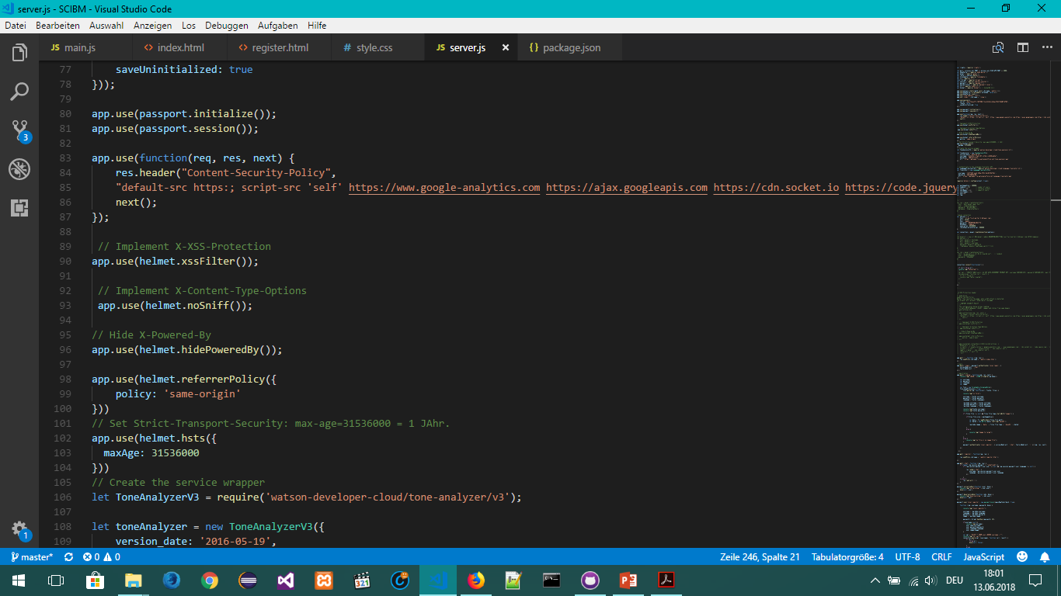
X-Content-Type-Options
The X-Content-Type-Options response HTTP header helps prevent browsers from trying to guess (“sniff”) the MIME type, which can have security implications.
Used helmet-module we added the X-Content-Type-Options header with a value of "nosniff" to inform the browser to trust what the site has sent is the appropriate content-type, and to not attempt "sniffing" the real content-type.

Slide 7
X-XSS-Protection
The X-XSS-PROTECTION header stops pages from loading when they detect reflected cross-site scripting (XSS) attacks.
So by adding the header we have enabled XSS filtering. Rather than sanitizing the page, the browser will prevent rendering of the page if an attack is detected.

Slide 8
Bruteforce…

Slide 9
Chat demonstration ?

Slide 10

Security icon: https://www.huddle.com/product/security/

