Slide 1


A simple chat server
Cloud Computing
Jan-Patrick Kirchner [742143], Felix Hennig [752734], Marija Belova [752684]

Slide 2
Requirements
Registration:
A user needs to enter a username, password, profile picture and language
The user credentials are stored persistently and securely in a Cloud SQL database
Login:
A user can login through a valid username & password
Send Messages:
IBM Tone Analyzer handles the incoming message and returns the current mood displayed as a emoticon
IBM Language Translator service translates an incoming chat message into the respective languages of the receivers

Slide 3
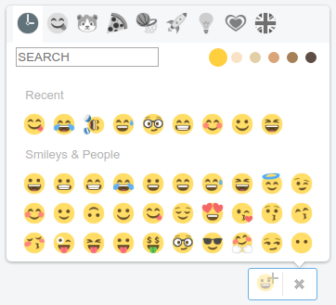
Requirements
TLS:
We ensured data confidentiality and integrity by using TLS channels
Additionally:
We added Emoticons for a real chat feeling

Slide 4
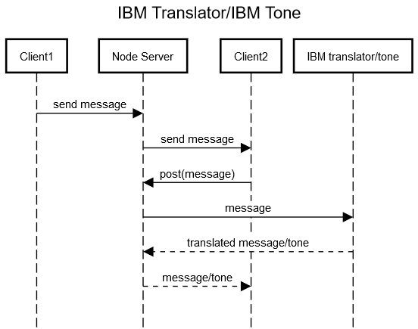
IBM Watson

Slide 5
Chat demonstration

Slide 6


