Slide 1

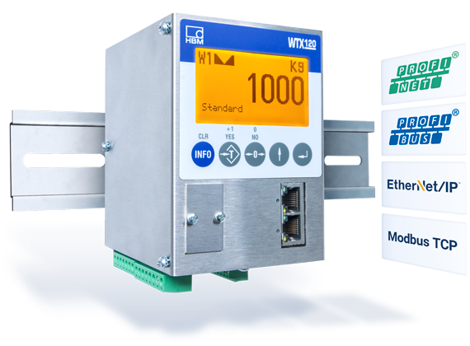
Connection via Modbus TCP WTX120
Version 1.5.3
Notes:
Sicherstellen, dass insbesondere bei 4 und 5 keine internen Infos rausgehen!

Slide 2
Agenda :
Prerequisites
Hardware
Software
Step-by-Step
Use Demo Examples
Programing own Window Using the API
Code Example
Writing into the WTX120
Calibration
Link Collection
Notes:
Evtl. erst Technologien und dann PanelX

Slide 3
1) Prerequisites – 1.1) Hardware
HBM WTX120 weighing terminal
Supply voltage for WTX120 (12V-30V, DC)
RJ45 Cable (“LAN” Cable)
A weighing sensor, e.g. HBM PW6C
Computer with LAN-port or which is connected to the same network as the WTX
Visual Studio 2017 hardware requirements:
Min. 1.8 GHz processor (dual-core recommended)
Min. 2 GB RAM (4 GB recommended)
Around 20-50 GB hard disk space

Slide 4
1) Prerequisites – 1.2) Software
Windows operating system, min. Win7 SP1
(for programming also macOS possible)
Min. Visual Studio (VS) 2013
.Net Version 4.5.2

Slide 5
1) VS Community License - Extract
“For organizations
An unlimited number of users within an organization can use Visual Studio Community for the following scenarios: in a classroom learning environment, for academic research, or for contributing to open source projects
For all other usage scenarios: In non-enterprise organizations, up to five users can use Visual Studio Community. In enterprise organizations (meaning those with >250 PCs or >$1 Million US Dollars in annual revenue)
For individuals
Any individual developer can use Visual Studio Community to create their own free or paid apps.”
From https://www.visualstudio.com/vs/community/ (02/14/2018)
After 30 days you have to log in with a Microsoft account to unlock the test version
Everyone else needs another license!

Slide 6
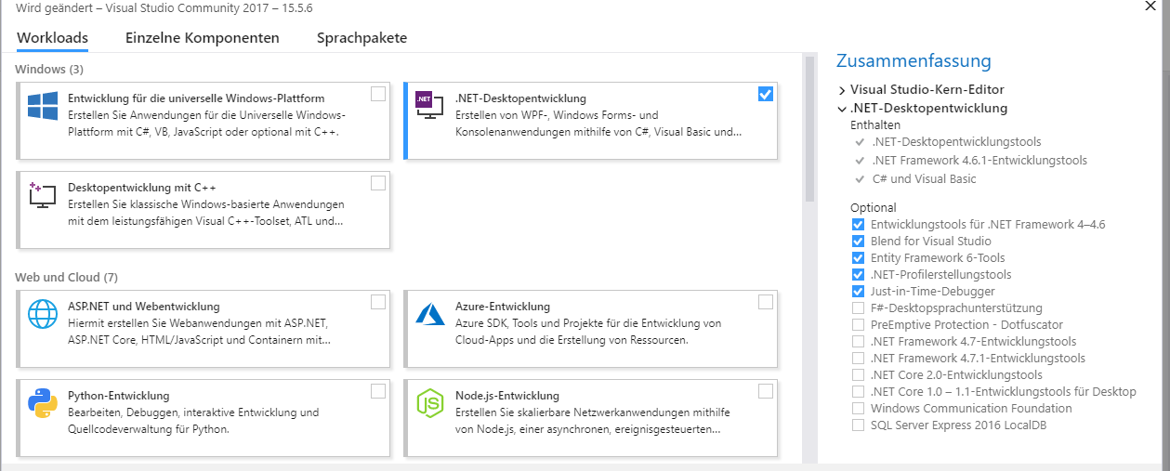
2) Step-by-Step: Software
You can find all required links for downloads in the Link-Collection
Install VS with .NET-Development extension or basic version and install required packages afterwards
Download ModbusTCP_WTX from GitHub
In ModbusTCP_WTX you have 3 applications:
- 1 : A console application (‘WTXModbusCL’) .
- 2 : A Windows form GUI application containing all input and output words for the WTX120 (‘WTXModbusGUI’).
- 3 : A ‘simple’ Windows form GUI application containing the most important words and features in a more clearer way (‘WTXModbusGUISimple’).
Picture: VS Required Tools and Features

Slide 7
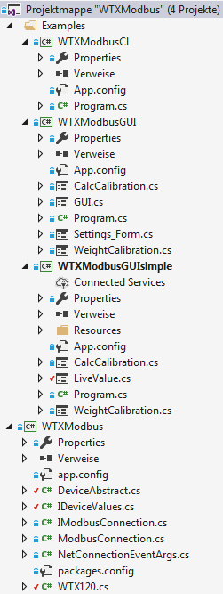
2) Step-by-Step: Connect WTX
Connect WTX120 with the same network as your PC (note: WTX does not support DHCP currently,only fixed IP)
Or connect directly to your PC, the IP-address in WTX must be the same, where the subnet-mask is 255, and different, where it is 0.
Open WTXModbus.sln in the main folder of the Modbus download
Project overview: 3 example applications, a command
line application (CL), 2 graphic applications (a simple
And an extended version) and the API WTXModbus.
You need internet access during the first build,
because WTXModbus downloads 2 NuGet-
packages one-time
Picture: Project overview– Solution explorer with the 1 console and 2 GUI applications, and the API WTXModbus.

Slide 8
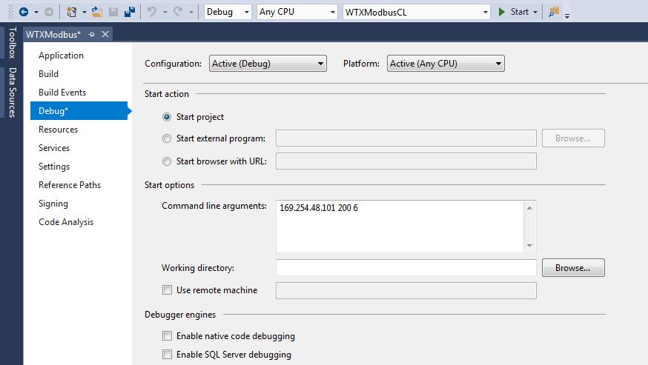
2) Step-by-Step: Demo Example Application
Start a demo example:
Note: if you choose WTXModbusCL, you have to set the IP in the VS project properties menu as an argument
Choose command line or graphic version
Use the IP of your WTX
Picture: WTXModbusCL Project Menu (Project-> WTXModbusCL Properties… -> Debug)
If a failure occurs during build, probably you have not installed all required VS packages

Slide 9
2) Step-by-Step:Demo Example Application–Start console application
Start a demo example:
Note: if you choose WTXModbusGUI or WTXModbusSimple, you have to set the IP in the VS project properties menu as an argument like in the slide before. Afterwards the connection to the WTX device will be established as soon as the console application starts.
WIRD HEUTE AM 24.5.2018 fertiggestellt.

Slide 10
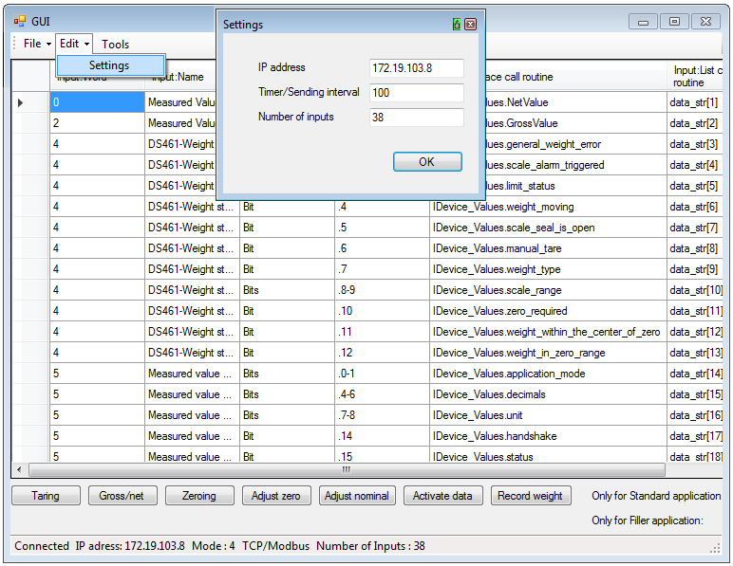
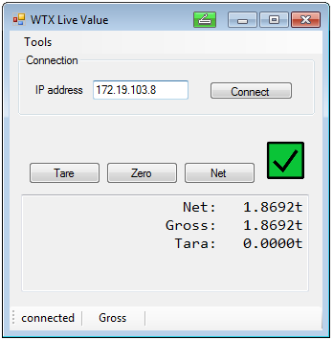
2) Step-by-Step: Demo Example Application – Start GUI
Start a demo example:
Note: if you choose WTXModbusGUI or WTXModbusSimple, you have to set the IP in the VS project properties menu as an argument like in the slide before. Additonal you change the IP address before and during the execution of the application by the the following strip menu.
WXModbusGUI : WTXModbusGUISimple:
- Start by clicking the strip menu button ‘File’ -> ‘Start’. - Start by clicking the button ‘Connect’.

Slide 11
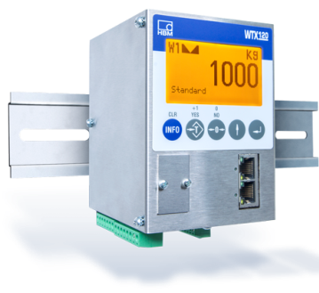
2) Step-by-Step: Use the API – Overview (1)
2 interfaces defining the methods for the TCP/IPModbus connection
(IModbusConnection) and for the specific values from your WTX
device (IDeviceValues).
A console program or form application has access to objects of
ModbusConnection and WTX120Modbus.
Real World
API
Interface :
IDeviceValues
Interface implemented by WTX120Modbus
Interface implemented by
ModbusConnection
Object of class ModbusConnection :
ModbusObj
Object of class WTX120Modbus
WTXObj
Interface :
IModbusConnection
has
IModbusConnection defines the methods to connect, to write and to read, implemented by the class ModbusConnection. It has an eventhandler to signalize that data has been read.
IDeviceValues defines the properties (attributes) for values from your WTX device, f.e. net value, gross value, status, handshake bits and an eventhandler to check if new data has been read and afterwards converted.

Slide 12
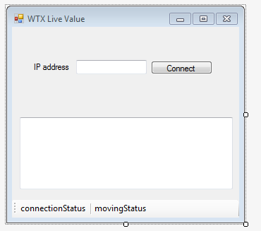
2) Step-by-Step: Use the API – Overview (2)
Methods of Modbus Connection:
Connect()
Read() Write(index, data)
Real World
API
Object of class ModbusConnection :
ModbusObj
Object of class WTX120Modbus:
WTXObj
CallbackMethod()
Async_Call(Opcode, CallbackMethod)
has
IP_Address,
isConnected, …
GrossValue,
NetValue ,…
API
Own User Interface : A Windows form or console application.
DataUpdateEvent?.Invoke(this, e);
WTXObj.DataUpdateEvent +=
ValuesOnConsole;
First an object of class ModbusConnection and WTX120Modbus have to be created with a timer interval as a parameter.
A timer in the class WTX120Modbus calls periodically Async_Call()
The method “Async_Call() updates the values in WTXObj via Modbus_TCP_obj.
CallbackMethod() in WTX120Modbus is executed as soon as the values are up-to-date
The data is called up after ‘.Invoke(this,e)’ in WTX120Modbus (method UpdateEvent) and fetched via an eventbased call by the GUI or console (‘WTXObj.DataUpdateEvent += ValuesOnConsole‘)
Picture: Example Window User Interface, given in the „WTXModbusSimpleGUI“ Application.

Slide 13
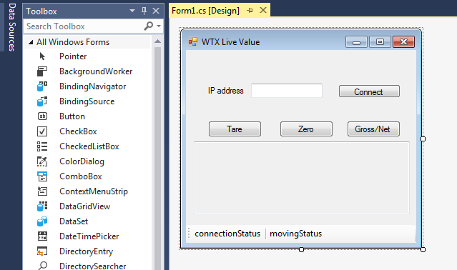
2) Step-by-Step: Make your own App
Add a new Windows Forms App project to the Solution
Use the VS Toolbox to create a display window (drag & drop)
It is recommended to use a timer from the toolbox to refresh the values
Double-click on buttons or timer to create empty methods in code
Use F7 to switch to the programming view
Picture: VS Toolbox with Example Window

Slide 14
2) Step-by-Step: Make your own App – Code example (1)
Description:
Code example:
Add ‘using Hbm.Devices.WTXModbus‘ and ‚using WTXModbus‘.
Create an object of ModbusConnection ‘ModbusObj’ with an IP Adress, an object of WTX120Modbus (With ModbusObj and a timer interval as parameters.
Call Connect() on Modbus object or via WTXObj.
Add the method ‘ValuesOnConsole’ to the Eventhandler ‘DataUpdateEvent’.
The method is called in the GUI or console once the data is read and translated to strings.
‘ValuesOnConsole’ updates the GUI or console with the newly arrived values from you WTX device.
using Hbm.Devices.WTXModbus;
using WTXModbus;
namespace CodeExample{
public class ClassExample{
private ModbusConnection ModbusObj;
private WTX120Modbus WTXObj;
public ClassExample(){ // Constructor
// ipAddress is a string like “199.199.21.1”
int interval=1000;//timer interval=1000ms(milli)
ModbusObj = new ModbusTCP(IPAddress);
WTXObj = new WTX120Modbus ModbusObj, interval);
WTXObj.getConnection.Connect();
// equal to : ModbusObj.Connect();
WTXModbusObj.DataUpdateEvent += ValuesOnConsole;
}
private void ValuesOnConsole(object sender, NetConnectionEventArgs<ushort[]> e)
{
Console.WriteLine(WTXObj.NetValue);
Console.WriteLine(WTXObj.GrossValue);
//Another example for ValuesOnConsole-next slide
}

Slide 15
2) Step-by-Step: Make your own App – Code example (2)
Description:
Code example:
‘ValuesOnConsole’ updates the GUI or console with the newly arrived values from you WTX device.
The values in ‘WTX.NetValue’ and ‘WTX.GrossValue’ have ushort as type. To convert them to strings there are methods automatically used like ‘comment_limit_status()’ or ‘measurement_with_comma()’ in the class WTX120Modbus.
In the method ‘ValuesOnConsole’ you only have to call the string array via ‘WTXModbusObj.get_data_str‘ and print the values on the GUI or console like in the code example.
If you want the values as ushort elements you can use for example: ‚WTXObj.NetValue‘
private void ValuesOnConsole(object sender, NetConnectionEventArgs<ushort[]> e)
{
// To print the net value as a string.
Console.WriteLine(WTXModbusObj.get_data_str[0]);
// To print the gross value as a string.
Console.WriteLine(WTXModbusObj.get_data_str[1]);
// To print the limit status as a string.
Console.WriteLine(WTXModbusObj.get_data_str[4]);
// As ushort or integer values:
Console.WriteLine(WTXObj.NetValue);
Console.WriteLine(WTXObj.GrossValue);
Console.WriteLine(WTXObj.limit_status);
}

Slide 16
Step-by-Step: Writing into the WTX120 device
First, create an object of the class ‘ModbusConnection’ and ‘WTX120Modbus’ to establish a connection and to run the timer.
For the purpose of writing : Call WTX_obj.Async_Call(Op_Code, CallbackMethod), which is an asynchronous method.
The callback method is called once the writing is completed to the WTX120, it updates the values and print it out on the console or form.
0x1 stands for taring, 0x2 for gross/net, 0x40 for zeroing
The method ‘Async_Call’ is called once a button or key is pressed (example on the next slide) in the form or program.cs .
For more information: Have a look at the manual ‘PLC link’ on page 152.
Op_Code | Meaning
0x1 | Taring
0x2 | Switch Gross / NET
0x40 | Zeroing
0x80 | Adjust zero
0x100 | Adjust nominal
0x800 | Activate data
0x1000 | Manual taring
0x4000 | Weight storage
… | …(see manual PLC)

Slide 17
2) Step-by-Step: Callback Method for writing
You call WTX_obj.Asnc_Call(0x2, Write_DataReceived) to switch the WTX120 between gross and net in the console or form application and once the values are updated after writing, the callback method is called.
Access to values e.g.: WTX_obj.NetValue, WTX_obj.GrossValue
You have access to all values mentioned in the WTX120 manual, chapter PLC link
Code example for the switching between gross and net:
Console application : Form / GUI application: _
// in the main() method for example:
value_outputwords = Console.ReadKey();
switch (value_outputwords.KeyChar)
{
case '0' : WTX_obj.Async_Call(0x1, Write_DataReceived);
break; // Taring
case '1' : WTX_obj.Async_Call(0x2, Write_DataReceived);
break; // Gross/Net
… }
private static void Write_DataReceived(IDeviceValues obj)
{
Console.WriteLine(„Write Executed“);
}
// Button Gross/Net:
private void button2_Click(object sender, EventArgs e)
{
if (WTXObj.getConnection.is_connected)
{
WTXObj.Async_Call(0x2, WriteDataReceived);
}
}
// CallbackMethod executed after write to WTX
public void WriteDataReceived(IDeviceValues deviceValues)
{
textBox2.Invoke(new Action(() =>
{
textBox2.Text = "write executed";
}));
//textBox2.Invoke needed,otherwise thread overlapping,exception
}

Slide 18
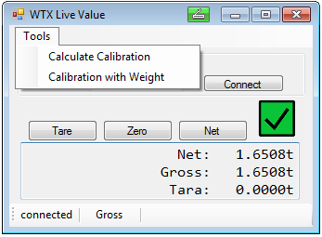
2) Step-by-Step: Calibration
In the API applications you can also calibrate your WTX device.
You can calculate the values for a dead load and a nominal load in a ratio in mV/V and write in into the WTX registers.
You can do as well a calibration with an individual weight : First you tip the value for the calibration weight, then you set the value for the dead load (method ‚MeasureZero‘), finally you set the value for the nominal weight in the WTX (method ‚Calibrate(calibrationValue)‘).
The following registers of the WTX120 have to be set:
In the GUI you can choose the calibration via tools:
‚Calculate Calibration‘ and ‚Calibration with weight‘.
Register | Name | Type | Bit | Content | Comment
0 | Control word | Bit | .7 | Adjust zero
0 | Control word | Bit | .8 | Adjust nominal
46 | Calibration weight | S32
48 | Zero load | S32 |  |  | 0x7FFFFFFF=auto measure weight
50 | Nominal load | S32 |  |  | 0x7FFFFFFF=auto measure weight

Slide 19
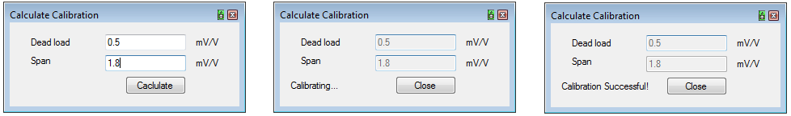
2) Step-by-Step: Calculate Calibration
You can calculate the values for a dead load and a nominal load(span) in a ratio in mV/V and write in into the WTX registers.
Procedure: First you have to tip in the dead/zero load and the span/nominal load . Then the preload is multiplied with 2/1000000. The nominal load is computed by the preload and the capacity with the multiplier of 2/1000000:
double DPreload = Preload * MultiplierMv2D;
double DNominalLoad = DPreload + (Capacity * MultiplierMv2D);
The preload is written to the WTX via register 48 and the new value is released with 0x80 the command „adjust zero“.
Afterwards the nominal load is written to the WTX via register 50 and the new value is released with the command „adjust nominal‘.
Example for the windows form in the GUI:
1) 2) 3)

Slide 20
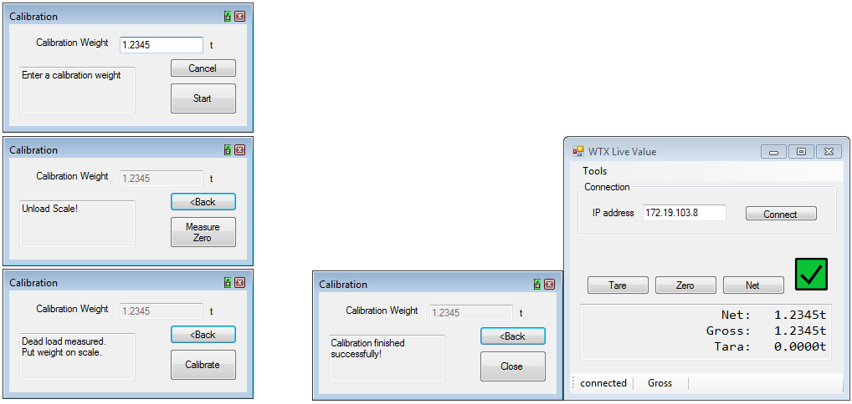
2) Step-by-Step: Calibration with an individual calibration weight
Procedure: First you have to enter a calibration weight, then measure zero, finally put weight on the scale of your
load cell or sensor and enter the button ‚calibrate‘, wait, which
takes up to 5 seconds till the calibration is finished.
In the console application:Therefore the methods as 1) calibration_weight_input(), 2)MeasureZero() and 3) Calibrate(..) are used one after another synchronously.
1) Writing 0x7FFFFFFF in 2) for the zero load, writing the calibration value and writing 0x7FFFFFFF again for setting the nominal load in 3).
2) 4) In the end, the calibration
is finished.
3) 4)

Slide 21
2) Step-by-Step: Outlook
For more details or functions have a look at the examples GUI and CL or at the WTX120 manual (updated version with all output word is in progress.
WTXModbusCL is the example API for a console application.
WTXModbusGUI has everything implemented, which is possible to do via Modbus
WTXModbusGUISimple is a shorter implementation with the most important features, like showing the net and gross measurement value, calibration , switching between gross and net, taring.
All implementations work with same classes WTX120Modbus, ModbusConnection, DeviceAbstract and with same interfaces.
If you want to implement an own application, it is recommended to be guided by the interfaces ‚IDeviceValues‘ and ‚IModbusConnection‘. The latter represents the connection with TCP/Modbus to the WTX and ‚IDeviceValues‘ represents the available values, which can be easily called via the interface from your application.
An application with Jetbus and Modbus is in work to get more informations and to get a redundant system.

Slide 22
3) Link Collection : “Alter Stand”
WTX120 Website:
https://www.hbm.com/en/6304/wtx120-industrial-and-legal-for-trade-weighing-terminal/
WTX120 Manual:
https://www.hbm.com/fileadmin/mediapool/hbmdoc/technical/a4500.pdf
ModbusTCP API on Github: (unofficial, later …/HBM)
https://github.com/leistner/ModbusTCP_WTX
Microsoft Visual Studio:
https://www.visualstudio.com/vs/

