Slide 1
Agenda
Polnish Client
Situation
Solution
Results
Next Steps
Identification of insolvent clients

Slide 2
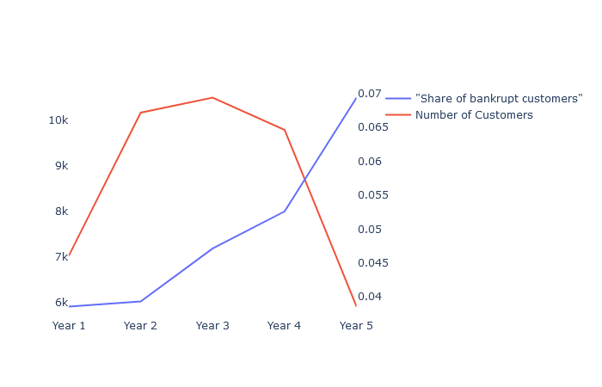




Situation
Small number of insolvencies have a potentially high impact on costs
Problems
Data – Starting point
Unidentified insolvencies lead to a higher rate of compensations than planned
Wrongly identified bankruptcies cause higher insurance premiums which may lead to higher contract terminations
Un- or bad estimated insolvency rates require higher equity shares. Therefore minimize the ability to leverage the available capital.
Historical Data of survived and insolvent companies after one to five years.
Data seems to be consistent since the share of bankrupt companies increases with time
Large deviations in the prediction of bankruptcy causes several negative cost and sales effects.

Slide 3
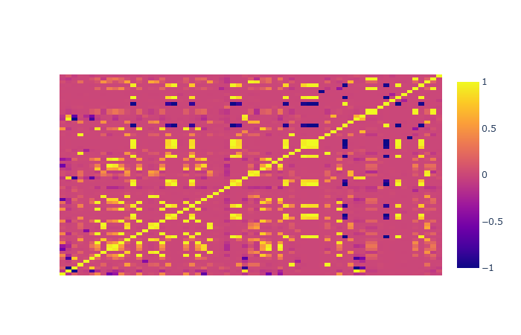
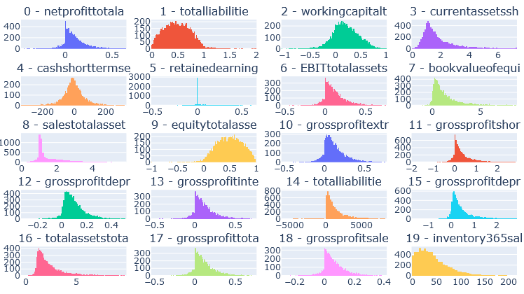
Situation
64 financial kpis are available and mostly complete (1.24% missing data in total)
Correlations
Distributions
While strong corrlation between some financial kpis are usual they may decrease the performance of the Classification Model.
Some Features have a non normal distribution which may aggravate the training of the classification model. Since this is not necessary it is an optional preprocessing step.
Correlations should be eleminated and features if possible transformed to normal distribution

Slide 4




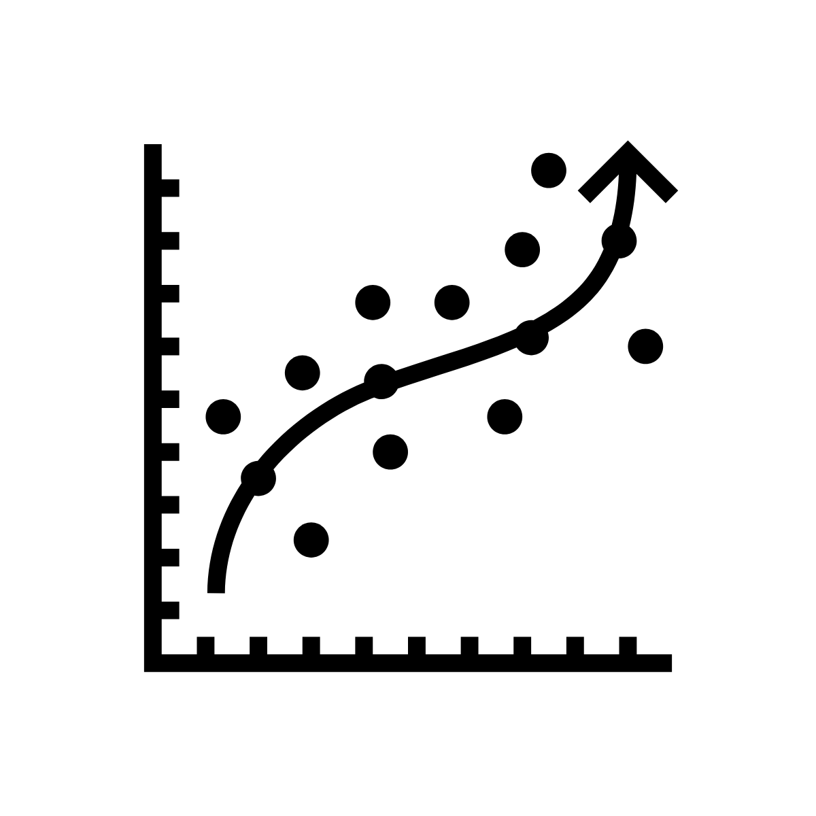
Solution
To maximize the generalization of our models we use cross validation
Validation framework
Algorithms
Data: 100 %
Train: 80%
Test: 20%
Logistic Regression
Extreme Gradient Boosting
Used for baseline prediction
Linear model that is easy to interpret since we have one coefficient per feature
Not prone for overfitting cause of the linearity
Needs several preprocessing steps
Captures non-linear relations
Ensemble of Trees makes it harder to interpret
Trees are able to fit to any function. Therfore, it´s prone to overfitting
Does not need any preprocessing
Train: 80%
Test: 20%
Train
Test: 20%
Train: 80%
Prediction for each Observation

Slide 5
Solution
The most important choice is the evaluation function. Especially, when handling imbalanced datasets.
Evaluation
Results – Best Model
We deal with 5-7% of insolvencies for each year. Therefore, a model that predicts no insolvencies already achieves an accuracy of 93-95%.
The choice of the evaluation measure dependes on the cost that is caused by false predictions
Its far more expensive to pay compensation than to lose a customer due to high insurance premiums. Therefore Recall is a good base measurement for this case in combination with a high Area-under-curve
Furthermore, we created the measure „Weigthed Accuracy“ which weights the positive cases by a numerical factor.
Logistic Regression
Extreme Gradient Boosting
max_iter: 1000
Preprocessor:
PCA with 99,9% variance
Downsampling
MeanReplacement
Standardizing
AUC: 0.765
WA: 0.713
n_rounds: 50
lambda (L2): 5
max_depth: 4
Column- and rowsample: 0.7
AUC: 0.952
WA: 0.881

Slide 6
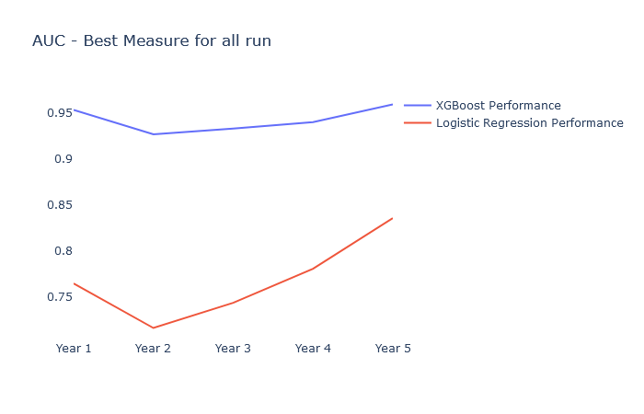
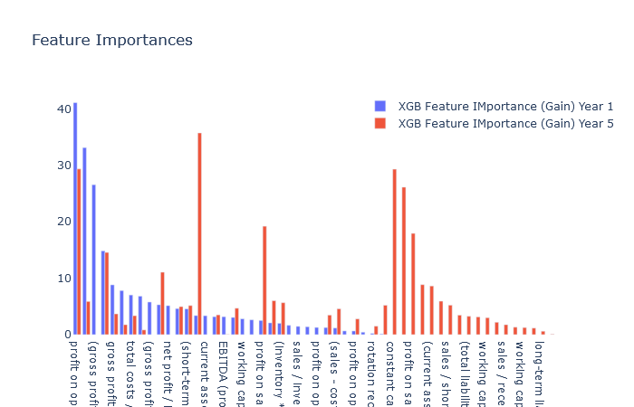
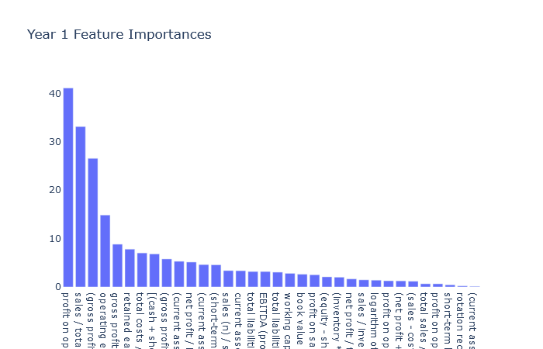
Solution
There are some single Features that have a strong impact on the model performance
Evaluation
Feature Importance
XGBoost outperforms Logistic Regression by more than 20%
Both have a similar pattern
Most of the information is covered by a small amount of features
Important features for Year 1 differ from the features of Year 5 (right figure)
There is potential in Feature Selecting since we a small amount of variables with a high information value and a lot of values with high correlations to each other

Slide 7
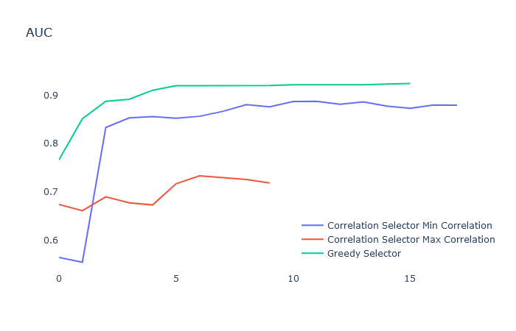
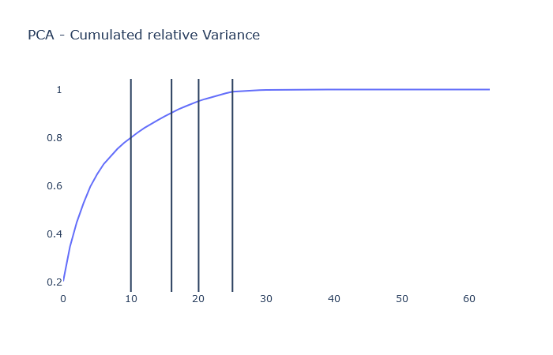
Solution
The number of required features can be significantly reduced with only a small decrease in performance
Feature Selector
We implemented two methods which iteratively reduce the amount of features
“Correlation Selection” selects features based on their sum of squared correlation to the remaining features.
“Greedy Selection” chooses iteratively the feature that improves the measure the most
While both Selector choose less than 25% of all variables till they abort the search, the greedy selector achieves the best measure with an AUC of 0.92.
With a decrease from 0.95 to 0.92 the AUC barely changes while we are able to save costs for gathering all features.
80%
90%
95%
99%

Slide 8
Next Steps – Future Projects
Knowing which company is likely default is one thing, knowing how much we can recover is another
This Project:
This project should be put into production to be able to raise the identified cost savings
As companies are no homogenous mass it isn’t enough to just predict which company is likely to default. We can build on this project to predict the recovery rate of the potential bankrupt companies. Some companies may be able to cover 90% of their liabilities after insolvency while other companies have too much liabilities and are barely able to cover more than 10%
New Projects:
Cross- und Upselling. Can we raise sales by identifying customers that probably need other insurances as well.
Fraud detection: All transactions and compensation requests can be preclassified whether they are likely to be fraudulent
Churn-Classification: Prevent the termination of contracts

Slide 9
Planned – but not implementd
Some planned features could have improved the measure or increase the generality of the results
Normalizing of features
Additional Test split that purpose is the last evaluation step to prove how well our model is able to generalize
Feature Selection: Costs of feature gathering as an additional regularization term of the cost function.
Run Greedy Selector for all Years
DALEX Plots for Evaluation of Feature Contribution to a single prediction
Watch out for potential causalities

Slide 10

Excourse: Weighted Accuracy
Weighted accuracy captures cost differences between the positive and negative class
$$Weighted Accuracy= \frac{\sum{(\left(y∧1\right)∧\left(\hat{y}∧1)\right)} ∗ α+\sum{(\left(y∧0\right)∧\left(\hat{y}∧0)\right)}}{\sum{\left(y∧1\right)∗α+\left(y∧0\right)}}$$
$$with α= \frac{cost not identified positive case }{cost not identified negative case}$$
If alpha goes against infinity the weighted accuracy will only the accuracy of matching all positive cases
If alpha goes against negative infinity the weighted accuracy will only be the accuracy of matching all negative cases

