Slide 1
Agenda
Polnish Client
Situation
Solution
Results
Next Steps
Identifying Identification of future insolvent companies

Slide 2
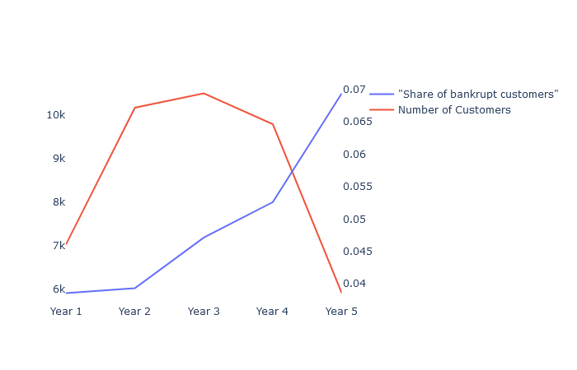




Situation
Small number of positive cases that have a potentially high impact on costs
Problems
Data – Starting point
Not identified insolvencies lead to a higher rate of compensations than planned
Wrongly identified bankruptcies cause higher insurance premiums which may lead to higher contract terminations
Un- or bad estimated insolvency rates require higher equity shares. Therefore minimize the ability to leverage the available capital.
Historical Data of survived and insolvent companies after one to five years.
Data seems to be consistent since the share of bankrupt companies increases with time
Large deviations in the prediction of bankruptcy causes several negative cost and sales effects.

Slide 3
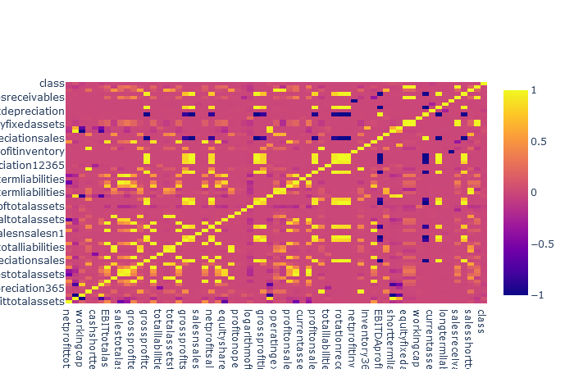
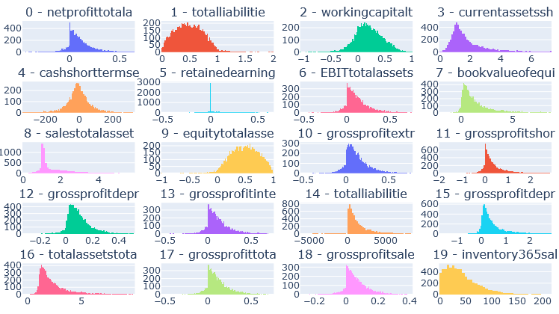
Situation
Small number of positive cases that have a potentially high impact on costs
Correlations
Distributions
While strong corrlation between some financial kpis are usual they may decrease the performance of the Classification Model.
Some Features have a non normal distribution which may aggravate the training of the classification model
Correlations should be eleminated and features if possible transformed to normal distribution

Slide 4
Solution
To maximize the number of evaluated sampled we use cross validation
Input
Data: 100 %
Train: 80%
Test: 20%
Train-
And
Test-
Splits
Train: 80%
Test: 20%
Train
Test: 20%
Train: 80%
Prediction
Prediction for each Observation

Slide 5
Solution
summary
 | Year 1 | Year 2 | Year 3 | Year 4 | Year 5
Observations | 7027
Insolvencies
Share of Ins.
Hier Evaluation darstellen
Hier XGBoost und LogisticRegression darstellen

Slide 6
Solution
summary
Hier CV Framework darstellen
Hier Feature Selection darstellen

Slide 7
Solution
results
Measures im Zeitverlauf darstellen
Hier Ergebnisse der Feature Selection

Slide 8
Next Steps
results
Measures im Zeitverlauf darstellen
Hier Ergebnisse der Feature Selection

