Slide 1
Agenda
Polnish Client
Situation
Solution
Results
Next Steps
Identifying Identification of future insolvent companies

Slide 2
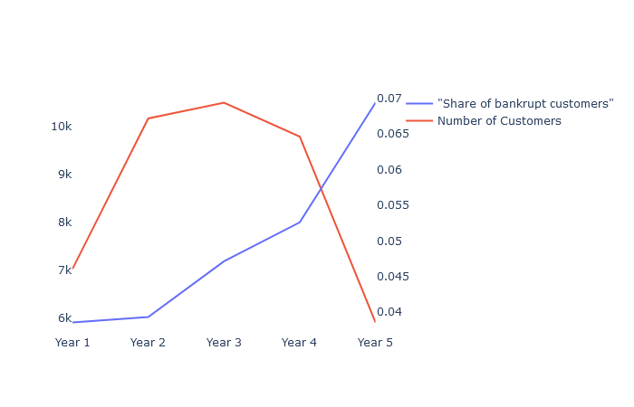




Situation
Small number of positive cases that have a potentially high impact on costs
Problems
Data – Starting point
Not identified insolvencies lead to a higher rate of compensations than planned
Wrongly identified bankruptcies cause higher insurance premiums which may lead to higher contract terminations
Un- or bad estimated insolvency rates require higher equity shares. Therefore minimize the ability to leverage the available capital.
Historical Data of survived and insolvent companies after one to five years.
Data seems to be consistent since the share of bankrupt companies increases with time
Large deviations in the prediction of bankruptcy causes several negative cost and sales effects.

Slide 3
Situation
summary
Hier einen Teil der Verteilungen darstellen
Hier Ergebnisse der PCA darstellen

Slide 4
Solution
summary
Hier Evaluation darstellen
Hier XGBoost und LogisticRegression darstellen

Slide 5
Solution
summary
Hier CV Framework darstellen
Hier Feature Selection darstellen

Slide 6
Solution
results
Measures im Zeitverlauf darstellen
Hier Ergebnisse der Feature Selection

Slide 7
Next Steps
results
Measures im Zeitverlauf darstellen
Hier Ergebnisse der Feature Selection

