Slide 1



Python Programming for Novice
Malvika Sharan & Olav Vahtras
Workshop: Software Writing Skills for Young Researchers 2015.09.23 - 2015.09.25
GFZ Helmholtz-Zentrum Potsdam, Germany

Slide 2
Python Programming for Novice
Malvika Sharan & Olav Vahtras
Day – 2: Session – 2
2015-09-24

Slide 3
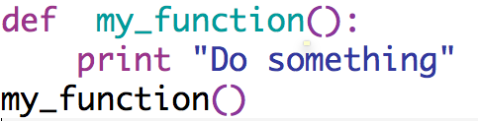
Functions
Functions are the reusable block of code that you can name
Using the name, a function can be executed any number of times
This reusability is called calling the function
You have been using built-in functions already
len(), range(), sorted(), max(), min(), sum() etc.
Function is important building block of a software
Structure of writing a function:
def (keyword) + function name (you choose) + ():
newline with 4 spaces or a tab + block of code
Call your function
Note: Codes at the 0 position
are always read

Slide 4
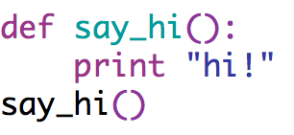
Functions
Non parametric function

Slide 5
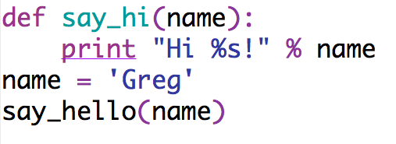
Functions
Non parametric function
Parametric function

Slide 6
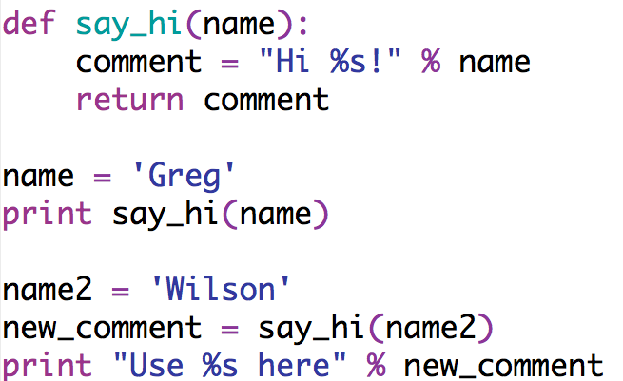
Functions
Non parametric function
Parametric function
Return values

Slide 7
Functions
Non parametric function
Parametric function
Return values
Local vs. global variables?
Do something with the values

Slide 8
Function Exercises
Let’s take our older codes (if.py or for.py) and write them in function

Slide 9
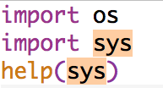
Packages
A module is a Python file that (generally) has only definitions of variables, functions, and classes.
Like functions, which are usable parts of a program, packages (also known as libraries) are reusable programs with several modules
Many powerful tools are built into Python which can be imported without rewriting (or even reading) them in the current program
Import (keyword) + package name: e.g.: import os, import sys
More at: https://pypi.python.org/pypi

Slide 10
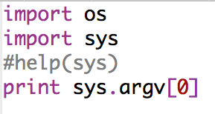
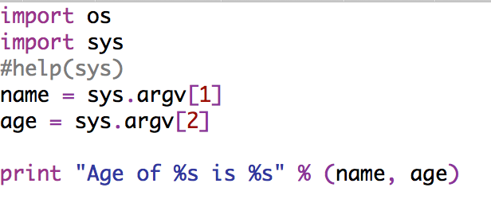
Packages
To known about the imported modules, type help(package name): help(sys)
argv -- command line arguments; argv[0] is the script pathname if known
python scriptname.py
Therefore anything written after the script pathname can be accessed as list like argv[1] and argv[2]
python scriptname.py input1 input2

Slide 11
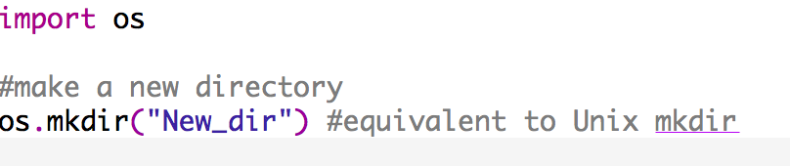
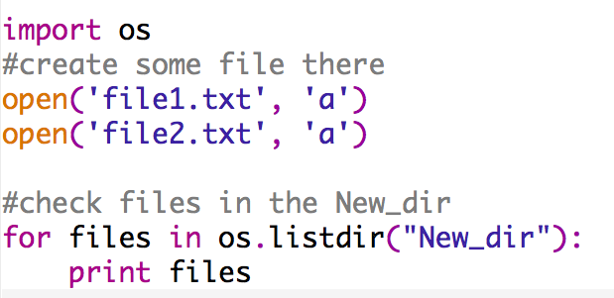
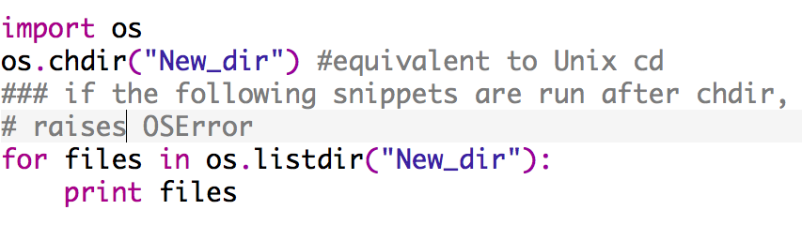
Packages
Package os, help(os)
Moving to error handling for a while

Slide 12
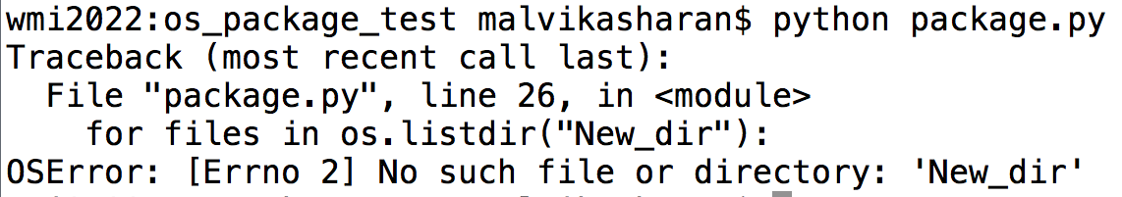
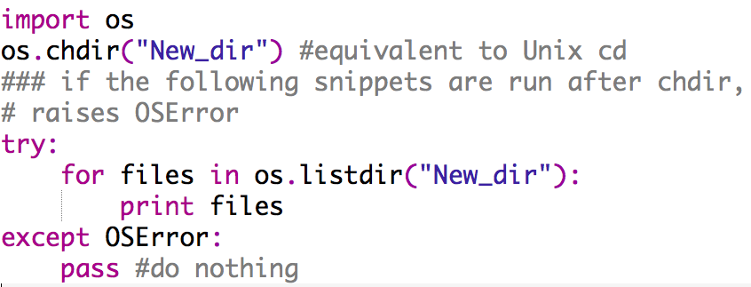
Errors
Errors and error handlers
Handle exception by try and except

Slide 13
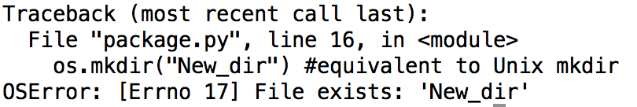
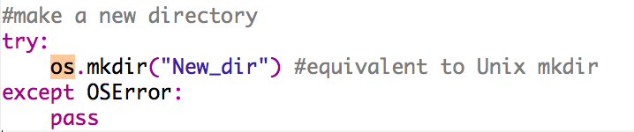
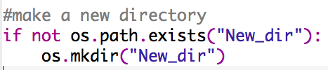
Errors
Try creating existing folder
try and except
Alternate option:
Back to package

Slide 14
Packages
The package matplotlib is widely used to visualize data as plots
import matplotlib
Specific modules (program) from the packages are imported as
from matplotlib import pyplot
import matplotlib.pyplot
Plot some data

Slide 15
Python Discussion
Is there something we need to revisit?
Do we have any trivial problem that everyone faces?
Was there something you wanted to learn and we did not cover so far?

Slide 16
Python Programming for Novice
Malvika Sharan & Olav Vahtras
Day – 2: Session – 3
2015-09-24

Slide 17
Task for the last session on Sept 24
From your current scientific interests identify/create a task
That involves repeated tasks like reading one or multiple files of same format
Requires you to extract certain information
Requires processing of the data like using certain formula for calculations
Requires you to create a new file with the processed information
Hands-on practice on your own project

