Slide 1



Python Programming for Novice
Malvika Sharan & Olav Vahtras
Workshop: Software Writing Skills for Young Researchers 2015.09.23 - 2015.09.25
GFZ Helmholtz-Zentrum Potsdam, Germany

Slide 2
Python Programming for Novice
Malvika Sharan & Olav Vahtras
Day – 2: Session – 1
2015-09-24

Slide 3
Recap
Yesterday we covered the following topics:
Print “Hello World!”, ‘literal constants like “strings”, “integers”, “floats” etc.’
Variables: Example
>>> book = ‘Game of Thrones’
>>> author = ‘R. R. Martin’
Printing several strings by using string format operator
>>> print “author of the book %s is %s” % (book, author)
Using math operators: float((2 + 3)-11*(6/7))
Data structures: creating, accessing, manipulating by adding and removing
MyList = [], MyList = [1, 2, ‘C’], MyList(“string”), MyList[-1] etc.
MyDict = {}, MyDict = {“Location” : “Winterfell”}, MyDict[“Head”] = “Eddard Stark”, MyDict.pop(“Head”), MyDict.items() etc.

Slide 4
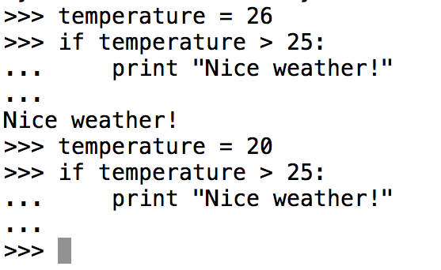
Control Flow
So far we commanded Python to do stuffs (print, add etc.)
Control-flow allows Python to take a decision and do different things depending on different situations
In Python are 3 control flow statements: If, for and while
The if statement is used to check a condition
Looks for answer in true or false
if the condition is true, block of codes inside the if statement will be executed
Checks if the value of temperature (>25)
Since its true, it executes the block of code
4 spaces or a tab
Since its false, it does not read the block of code that belongs to our if-statement

Slide 5
Editors
We will continue with the if-statement but let’s first address the problem of writing codes on terminal
No one wants to type the same code again and again
We can solve this by writing our codes/snippets using an editor and saving them for future use
There are several powerful editors like: Vim, Emacs, Komodo etc.
And some easy to use editors: gedit, nano, PyCharm and Notepad++
The codes are saved by using name of file followed by ‘.py’
Please create a python script called if.py and repeat the last task
Using ‘python if.py’, we can execute the python codes

Slide 6
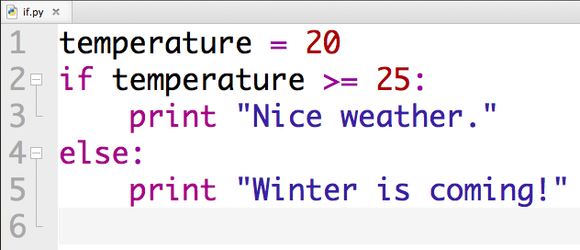
If Statement
When if statement is false, Python executes the anther block of codes in the else statement

Slide 7
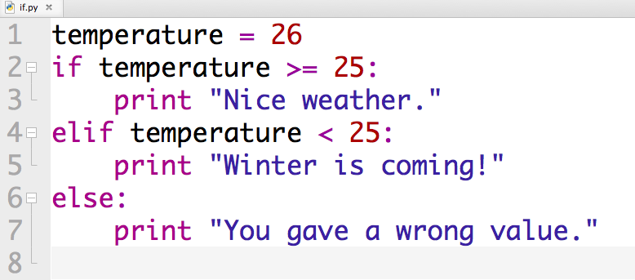
If Statement
When if statement is false, Python executes the anther block of codes in the else statement
Multiple conditions can be given by introducing elif statement

Slide 8
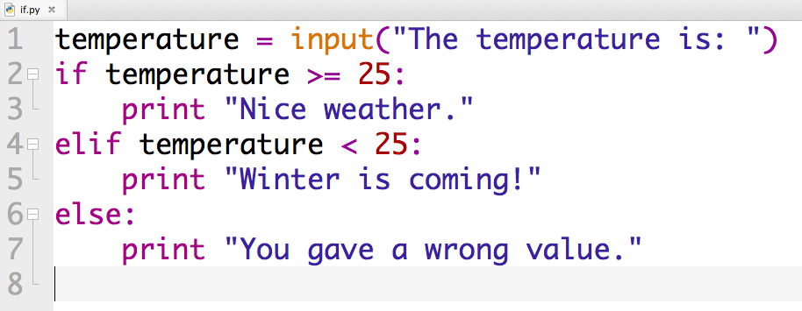
If Statement Exercise - 1
Take input from terminal by using input() or raw_input()
Great! but temperature above 40 is not nice
How to test multiple conditions before executing code?

Slide 9
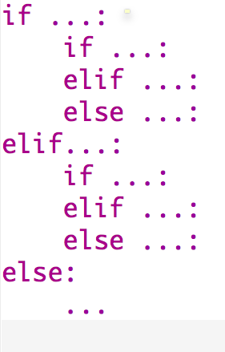
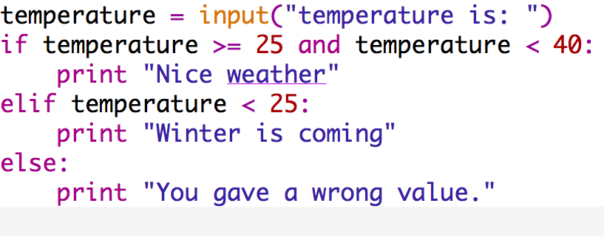
If Statement
1. By not so elegant nested if statements
2. Connecting conditions by Boolean (and, or, not) and extend your code
Notes:
What happens when you do not give any value

Slide 10
If Statement
1. By not so elegant nested if statements
2. Connecting conditions by Boolean (and, or, not) and extend your code
Check following statements (line-2):
Warning: English’s ‘or’ and Python’s ‘or’ are not always the same
Notes:
What happens when you do not give any value

Slide 11
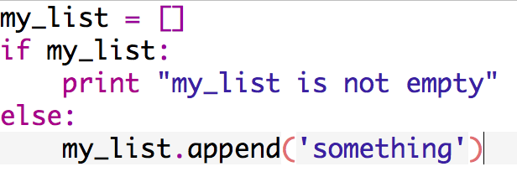
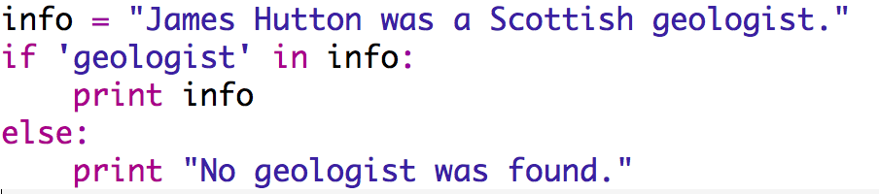
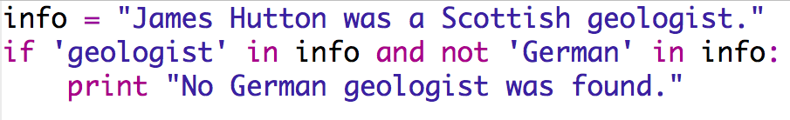
If Statement
Some more useful use of if statements:
Check if a variable or data type exists (not empty)
Checks if an item exists in a string or data structure (if ‘x’ in list:)
Or does not exist
Notes:
What happens when you do not give any value

Slide 12
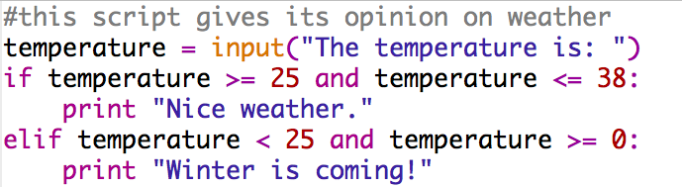
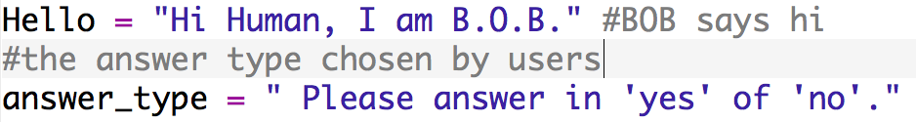
Commenting and Annotating Codes
“#” for writing comments or commenting out you codes
Annotate your codes so other’s can learn what your code is doing

Slide 13
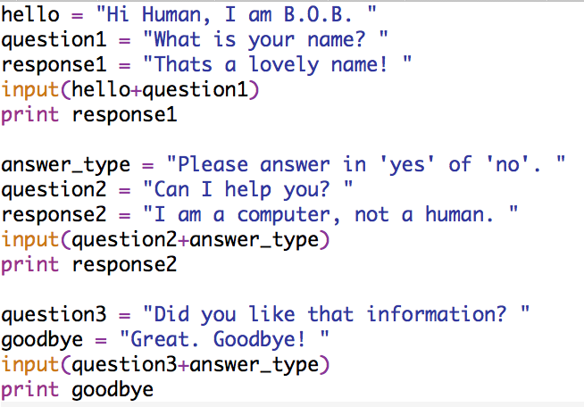
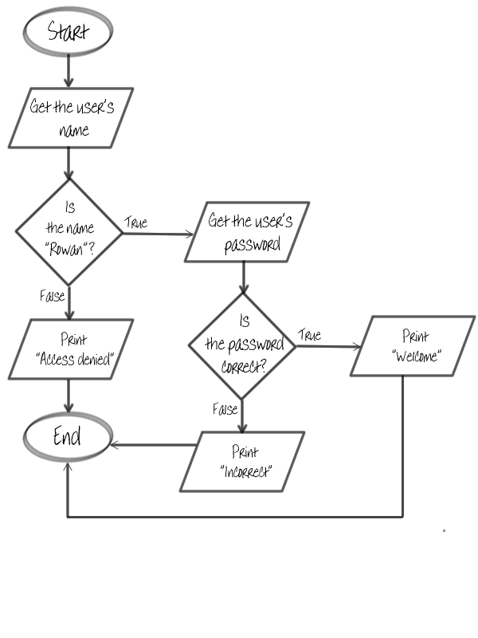
If Statement Exercise - 2
Problem 1 (bob.py)
Problem 2 (user.py)
Make B.O.B (Basic Output Being) smarter by letting it differentiate “yes” and “no” and respond to the user accordingly.
For example: if the answer of question2 is in yes, then let B.O.B. help user somehow and if the answer is no say goodbye already!
http://usingpython.com/python-if-else-statements/

Slide 14
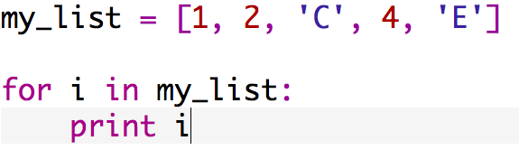
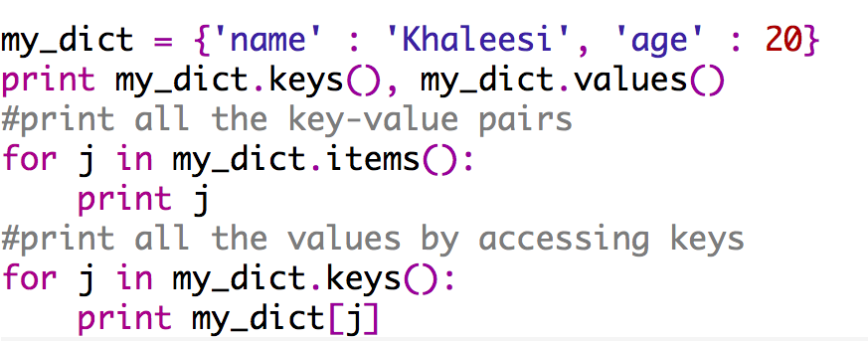
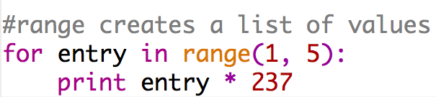
For-loop
Most often we carry out the same task repeatedly
Reading each items in list or dict
Reading several files of same file format
Extracting information
Correcting a misprinted word in several files
The For loop of for … in statement is the most powerful way to tackle the repeated tasks
Use range:

Slide 15
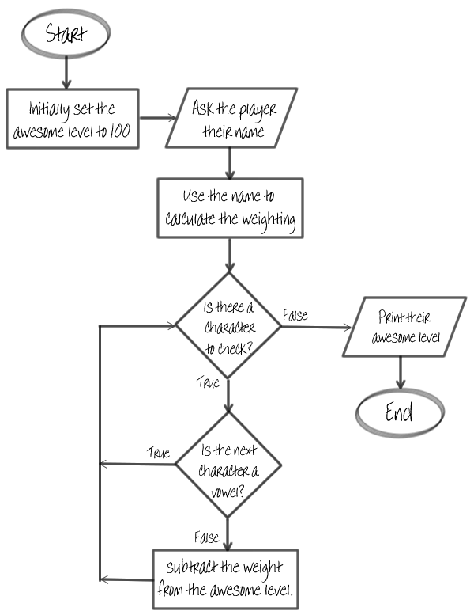
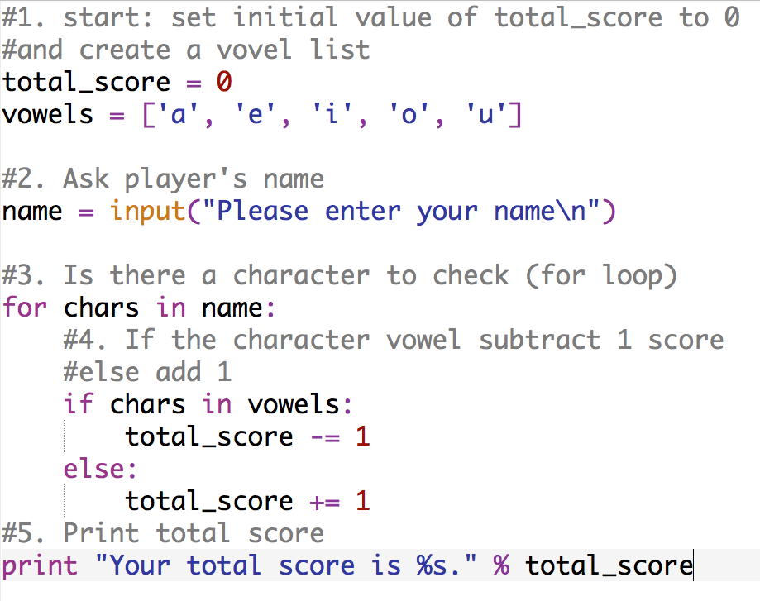
For-loop Example
Script: name_score.py
i. total_score = 0
ii. Create a list of vowels
for-loop through the characters
No more characters
Print
score
Add 1
If else
statement
Subtract 1
Adapted from: http://usingpython.com/python-for-loop/

Slide 16
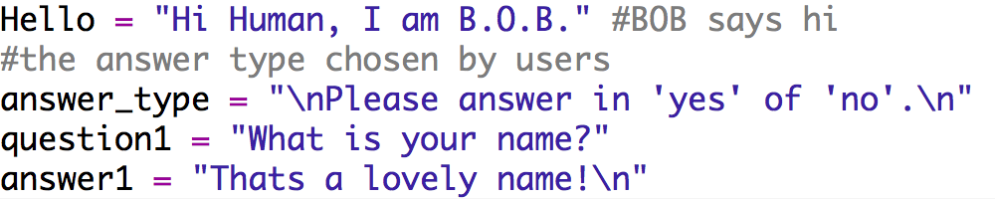
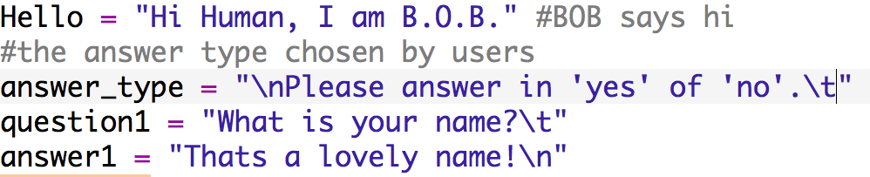
Printing Newline and Tab
Most commonly used in creating files and tables
“\n” for newline
“\t” for tab ()

Slide 17
File Handling
File handling refers to creating, opening, reading and writing files
Please see the script “file_handle.py”
fh = open(): open a file and assign it to a variable fh
open(filename, ‘a’): create an empty file
fh = open(filename, ‘r’): read an existing file
fh = open(filename, ‘w’): write in a new file
fh.close(): close the open file
Learn how to use if-statements and for-loops in file handling

