Slide 1



Python Programming for Novice
Malvika Sharan & Olav Vahtras
Workshop: Software Writing Skills for Young Researchers 2015.09.23 - 2015.09.25
GFZ Helmholtz-Zentrum Potsdam, Germany

Slide 2
Topics to be discussed
Basics (What is? And How to?)
How to read, write, manipulate and process information
How to get the repeated task done without repeated coding
Most importantly, using Python to deal with your data
Link to all the documents for this coursehttps://github.com/malvikasharan/software_writing_skills_potsdam/tree/potsdam
References for this course: ‘A Byte of Python’ by Swaroop C. H. along with several resources mentioned in the GitHub repository
ASK when something is not clear

Slide 3
Python Programming for Novice
Malvika Sharan & Olav Vahtras
Day – 1
2015-09-23

Slide 4
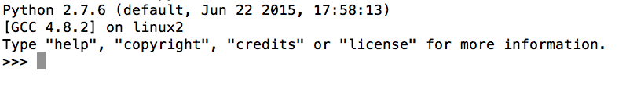
“Hello World!”
Open your terminal
Run Python (Type ‘python’ + Enter-key)
You would see information similar to this:
Type quit() + Enter-key to quit
Traditional “Hello World!”
Run Python
Type and enter+key
print “Hello World!”

Slide 5
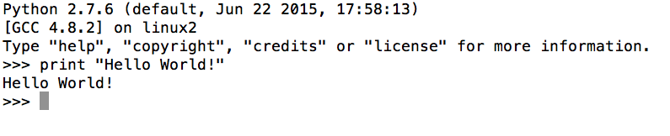
“Hello World!”
Open your terminal
Run Python (Type ‘Python’ + Enter-key)
You would see something similar like this information
Type quit() + Enter-key to quit
Traditional “Hello World!”
Run Python
Type and enter+key
print “Hello World!”

Slide 6
Literal Constants
We use the values of literals literally
These values represent themselves and nothing else
int(): Integers or whole numbers of any length like 2, 30, 1000
float(): Floats or floating point numbers like 1.9, 30.01, 1e3
str(): String or sequence of characters like “Hello”, “1 World”, “&”
Single quote and double quotes
Either of the quote can be used to print a string
Spaces, tabs, comma etc. inside the quotes are preserved
Triple Quotes
Multi line strings can be specified by triple quotes (‘’’ or “””)

Slide 7
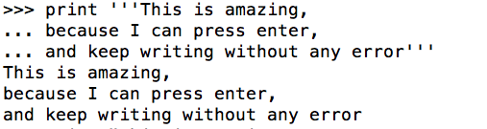
Literal Constants
you use the values of literals literally
These values represent themselves and nothing else
int(): Integers or whole numbers of any length like 2, 30, 1000
float(): Floats or floating point numbers like 1.99, 30.001, 1e3
str(): String or sequence of characters like “Hello World”
Single quote and double quotes
Either of the quote can be used to print a string
Spaces, tabs, comma etc. inside the quotes are preserved
Triple Quotes
Multi line strings can be specified by triple quotes (‘’’ or “””)

Slide 8
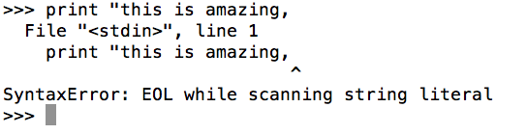
Literal Constants
you use the values of literals literally
These values represent themselves and nothing else
int(): Integers or whole numbers of any length like 2, 30, 1000
float(): Floats or floating point numbers like 1.99, 30.001, 1e3
str(): String or sequence of characters like “Hello World”
Single quote and double quotes
Either of the quote can be used to print a string
Spaces, tabs, comma etc. inside the quotes are preserved
Triple Quotes
Multi line strings can be specified by triple quotes (‘’’ or “””)

Slide 9
“Hello World!” and Literal Constants
Exercises:
Print more strings
Print numbers
Hint: does not need quotes
Print a float with int() and integer with float() types
Print multiple strings and numbers together
Hint 1: use comma as separator
Hint 2: use plus sign (+) to connect
gives error (or sum, when int1+int2) with numbers, how to solve this?
Print a string with double quote
Example: “this string appears with double quotes”

Slide 10
Variables
Using literal constants will become boring
What does Python do if I am writing everything on my own?
Variables are variables, their values can change
Allow storing any information in your computer’s memory
We need a method to access them by giving them names (Identifiers)
Rules:
The identifiers are case sensitive
myname and MyName are different
The name starts with a letter or alphabet
Followed by letters, underscores or digits (name_1)

Slide 11
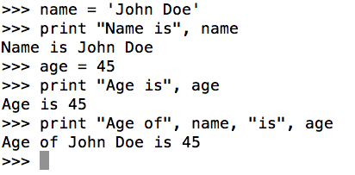
Variables
Using literal constants will become boring
“What would Python do if I am writing everything on my own?”
Variables are variables, their values can change
Allow storing any information in your computer’s memory
We need a method to access them by giving them names (Identifiers)
Rules:
The identifiers are case sensitive
myname and MyName are different
The name starts with a letter or alphabet
Followed by letters, underscores or digits (name_1)

Slide 12
String Formatting
The string format operators allows formatting output of an ordered strings
Previous example: print “Age of”, name, “is”, age
Smarter way 1: print “Age of {} is {}”.format(name, age)
Smarter way 2: print “Age of %s is %s” % (name, age)
There are several options with %:
%s: string
%d: decimal point number
%f: float point number
%.2f: float point number to
2 decimal places
Etc.
Print the output by string format operators

Slide 13
Variables Exercises
Exercises:
Assign any value to variable i, print and check the value
Example: i = 10
Reassign a different value to i, print and check
Example: i = 23
You just overwrote the value of i, the last assigned value is the current value
Assign multiple variables same values, print and check
Example: a = b = c = 59
Assign multiple variables (a, b, c) different values, print and check
In separate lines (a = 1 + Enter-key, b = 2 + Enter-key, c = 3 + Enter-key)
In same line (a, b, c = 1, 2, 3)

Slide 14
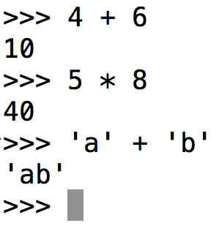
Operators and Operands
Operators are functionality that do something and can be represented by the symbols such as + or special keywords
Operators operate on data referred as operands
For example:
Operands
Operators
We already saw that
in ‘Printing’

Slide 15
Operators and Operands Exercises
Exercises: Assign numerical values to X and Y and do the following
Sum x and y by plus: x + y
Subtract y from x by minus: x - y
Multiply x and y: x * y
Multiply a string with y: ‘X’ * y
Return x to the power of y: x**y
Divide x by y: x/y
Return remainder of x divided by y: x % y
Check if x is greater than y: x > y
Check if x is smaller than y: x < y
Check if x is less than or equal to 100: x <= 100
Check if y is greater than or equal to 5: y >= 100
Check if x is equal to y: x == y
Check if x is not equal to y: x != y

Slide 16
Math Operators and Operands - 1
We can use multiple operators together
Evaluation order is what high school taught us: BODMAS
B: Brackets first
O: Orders (i.e. Powers and Square Roots, etc.)
DM: Division and Multiplication (left-to-right)
AS: Addition and Subtraction (left-to-right)
Division before multiplication and addition before subtraction
However the order can be altered by using brackets
Example: 4/2*3+1-5 = 2 but 4/2*(3+1-5) = -2
Use multiple operators (example: x+y*y/x)

Slide 17
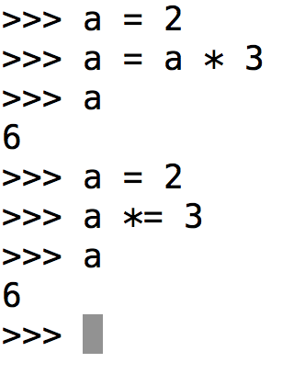
Math Operators and Operands - 2
Operands can be over-written
Solution – 1
Assign a value to variable a
Reassign/overwrite value of a as a * 3

Slide 18
Math Operators and Operands - 3
Shortcuts for math operations:
Solution – 1
Assign a value to variable a
Reassign/overwrite value of a as a * 3
Solution - 2

Slide 19
Data Structures
Data Structures are containers that hold/store a collection of data/object together
There are two built-in data structures that we will discuss here
List (list): holds ordered collection of objects separated by comma
Objects are present in the given order any change in introduced
Lists are mutable: data can be added and removed
An empty list are created as: my_list = []
A list with values are created as: my_list = [1, 2, ‘a’, ‘b’]

Slide 20
Data Structures Exercises - 1
Exercises: print and check at each step
help(list)
1. create a list with five items and follow the exercise (hint: my_list = [1, 2, ‘C’, 4, ‘E’])
2. Add/append an item: my_list.append(‘X’)
3. Access the list item by index, which are the position of items (counted from 0)
Access the 1st item: my_list[0] (square brackets to define the index)
Access the last item: my_list[-1]
Access the 4th item (?)
Access items from position 2 to 4: my_list[1:4]
Here 4 means item in the 5th position, last mentioned index is not accessed
Access items at the index 2 to the second last position (?)
Access items from the beginning to the position 4: mylist[:4]
Access items at the index 2 to the last position (?)
4. Insert an item in the 4th position: my_list.insert(3, ‘X’)

Slide 21
Data Structures Exercises - 2
Exercises: print and check at each step
5. Check the items in the list and find the number of items: len(my_list)
6. Remove ‘X’ from the list: my_list.remove(‘X’)
Check the length again
5. Remove an item from a position from any index (i=3): my_list.pop([i])
8. Get maximum value in the list: max(my_list)
9. Get minimum value in the list: min(my_list)
Letters are considered larger than digits
10. Reverse items in the list: my_list.reverse()
11. Sort items of the list: sorted(my_list)
Reverse the items again
12. Summed up the value of a list containing all the numerical items: sum(list_num)
Hint: list_num = [1, 2, 3, 4]

Slide 22
Data Structures Exercises - 3
Exercises: print and check at each step
13. Convert a string into list: list(my_string)
Hints: string = ‘convert string into list’
14. Count the occurrence of an item
hint-1: list(‘convert string into list’).count(‘t’)
hint-2: new_list = list(‘convert string into list’)
new_list.count(‘t’)
15. Convert a string into list by splitting it by space: my_string.split(‘ ’)
Try splitting by different lists by different characters

Slide 23
Data Structures Exercises - 4
Exercises: print and check at each step
16. Get unique items of the list: set(new_list)
Note: Set is another data structute, with an unordered collection without duplicates Created as: my_set = set()
17. Dealing with two lists: define 2 lists with some items (list1 and list2)
Create a third list as list3: list3 = list1 + list2
Extend list1 by list2: list1.extend(list2)
Create a list with only unique items from the lists: set(list1).union(list2)
Find common items in the lists: set(list1).intersection(list2)

Slide 24
Data Structures
Data Structures are containers that hold/store a collection of data/object together
There are two built-in data structures that we will discuss here
List (list): holds ordered collection of objects separated by comma
Objects are present in the given order any change in introduced
Lists are mutable: data can be added and removed
An empty list are created as: my_list = []
A list with values are created as: my_list = [1, 2, ‘a’, ‘b’]
Dictionary (dict): a list of key-value pairs where key can be any numbers or strings and values can be any arbitrary python object
An empty dict is created as: my_dict = {} or my_dict()
Key and value are separated by a colon (:)
A list with key-value pairs are created as: my_dict = {‘Key_1’: ‘Val_1’}

Slide 25
Data Structures Exercises - 5
Exercises: print and check at each step
help(dict)
1. Create a dictionary with key-value pairs: my_dict = {‘name’ : ‘Khaleesi’, ‘age’ : 20}
2. Access value by a key: my_dict[‘name’] or my_dict.get(‘name’)
3. Add more items to the dictionary: my_dict[‘occupation’] = ‘Queen’
4. Print all the items: my_dict
4. Print all the key-value pairs as list: my_dict.items()
5. Print all the keys of the dictionary as list: my_dict.keys()
6. Print all the values of the dictionary as list: my_dict.values()
7. Remove a key-value pair: my_dict.pop(‘age’)
8. Remove the last key-value pair: my_dict.popitem()
9. Check if a key is in the dict: ‘location’ in my_dict and ‘age’ in my_dict
10. Remove all the items from the dict: my_dict.clear()

Slide 26
Task for the last session on Sept 24
From your current scientific interests identify/create a task
That involves repeated tasks like reading one or multiple files of same format
Requires you to extract certain information
Requires processing of the data like using certain formula for calculations
Requires you to create a new file with the processed information

Slide 27
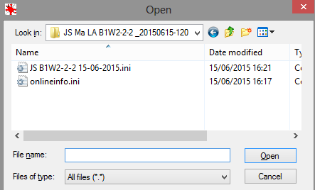
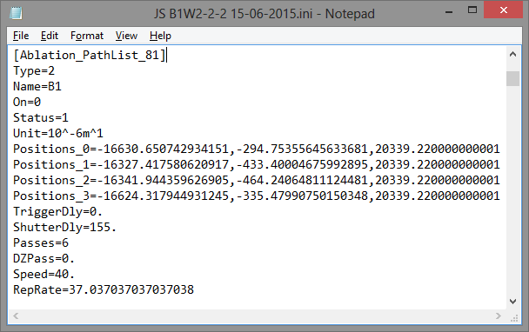
Task for the last session on Sept 24
An example from Dr. Jan A. Schuessler:
He uses Laser Ablation System, that generates a text file containing several entries with x, y, z coordinates and other parameters
Task:
Read the file contents
Record information of each parameters for each entry
Create an output file containing table with chosen information
1
3
2
Content of the slides by Dr. Jan A. Schuessler

