Slide 1
External shocks and police legitimacy
Felix M. Enterkin

Slide 2
Background
Police legitimacy is often viewed as a matter of procedural justice (Tyler 1990), but less is known about the influence of external factors.
Multiple factors may influence how people view and identify with police authority.
There is some evidence to suggest crisis point, such as public health emergencies (Silbey 2021) or terrorist attacks (LaFree and Adamczyk 2017), are associated with changes in public perceptions of police authority.
I ask whether a terrorist attack has a causal impact on perceptions of police legitimacy.

Slide 3
Theory: The Rally-Round-the-Flag Effect
Exogenous shocks, such as terrorist attacks, often generate a rally effect :
  Increased support for the nation and institutions, increased outgroup hostility, and conservative shift (Godefroidt 2023).
This is consistent with in-group/out-group theories that suggest an external threat will drive social cohesion
This observed rally effect is driven by an ingroup/outgroup identification response
  Threats create a salient distinction between the threat and the political community under attack
  The police may be perceived as part of the collective under attack and benefit from an increase in support

Slide 4
Hypothesis
H1: Exposure to a Terrorist Attack will increase perceptions of police legitimacy
H2: This effect will diminish with time and return to pre-event levels

Slide 5
Quasi-Experimental Design
I leverage an unexpected event during survey design (Munoz et al 2020)
  Exploit overlap with a terrorist attack and survey fieldwork (European Social Survey, Round 5)
  Respondents immediately before and after the event survey are used as control and treatment groups
  Those surveyed after the event are assumed to be ‘exposed’ to terrorism
Two Case Studies:
Stockholm Bombing 2010, Sweden
Domodedovo Airport Bombing 2011, Russia

Slide 6
Six-Legitimacy-Related Attitudes
Round 5 of the ESS includes a Trust in Justice model
Legitimacy is broken down into multiple separate components
Trust in the police
Obligation to obey the police
Moral alignment with police
Perception of police as lawful
Perception of procedural fairness
Perceptions of police effectiveness

Slide 7
The Two Cases
Policing in Sweden
High levels of legitimacy
Characterized by a procedural justice model
Event: Stockholm Bombing 2010
Small attack (botched)
2 injured, attacker killed
Policing in Russia
Low levels of legitimacy
Characterized by bribery and corruption
Event: Domodedovo Airport Bombing 2011
Large attack
37 killed, 150+ injured

Slide 8
Internation-to-treat effects
Estimates are calculated using a local randomization approach to regression discontinuity
Difference in mean in treatment vs control in a small window either side of the event
Bandwidths are run from 1 to 8 weeks to assess the duration of effect

Slide 9
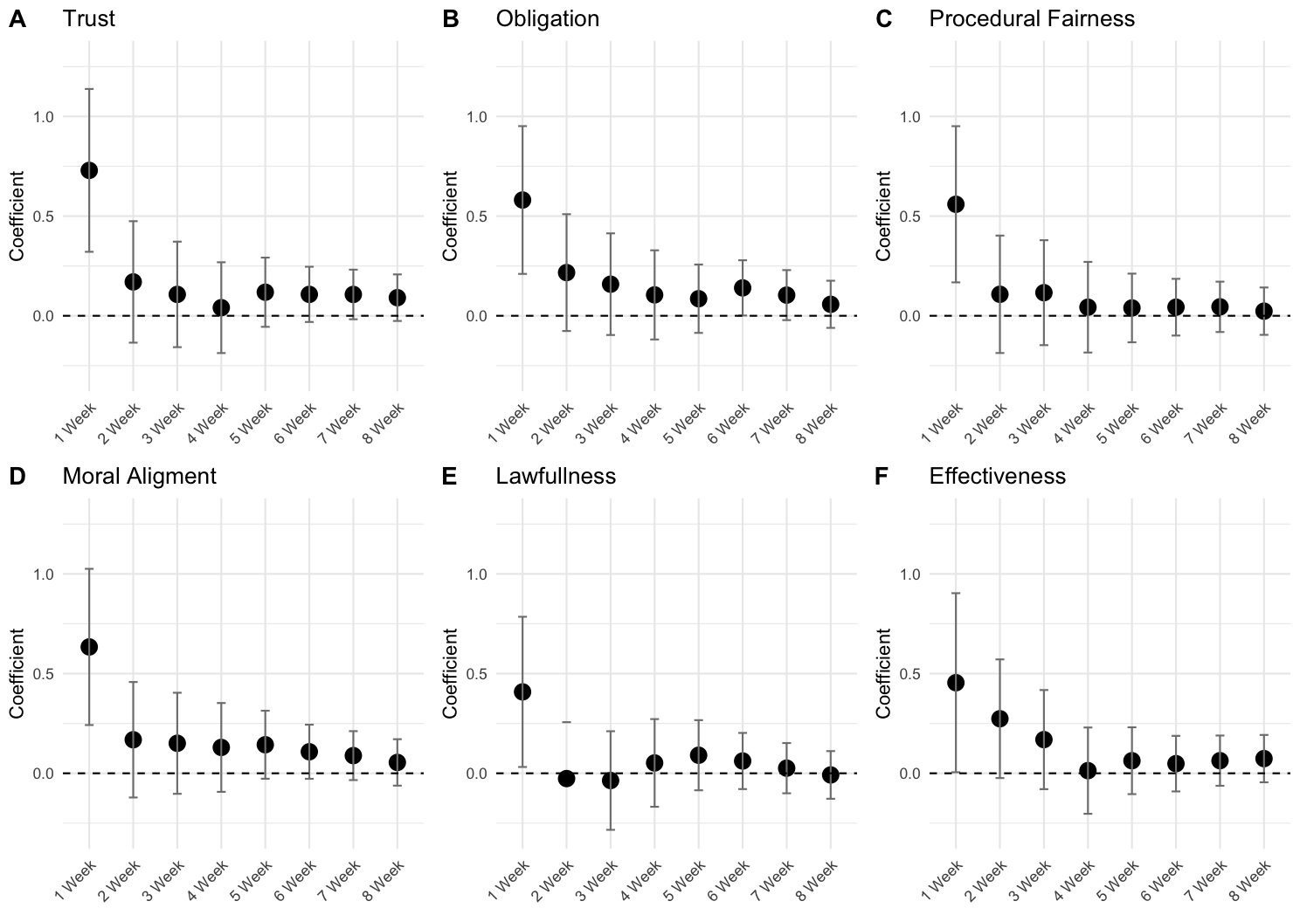
Case Study 1 – Sweden

Slide 10
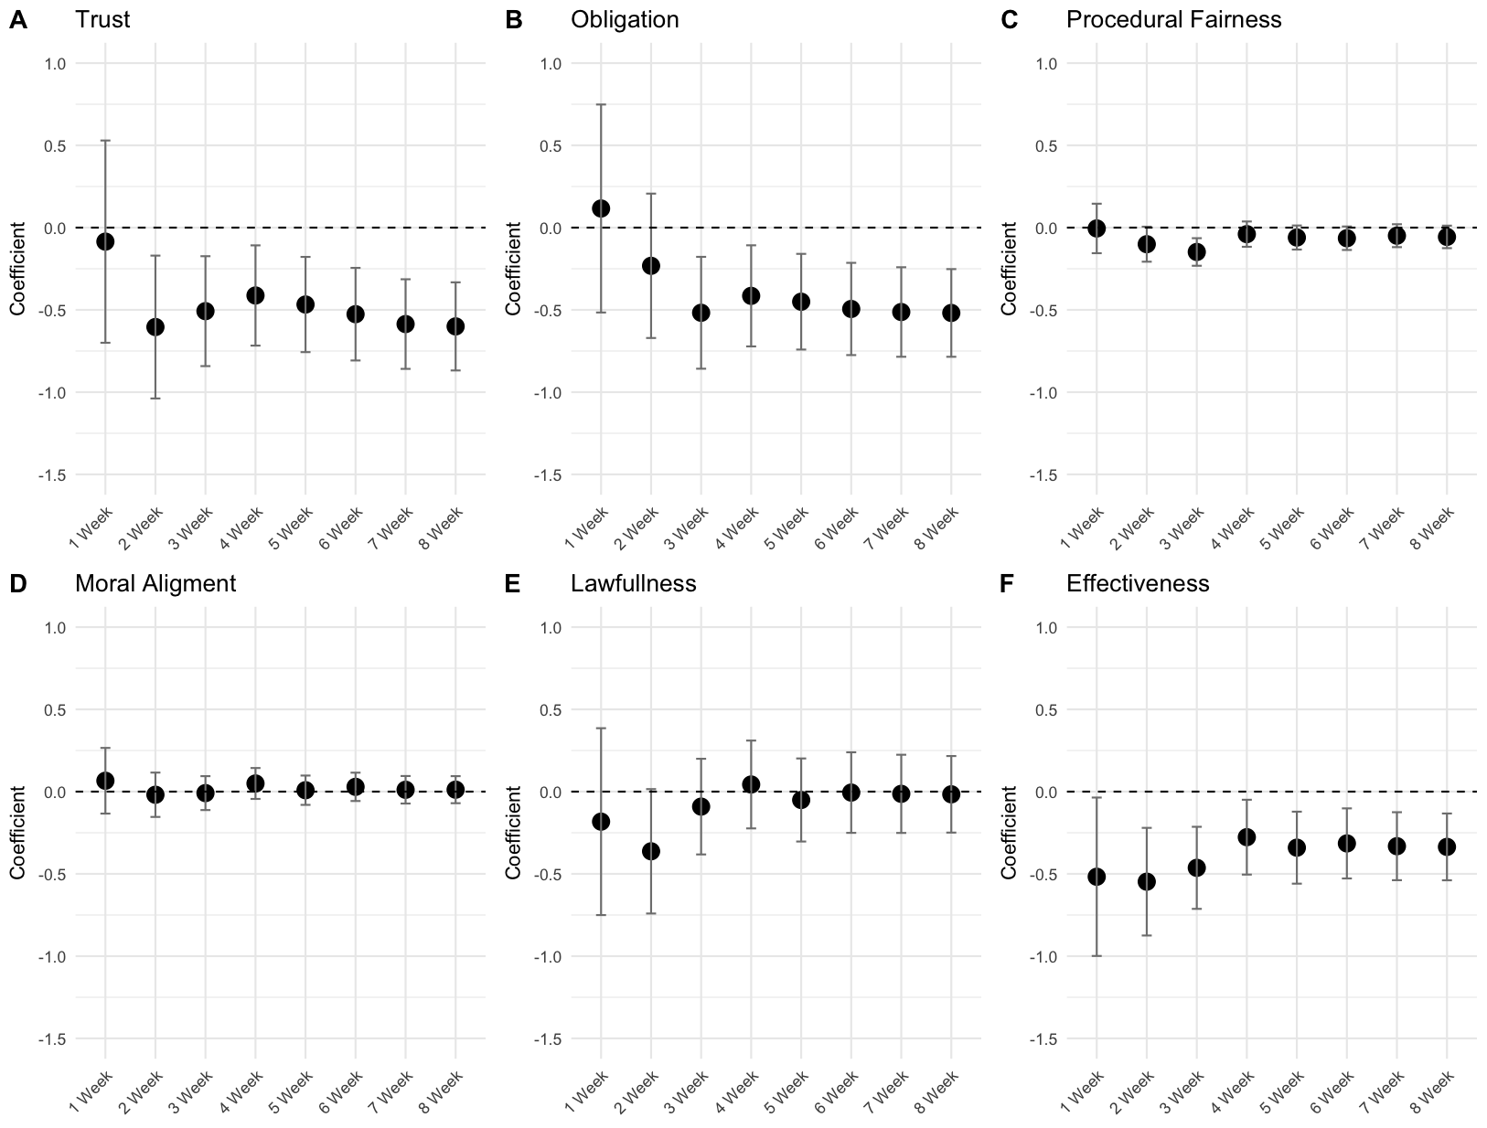
Case Study 2: Russia

Slide 11
Summary of Findings
In Sweden all attitudes shift significantly upwards in response to a threat
In Russia Attitudes are unchanged if not in decline
Robustness test suggest the three variables that shift were declining in Russia before the attacks
Possible explanations:
The difference does not appear to be about scale
In Russia perceptions of and identification with the police are low, they may not be viewed as part of the community

Slide 12
Implication
Legitimacy can shift at least temporarily in line with exogenous events and shocks (at least temporarily)
All legitimacy measures shift I relative unison suggesting not simply an instrumental increase in support but a change in orientation towards police authority
While a terrorist attack may be sufficient to shift perceptions of police other factors are clearly at play

Slide 13
Thank you!
References
Godefroidt, A., 2023. How terrorism does (and does not) affect citizens’ political attitudes: A meta‐analysis. American journal of political science, 67(1), pp.22-38.
LaFree, G. and Adamczyk, A., 2017. The impact of the Boston marathon bombings on public willingness to cooperate with police. Justice quarterly, 34(3), pp.459-490.
Muñoz, J., Falcó-Gimeno, A. and Hernández, E., 2020. Unexpected event during survey design: Promise and pitfalls for causal inference. Political analysis, 28(2), pp.186-206.
Sibley, C. G., Greaves, L. M., Satherley, N., Wilson, M. S., Overall, N. C., Lee, C. H. J., Milojev, P., Bulbulia, J., Osborne, D., Milfont, T. L., Houkamau, C. A., Duck, I. M., Vickers-Jones, R., & Barlow, F. K. (2020). Effects of the COVID-19 pandemic and nationwide lockdown on trust, attitudes toward government, and well-being. American Psychologist, 75(5), 618–630.
Tyler, T.R., 1990. Why people obey the law.

