Slide 1















Migraine Data Analysis
Felix M. Schneider 24.11.2022

Slide 2
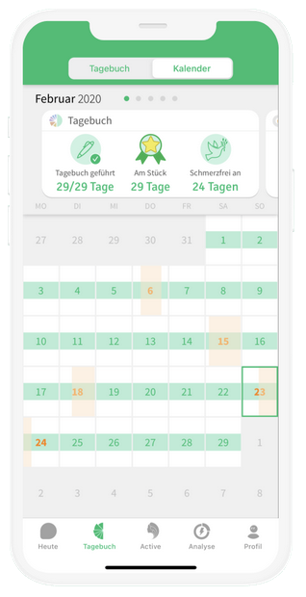


Analysis of a Migraine Data Set
Analysis of a Migraine Data Set
Analysis of a Migraine Data Set
Migraine Data Analysis
Introduction Challenges Processing Results
Project Idea
M-sense:
    Headache Diary App
    running for 6 years (2016-2022)
    Data from 80000 users
Backend: Postgres Database
(running on and using )
Questions:
Periodicity in the occurrence of headache days?
What are potential headache triggers?
Make use out of it for prediction?
External Partner:
Markus Dahlem (CEO Founder)
1/5

Slide 3



Migraine Data Analysis
Introduction Challenges Processing Results
I. Data Extraction
Data were delivered as a binary Postgres dump
Size: 26.2 GB
First try: run it locally not possible due to HD restrictions
Solutions:
  Set up database on external hard disk
    format external hard disk as EXT4
    mount hard disk as if it was an internal HD
    change postgres data path from /var/… to mount point
Size of extracted data set: 137GB Data of about 80.000 users
pg_restore
EXT4
2/5

Slide 4
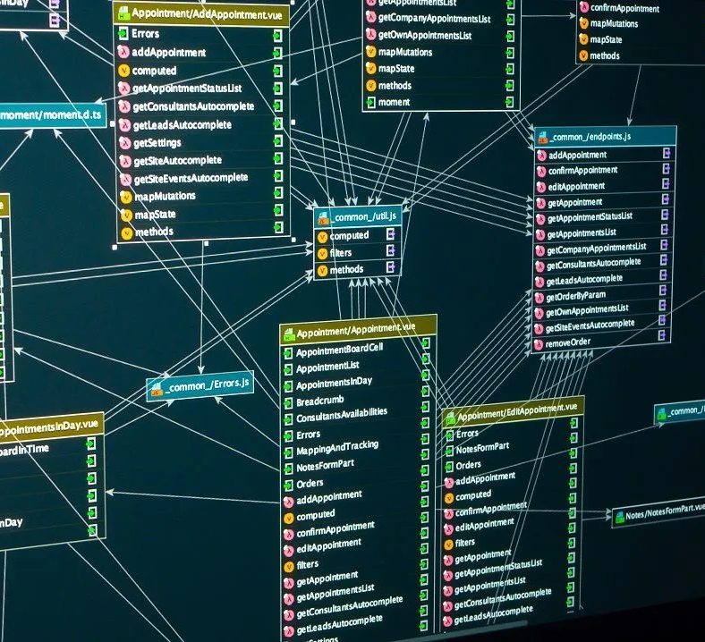
Migraine Data Analysis
Introduction Challenges Processing Results
II. Working with “Big Data”
Access the data:
Database shape complicated
advanced SQL-Queries are needed to retrieve headache time series data
Solution:
python Class NslUser.py
    comfortable access data
    using
    apply operations
3/5

Slide 5
Migraine Data Analysis
-- SQL-QUERY TO RETRIEVE HEADACHE TIME SERIES FOR USER 11 --
WITH CTE1 AS (
SELECT event_time_range, value FROM
quantity q JOIN factor f
ON q.user_id = f.user_id
AND q.server_factor_id = f.server_factor_id
WHERE q.user_id = 11
AND global_id IN ('headacheType')
AND q.deleted_at IS null
ORDER BY LOWER(event_time_range)),
CTE2 AS (
SELECT GENERATE_SERIES(LOWER(event_time_range)::DATE,
UPPER(event_time_range)::DATE, '1 day') AS hd, value FROM CTE1),
CTE_MIN_MAX AS (
SELECT MIN(hd) AS min_hd, MAX(hd) AS max_hd FROM CTE2),
CTE_TIMELINE AS (
SELECT GENERATE_SERIES(min_hd::DATE, max_hd::DATE, '1 day') AS timel FROM CTE_MIN_MAX)
SELECT timel, CASE WHEN value IS null THEN 0 ELSE value END AS value_ FROM
CTE_TIMELINE cte_t LEFT JOIN CTE2 c2
ON cte_t.timel = c2.hd
ORDER BY cte_t.timel;
Introduction Challenges Processing Results
II. Working with “Big Data”
Access the data:
Database shape complicated
advanced SQL-Queries are needed to retrieve headache time series data
Solution:
python Class NslUser.py
    comfortable access data
    using
    apply operations
3/5

Slide 6
Migraine Data Analysis
Introduction Challenges Processing Results
II. Working with “Big Data”
Access the data:
Database shape complicated
advanced SQL-Queries are needed to retrieve headache time series data
Solution:
python Class NslUser.py
    comfortable access data
    using
    apply operations
3/5

Slide 7

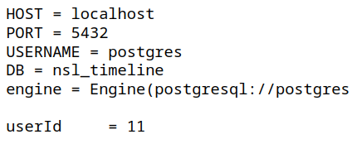
Migraine Data Analysis
Introduction Challenges Processing Results
II. Working with “Big Data”
Access the data:
Database shape complicated
advanced SQL-Queries are needed to retrieve headache time series data
Solution:
python Class NslUser.py
    comfortable access data
    using
    apply operations
Initialization
3/5
3/5

Slide 8

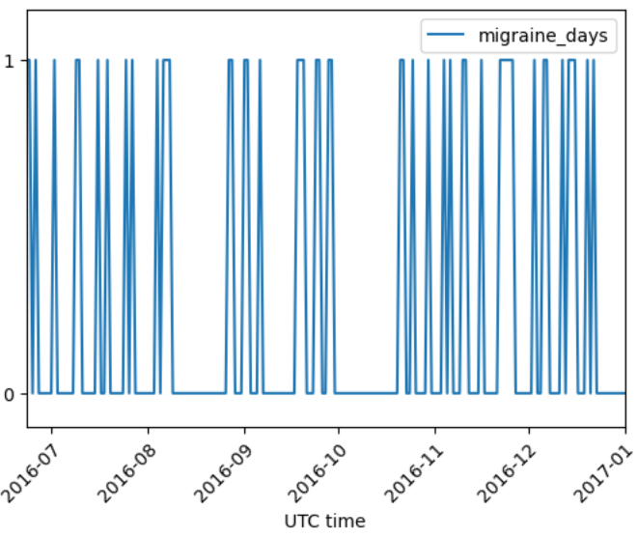
Migraine Data Analysis
Introduction Challenges Processing Results
II. Working with “Big Data”
Access the data:
Database shape complicated
advanced SQL-Queries are needed to retrieve headache time series data
Solution:
python Class NslUser.py
    comfortable access data
    using
    apply operations
3/5
3/5

Slide 9

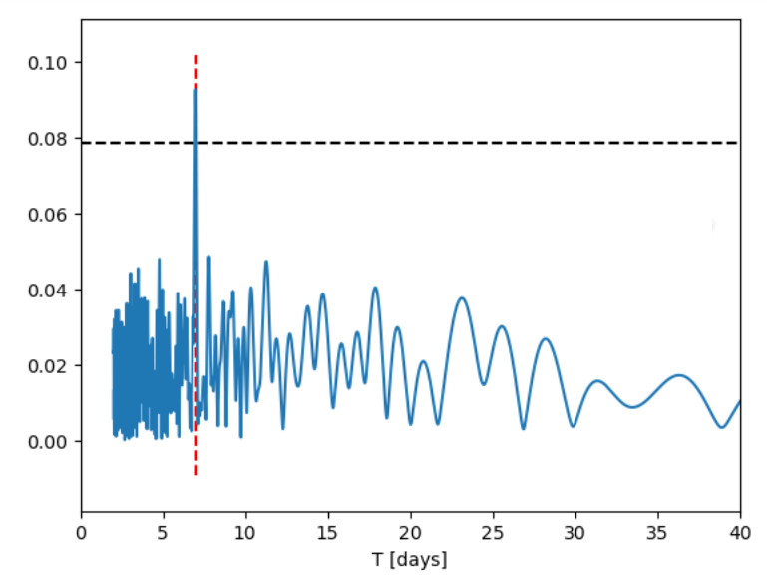
Migraine Data Analysis
Introduction Challenges Processing Results
II. Working with “Big Data”
Access the data:
Database shape complicated
advanced SQL-Queries are needed to retrieve headache time series data
Solution:
python Class NslUser.py
    comfortable access data
    using sqlalchemy
    apply operations
II. Working with “Big Data”
Access the data:
Database shape complicated
advanced SQL-Queries are needed to retrieve headache time series data
Solution:
python Class NslUser.py
    comfortable access data
    using
    apply operations
3/5
3/5

Slide 10
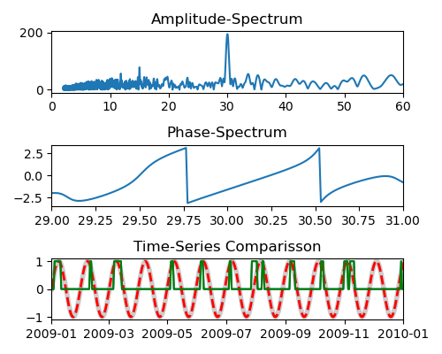
Migraine Data Analysis
Introduction Challenges Processing Results
Spectral Analysis
Each Time-Series can be approximated by sum of cos functions with different amplitudes, frequencies ω and phase φ
Σ A_{k} * cos(ω_{k}t + φ_{k})
Fourier-Transformation (numpy.fft.fft):
Unfolding spectral components:
    Amplitude and Phase Spectrum:
        A(ω) cos(ωt + φ(ω))
Analyze whole dataset:
Spectra of 40000 user
4/5
4/5

Slide 11
Migraine Data Analysis
Introduction Challenges Processing Results
Spectral Analysis
Each Time-Series can be approximated by sum of cos functions with different amplitudes, frequencies ω and phase φ
Σ A_{k} * cos(ω_{k}t + φ_{k})
Fourier-Transformation (numpy.fft.fft):
Unfolding spectral components:
    Amplitude and Phase Spectrum:
        A(ω) cos(ωt + φ(ω))
Analyze whole dataset:
Spectra of 40000 user
4/5
4/5

Slide 12
Migraine Data Analysis
Introduction Challenges Processing Results
Spectral Analysis
Each Time-Series can be approximated by sum of cos functions with different amplitudes, frequencies ω and phase φ
Σ A_{k} * cos(ω_{k}t + φ_{k})
Fourier-Transformation ( numpy.fft.fft):
Unfolding spectral components:
    Amplitude and Phase Spectrum:
        A(ω) cos(ωt + φ(ω))
Analyze whole dataset:
Spectra of 40000 user
4/5
4/5

Slide 13
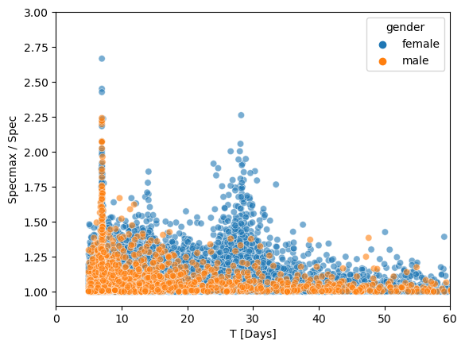
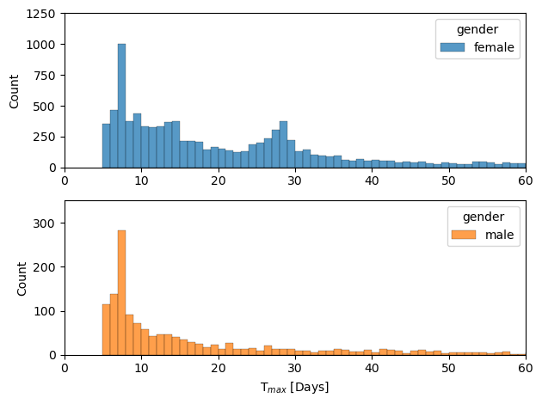
Analysis of a Migraine Data Set
Introduction Challenges Processing Results
Dominant Period
Count Plot of dominant Period:
male + female: dominant peek only at 7 days
female : 2nd peak at menstruation cycle
Overall about 35000
5/5
5/5

Slide 14
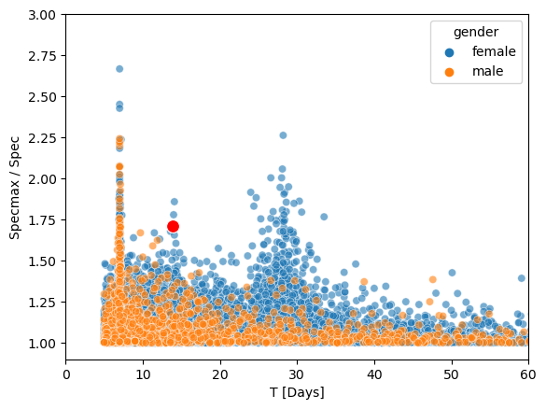
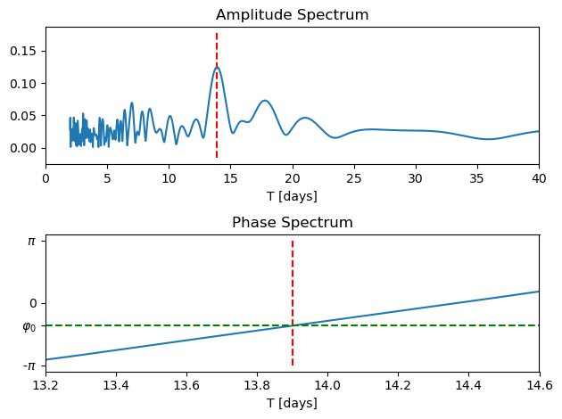
Analysis of a Migraine Data Set
Introduction Challenges Processing Results
Dominant Period
Overall about 35000
5/5
5/5

Slide 15
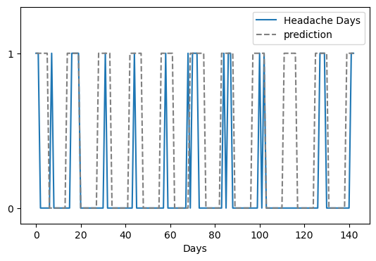
Analysis of a Migraine Data Set
Introduction Challenges Processing Results
Dominant Period
Periodicity based Prediction:
accuracy and recall relatively high
Overall about 35000
5/5
5/5

Slide 16

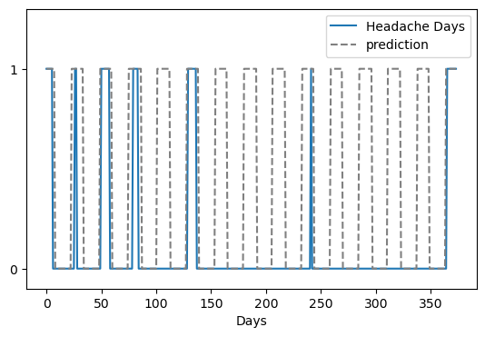
Analysis of a Migraine Data Set
Introduction Challenges Processing Results
Dominant Period
Periodicity based Prediction:
accuracy and recall relatively high
Overall about 35000
5/5
5/5

Slide 17

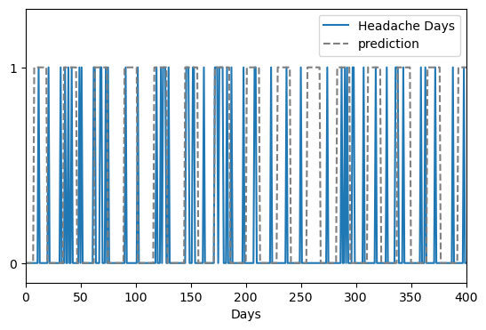
Analysis of a Migraine Data Set
Introduction Challenges Processing Results
Dominant Period
Periodicity based Prediction:
accuracy and lower recall
(many false negative)
Overall about 35000
5/5
5/5

Slide 18



Thank You!
Markus Dahlem
-Team / Teachers
    Dina
    Jens
    Rakib
    Carmine
    Marija
    Sara
    Thomas
    ...
- Cohort
Especially:
    Liljana: conceptual discussion
    Florian: SQL-support
    ALL GARLICS for a very good time
(Funding)
My familiy: Anja, Paul, Hannah and Luise

Slide 20
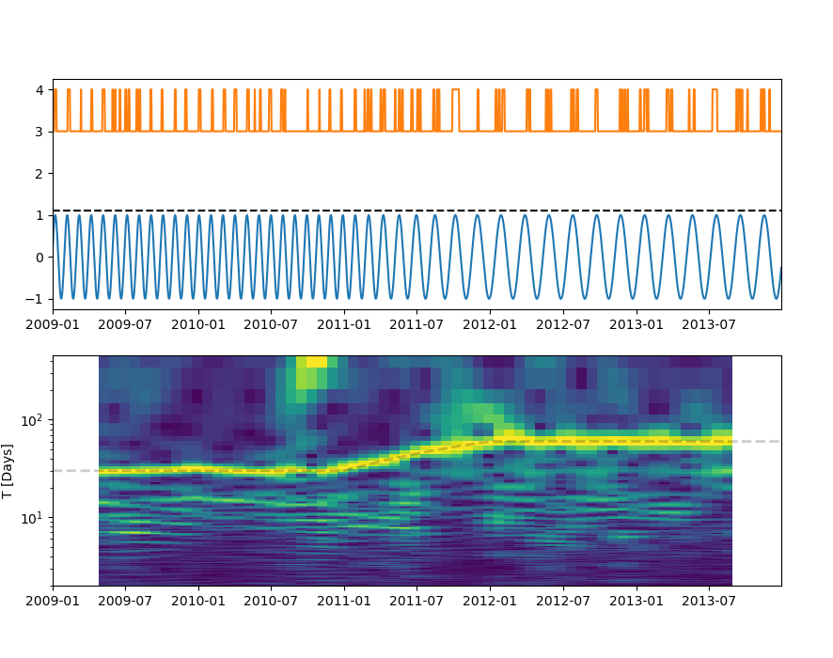
Next Steps
Evaluate for which users periodicity based prediction is possible
Define/choose metric for prediction evaluation
      accuracy, recall, precision, ...
Investigate statistic for “non-periodic” events
Spectrogram
Implement Frequency Adaptation:
Allow Period changes:
Update frequency with incoming data in order to account for periodicity changes
Windowed Fourier Analysis
Kalman Filter

Slide 21
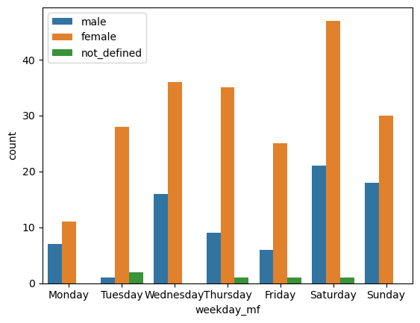
Most frequent day of week for T=7.0 users

Slide 22
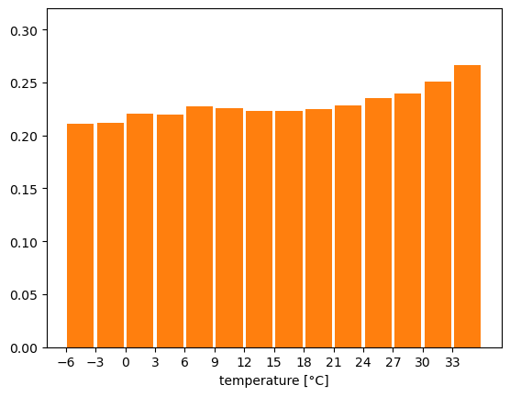
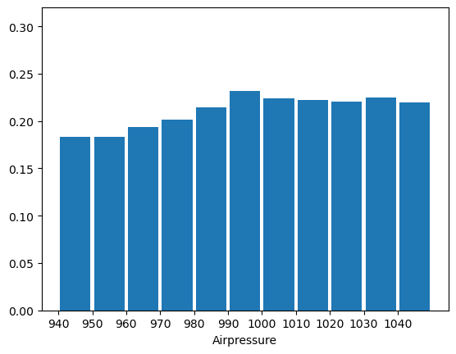
Dependency on Weather Data
Normalized Distributions: Fraction of data with headachday = 1
Temperature
Airpressure

Slide 23
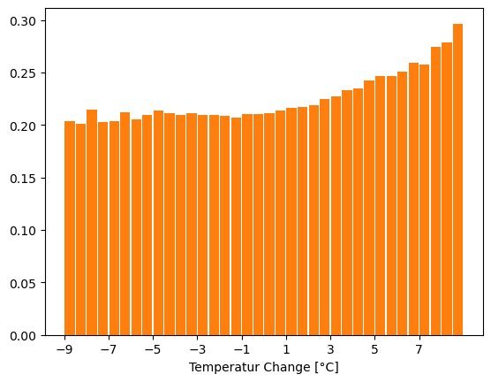
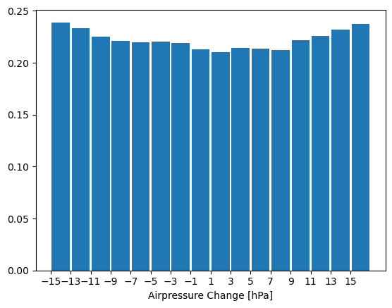
Dependency on Weather Data
Normalized Distributions: Fraction of data with headachday = 1
Temperature Change
Airpressure Change

Slide 25

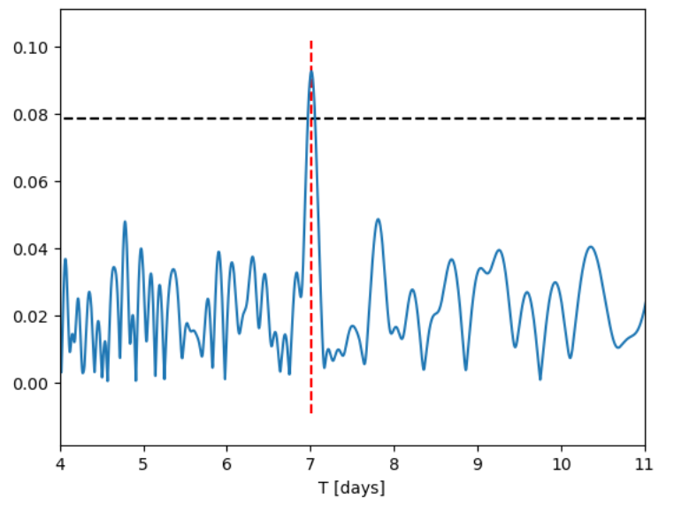
Migraine Data Analysis
Introduction Challenges Processing Results
II. Working with “Big Data”
Access the data:
Database shape complicated
advanced SQL-Queries are needed to retrieve headache time series data
Solution:
python Class NslUser.py
    comfortable access data
    using
    apply operations
3/5
3/5

