Slide 1
Analyse data

Slide 2
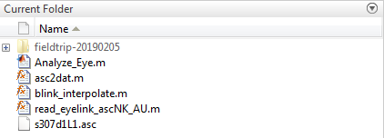
Code source
To analyze the data we use a script that is modified from a script that was written by Anne Urai (2016)
Urai, A.E., Braun, A. & Donner, T.H. Pupil-linked arousal is driven by decision uncertainty and alters serial choice bias. Nature Communications 8,14637 (2017). DOI: 10.1038/ncomms14637
https://github.com/anne-urai/pupil_preprocessing_tutorial
It relies on the fieldtrip toolbox, please download it and save it in your working directory
http://www.fieldtriptoolbox.org/download
Robert Oostenveld, Pascal Fries, Eric Maris, and Jan-Mathijs Schoffelen. FieldTrip: Open Source Software for Advanced Analysis of MEG, EEG, and Invasive Electrophysiological Data. Computational Intelligence and Neuroscience, vol. 2011, Article ID 156869, 9 pages, 2011. doi:10.1155/2011/156869.
All the code is open access
But please cite these people if you use the code !
This is how your working directory should look like to test the code

Slide 3
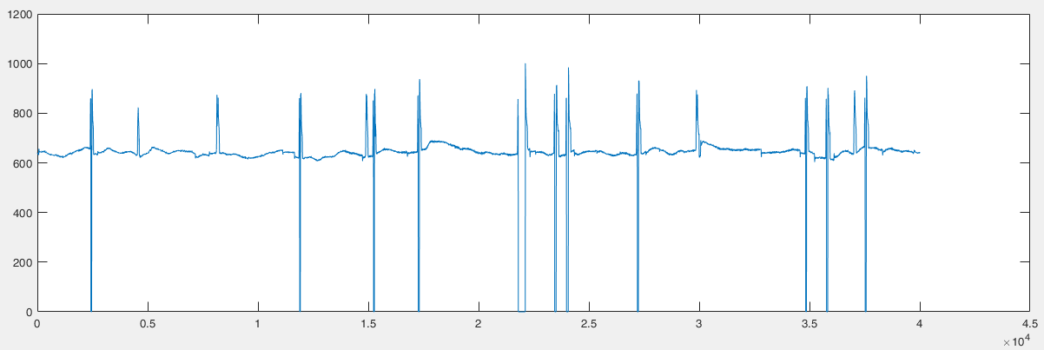
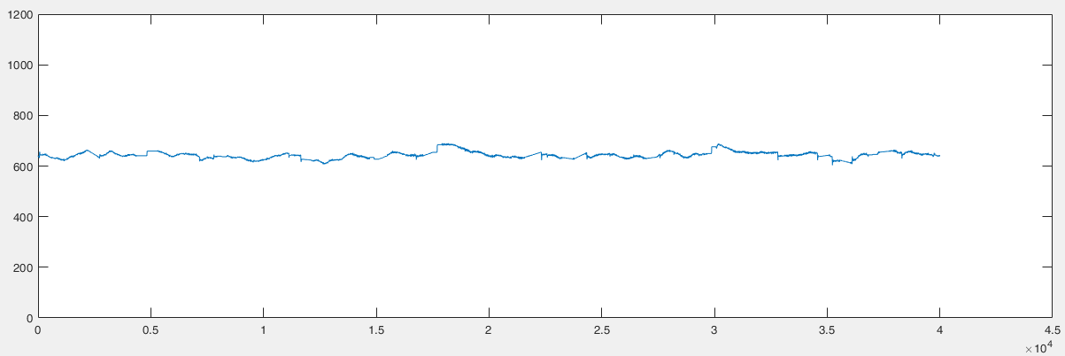
Run script – Analyze_Eye.m
Make the folder analyse_eye your working directory in MatLab (see figure on previous page)
Important: do not add all subfolders, especially do not add the complete fieldtrip folder to the working directory; the code takes care about adding what is needed
The file that you want to analyse needs to be in your working directory too, or you have to chance the referencing
Simply run the script
The script creates several structures
asc = raw data file (Fig 1.)
dat = blink interpolated data file (Fig 2.)
event = contains the events that you messaged to the eye link recording during your experiment (see presentation Integrate Matlab and Eyelink)
These structures can be used to analyze the eye traces with the research question of interest
( Example: The folder “analyse_eye” contains an example file ‘e307d1L1.asc’; just doubleclick Analyze_Eye.m in that folder and run the script, it will process the example file; can take a few minutes to be done depending on your machine )
Fig. 1: X coordinate of the raw eye trace plotted over time, sample from structure ‘asc’ ( asc.dat(2,:) ); from example file ‘s307d1T1.asc’
Fig. 2: Same x coordinate (but blink interpolated) of the eye trace plotted over time, sample from structure ‘dat’ ( dat.gazex(:) )

