Slide 1
Intelligent Learning of Nature (iLoN) Research Lab
iLoN Lab member’s name
Advisor: Lan-Da Van (范倫達), Ph. D.
Department of Computer Science
National Chiao Tung University
Taiwan, R.O.C.
Sep. 14, 2019

Slide 2
Introduction
Survival analysis
Need strict assumptions (Independence)
Distributional parameters are fitted
RNN
Model sequential data (complex dependence)
Non-linear association
Point estimate
MAT-RNN
Probabilistic approach + sequence-to-sequence approach
Distributional estimate

Slide 3
Beware of Weibull euphoria
The Weibull distribution has a:
Continuous and discrete variant
Expressive. Can take many shapes by adjusting its two parameters.
Closed form PDF, CDF, PMF, expected value, Median, Mode, Quantile function (inverse CDF)
Used everywhere for predicting things that will brake since it magically appears in nature just like the normal distribution
Weakest link property : If a system breaks with the failure of any of its independent identical components then the time to failure is approximately Weibull distributed.
Built in regularization mechanisms. By controlling the size of ββ we control the peakedness hence the confidence of predicted location.

Slide 4
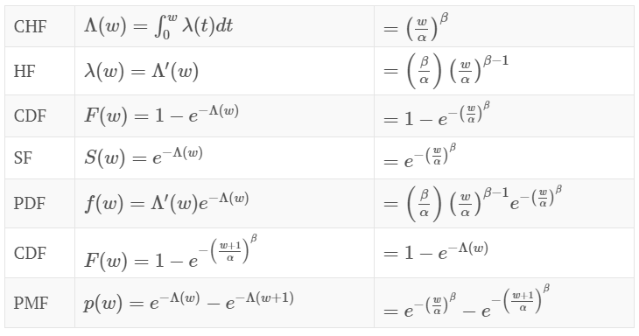
Weibull distribution

Slide 5



HF & CDF
HF: Calculating the failure rate for ever smaller intervals of time
CHF: HF must not decrease too quickly, since, by definition, the cumulative hazard has to diverge.

Slide 6


CDF & PDF
CDF: the cumulative distribution function (CDF) of a real-valued random variable X
PDF: probability density function is a function whose value at any given sample in the sample space can be interpreted as providing a relative likelihood that the value of the random variable would equal that sample.
S(t)

Slide 7
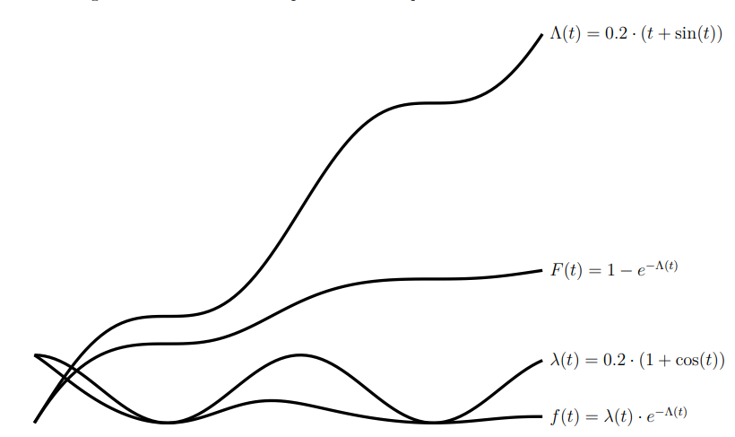
Example for 4 function

Slide 8
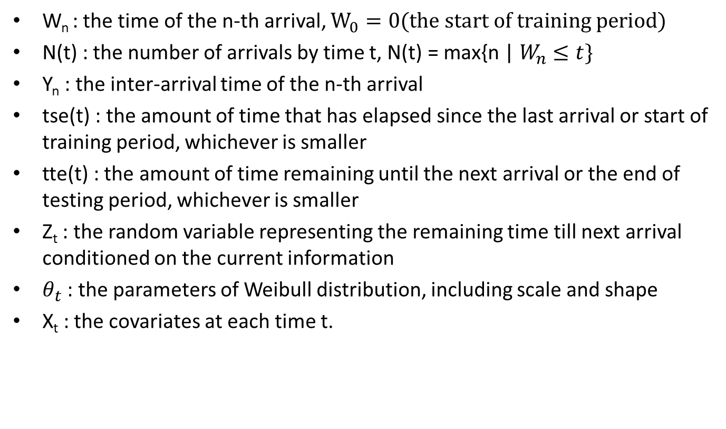
Parameters
W_{n} : the time of the n-th arrival, $W_{0}=0(the start of training period)$
N(t) : the number of arrivals by time t, $\text{N}\text{(}\text{t}\text{) = }\text{max}\text{\{}\text{n}\text{ | }W_{n}≤t\}$
Y_{n} : the inter-arrival time of the n-th arrival
tse(t) : the amount of time that has elapsed since the last arrival or start of training period, whichever is smaller
tte(t) : the amount of time remaining until the next arrival or the end of testing period, whichever is smaller
Z_{t} : the random variable representing the remaining time till next arrival conditioned on the current information
$θ_{t}$ : the parameters of Weibull distribution, including scale and shape
X_{t} : the covariates at each time t.

Slide 9
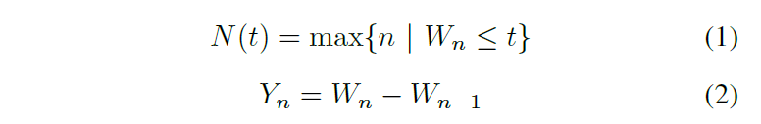
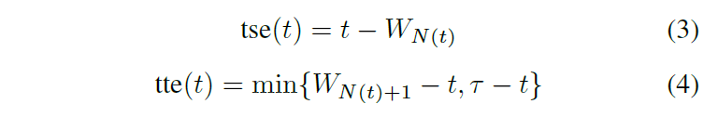
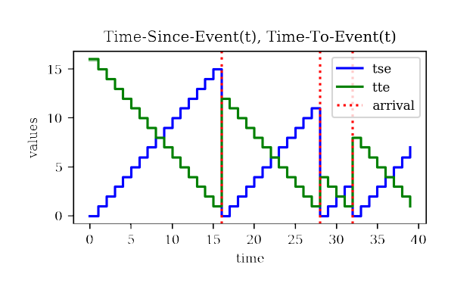
Implementation

Slide 10

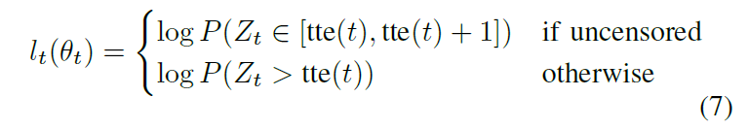
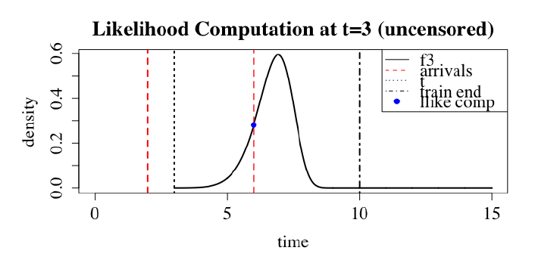
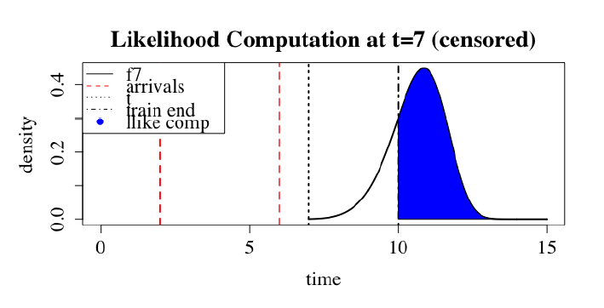

Implementation

Slide 11
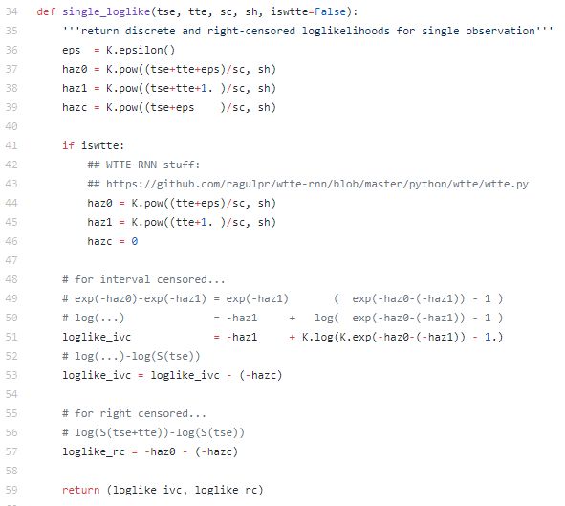
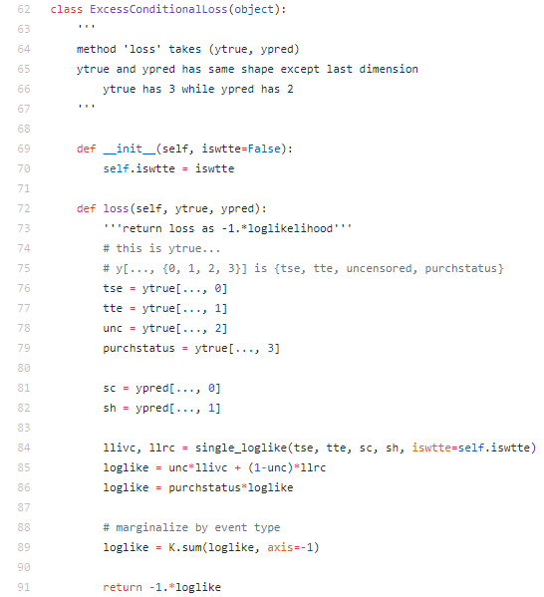
Loss Function

Slide 12
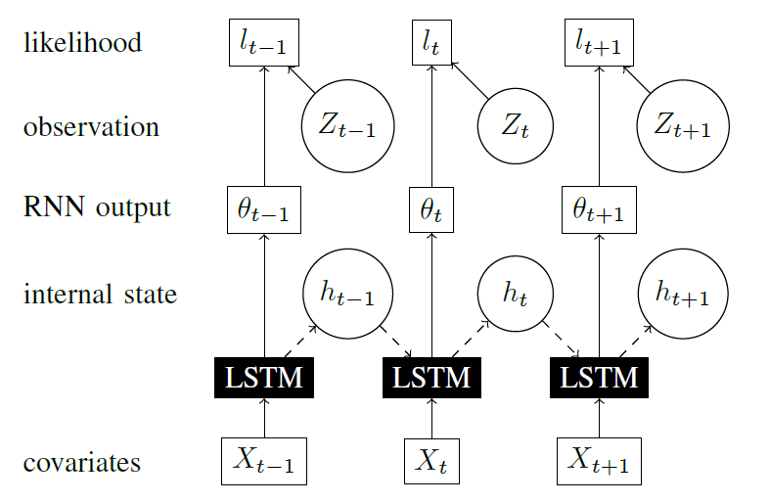
An RNN with distributional outputs
Outputs (θ_{t}) are generated by an LSTM. Log-likelihoods at each time are computed as log of densities parametrized by t, evaluated at Z_{t} .
h_{t} : hidden state
x_{t} : input (covariates)
θ_{t} : outputs
l_{t} : log-likelihood

Slide 13
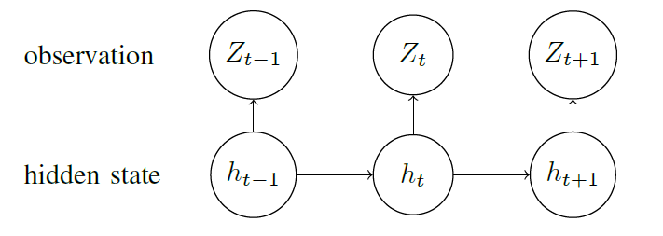
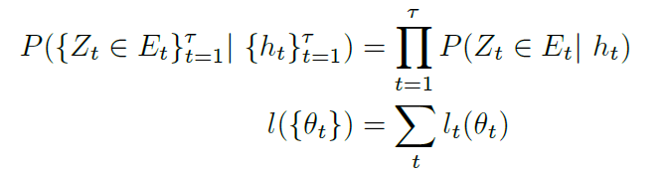

Computing Overall Loss through Conditional Independence
Compute the sum of log-likelihood and distribution function for the entire time. Then, maps X_{t} to (θ_{t}, h_{t}).

Slide 14


Extension to Multi-Variate Waiting Times
To model multivariate arrivals, there several different arrival processes of interest, then, we can get the distribution function for each process.
We merely require that the emissions are conditionally independent given ht. This then allows us to compute the log-likelihood at each time as a sum.

Slide 15
Masking of Non-Inter-Arrival-Times
Masking of Non-Inter-Arrival-Times:
ensures that RNN parameters are not updated due to losses incurred during these times.
Predicting Time to Next Arrival:
we are concerned with the next arrival time after the end of training period (time τ), we can compute many different values of interest.

Slide 16
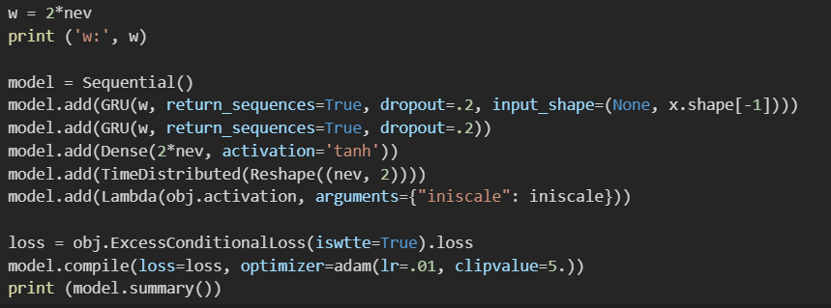
Recurrent Neural Net Structure
Model tuning method:
Non-zero initial state
Dropout

Slide 17
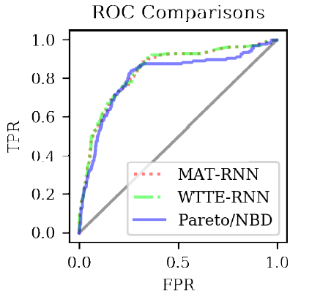
EXPERIMENTAL RESULTS
Comparison on CDNOW dataset (Binary Classification)
Predict if purchases are made during a testing period

Slide 18
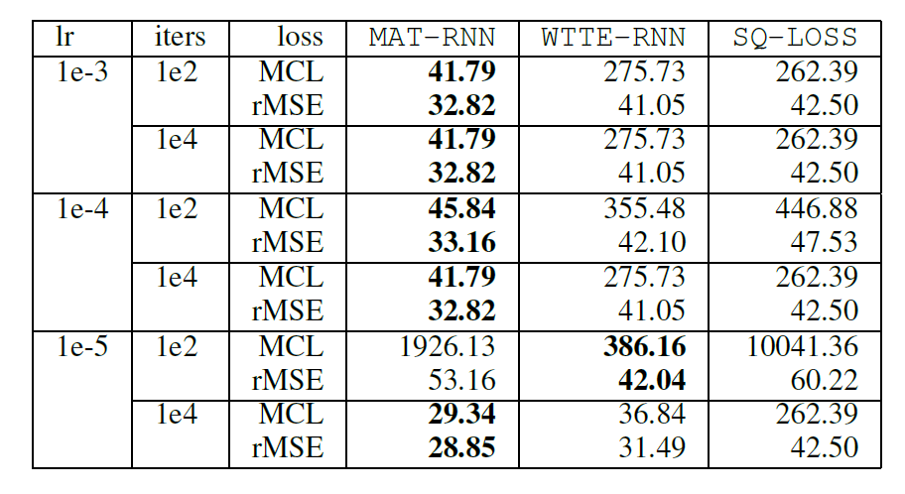
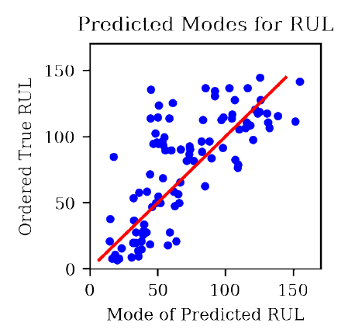
EXPERIMENTAL RESULTS
Comparison on CMPASS dataset (Point estimate)
Predict the remaining useful lifetime, or the time to failure

Slide 19
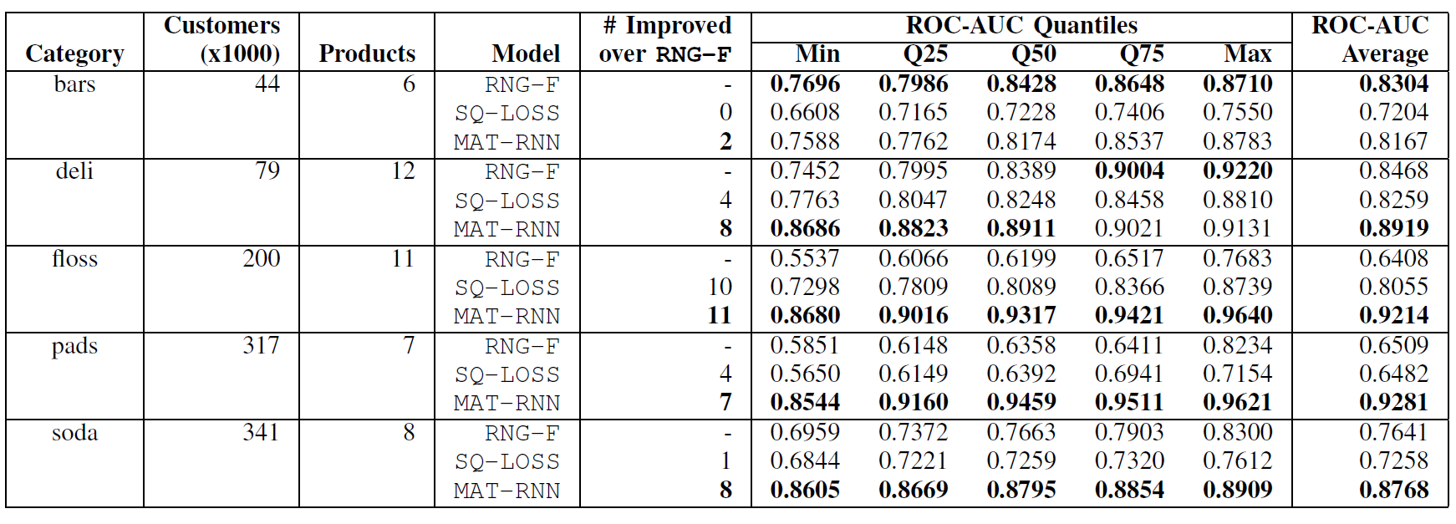
EXPERIMENTAL RESULTS
Demand Forecasts for a Large Retailer
Predict whether an event will arrive within τ time after the end of the training period.

