Slide 1
Pandas

Slide 2
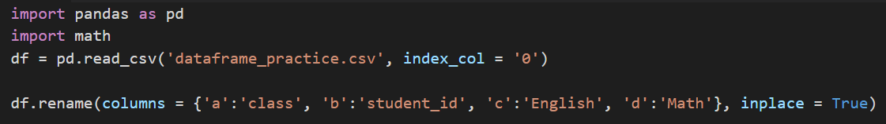
Step1: set column name from ('a', 'b', 'c', 'd') to ('class', 'student_id', 'English', 'Math')

Slide 3
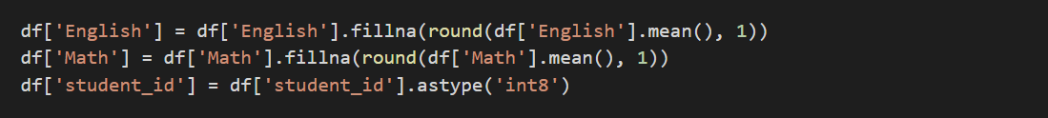
Step2: Set missing values to mean score of English or Math respectively. Round to the first decimal place. Set student_id to int8

Slide 4
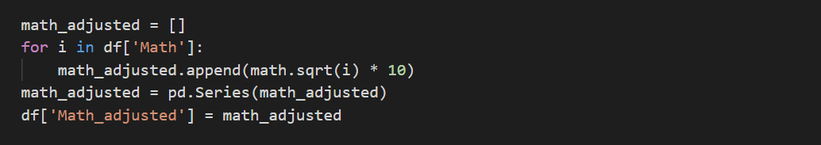
Step3: create column [Math_adjusted]: sqrt(Math) * 10

Slide 5
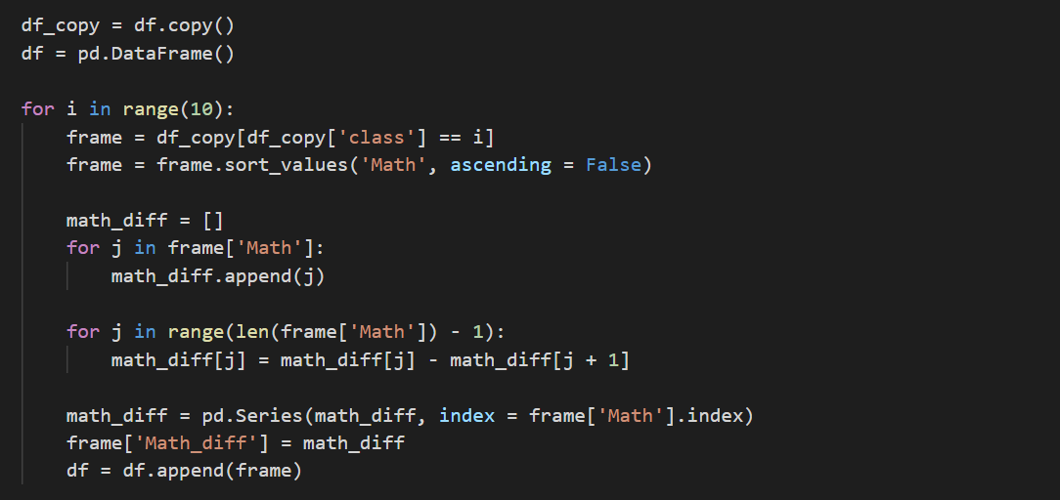
Step4: create column [Math_diff]: Order Math score in descending. And get diff of (nth - n+1th).

Slide 6
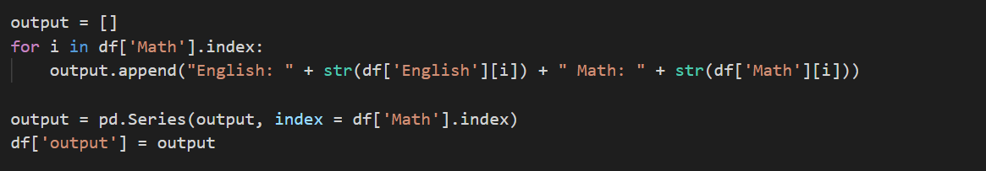
Step5: create column [output]: Use string concatenate to produce "English: 100, Math: 100" for each student.

Slide 7
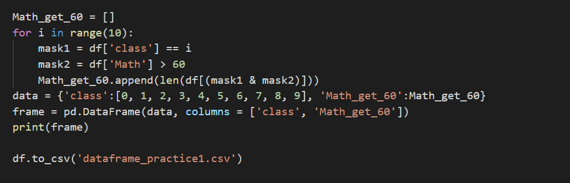
Step6: create dataframe [class, Math_get_60]: Count Math score > 60 in each class

Slide 8
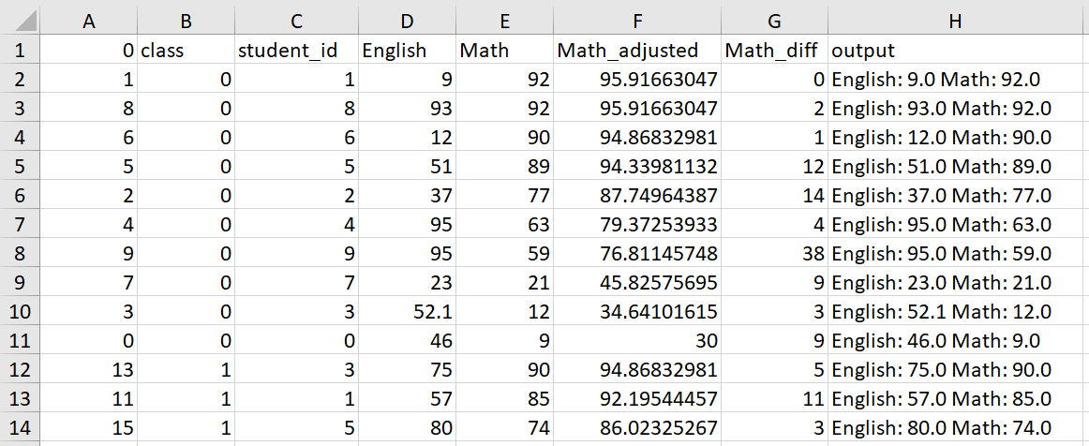
Result

Slide 9
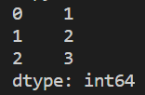


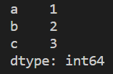
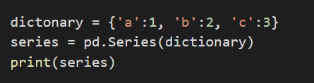
Series

Slide 10
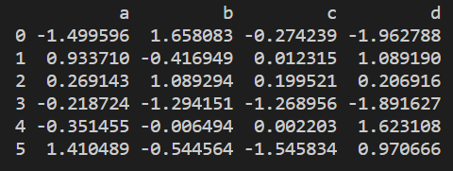
Dataframe

Slide 11
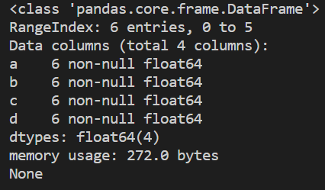

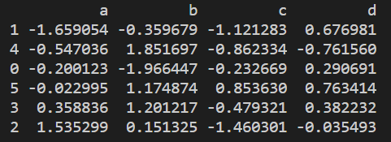
Dataframe
df.info():
df.columns:
df.sort_values():

Slide 12
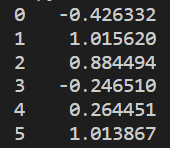

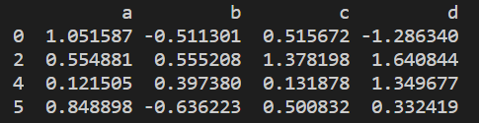

df[]

Slide 13




df.loc & df.iloc

Slide 14
read_csv
Path or buf
Index_col:
Column to use as the row labels of the DataFrame. If a sequence is given, a MultiIndex is used.

Slide 15

to_csv
Path or buf
Index:
Write row names (index)

