Slide 1
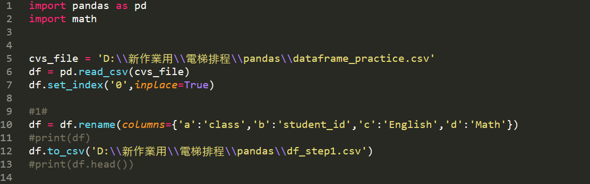

Slide 2
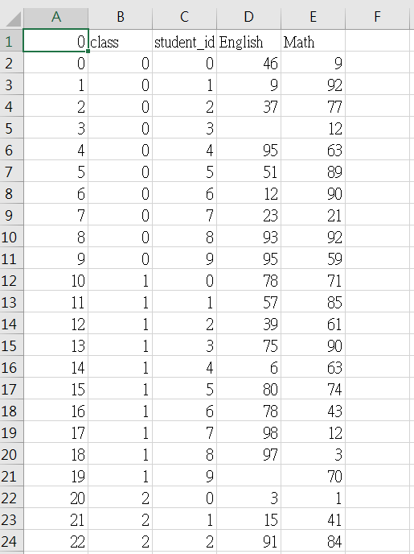

Slide 3
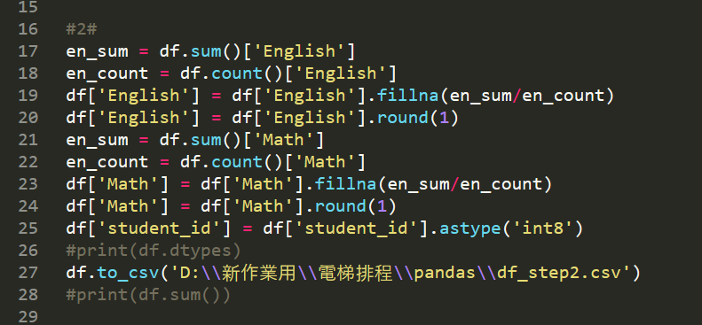

Slide 4
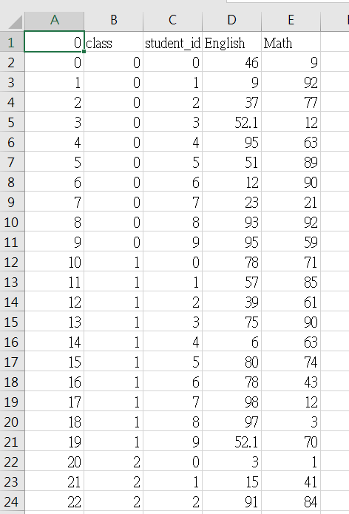

Slide 5
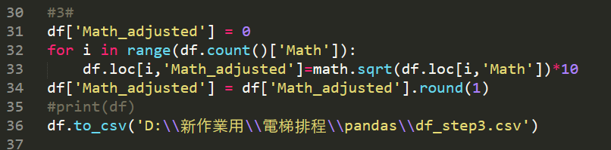

Slide 6
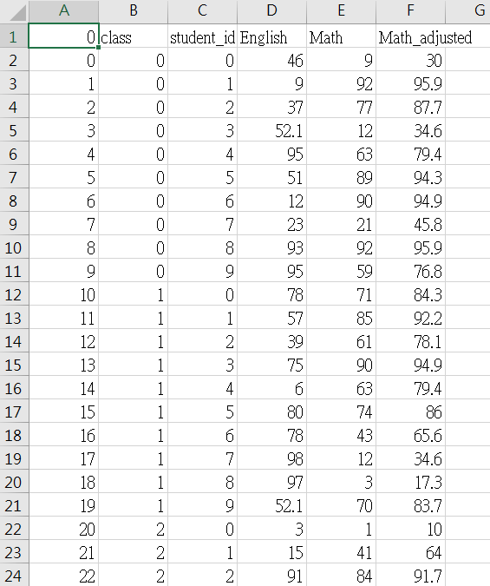

Slide 7
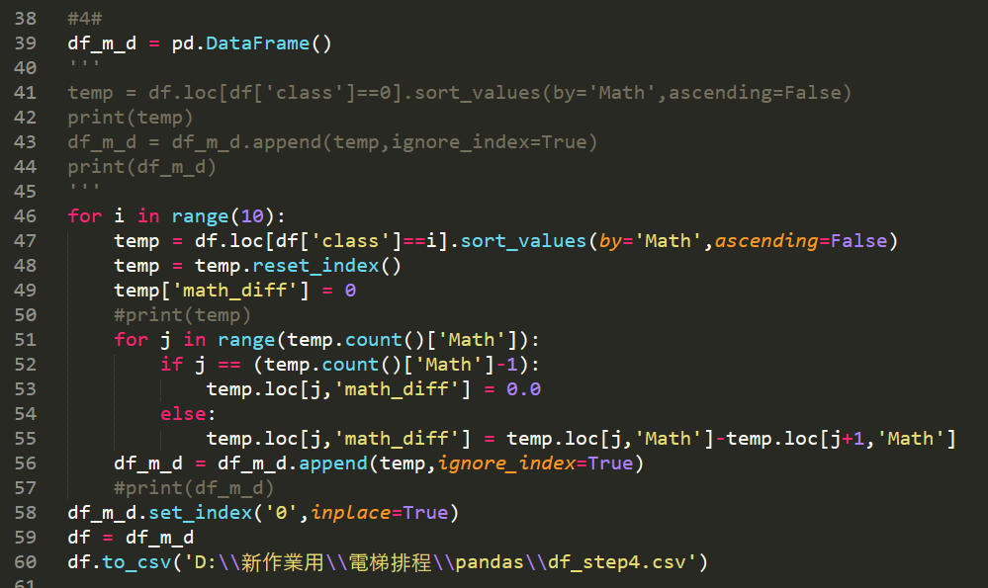

Slide 8
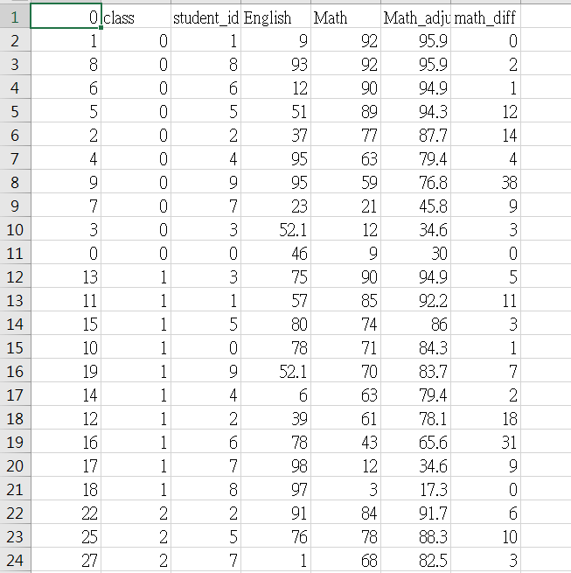

Slide 9
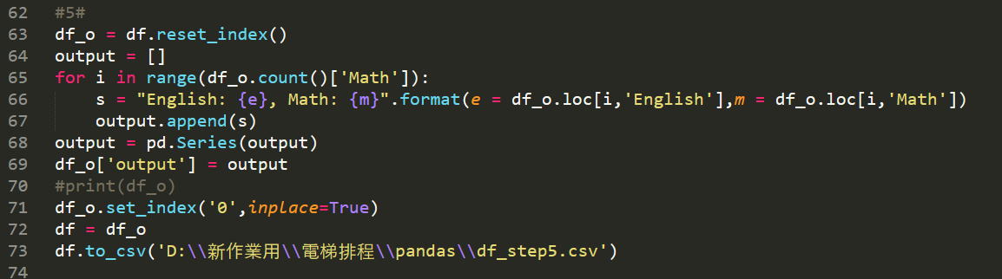

Slide 10
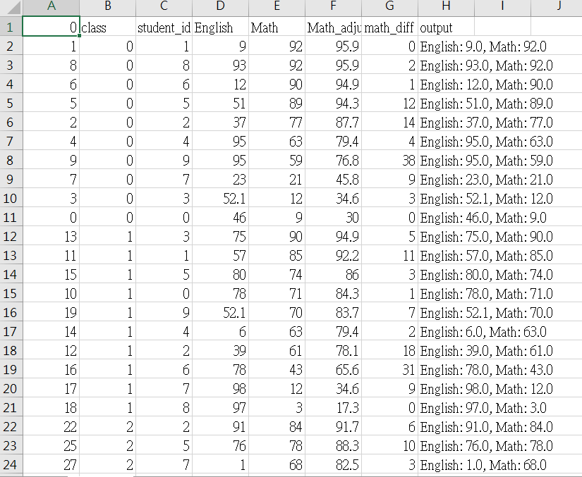

Slide 11
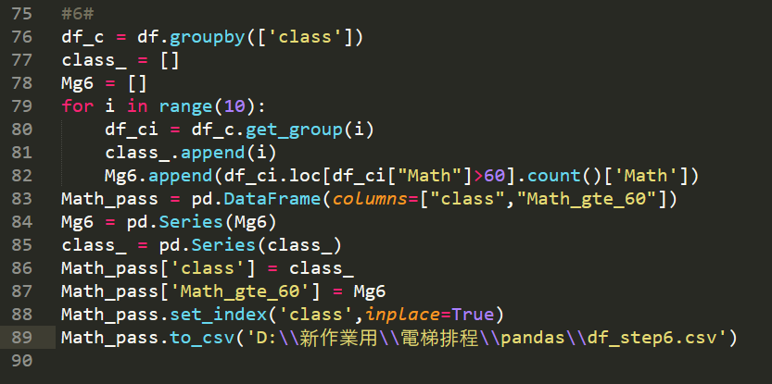
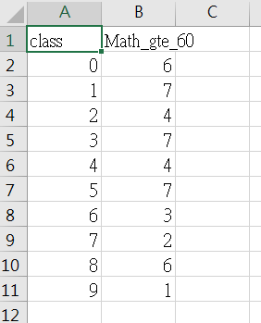

Slide 12
groupby
DataFrame.groupby(by=None, axis=0, level=None, as_index=True, sort=True,
group_keys=True, squeeze=False, observed=False, **kwargs)
A groupby operation involves some combination of splitting the object, applying a function, and combining the results.
Type:pandas.core.groupby.DataFrameGroupBy
by : mapping, function, label, or list of labels
axis : {0 or ‘index’, 1 or ‘columns’}, default 0
level : int, level name, or sequence of such, default None
sort : bool, default True
group_keys : bool, default True

Slide 13
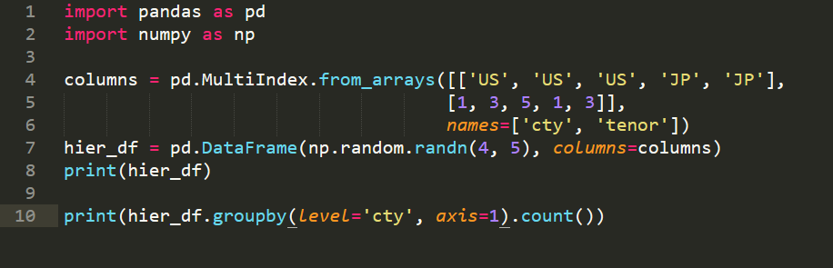
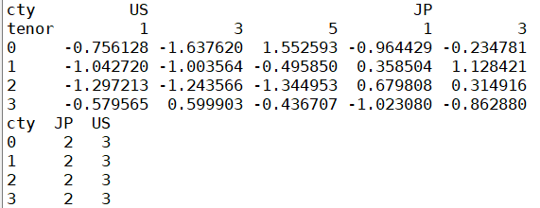
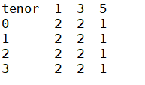
groupby(level=?)

Slide 14
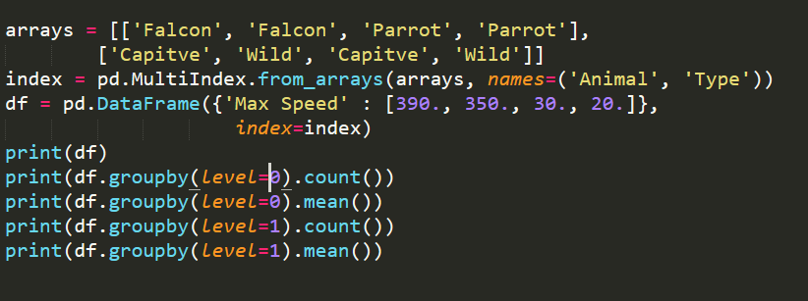
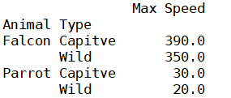





Slide 15
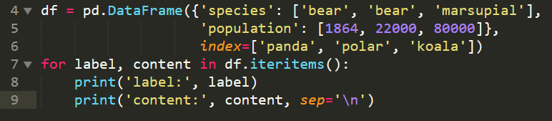

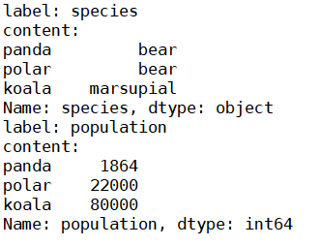
iterrows、itertuples、iteritems

Slide 16

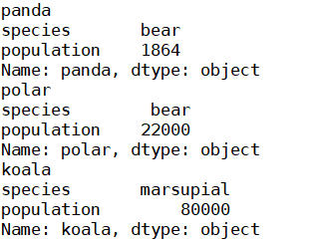



Slide 17
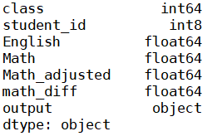
dtypes
1. float 2. int 3. bool 4. datetime64[ns] 5. datetime64[ns, tz] 6. timedelta[ns] 7. category 8. object

