Slide 2
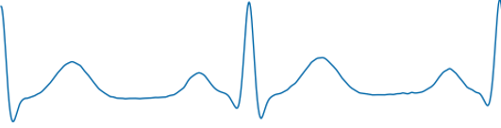
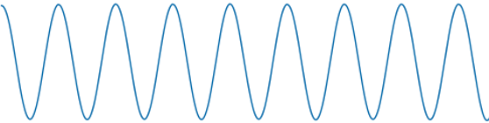
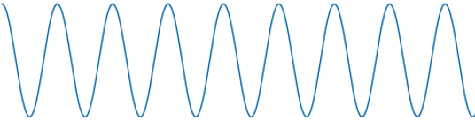
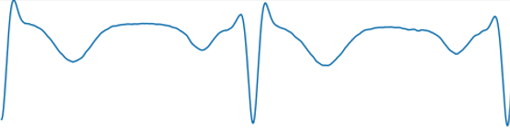



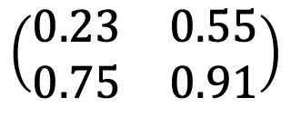

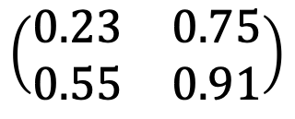




Experiment Design Goal
Goals of this project:
Evaluate ICA -Algorithms in terms of robustness
Elaborating new approaches to increase robustness against noise and outliers in EEG-measurements
How can we evaluate the ICA-Algorithms?
The ICA-Algorithms return the reconstructed Signal $\hat{X }$and an estimated Mixing Matrix $\hat{A}$
2 options: compare Input and Reconstructed Signals or Compare Mixing Matrix A with its estimate $\hat{A}$
$$vs.$$
$$\left(\begin{matrix}0.23 & 0.75 \\ 0.55 & 0.91\end{matrix}\right)$$
$$vs.$$
$$\left(\begin{matrix}0.23 & 0.55 \\ 0.75 & 0.91\end{matrix}\right)$$
$$X$$
$$\hat{X }$$
$$A$$
$\hat{A}$
Problems:
The solution of ICA is not unique: $\hat{A}$ and $\hat{X }$ can pertubed, scaled or have sign changes
Find Metrics which deal with that

Slide 3
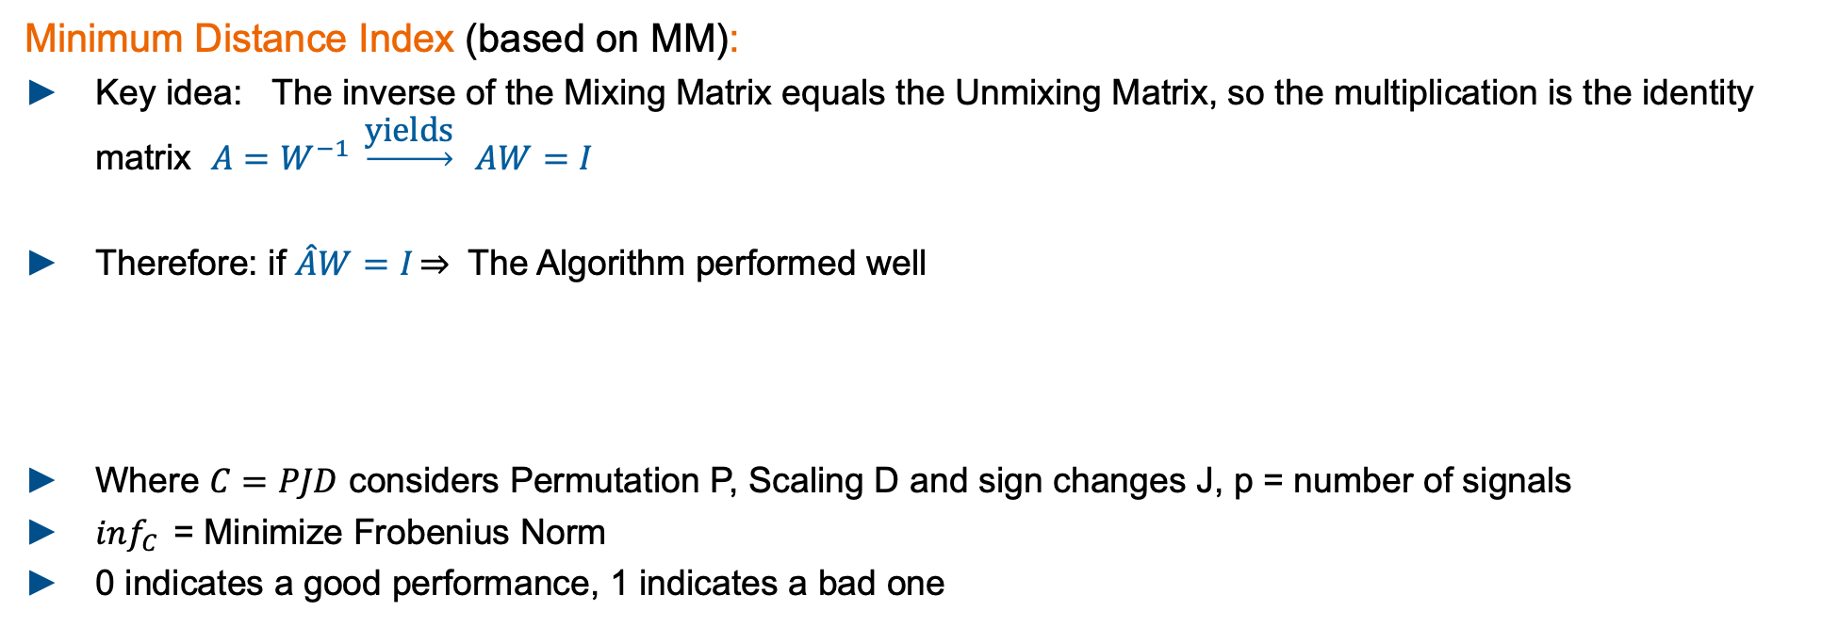
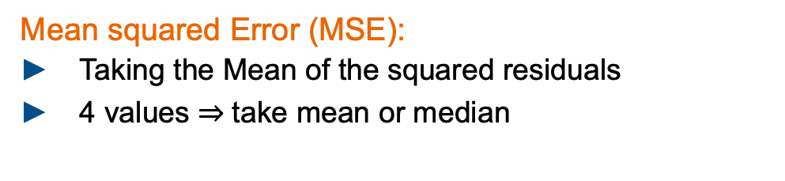
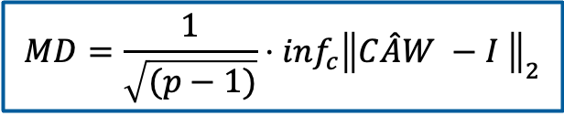
Experiment Design Metrics: MD, MSE
Minimum Distance Index (based on MM):
Key idea: The inverse of the Mixing Matrix equals the Unmixing Matrix, so the multiplication is the identity matrix $A=W^{−1} \underset{→}{\text{yields}} AW=I$
Therefore: if $\hat{A}W=I\overset{⇒}{}$ The Algorithm performed well
Where $C=PJD$ considers Permutation P, Scaling D and sign changes J, p = number of signals
$inf_{C}{ }$= Minimize Frobenius Norm
0 indicates a good performance, 1 indicates a bad one
$$MD=\frac{1}{\sqrt{(p−1)}}⋅inf_{c}{{\left\|C\hat{A}W −I \right\|}_{2}}$$
Mean squared Error (MSE):
Taking the Mean of the squared residuals
4 values take mean or median
Problem:
Required groundtruth data for X and A
residuals

Slide 4
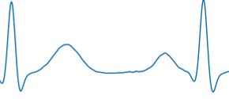
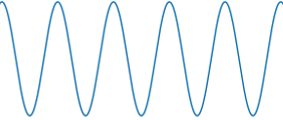
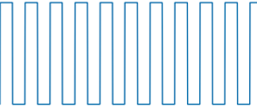
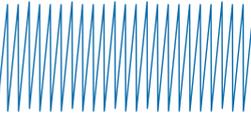
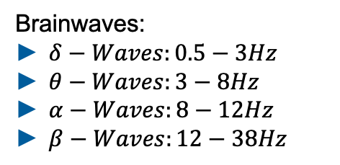
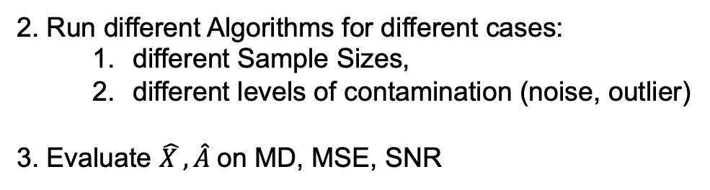
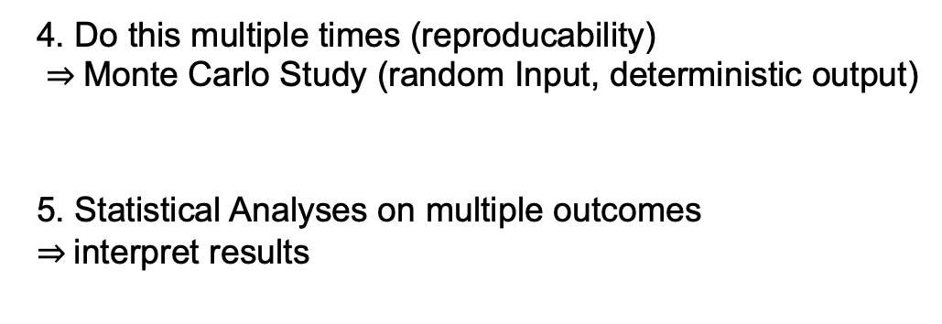
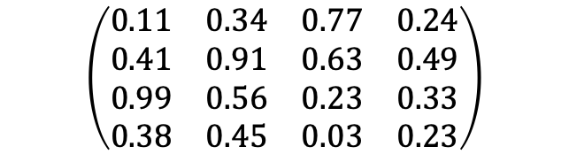
Experiment Design General approach
What do we have to do:
Generate ideal Input Signals $X∈ ℝ^{4x10000}$ and a random ideal Mixing Matrix. $A ∈ ℝ^{4x4}$ groundtruth
Standard Signals:
ECG Signal: 2Hz
Sinus: 5Hz
Rectangle: 10Hz
Sawtooth: 25Hz
fs: 1000Hz
Normalized to [-1,1]
$$\left(\begin{matrix}0.11 & 0.34 & 0.77 & 0.24 \\ 0.41 & 0.91 & 0.63 & 0.49 \\ 0.99 & 0.56 & 0.23 & 0.33 \\ 0.38 & 0.45 & 0.03 & 0.23\end{matrix}\right)$$
Brainwaves:
$δ−Waves:0.5−3Hz$
$θ−Waves:3−8Hz$
$α−Waves:8−12Hz$
$β−Waves:12−38Hz$
2. Run different Algorithms for different cases:
different Sample Sizes,
different levels of contamination (noise, outlier)
3. Evaluate $\hat{X },\hat{A}$on MD, MSE, SNR
4. Do this multiple times (reproducability)
Monte Carlo Study (random Input, deterministic output)
5. Statistical Analyses on multiple outcomes
interpret results

Slide 5

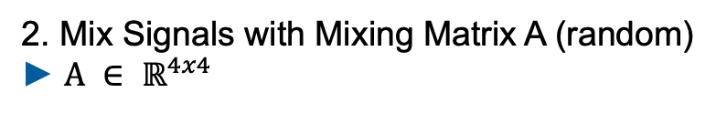

Experiment Design Monte Carlo Flow Chart
Input Signals
Standard Input Signals
ECG, Sinus, Rectangle, Sawtooth
Runs = 1000
2. Mix Signals with Mixing Matrix A (random)
$A ∈ ℝ^{4x4}$
Mix Signals
Contaminate Signals
3. Contaminate Signals
Add single or patchy Outlier (1000std) and/or white noise (3std)
Whitening
4. Whitening Process
Decorrelate Signals: meaning that the covariance matrix is diagonal and that all the diagonal elements are equal.
ICA
5. Perform ICA
4 Algos: JADE, RADICAL, CoroICA, PowerICA
$$\hat{X}$$
$$Â$$
Evaluate on Metrics
6. Evaluate Single Run
Minimum Distance, MSE
7. Evaluate ICA
Get 1000 MDs and MSEs.
Empirical Data Analyses
BoxPlot

Slide 6
Experiment Design Expirement Types
1.) Focus on Sample Size
Initialize standard signals with different Sample Sizes: 1000, 2500, 5000, 10000, 15000
Type I: No Noise, No Outlier, 1000 runs
Type II: 40dB SNR, No Outlier, 1000 runs
Type III: No Noise, 0.1% Outlier with std = 100, 1000 runs
Type IV: 40dB SNR, 0.1% Outlier with std = 100, 1000 runs
2.) Focus on amount of noise/outlier
Initialize standard signals with fix Sample Size of 10000
Type V: increase noise SNR: 40 dB, 30 dB, 20 dB, 10 dB, 6 dB, 3 dB
Type VI: increase Outlier patchy %: 0.1, 0.25, 0.5, 1, 1.5, 5, 10, 20, 50 with 1000 STD
Type VII: increase Outlier impulsive %: 0.1, 0.25, 0.5, 1, 1.5, 5, 10, 20, 50 with 1000 STD
Type VIII: increase Outlier amount = 1, with 3, 10, 50, 100, 1000 STD

Slide 7
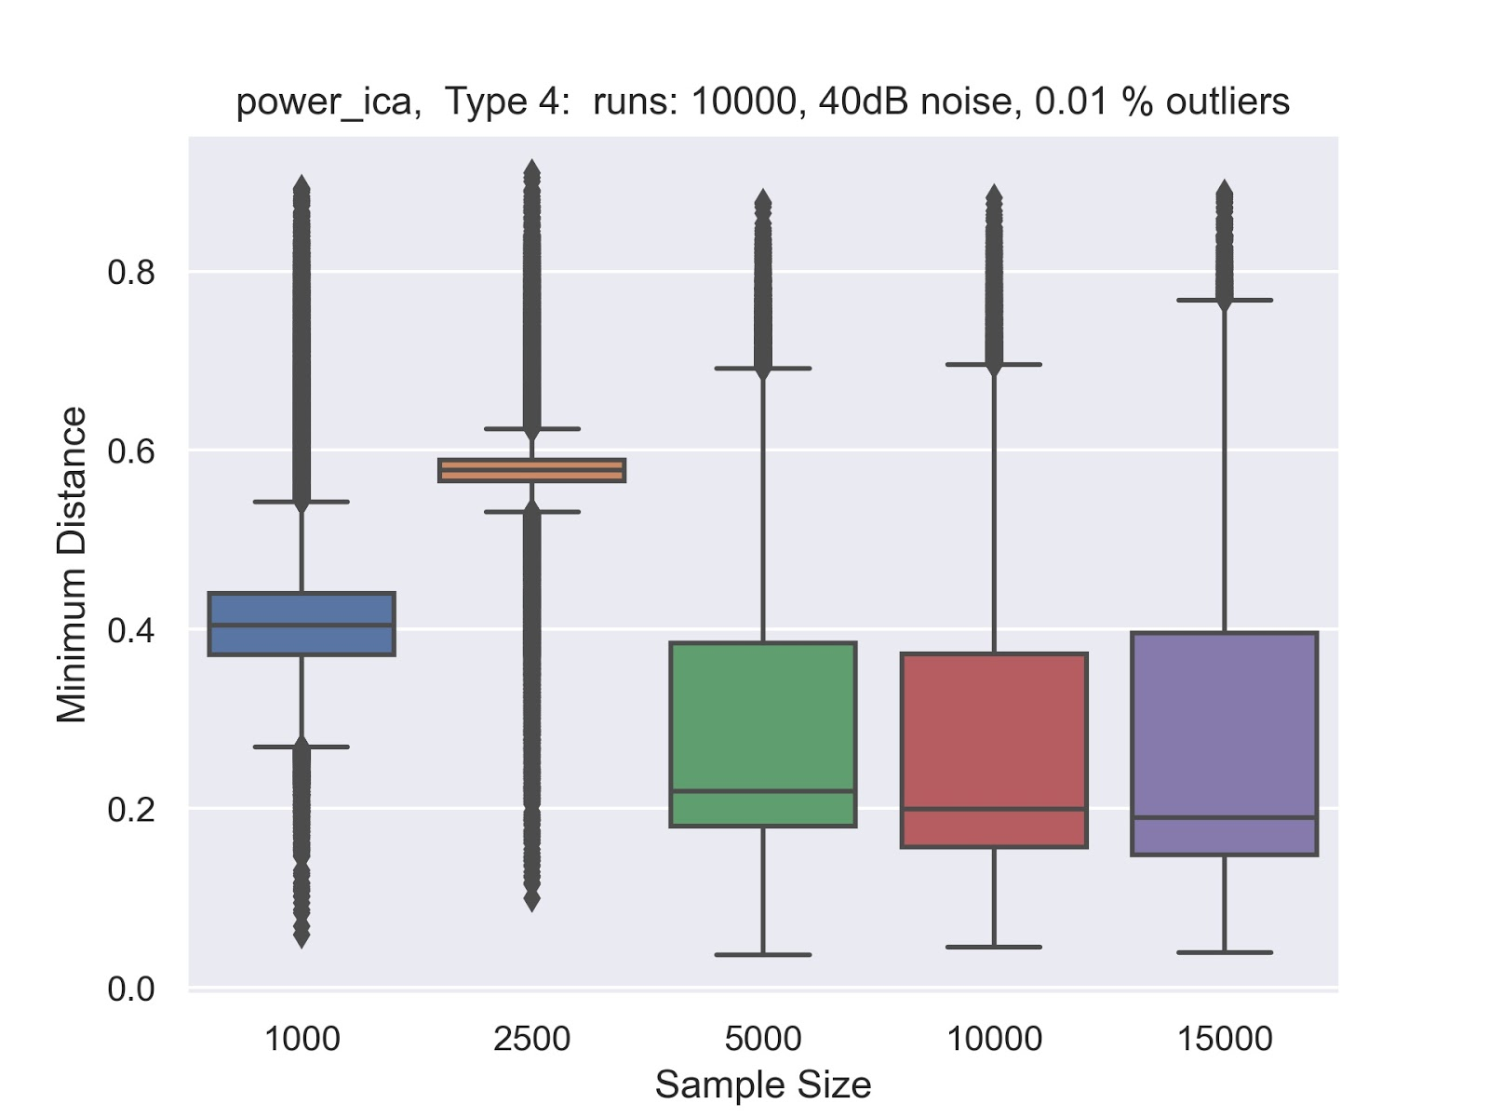
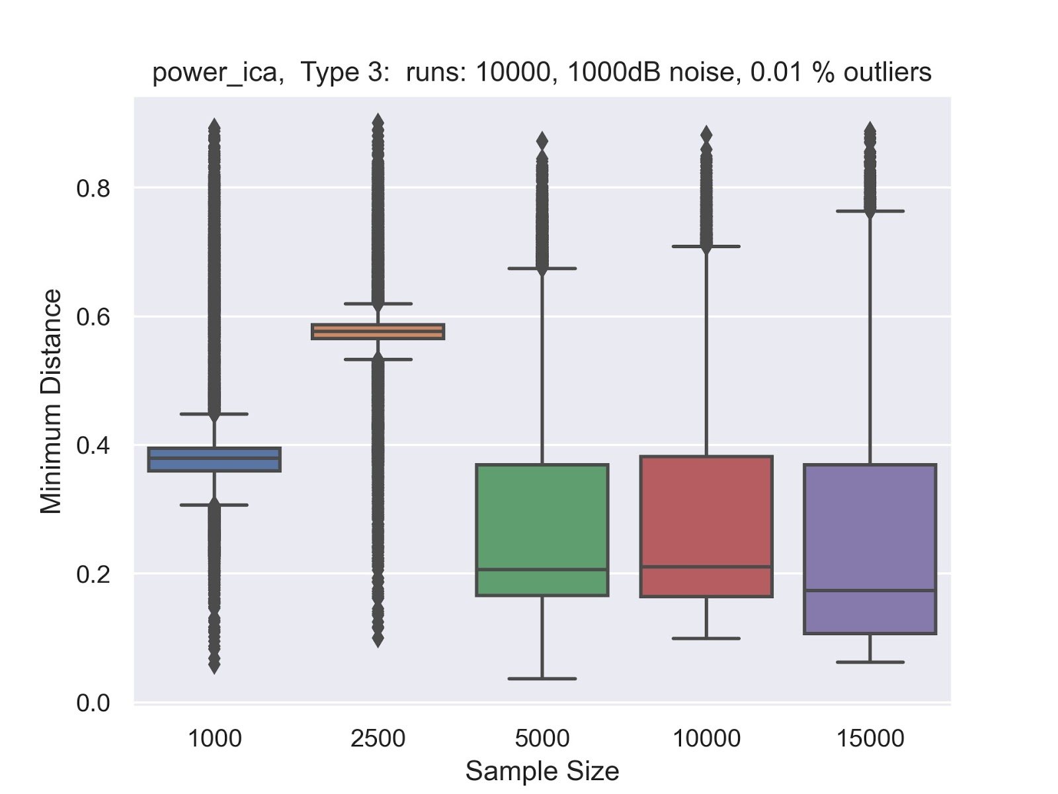
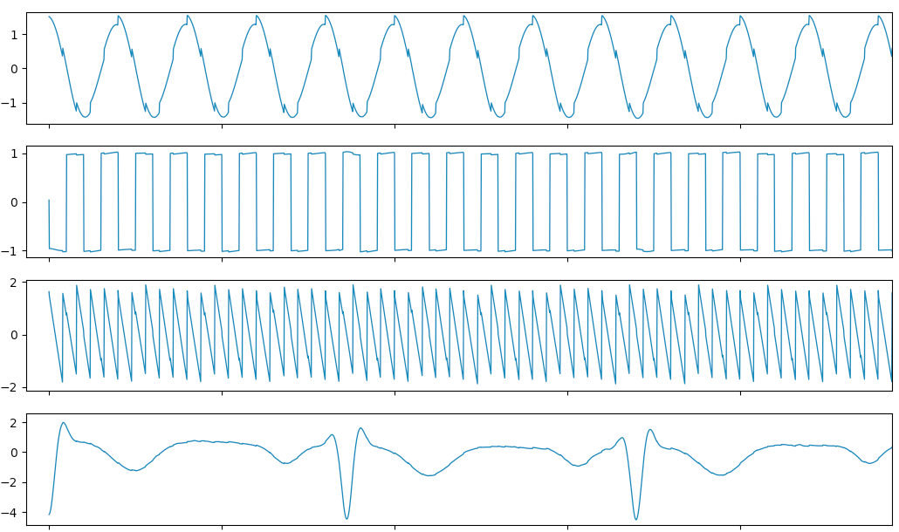
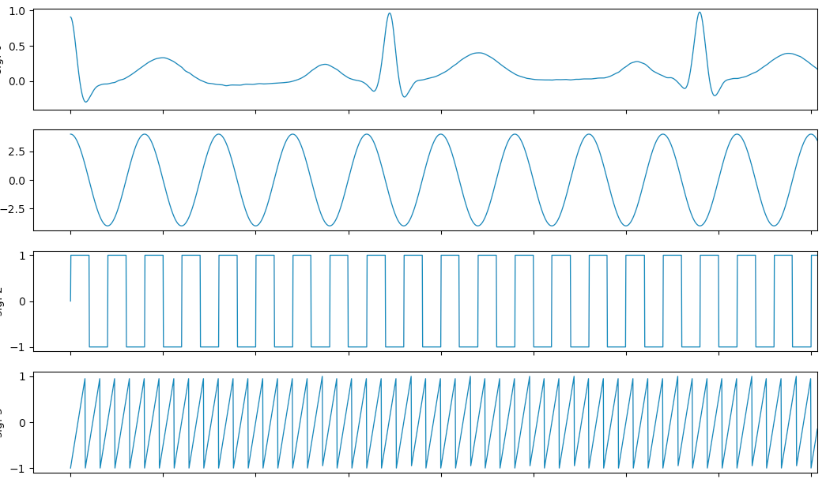
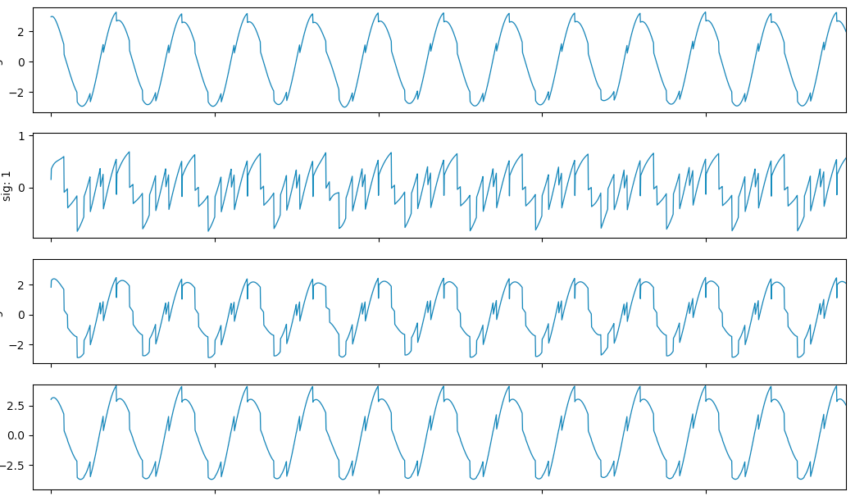
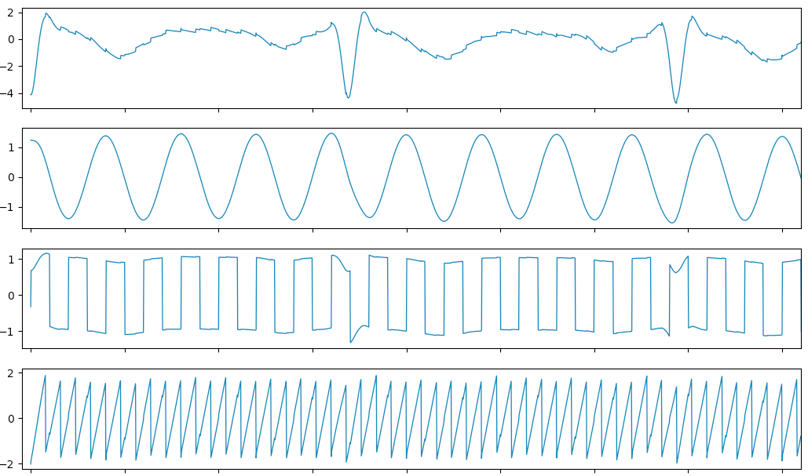
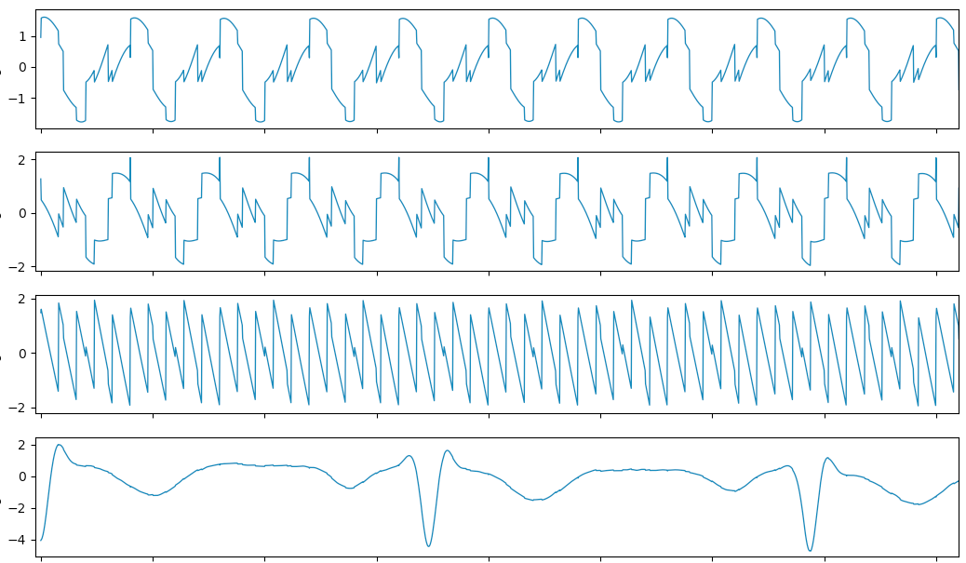
Results Type 1 - 4
MD = 0.2
MD = 0.4
MD = 0.6

Slide 8
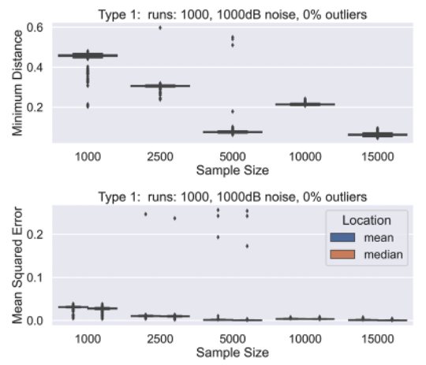
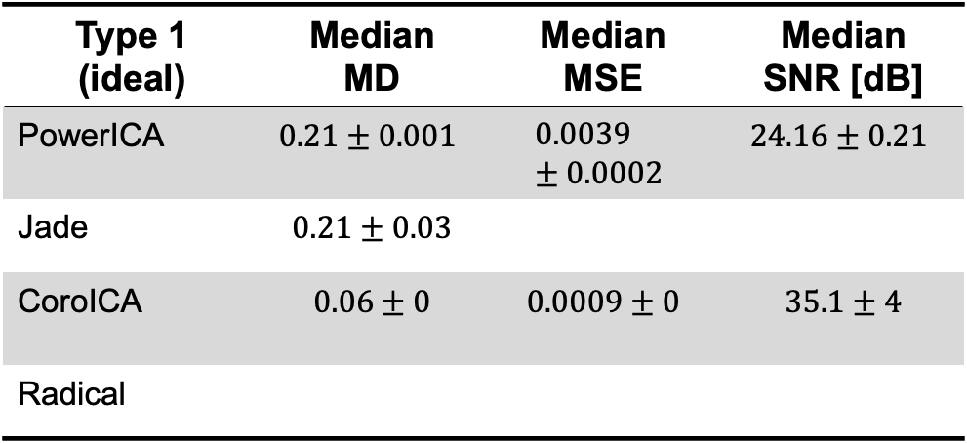
Results Type 1 - 4
Sample Size 10000
Type 1 (ideal) | Median MD | Median MSE | Median SNR [dB]
PowerICA | $$0.21±0.001$$ | $$0.0039±0.0002$$ | $$24.16±0.21$$
Jade | $$0.21±0.03$$
CoroICA | $$0.06±0$$ | $$0.0009±0$$ | $$35.1±4$$
Radical

Slide 9
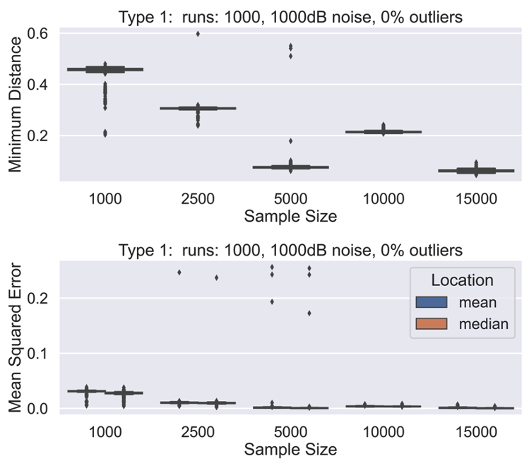
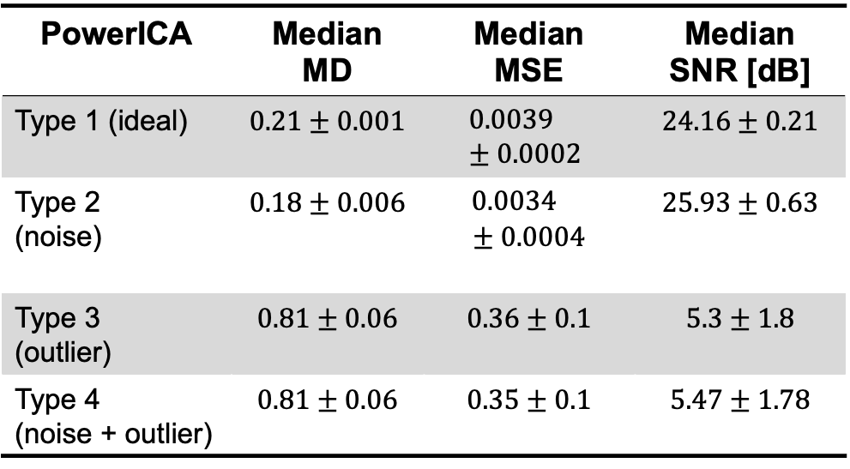
Results Type 1 - 4
Power ICA
PowerICA | Median MD | Median MSE | Median SNR [dB]
Type 1 (ideal) | $$0.21±0.001$$ | $$0.0039±0.0002$$ | $$24.16±0.21$$
Type 2 (noise) | $$0.18±0.006$$ | $0.0034$ $$± 0.0004$$ | $$25.93±0.63$$
Type 3 (outlier) | $$0.81±0.06$$ | $$0.36±0.1$$ | $$5.3±1.8$$
Type 4 (noise + outlier) | $$0.81±0.06$$ | $$0.35±0.1$$ | $$5.47±1.78$$
Next Step:
How much noise does it take to cause a breakdown ?
Sample Size of min. n = 5000 is neccessary
Even 0.1% Outlier causes failure for every algorithm
For 40dB SNR -> variance increses slightly, more outliers

Slide 10
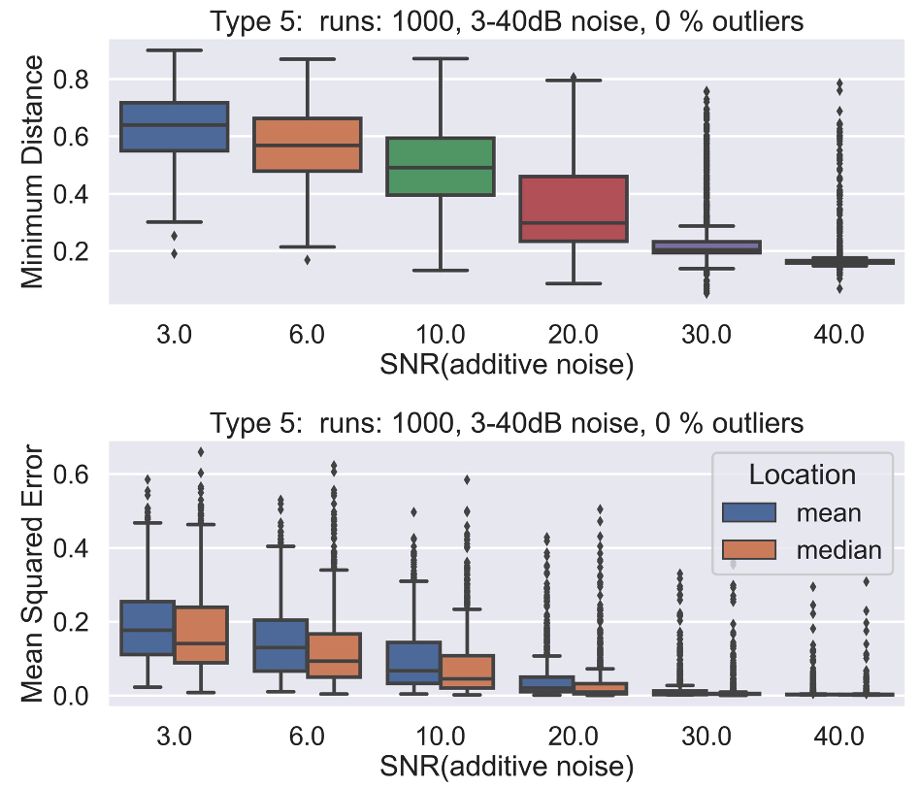

Results Type 5 - 7
Power ICA
Type 6-7:
Complete breakdown even for 1 outlier
Type 5:
Noise <20dB SNR breakdown
Did our Robustness Plugins improve the results ?
Robust Covariance Estimation in Whitening:
Causes breakdown
Robust objective Function in higher Order statistics:
JADE: Causes breakdown
Conclusion:
Preprocessing of the data essential! -> Outlier removal + Smoothing
We need new approaches to improve the performance

Slide 11
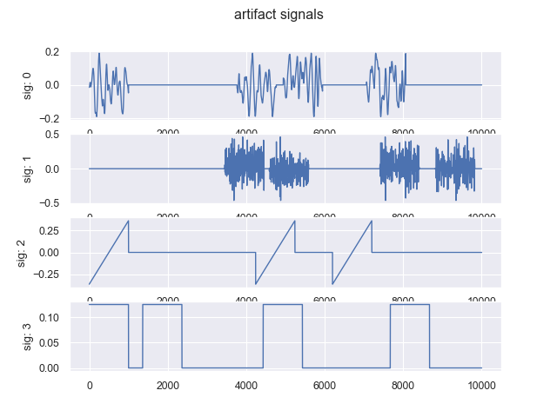
EEG case study Semi Synthetic EEG data as Input Signals
Semi Synthetic electroencephalogram - EEG data
1. Use real EEG data as Inputs
Insert Plot here
2. Mix Data with random Mixing Matrix
Eye Blink
3. Add 1 realistic artifact, on mixed data
Optional: Add single or patchy Outliers and white noise (3std)
Artifacts which typically come along with EEG data
Muscle
Electrical
Electrical

Slide 12
EEG case study Results with Semi Synthetic EEG data
Able to reconstruct the EEG signals and Artifacts
Insert Plot here

Slide 13
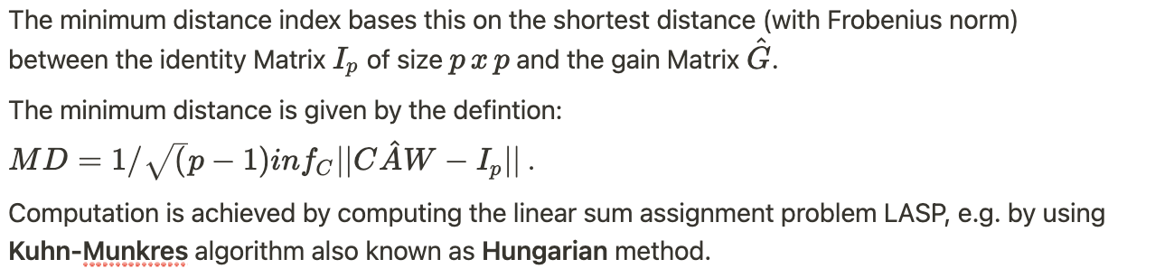
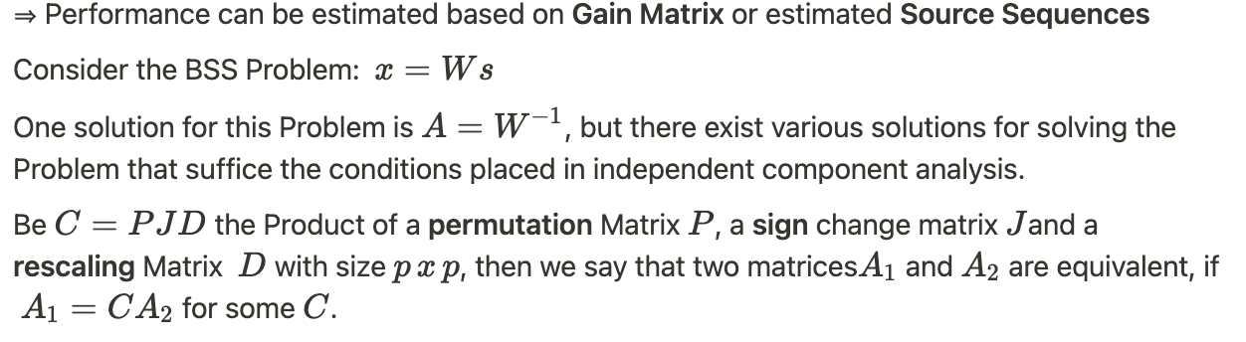
Minimum Distance
MD of 0 -> good, MD->1 bad, Optimum = Identity, Only possible if Ground truth
availavble

Slide 14
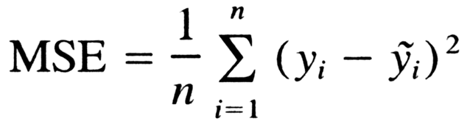
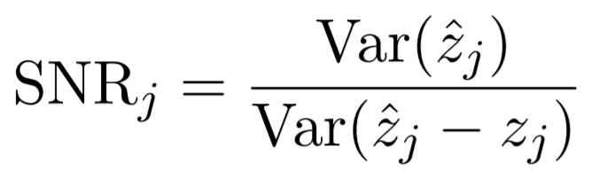
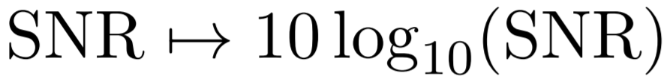
MSE, SNR
Evaluate for every single signal

Slide 15
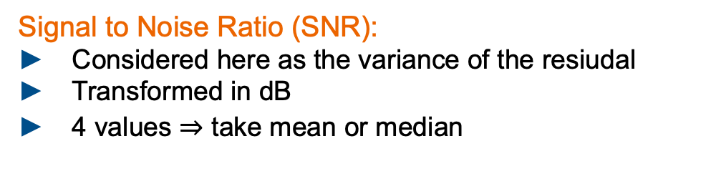
Delorme one slide -> near eeg, closer to reality
2. cases -> classical rosbustness
-> eeg like artifacts
Good and bad recon
Possible Reasons:
Distributions don‘t follow the expected model
Important values are weighted down by new objective functions
Signal to Noise Ratio (SNR):
Considered here as the variance of the resiudal
Transformed in dB
4 values take mean or median
Matrix fett schreiben
Eventuelle andere Signale zeigen auf slide 1
4 Signale ersetzen
Drop bei 10000 erklären -> auf drawbacks von MD hinweisen.
Evtl auch nur bis 5000 zeigen

Slide 16
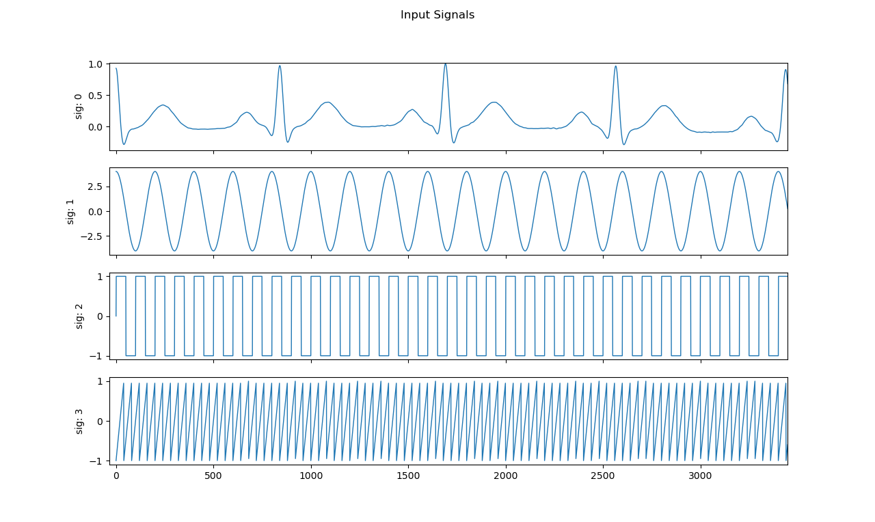
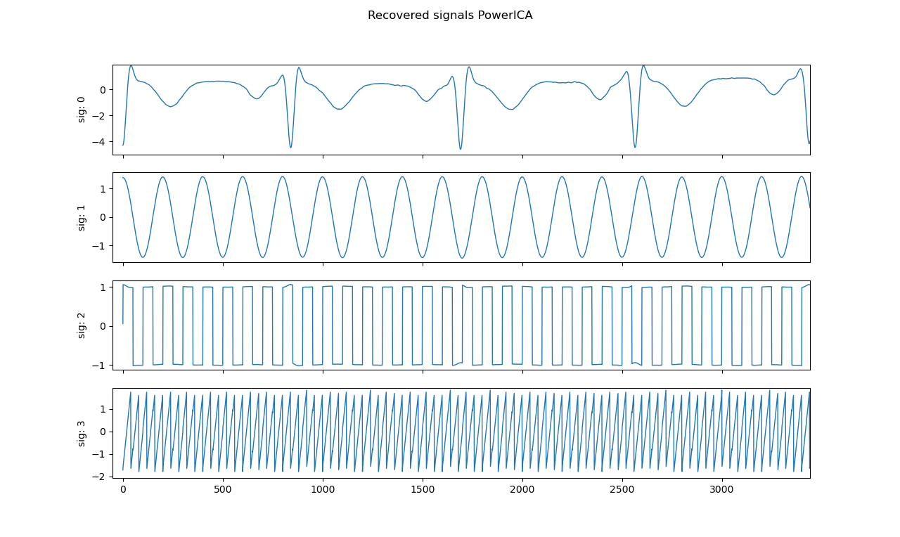

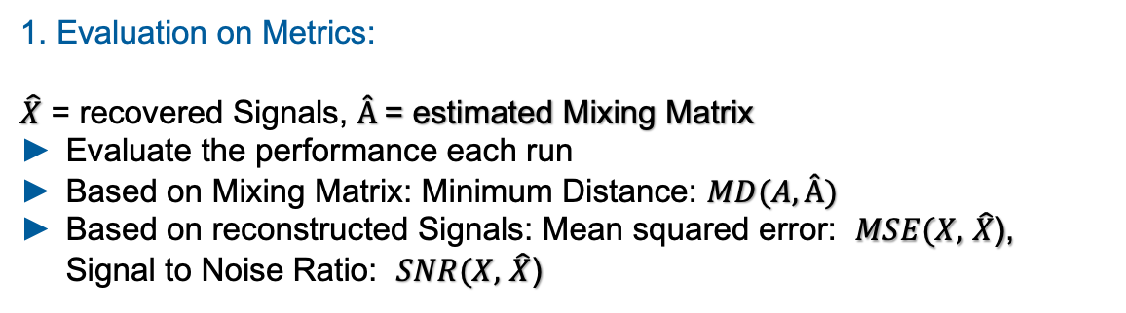

Experiment Design Monte Carlo Flow Chart III
Input Signals
How do we measure the performance of the Algorithms ?
Runs = 1000
Mix Signals
1. Evaluation on Metrics:
$\hat{X}$ = recovered Signals, $Â$= estimated Mixing Matrix
Evaluate the performance each run
Based on Mixing Matrix: Minimum Distance: $MD(A,Â)$
Based on reconstructed Signals: Mean squared error: $MSE(X,$ $\hat{X}$), Signal to Noise Ratio: $SNR(X,$ $\hat{X}$)
Contaminate Signals
Whitening
ICA
vs.
$$\hat{X}$$
$$Â$$
Evaluate on Metrics
2. Empirical Data Analyses
Get 1000 (#runs) metrics
Calcualte: Mean, Standard Deviation, Median, nMAD of MD,MSE,SNR
BoxPlot
Empirical Data Analyses

Slide 17
Experiment Design Monte Carlo Flow Chart II
Input Signals
Runs = 1000
Whitening
Mix Signals
Plug in robustness
Perform Robust Covariance Estimation from Python Package RobustSP
Spatial Median
M-Estimator of Scatter Matrix (Huber)
Contaminate Signals
Whitening
ICA
Independent Component Analyses
Perform ICA by 4 different Algorithms: JADE, RADICAL, CoroICA, PowerICA
Plug in Robustness JADE: Replace Expected Value by robust objective function.
Huber, Tukey
Evaluate on Metrics
Empirical Data Analyses

