Slide 1

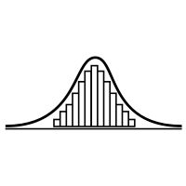
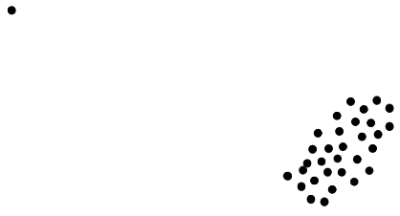

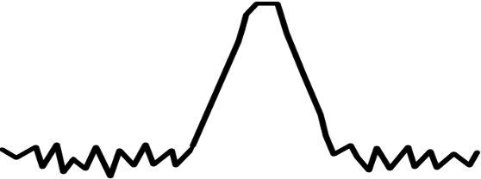
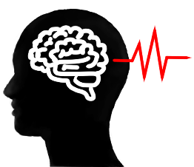
Shortcomings
Significant performance loss for sample sizes with N << 5000
Unable to recover more than one Gaussian signal
For SNR ≤ 20dB high variance in performance
Failures become increasingly likely
Inherently unrobust against outliers
A single outlier will lead to failure of the method
N
Samples
Gaussian
SNR ≤ 20dB
Outlier

Slide 2
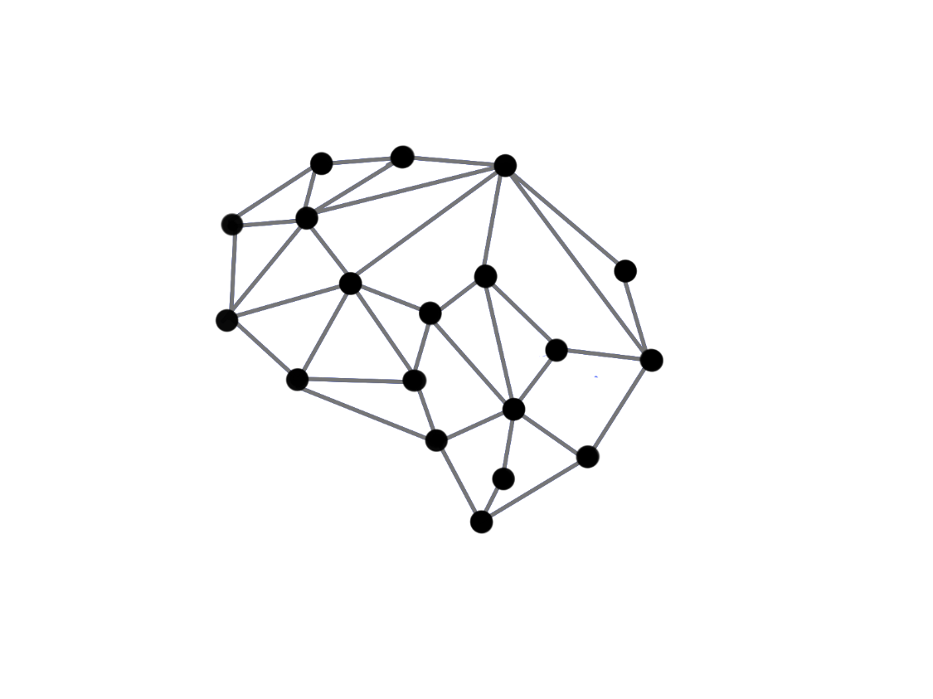

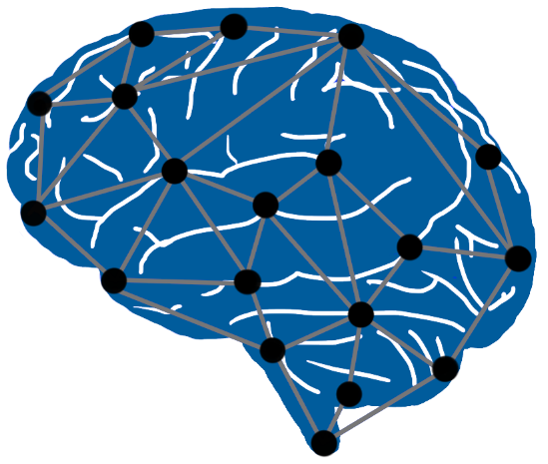
Recent Developments
In 2010: Blind Source Separation(BSS) using graph theory
In 2020: First approaches to combine non-gaussianity based BSS with graph-based BSS (Jari Miettinen)
What is the idea?
Design a method that uses:
Non-Gaussianity measure (classic ICA)
Information about underlying graph structure
Combine those in a way that they complement each other

Slide 3
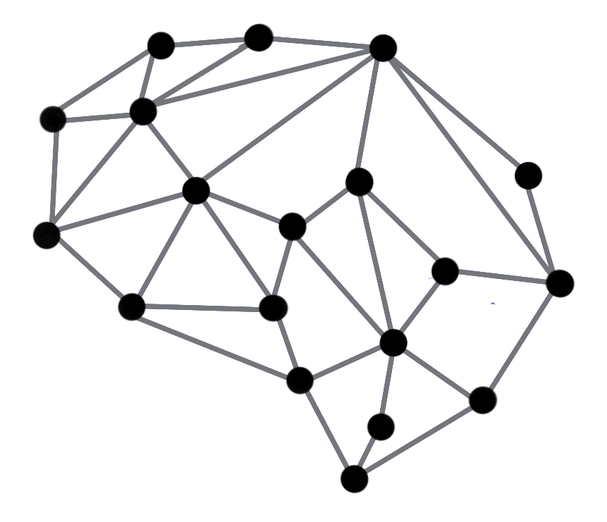


Graph Blind Source Separation
What are Graphs?

Slide 4
Graph Blind Source Separation - What are Graphs?
Graphs are structures build by vertices that are connected by edges
Edges represent proximity between two vertices
Graph structure can be stored in a matrix ⇒ The adjacency matrix A
Examples: Social networks, sensor networks, brain networks, etc.
0 1 1 1 1 1 1
7
2
1 0 0 0 0 0 0
1 0 0 0 0 0 0
A =
1 0 0 0 0 0 0
6
1
3
1 0 0 0 0 0 0
1 0 0 0 0 0 0
4
1 0 0 0 0 0 0
5
Undirected unweighted graph

Slide 5
Graph Blind Source Separation - What are Graphs?
Graphs are structures build by vertices that are connected by edges
Edges represent proximity between two vertices
Graph structure can be stored in a matrix ⇒ The adjacency matrix A
Examples: Social networks, sensor networks, brain networks, etc.
0 1 1 1 1 1 1
7
2
1 0 0 0 0 0 0
1 0 0 0 0 0 0
A =
1 0 0 0 0 0 0
6
1
3
1 0 0 0 0 0 0
1 0 0 0 0 0 0
4
1 0 0 0 0 0 0
5
Undirected unweighted graph

Slide 6
Graph Blind Source Separation - What are Graph Signals?
Analogy to discrete time signals
Simplest case: Recursive Line Graph
Each node represents a sample point
Directed graph ⇒ unsymmetric adjacency
0
1
2
3
…
N
n ∈ ℕ, n ≤ N
0 1 0 0 0 0 … 0
0 0 1 0 0 0 … 0
0 0 0 1 0 0 … 0
A =
0 0 0 0 1 0 … 0
. . . . . . … 0
. . . . . . … 1
1 0 0 0 0 0 … 0

Slide 7
Graph Blind Source Separation - What are Graph Signals?
Analogy to discrete time signals
Simplest case: Recursive Line Graph
Multiple Signals can share the same Graph
In this case: The class of all Periodic Signals with Period N
0
1
2
3
…
N
n ∈ ℕ, n ≤ N
0 1 0 0 0 0 … 0
0 0 1 0 0 0 … 0
0 0 0 1 0 0 … 0
A =
0 0 0 0 1 0 … 0
. . . . . . … 0
. . . . . . … 1
1 0 0 0 0 0 … 0

Slide 8

Graph Blind Source Separation - What are Graph Signals?
Analogy to discrete time signals
Simplest case: Recursive Line Graph
We call ${XA}^{k}=X^{(k)}$ a graph-shift by k
For Line Graph ⇔ Shift Operator as known from Digital Signal Processing
When a graph-shift is applied, the signal will shift along every connected path made up of the k nearest edges.
k = 1 shift
0
1
2
3
…
N
n ∈ ℕ, n ≤ N

Slide 9
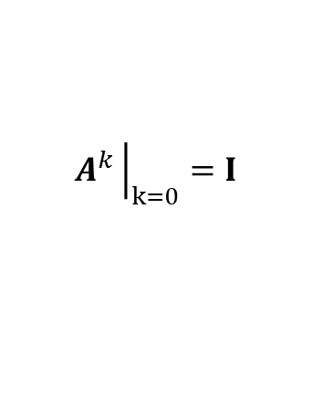
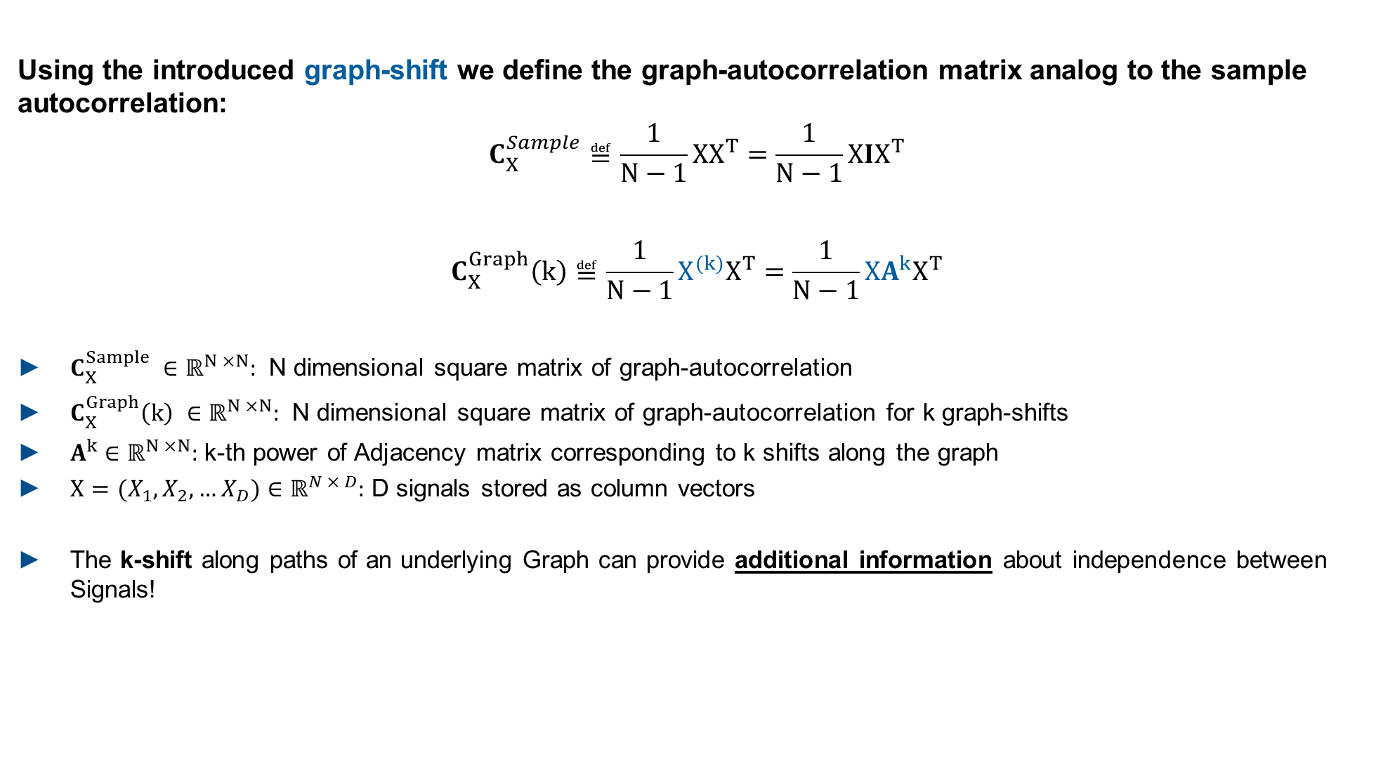
Graph Blind Source Separation - Graph-Autocorrelation
Using the introduced graph-shift we define the graph-autocorrelation matrix analog to the sample autocorrelation:
$$C_{X}^{Sample}≝\frac{1}{N−1}XX^{T}=\frac{1}{N−1}XIX^{T}$$
$$C_{X}^{Graph}\left(k\right)≝\frac{1}{N−1}X^{(k)}X^{T}=\frac{1}{N−1}XA^{k}X^{T}$$
$C_{X}^{Sample} ∈{\text{ℝ}}^{N ×N}:$ N dimensional square matrix of graph-autocorrelation
$C_{X}^{Graph}\left(k\right) ∈{\text{ℝ}}^{N ×N}:$ N dimensional square matrix of graph-autocorrelation for k graph-shifts
$A^{k}∈{\text{ℝ}}^{N ×N}:$ k-th power of Adjacency matrix corresponding to k shifts along the graph
$X=(X_{1}, X_{2},…X_{D})∈{\text{ℝ}}^{N × D}:$ D signals stored as column vectors
The k-shift along paths of an underlying Graph can provide additional information about independence between Signals!
$$A^{k}{\left.​\right|}_{k=0}=I$$

Slide 10







Graph Blind Source Seperation - Graph Decorrelation
Find a matrix $U$ that diagonalizes $UC_{X}^{Graph}U^{T}$ as much as possible
The solution for $U$ decorrelates the signals $X$ in the graph-sense
$U$ is a solution of the BSS problem for graph-signals
Advantages | Disadvantages
No assumptions about the distribution of the signals | Graph structure not always directly available
No Large sample size required | Highly dependent on accurately estimated graph
Graph structure in many real- world problems
N

Slide 11
Graph Blind Source Seperation - Graph Decorrelation
PowerICA shortcomings:
Significant performance loss for sample sizes with N << 5000
Unable to recover more than one gaussian signal
Advantages | Disadvantages
No assumptions about the distribution of the signals | Graph structure not always directly available
No Large sample size required | Highly dependent on accurately estimated graph
Graph structure in many real- world problems
N
Graph based BSS and non-gaussianity based BSS seem to make up for each others weak points.

Slide 12






Graph Blind Source Seperation - Composite Objective
How can we combine them?
Approach from Jari Miettinen et al. (Aalto University)
Solution: composite objective function $f$:
PowerICA objective:
Maximize estimate of negentropy as a measure of non-Gaussianity with the Lagrangian method.
$\text{(1−}\text{λ}$)
$$\text{(1−}\text{λ}\text{)}$$
+
Composite objective function $f$
Graph decorrelation objective:
Diagonalize graph-autocorrelation as much as possible. For only one adjacency ⇒ eigenvalue problem.
$$\text{λ}$$
Balance Parameter
$$\text{0 < }\text{λ}\text{ < 1}$$

