Slide 1
Overview
Graph Blind Source Separation results
Summary of major outcomes
Problems and future research

Slide 2
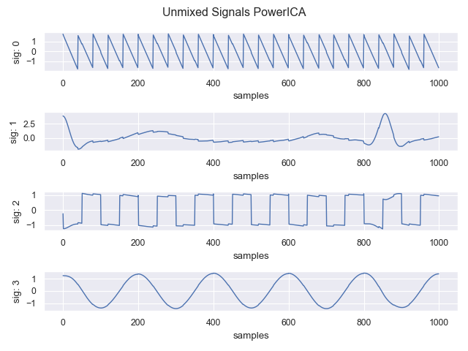
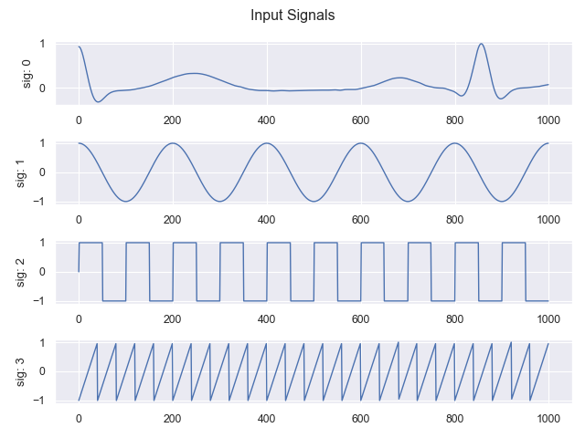
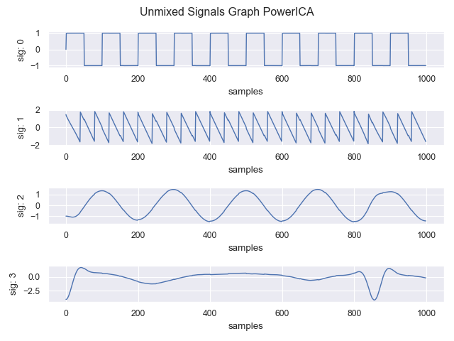
Graph BSS Results Clean data
Standard signals (Cos, Rect, ECG, Saw)
Clean data: Better results than standard PowerICA (1000 samples)

Slide 3
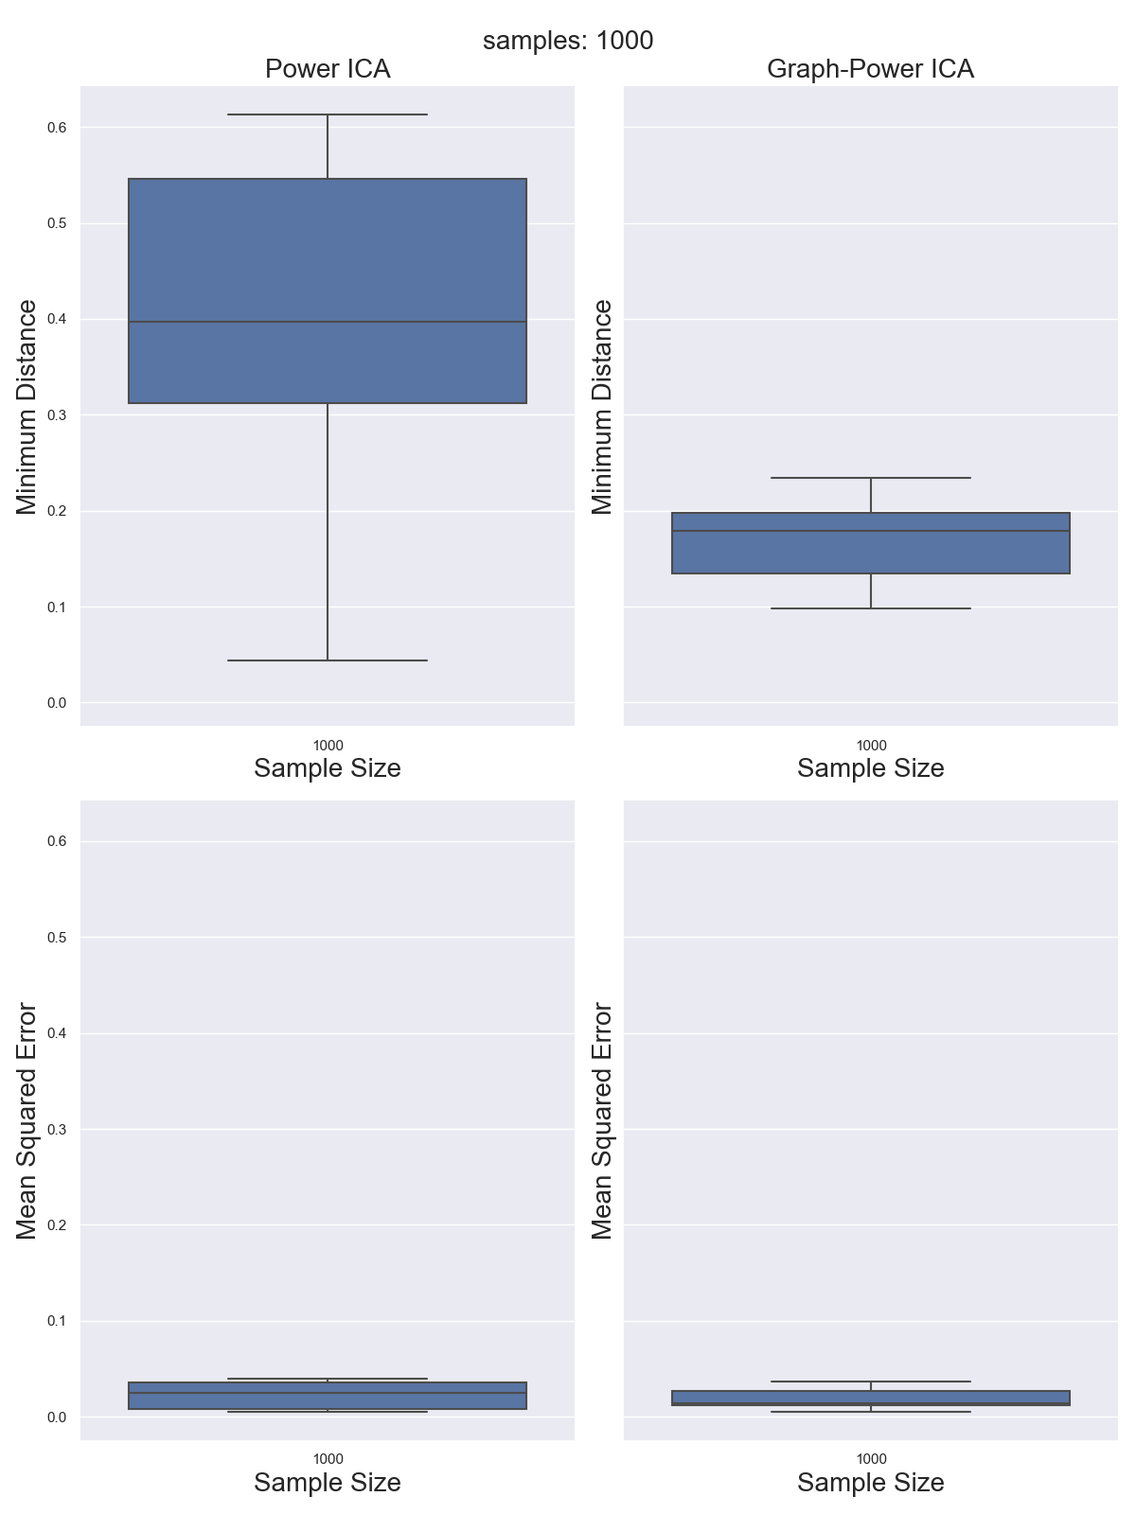
Graph BSS Results Clean data
Standard signals (Cos, Rect, ECG, Saw)
Clean data: Better results than standard PowerICA (1000 samples)
0,4
0,19

Slide 4
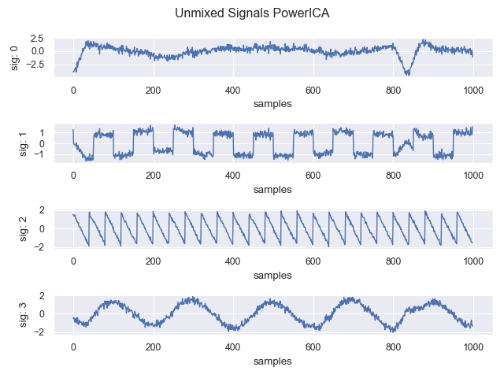
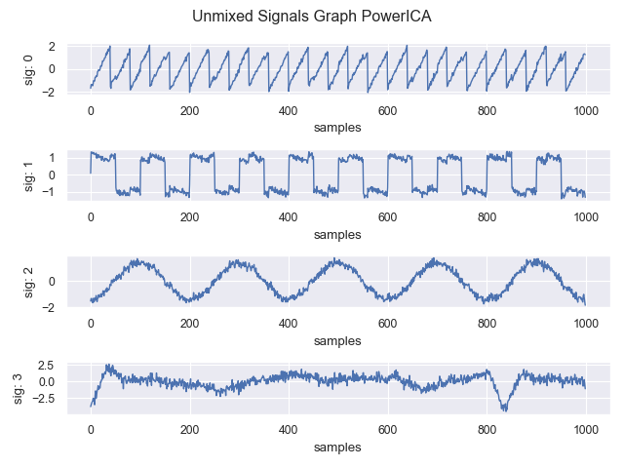
Graph BSS Results Noisy data
Comparable for noisy signals (up to 20dB SNR)

Slide 5
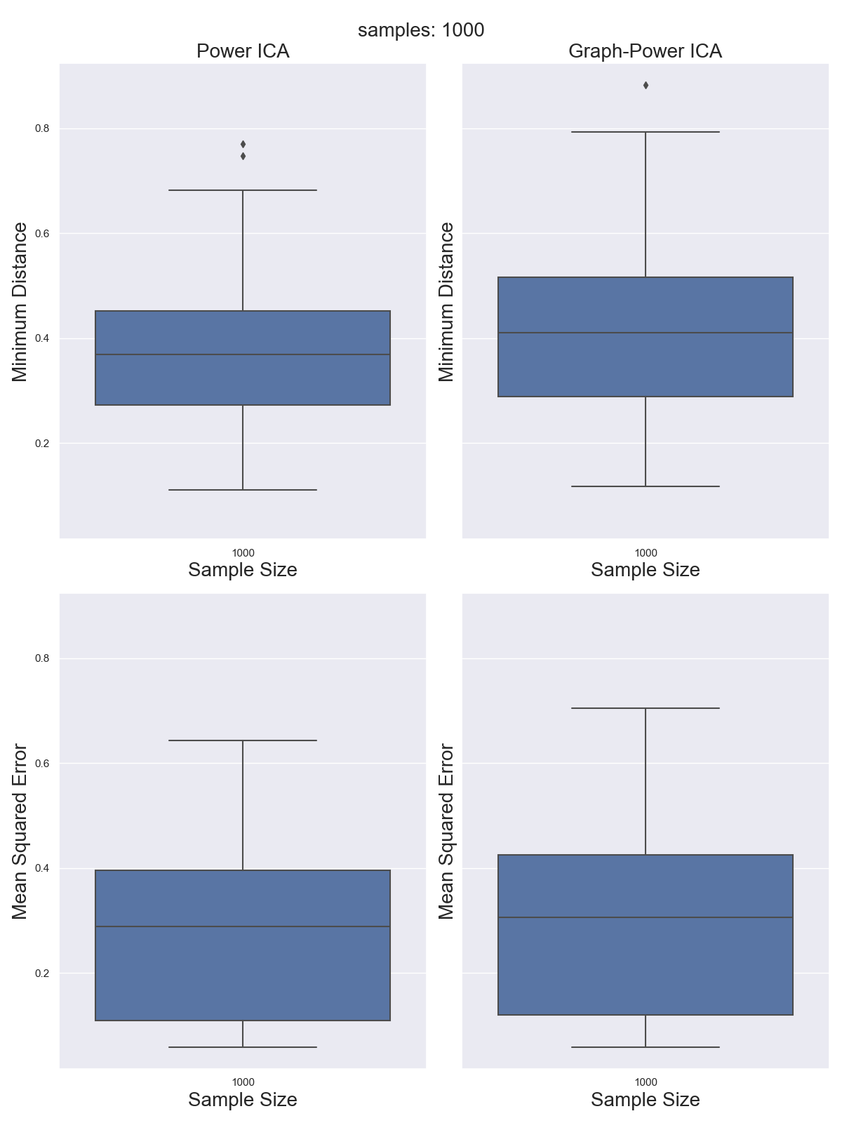
Graph BSS Results Noisy data
Comparable for noisy signals (up to 20dB SNR)
0,38

Slide 6
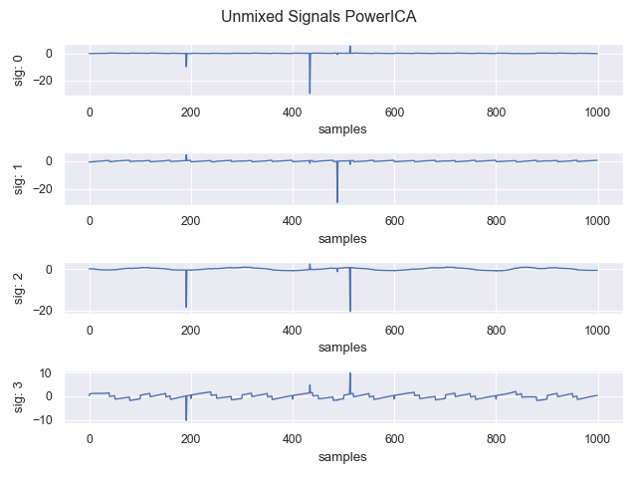
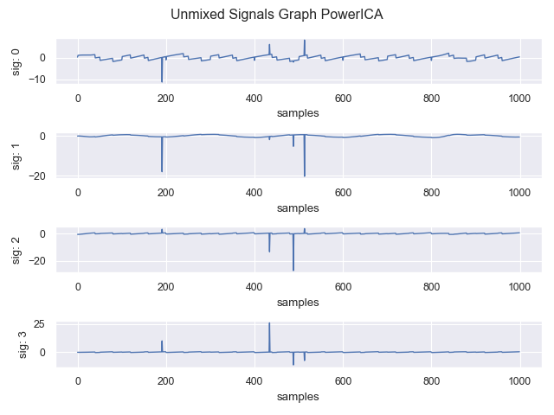
Graph BSS Results Outlier contamination
Breakdown point already with one large outlier (100std)

Slide 7
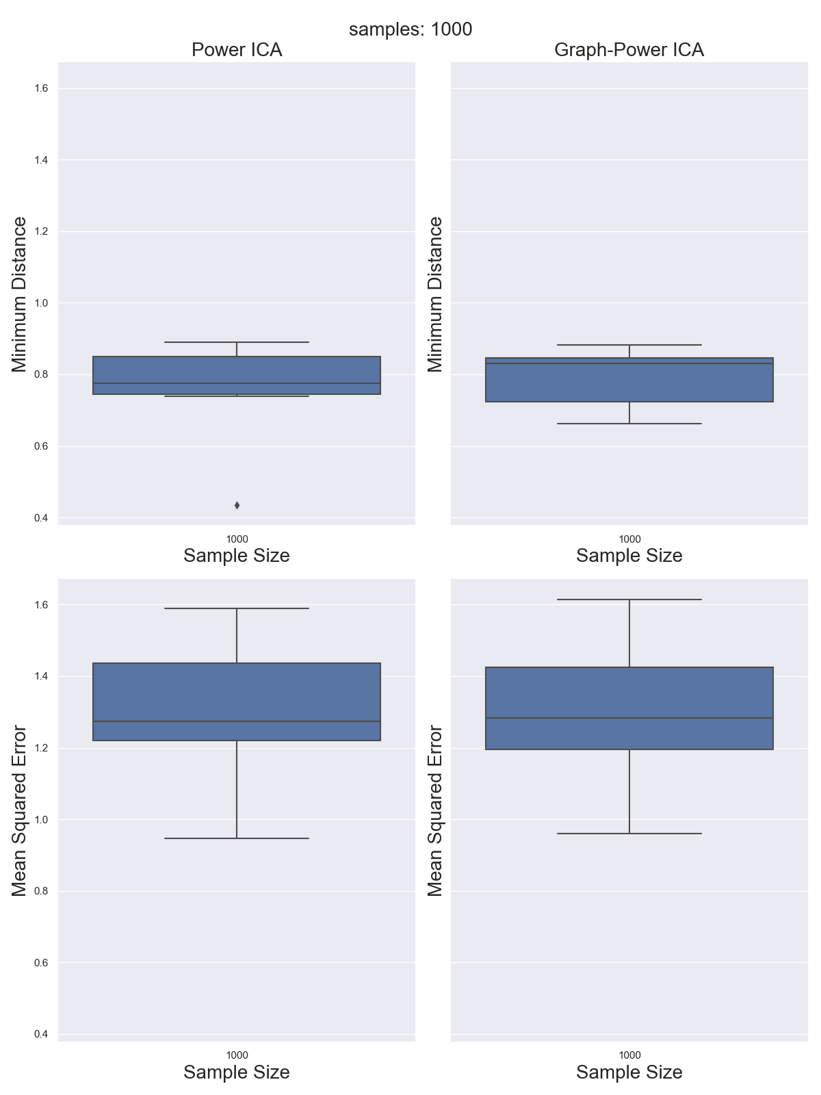
Graph BSS Results Outlier contamination
Breakdown point already with one large outlier (100std)
0,8

Slide 8
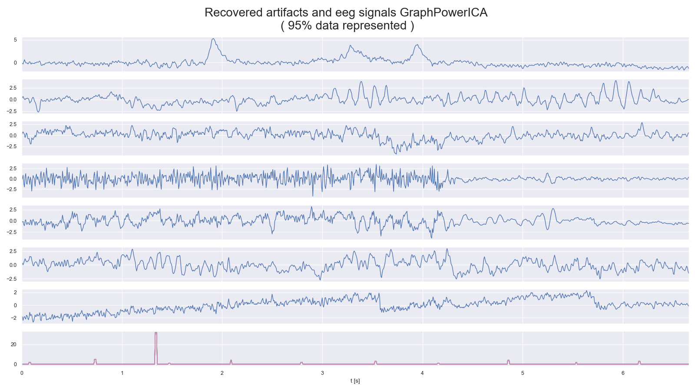
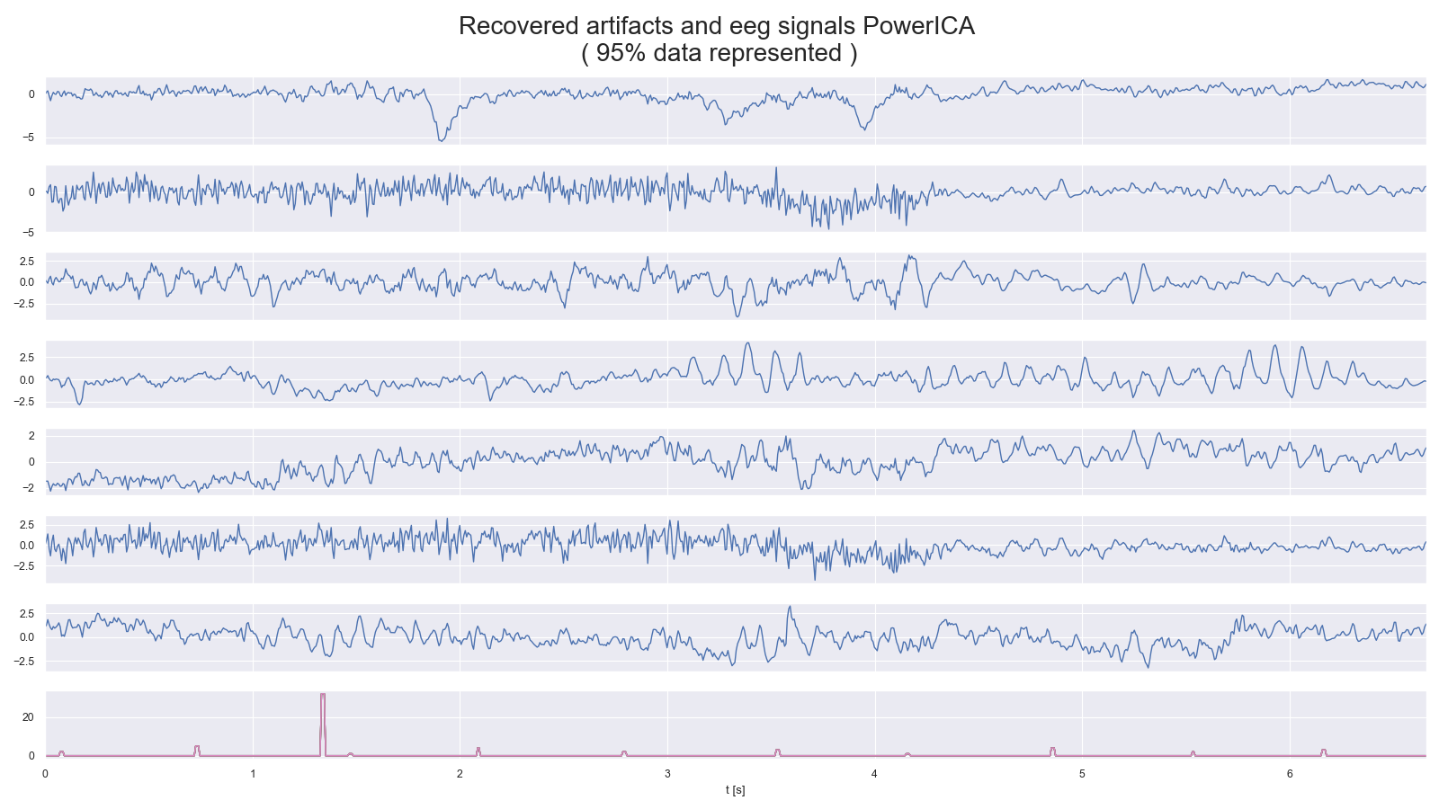
Graph BSS Results
Also possible for semi-synthetic EEG data

Slide 9
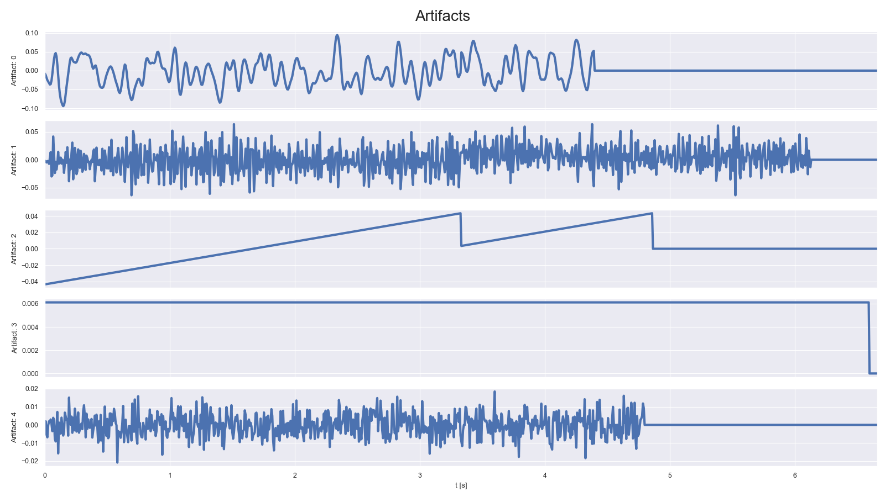
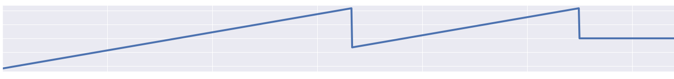
Graph BSS Results
Artifacts clearly extractable

Slide 10
Graph BSS Results
Events clearly extractable

Slide 11
Overview
Graph Blind Source Separation results
Summary of major outcomes
Problems and future research

Slide 12
Summary of major outcomes
Question 1: What is ICA?
Question 2: How to compare algorithms?
Question 3: Which algorithm performs best? What happens with noise or outlier?
Question 4: How to robustify algorithms?
Question 5: What is Graph Signal processing / Graph BSS?
Question 6: Outcomes of Graph Signal processing?

Slide 13
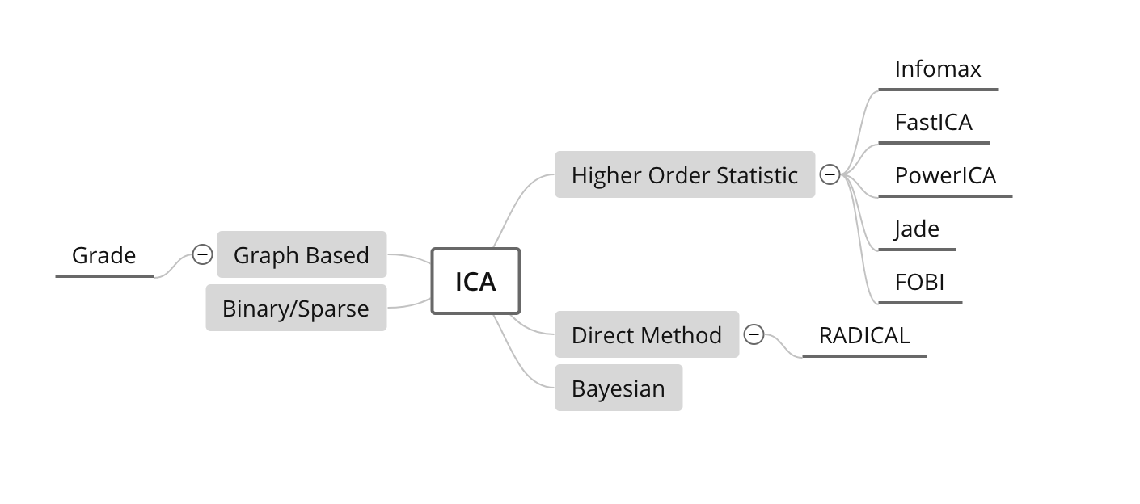
Summary of major outcomes Question 1: What is ICA?
Mathematical concept to extract (independent = non-gaussian) signals from mixed signals
Different approaches to obtain the demixing matrix → 4 algorithms
„ICA tries to decorrelate mixed up signals and find the optimal demixing matrix based on optimizing different measures of independence“
CoroICA

Slide 14
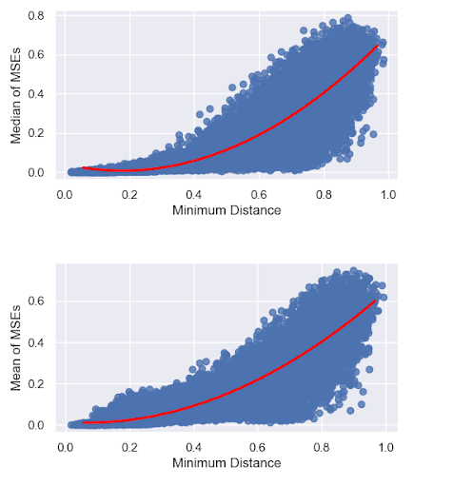
Summary of major outcomes Question 2: How to compare algorithms?
Minimum distance, MSE and SNR
Correlation of different metrics important
„One Metric sometimes provides not
the whole information: We need to find
how different metrics correlate“

Slide 15
Summary of major outcomes Question 3: Which algorithm performs best? What happens with noise or outlier?
Monte Carlo run with 10.000 runs: Evaluate metrics
More or less similar with good data (simulated (stationary) and real EEG data with added artifacts (non-stationary))
PowerICA: quite good with reasonable SNR (~20dB), fast and with low variance
Low sample sizes are problematic (<5000 samples)
Higher noise than 20dB SNR: smoothly becoming worse
All reach breakdown point with one large outlier
„All four algorithms: Good performance on well behaving data but higher noise level or larger outlier cause failure ➔ No real robust algorithm“

Slide 16
Summary of major outcomes Question 4: How to robustify?
Whitening process crucial for algorithms
Different objective functions for some algorithms
Initialization quite important (local maxima/minima)
Within algorithms: quite complicated → model based
What we tried:
Plug-in robustness of covariance estimation in whitening process
Trying out different robust objective functions
Initialize PowerICA with Radical as a global optimizer
„No real improvement: sometimes with noise a bit better, but still low
breakdown point”

Slide 17
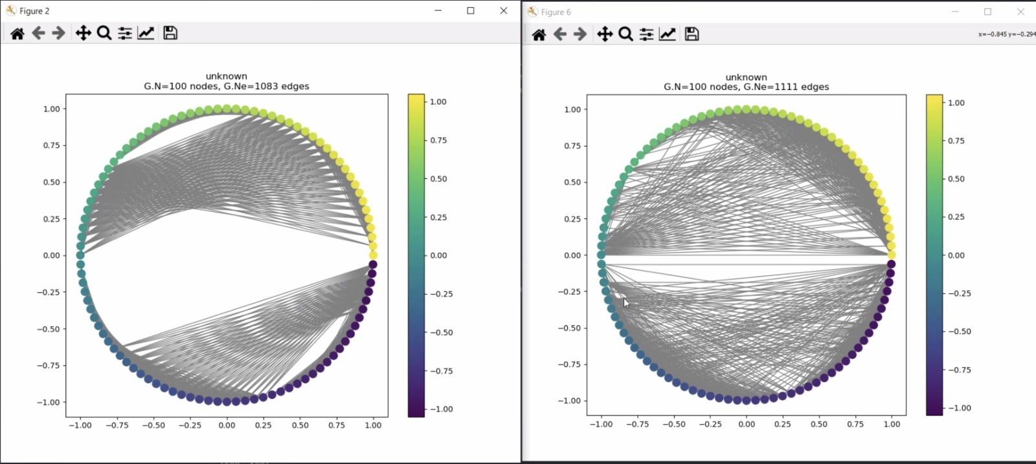
Summary of major outcomes Question 5: What is Graph Signal processing / Graph BSS?
Graph signal processing: Use proximity/similarity between components of the underlying signal
„Graph BSS tries to combine the ICA approach to maximize the measure of independence and the graph signal approach to decorrelate the nodes of the graph”
Circular sinusoidal graph signal:
With noise:

Slide 18
Summary of major outcomes Question 6: Outcomes of Graph BSS?
Monte Carlo with 1000 runs:
Better Blind Source Separation with good signals (low sample size)
Real EEG data with artifacts separable
Similar with noisy data
Breakdown point with one outlier as well
Problem with graph structure
„Graph BSS is good for low sample sizes and if the graph structure is available. Otherwise similar outcomes as standard BSS”

Slide 19
Overview
Graph Blind Source Separation results
Summary of major outcomes
Problems and future research

Slide 20
Problems and future research
Problems:
Low Breakdown point
High noise dependency
Sample size important for standard ICA
Graph structure estimation: How to find correlation of graph signals?
Covariance estimation in higher dimensions problematic
Time consumption for real time EEG analysis
Future research:
Robust whitening / preprocessing
Incorporate noise process and outlier in model for ICA algorithm
Find good graph structure estimation
Robust covariance estimation in high dimensions

Slide 21

Thank you for your attention!

