Slide 1
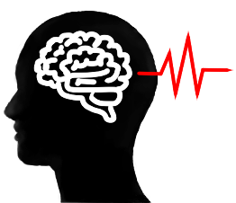
Overview
Graph Blind Source Separation
Graph Blind Source Separation results
Summary of major outcomes
Problems and future research

Slide 2

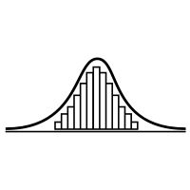


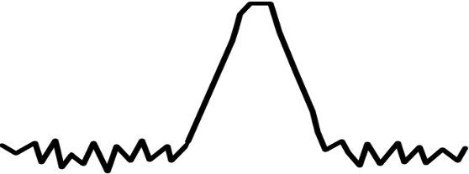
Shortcomings
Significant performance loss for sample sizes with N << 5000
Unable to recover more than one Gaussian signal
For SNR ≤ 20dB high variance in performance
Failures become increasingly likely
Inherently unrobust against outliers
A single outlier will lead to failure of the method
N
1. Samples
2. Gaussian
3. SNR ≤ 20dB
4. Outlier

Slide 3


Recent Developments
In 2010: Blind Source Separation(BSS) using graph theory
In 2020: First approaches to combine non-gaussianity based BSS with graph-based BSS (Jari Miettinen)
What is the idea?
Design a method that uses:
Non-Gaussianity measure (classic ICA)

Slide 4
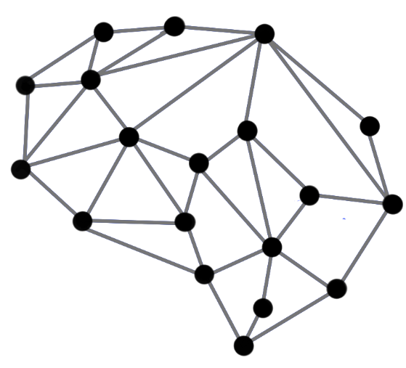
Recent Developments
In 2010: Blind Source Separation(BSS) using graph theory
In 2020: First approaches to combine non-gaussianity based BSS with graph-based BSS (Jari Miettinen)
What is the idea?
Design a method that uses:
Non-Gaussianity measure (classic ICA)
Information about underlying graph structure
Combine those in a way that they complement each other

Slide 5
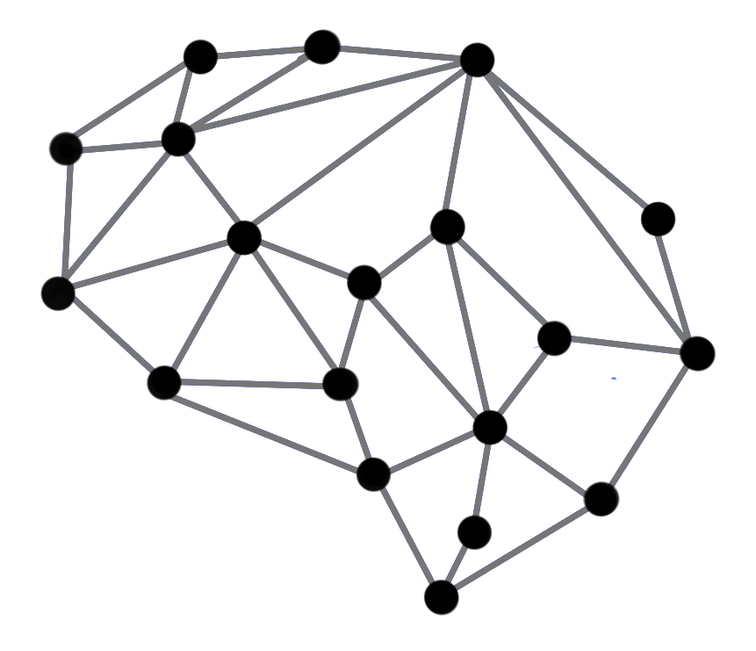


Graph Blind Source Separation
What are Graphs?

Slide 6
Graph Blind Source Separation What are Graphs?
Graphs are structures build by vertices that are connected by edges
Edges represent proximity between two vertices
Graph structure can be stored in a matrix ⇒ The adjacency matrix A
Examples: Social networks, sensor networks, brain networks, etc.
0 1 1 1 1 1 1
7
2
1 0 0 0 0 0 0
1 0 0 0 0 0 0
A =
1 0 0 0 0 0 0
6
1
3
1 0 0 0 0 0 0
1 0 0 0 0 0 0
4
1 0 0 0 0 0 0
5
Undirected unweighted graph

Slide 7
Graph Blind Source Separation What are Graphs?
Graphs are structures build by vertices that are connected by edges
Edges represent proximity between two vertices
Graph structure can be stored in a matrix ⇒ The adjacency matrix A
Examples: Social networks, sensor networks, brain networks, etc.
0 1 1 1 1 1 1
7
2
1 0 0 0 0 0 0
1 0 0 0 0 0 0
A =
1 0 0 0 0 0 0
6
1
3
1 0 0 0 0 0 0
1 0 0 0 0 0 0
4
1 0 0 0 0 0 0
5
Undirected unweighted graph

Slide 8
Graph Blind Source Separation What are Graph Signals?
Analogy to discrete time signals
Simplest case: Recursive Line Graph
Each node represents a sample point
Directed graph ⇒ unsymmetric adjacency
0
1
2
3
…
N
n ∈ ℕ, n ≤ N
0 1 0 0 0 0 … 0
0 0 1 0 0 0 … 0
0 0 0 1 0 0 … 0
A =
0 0 0 0 1 0 … 0
. . . . . . … 0
. . . . . . … 1
1 0 0 0 0 0 … 0

Slide 9
Graph Blind Source Separation What are Graph Signals?
Analogy to discrete time signals
Simplest case: Recursive Line Graph
Multiple Signals can share the same graph
In this case: The class of all periodic signals with period N
0
1
2
3
…
N
n ∈ ℕ, n ≤ N
0 1 0 0 0 0 … 0
0 0 1 0 0 0 … 0
0 0 0 1 0 0 … 0
A =
0 0 0 0 1 0 … 0
. . . . . . … 0
. . . . . . … 1
1 0 0 0 0 0 … 0

Slide 10

Graph Blind Source Separation What are Graph Signals?
Analogy to discrete time signals
Simplest case: Recursive Line Graph
We call ${XA}^{k}=X^{(k)}$ a graph-shift by k
For Line Graph ⇔ Shift operator as known from Digital Signal Processing
When a graph-shift is applied, the signal will shift along every connected path made up of the k nearest edges.
k = 1 shift
0
1
2
3
…
N
n ∈ ℕ, n ≤ N

Slide 11
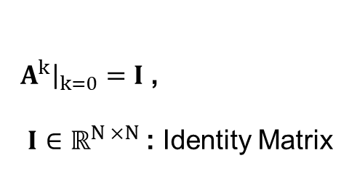
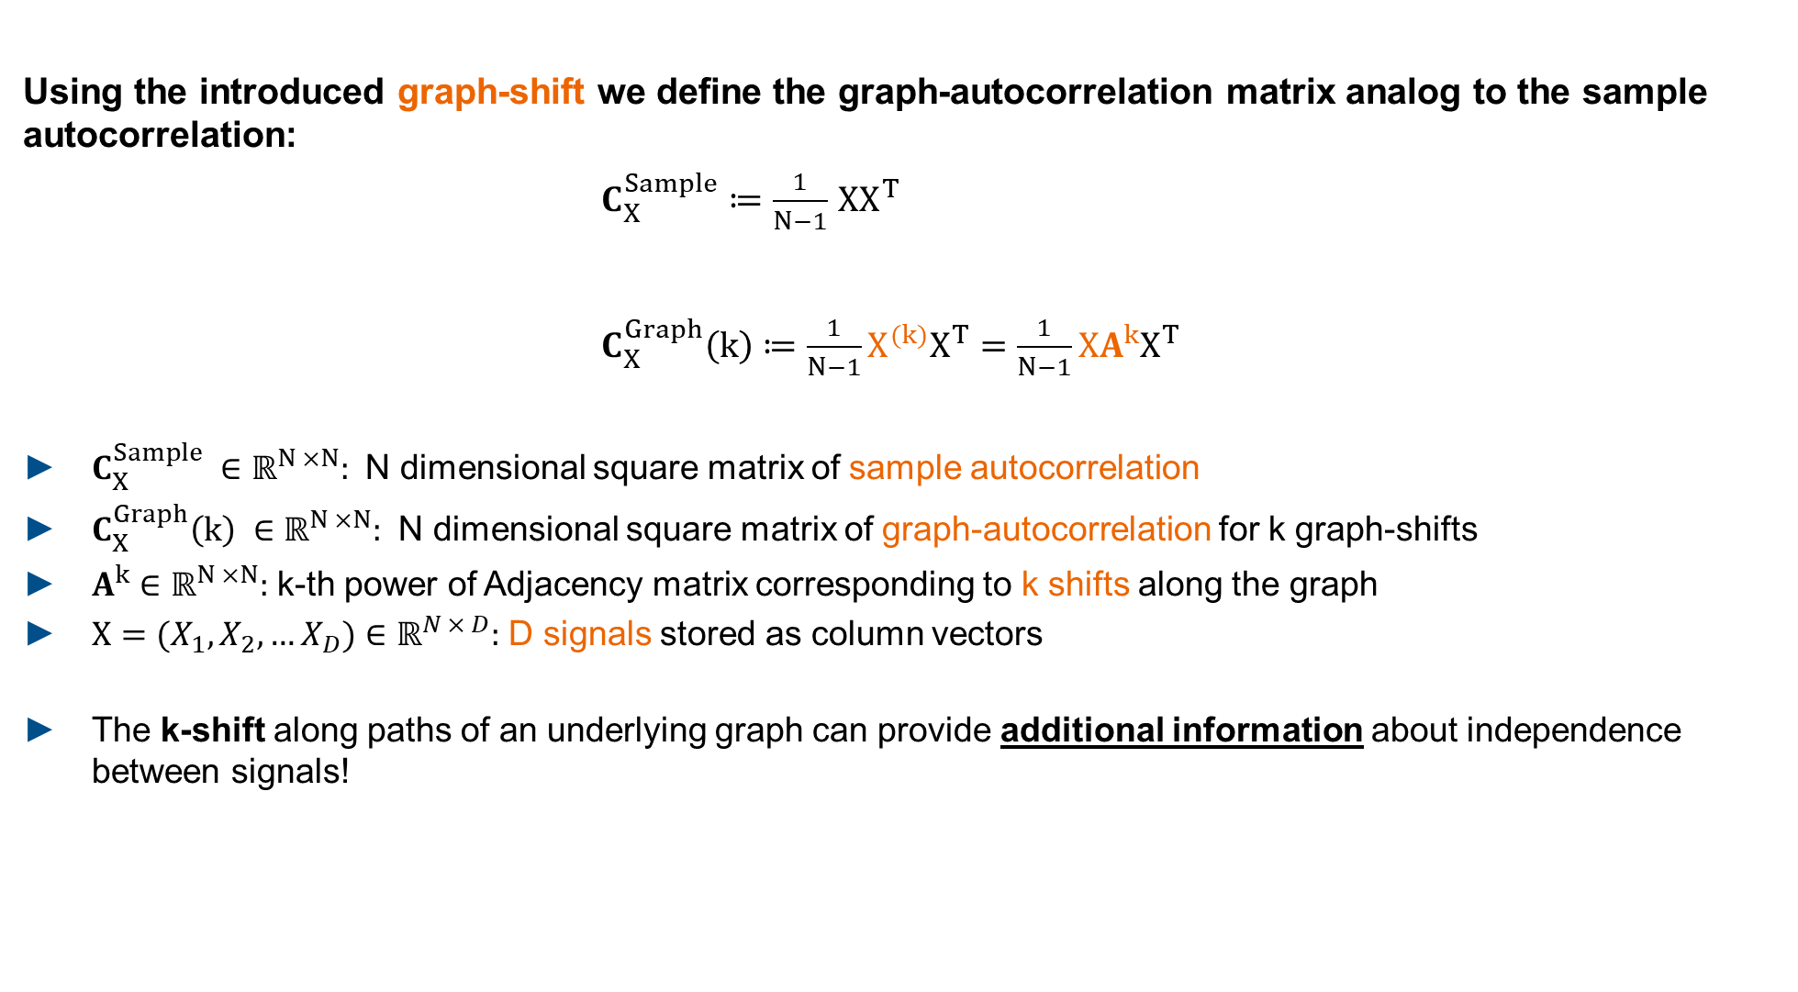

Graph Blind Source Separation Graph-Autocorrelation
Using the introduced graph-shift we define the graph-autocorrelation matrix analog to the sample autocorrelation:
$C_{X}^{Sample}≔\frac{1}{N−1}$ $XX^{T}$
$C_{X}^{Graph}\left(k\right)≔\frac{1}{N−1}X^{(k)}X^{T}=\frac{1}{N−1}XA^{k}X^{T}$
$C_{X}^{Sample} ∈{\text{ℝ}}^{N ×N}:$ N dimensional square matrix of sample autocorrelation
$C_{X}^{Graph}\left(k\right) ∈{\text{ℝ}}^{N ×N}:$ N dimensional square matrix of graph-autocorrelation for k graph-shifts
$A^{k}∈{\text{ℝ}}^{N ×N}:$ k-th power of Adjacency matrix corresponding to k shifts along the graph
$X=(X_{1}, X_{2},…X_{D})∈{\text{ℝ}}^{N × D}:$ D signals stored as column vectors
The k-shift along paths of an underlying graph can provide additional information about independence between signals!
$=\frac{1}{N−1}$ $XIX^{T}$
$A^{k}{\left.​\right|}_{k=0}=I$ ,
$I$ $∈{\text{ℝ}}^{N ×N}$: Identity Matrix

Slide 12


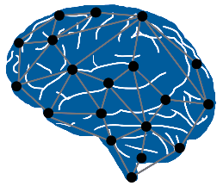



Graph Blind Source Seperation Graph Decorrelation
Find a matrix $U$ that diagonalizes $UC_{X}^{Graph}U^{T}$ as much as possible
The solution for $U$ decorrelates the signals $X$ in the graph-sense
$U$ is a solution of the BSS problem for graph-signals
Advantages | Disadvantages
Independent of data distribution | Graph structure not directly available
Works well with small sample sizes | Highly dependent on accurate graph
Graph structure in many real- world problems
N

Slide 13
Graph Blind Source Seperation Graph Decorrelation
PowerICA shortcomings:
Significant performance loss for sample sizes with N << 5000
Unable to recover more than one gaussian signal
Advantages | Disadvantages
Independent of data distribution | Graph structure not directly available
Works well with small sample sizes | Highly dependent on accurate graph
Graph structure in many real- world problems
N
Graph based BSS and non-gaussianity based BSS seem to make up for each others weak points.

Slide 14






Graph Blind Source Seperation Composite Objective
How can we combine them?
Approach from Jari Miettinen et al. (Aalto University)
Define composite objective function $f_{composite}$:
PowerICA objective:
Maximize estimate of negentropy as a measure of non-Gaussianity with the Lagrangian method.
$$\text{(1−}\text{λ}\text{)}$$
+
Composite objective function $f_{composite}$
Graph decorrelation objective:
Diagonalize graph-autocorrelation as much as possible. For only one adjacency ⇒ eigenvalue problem.
$$\text{λ}$$
Balance Parameter
$$\text{0 < }\text{λ}\text{ < 1}$$

Slide 15
Overview
Graph Blind Source Separation
Graph Blind Source Separation results
Summary of major outcomes
Problems and future research

Slide 16
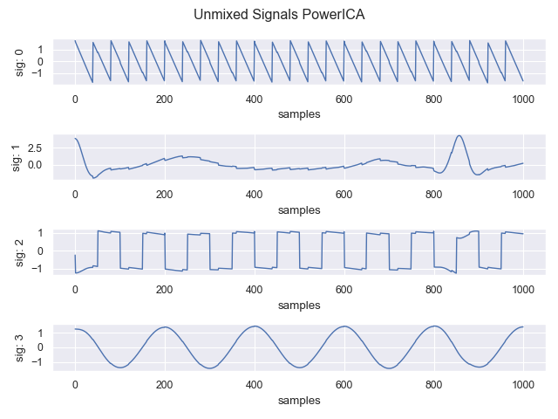
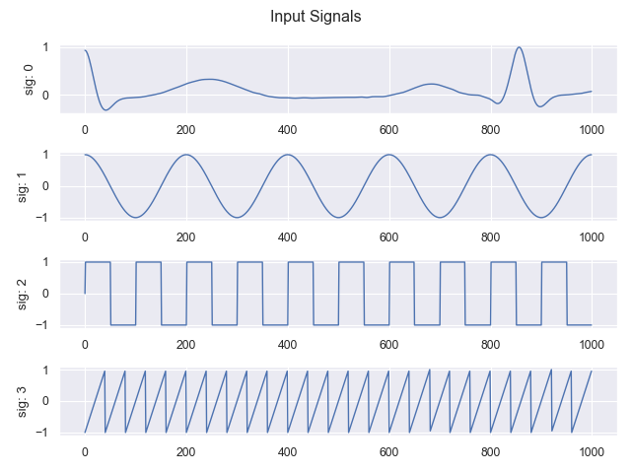
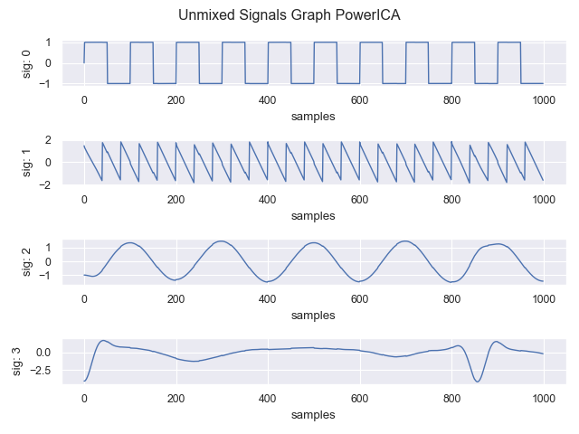
Graph BSS Results Clean data
Standard signals (Cos, Rect, ECG, Saw)
Clean data: Better results than standard PowerICA (1000 samples)

Slide 17
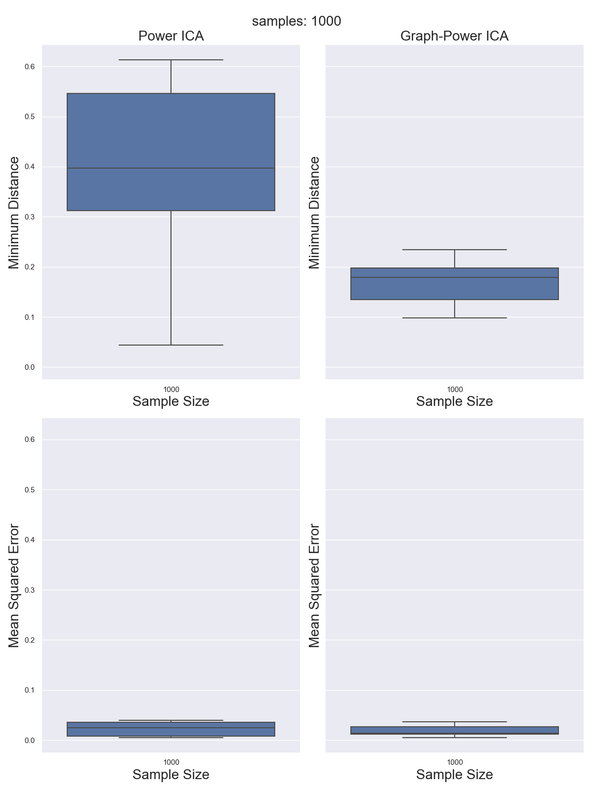
Graph BSS Results Clean data
Standard signals (Cos, Rect, ECG, Saw)
Clean data: Better results than standard PowerICA (1000 samples)
0,6
0,4
0,19
0,1
0,6
0,1

Slide 18
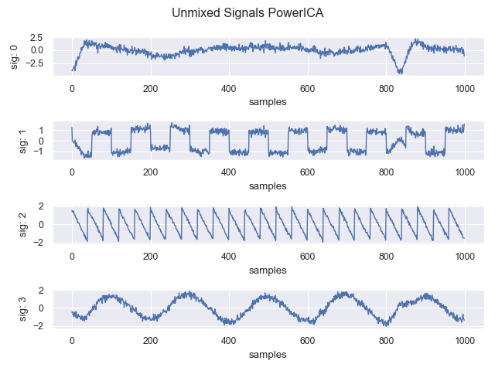
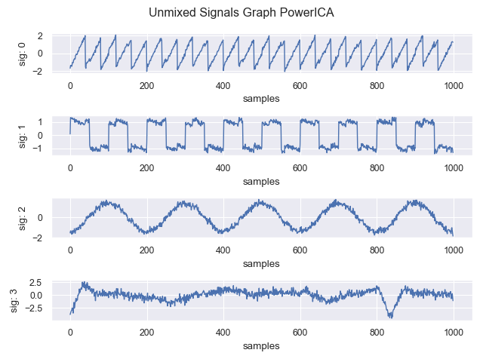
Graph BSS Results Noisy data
Comparable for noisy signals (up to 20dB SNR)

Slide 19
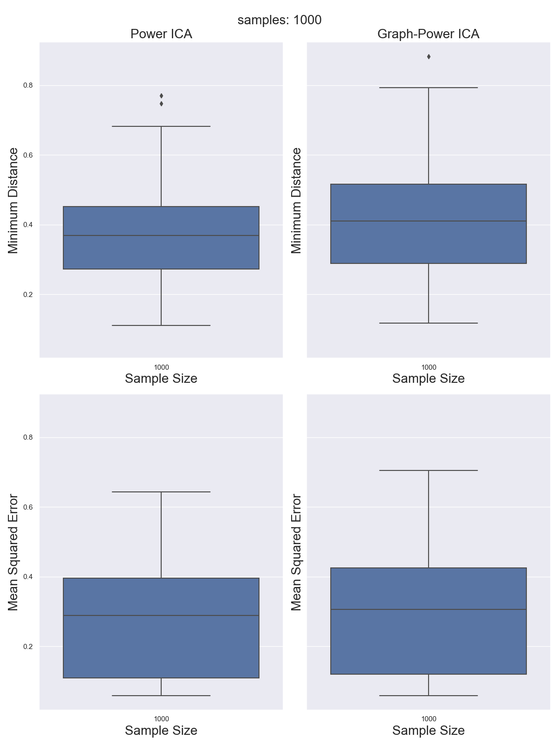
Graph BSS Results Noisy data
Comparable for noisy signals (up to 20dB SNR)
0,8
0,38
0,2
0,8
0,2

Slide 20
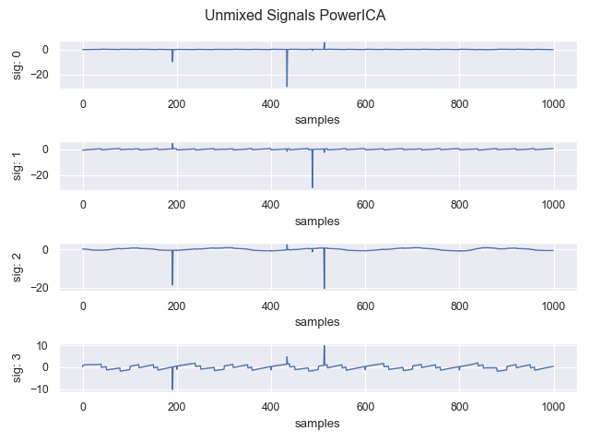
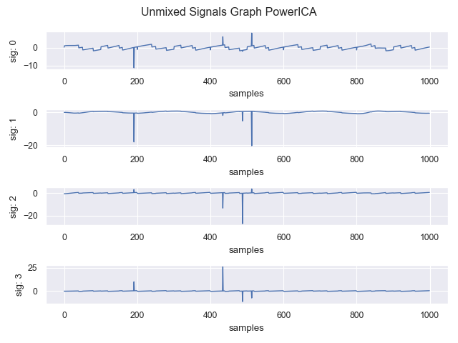
Graph BSS Results Outlier contamination
Breakdown point already with one large outlier (100std)

Slide 21
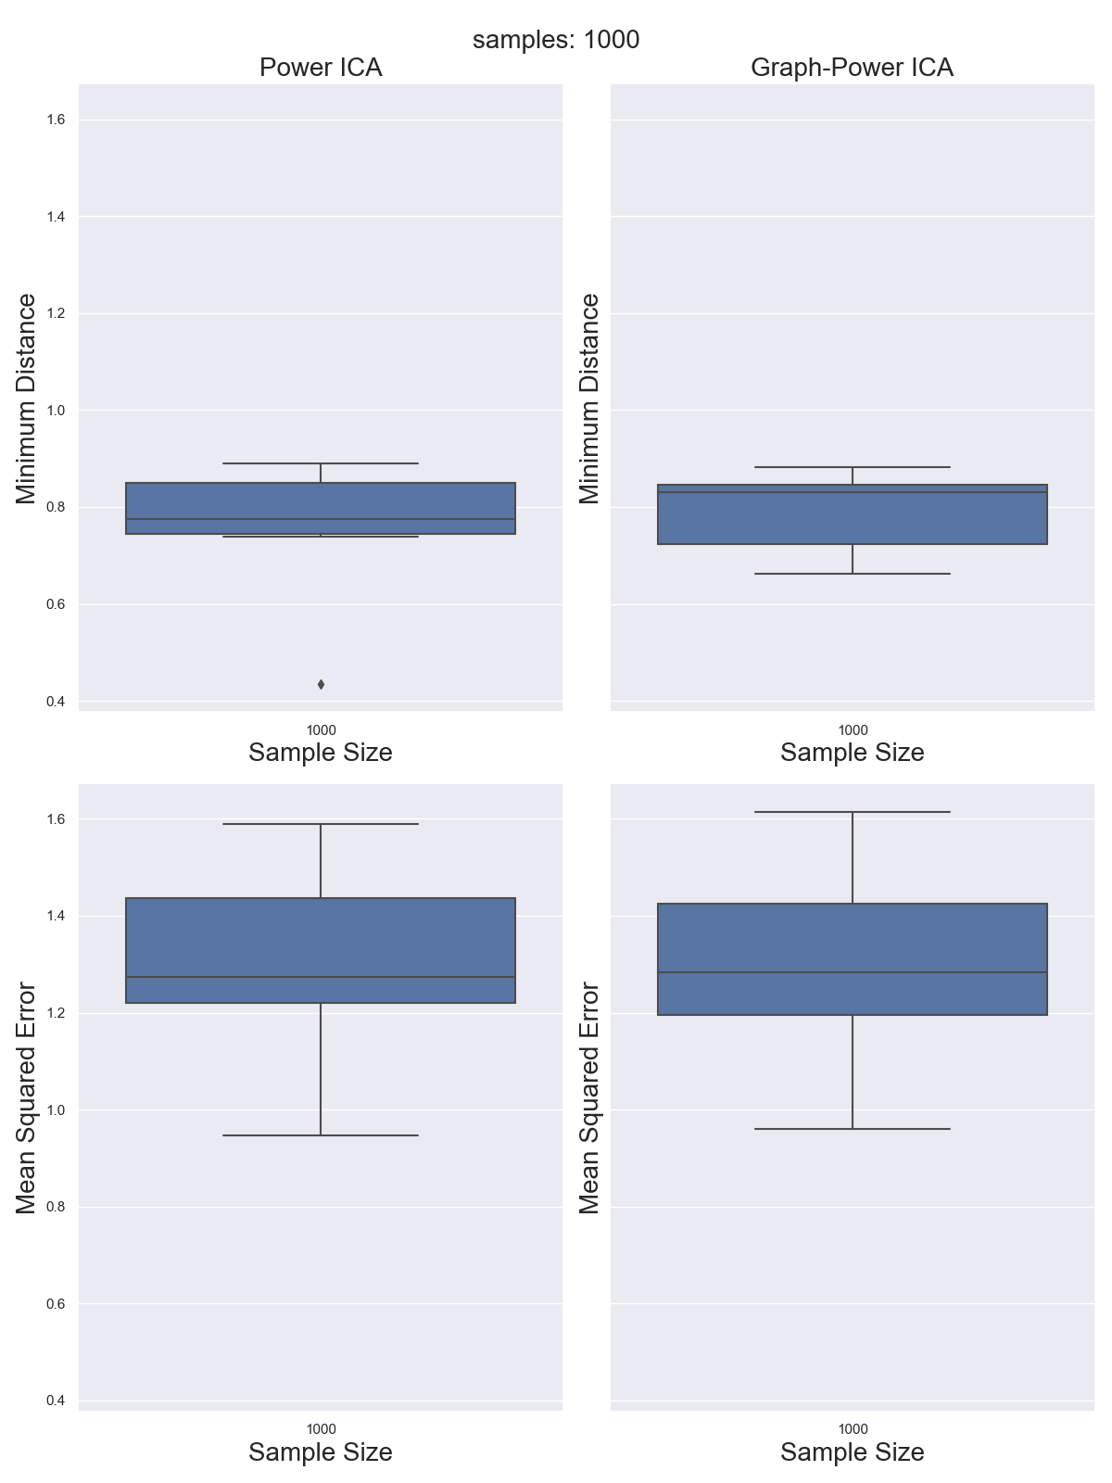
Graph BSS Results Outlier contamination
Breakdown point already with one large outlier (100std)
1,4
0,8
0,4
1,4
0,4

Slide 22
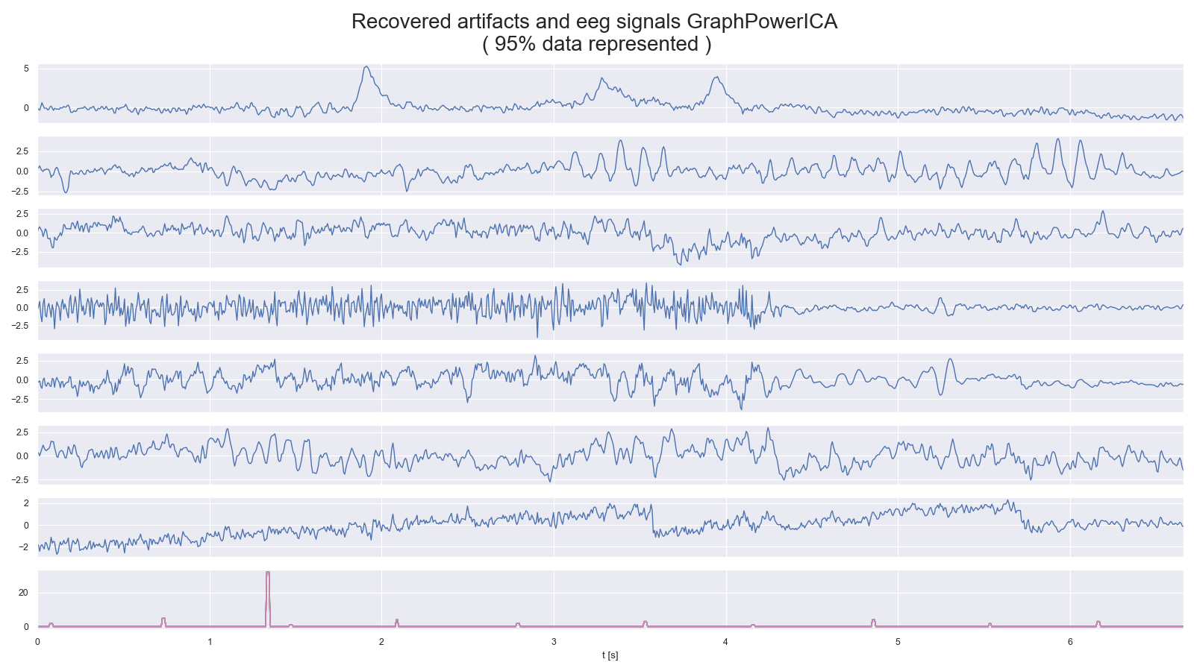
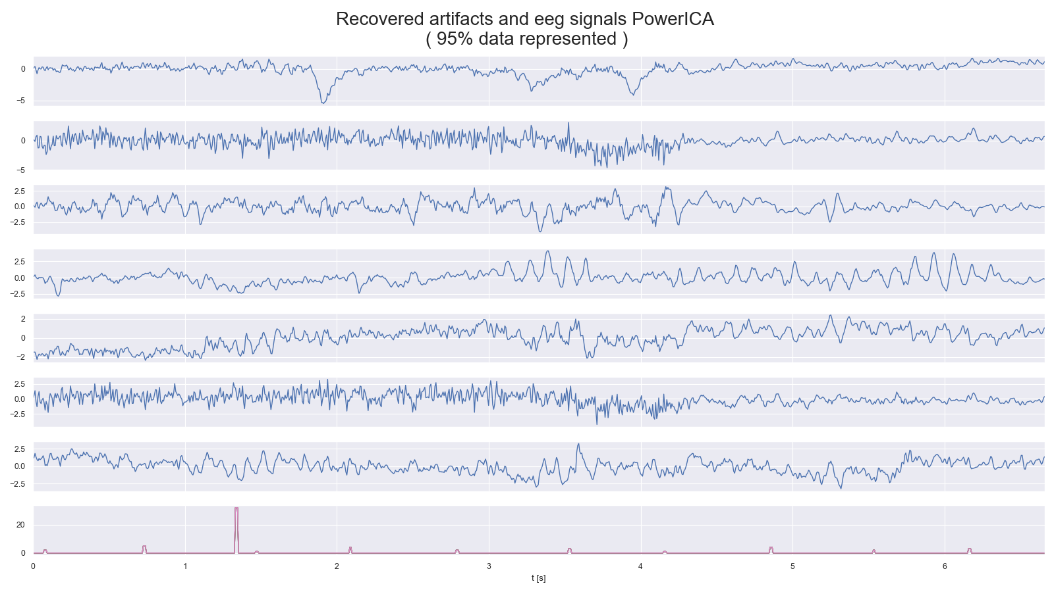
Graph BSS Results
Also possible for semi-synthetic EEG data
0
1
2
3
4
5
6
0
1
2
3
4
5
6
t[s]
t[s]

Slide 23
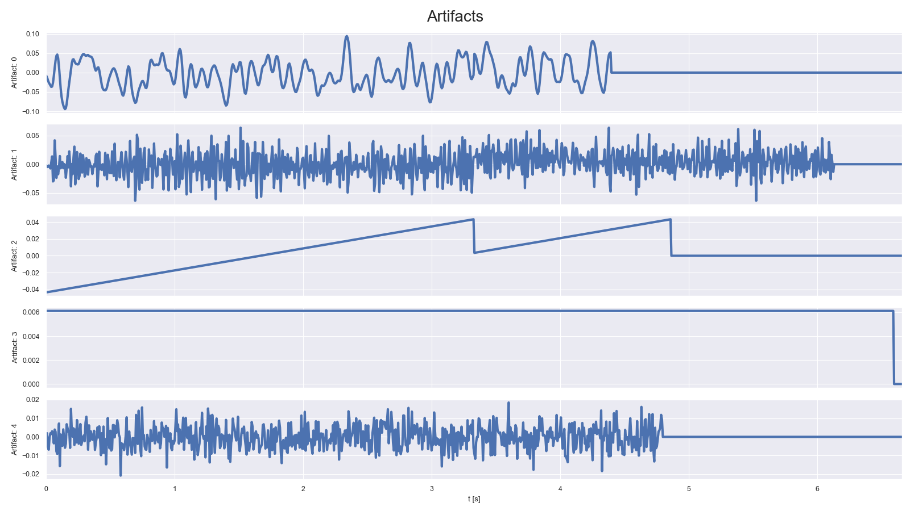
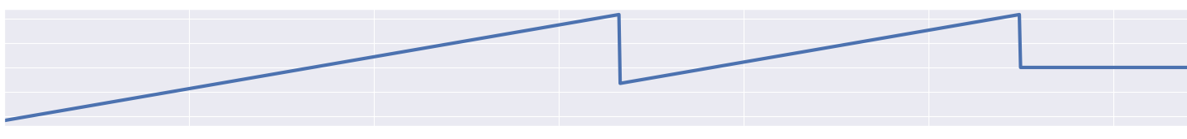
Graph BSS Results Semi-synthetic EEG data
Artifacts clearly extractable:

Slide 24
Graph BSS Results Semi-synthetic EEG data
Events clearly extractable:
Button push
Visual stimulus
0
1
2
3
t[s]
4
5
6

Slide 25
Overview
Graph Blind Source Separation
Graph Blind Source Separation results
Summary of major outcomes
Problems and future research

Slide 26
Summary of major outcomes
Question 1: What is ICA?
Question 2: How to compare algorithms?
Question 3: Which algorithm performs best? What happens with noise or outlier?
Question 4: How to robustify algorithms?
Question 5: What is Graph Signal processing / Graph BSS?
Question 6: Outcomes of Graph Signal processing?

Slide 27
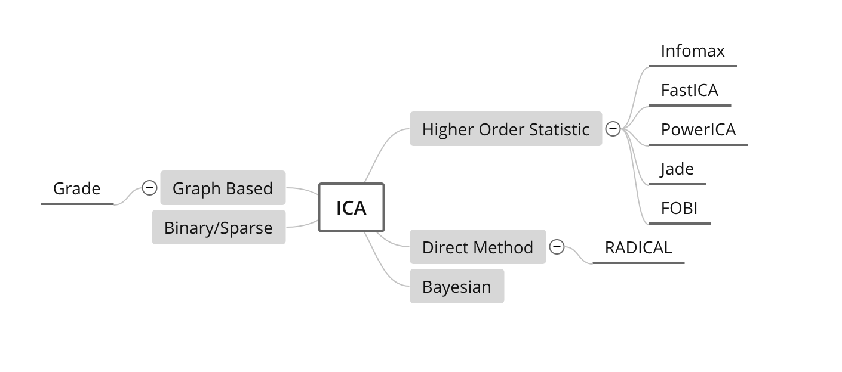
Summary of major outcomes Question 1: What is ICA?
Mathematical concept to extract (independent = non-gaussian) signals from mixed signals
Different approaches to obtain the demixing matrix → 4 algorithms
„ICA tries to decorrelate mixed up signals and find the optimal demixing matrix based on optimizing different measures of independence“
CoroICA

Slide 28
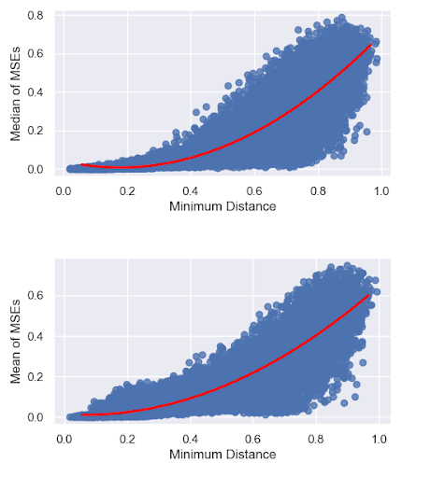
Summary of major outcomes Question 2: How to compare algorithms?
Minimum distance, MSE and SNR
Correlation of different metrics important
„One Metric sometimes provides not
the whole information: We need to find
how different metrics correlate“
0,8
0,6
0,4
Median of MSEs
0,2
0,0
0,0
0,2
0,4
0,6
0,8
1,0
Minimum Distance
0,6
0,8
0,6
0,4
0,4
Mean of MSEs
0,19
0,2
0,0
0,1
0,0
0,2
0,4
0,6
0,8
1,0
Minimum Distance

Slide 29
Summary of major outcomes Question 3: Which algorithm performs best? What happens with noise or outlier?
Monte Carlo run with 10.000 runs: Evaluate metrics
More or less similar with good data (simulated (stationary) and real EEG data with added artifacts (non-stationary))
PowerICA: quite good with reasonable SNR (~20dB), fast and with low variance
Low sample sizes are problematic (<5000 samples)
Higher noise than 20dB SNR: smoothly becoming worse
All reach breakdown point with one large outlier
„All four algorithms: Good performance on well behaving data but higher noise level or larger outlier cause
failure ➔ No real robust algorithm“

Slide 30
Summary of major outcomes Question 4: How to robustify?
Whitening process crucial for algorithms
Different objective functions for some algorithms
Initialization quite important (local maxima/minima)
Within algorithms: quite complicated → model based
What we tried:
Plug-in robustness of covariance estimation in whitening process
Trying out different robust objective functions
Initialize PowerICA with Radical as a global optimizer
„No real improvement: sometimes with noise a bit better, but still low
breakdown point”

Slide 31
Summary of major outcomes Question 5: What is Graph Signal processing / Graph BSS?
Graph signal processing: Use proximity/similarity between components of the underlying signal
„Graph BSS tries to combine the ICA approach to maximize the measure of independence and the graph signal approach to decorrelate the nodes of the graph”
0
1
2
3
…
N

Slide 32
Summary of major outcomes Question 6: Outcomes of Graph BSS?
Monte Carlo with 1000 runs:
Better Blind Source Separation with good signals (low sample size)
Real EEG data with artifacts separable
Similar with noisy data
Breakdown point with one outlier as well
Problem with graph structure
„Graph BSS is good for low sample sizes and if the graph structure is available. Otherwise similar outcomes as standard BSS”

Slide 33
Overview
Graph Blind Source Separation results
Summary of major outcomes
Problems and future research

Slide 34
Problems and future research
Problems:
Low Breakdown point
High noise dependency
Sample size important for standard ICA
Graph structure estimation: How to find correlation of graph signals?
Covariance estimation in higher dimensions problematic
Time consumption for real time EEG analysis
Future research:
Robust whitening / preprocessing
Incorporate noise process and outlier in model for ICA algorithm
Find good graph structure estimation
Robust covariance estimation in high dimensions

Slide 35
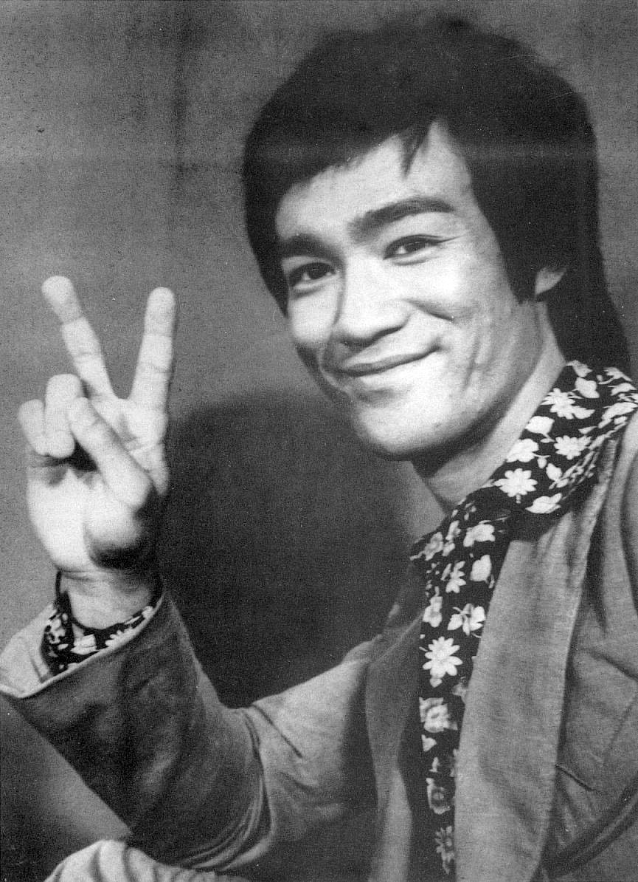
Thank you for your attention!

