Slide 2
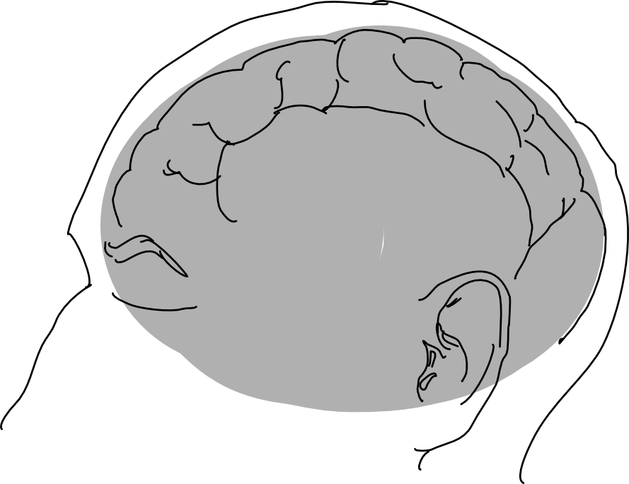
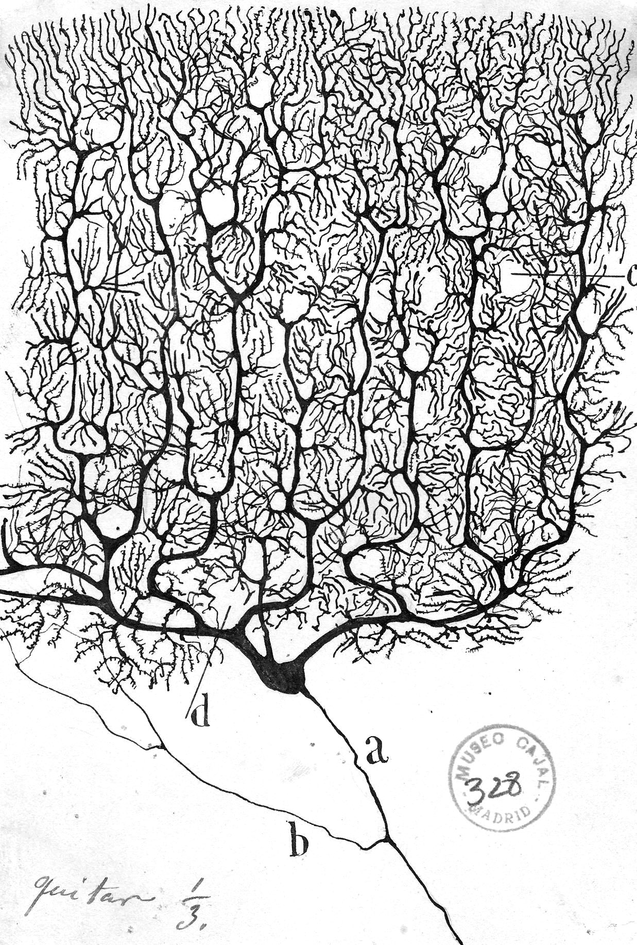
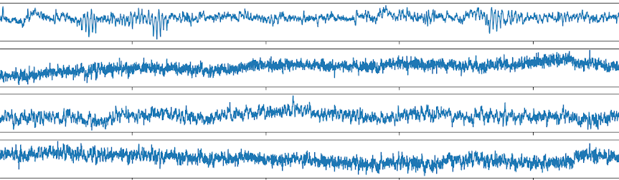
Motivation Challenge of Working with EEG Data
Electroencephalogram (EEG) Concept
What we wish to have?
We are observing the "oscillating slow fields" of neurons in the upper layers of the cerebral cortex.
These changes in electrical potential lead a neuron to be more likely or less likely to fire action potentials and are important in encoding information in the brain.
What do we get in experiments?
“
Working with EEG data is
therefore the process of source separation
EEG Channels
time t in seconds

