Slide 1
Agenda
1. Understanding the Basis of Source Separation via an Intuitive Example-Driven
Approach
2. Discussion of Experiment Design
3. Graph Blind Source Separation
4. Graph Blind Source Separation results
Summary of major outcomes
Problems and future research

Slide 2

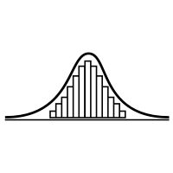
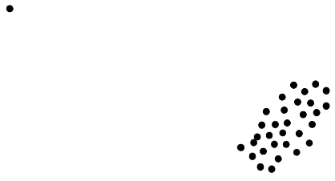

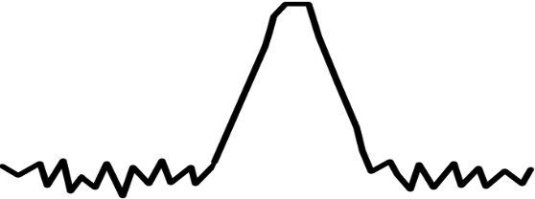
Shortcomings
Significant performance loss for sample sizes with N << 5000
Unable to recover more than one Gaussian signal
For SNR ≤ 20dB high variance in performance
Failures become increasingly likely
Inherently unrobust against outliers
A single outlier will lead to failure of the method
N
1. Samples
2. Gaussian
3. SNR ≤ 20dB
4. Outlier

Slide 3


Recent Developments
In 2010: Blind Source Separation(BSS) using graph theory [1]
In 2020: First approaches to combine non-Gaussianity based BSS with graph based BSS (Jari Miettinen et al.) [2]
What is the idea?
Design a method that uses:
Non-Gaussianity measure (classic ICA)

Slide 4
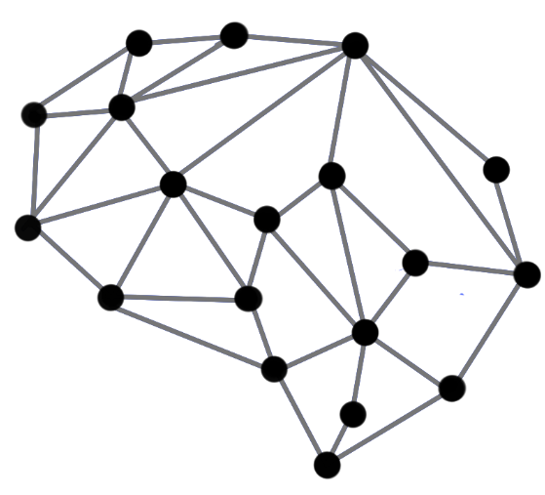
Recent Developments
In 2010: Blind Source Separation(BSS) using graph theory [1]
In 2020: First approaches to combine non-Gaussianity based BSS with graph based BSS (Jari Miettinen et al.) [2]
What is the idea?
Design a method that uses:
Non-Gaussianity measure (classic ICA)
Information about underlying graph structure
Combine those in a way that they complement each other

Slide 5
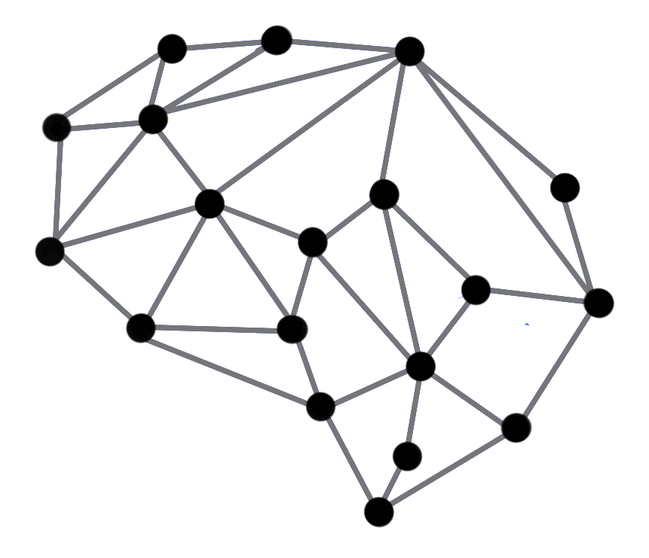

Graph Blind Source Separation What are Graphs?

Slide 6
Graph Blind Source Separation What are Graphs?
Graphs are structures build by vertices that are connected by edges
Edges represent proximity between two vertices
Graph structure can be stored in a matrix ⇒ The adjacency matrix A
Examples: Social networks, sensor networks, brain networks, etc. [3]
0 1 1 1 1 1 1
7
2
1 0 0 0 0 0 0
1 0 0 0 0 0 0
A =
1 0 0 0 0 0 0
6
1
3
1 0 0 0 0 0 0
1 0 0 0 0 0 0
4
1 0 0 0 0 0 0
5
Undirected unweighted graph

Slide 7
Graph Blind Source Separation What are Graphs?
Graphs are structures build by vertices that are connected by edges
Edges represent proximity between two vertices
Graph structure can be stored in a matrix ⇒ The adjacency matrix A
Examples: Social networks, sensor networks, brain networks, etc. [3]
0 1 1 1 1 1 1
7
2
1 0 0 0 0 0 0
1 0 0 0 0 0 0
A =
1 0 0 0 0 0 0
6
1
3
1 0 0 0 0 0 0
1 0 0 0 0 0 0
4
1 0 0 0 0 0 0
5
Undirected unweighted graph

Slide 8
Graph Blind Source Separation What are Graph Signals?
Analogy to discrete time signals
Simplest case: Recursive Line Graph
Each node represents a sample point
Directed graph ⇒ unsymmetric adjacency [3]
0
1
2
3
…
N
n ∈ ℕ, n ≤ N
0 1 0 0 0 0 … 0
0 0 1 0 0 0 … 0
0 0 0 1 0 0 … 0
A =
0 0 0 0 1 0 … 0
. . . . . . … 0
. . . . . . … 1
1 0 0 0 0 0 … 0

Slide 9
Graph Blind Source Separation What are Graph Signals?
Analogy to discrete time signals
Simplest case: Recursive Line Graph
Multiple Signals can share the same graph
In this case: The class of all periodic signals with period N [3]
0
1
2
3
…
N
n ∈ ℕ, n ≤ N
0 1 0 0 0 0 … 0
0 0 1 0 0 0 … 0
0 0 0 1 0 0 … 0
A =
0 0 0 0 1 0 … 0
. . . . . . … 0
. . . . . . … 1
1 0 0 0 0 0 … 0

Slide 10

Graph Blind Source Separation What are Graph Signals?
Analogy to discrete time signals
Simplest case: Recursive Line Graph
We call ${XA}^{k}=X^{(k)}$ a graph shift by k
For Line Graph ⇔ Shift operator as known from Digital Signal Processing
When a graph shift is applied, the signal will shift along every connected path made up of the k nearest edges. [3]
k = 1 shift
0
1
2
3
…
N
n ∈ ℕ, n ≤ N

Slide 11
Graph Blind Source Separation What are Graph Signals?
Analogy to discrete time signals
Simplest case: Recursive Line Graph
We call ${XA}^{k}=X^{(k)}$ a graph shift by k
For Line Graph ⇔ Shift operator as known from Digital Signal Processing
When a graph shift is applied, the signal will shift along every connected path made up of the k nearest edges. [3]
k = 1 shift
0
1
2
3
…
N
n ∈ ℕ, n ≤ N

Slide 12
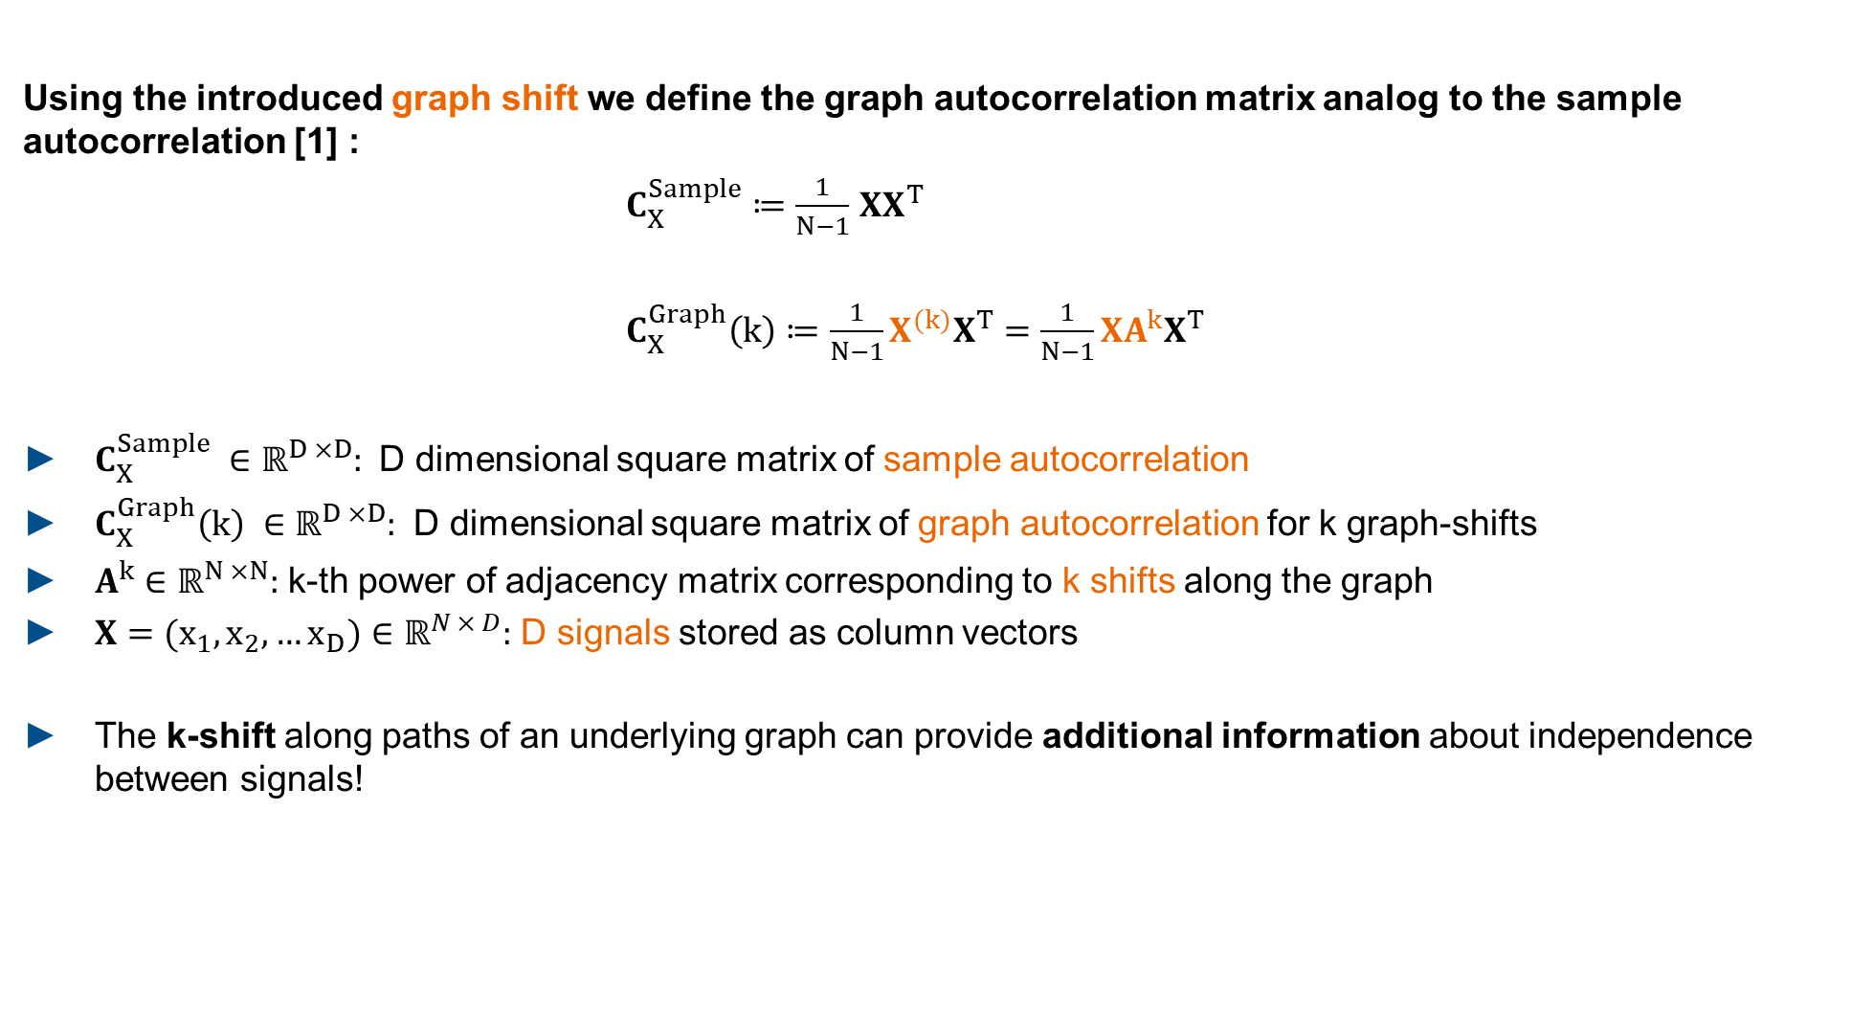

Graph Blind Source Separation Graph Autocorrelation
Using the introduced graph shift we define the graph autocorrelation matrix analog to the sample autocorrelation [1] :
$C_{X}^{Sample}≔\frac{1}{N−1}$ $XX^{T}$
$C_{X}^{Graph}\left(k\right)≔\frac{1}{N−1}X^{(k)}X^{T}=\frac{1}{N−1}XA^{k}X^{T}$
$C_{X}^{Sample} ∈{\text{ℝ}}^{D ×D}:$ D dimensional square matrix of sample autocorrelation
$C_{X}^{Graph}\left(k\right) ∈{\text{ℝ}}^{D ×D}:$ D dimensional square matrix of graph autocorrelation for k graph-shifts
$A^{k}∈{\text{ℝ}}^{N ×N}:$ k-th power of adjacency matrix corresponding to k shifts along the graph
$X=(x_{1}, x_{2},…x_{D})∈{\text{ℝ}}^{N × D}:$ D signals stored as column vectors
The k-shift along paths of an underlying graph can provide additional information about independence between signals!
$=\frac{1}{N−1}$ $XIX^{T}$
$A^{k}{\left.​\right|}_{k=0}=I$ ,
$I$ $∈{\text{ℝ}}^{N ×N}$: Identity Matrix

Slide 13


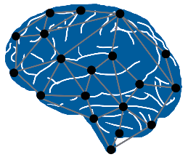

Graph Blind Source Seperation Graph Decorrelation
Find a matrix $U$ that diagonalizes $UC_{X}^{Graph}U^{T}$ as much as possible [1]
The solution for $U$ decorrelates the signals $X$ in the graph-sense
$U$ is a solution of the BSS problem for graph-signals
Advantages | Disadvantages
Independent of data distribution | Graph structure not directly available
Works well with small sample sizes | Highly dependent on accurate graph
Graph structure in many real- world problems
N

Slide 14
Graph Blind Source Seperation Graph Decorrelation
PowerICA shortcomings:
Significant performance loss for sample sizes with N << 5000
Unable to recover more than one Gaussian signal
Advantages | Disadvantages
Independent of data distribution | Graph structure not directly available
Works well with small sample sizes | Highly dependent on accurate graph
Graph structure in many real- world problems
N
Graph based BSS and non-Gaussianity based BSS seem to make up for each others weak points.

Slide 15





Graph Blind Source Seperation Composite Objective
How can we combine them?
Approach from Jari Miettinen et al. (Aalto University) [2]
Define composite objective function $f_{composite}$:
PowerICA objective:
Maximize estimate of non-Gaussianity with the Lagrangian method.
$$\text{(1−}\text{λ}\text{)}$$
+
Composite objective function $f_{composite}$
Graph decorrelation objective:
Diagonalize graph autocorrelation matrix(matrices) as much as possible. For only one adjacency ⇒ eigenvalue problem.
$$\text{λ}$$
Balance Parameter
$$\text{0 < }\text{λ}\text{ < 1}$$

Slide 16
Literature
[1] Graph Signal Processing Meets Blind Source Separation, Jari Miettinen, Esa Ollila et al., 2020
[2] Second-Order Source Separation Based on Prior Knowledge Realized in a Graph Model, Florian Blöchl, Andreas Kowarsch, Fabian J. Theis, 2010
[3] Cooperative and Graph Signal Processing Principles and Applications, Petar Djuric, Cédric Richard, 2018

