Slide 1
Agenda
1. Understanding the Basis of Source Separation via an Intuitive Example-Driven
Approach
2. Discussion of Experiment Design
3. Graph Blind Source Separation
4. Graph Blind Source Separation results
5. Summary of major outcomes
6. Problems and future research
Notes:
Now we procede with the next part of our presentation, which covers Graph BSS

Slide 2

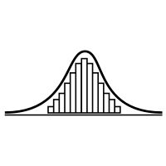
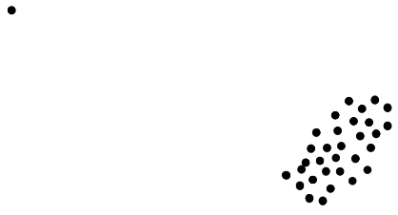

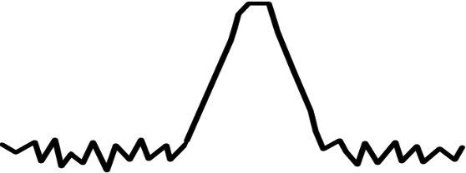
Shortcomings
Significant performance loss for sample sizes with N << 5000
Unable to recover more than one Gaussian signal
For SNR ≤ 20dB high variance in performance
Failures become increasingly likely
Inherently unrobust against outliers
A single outlier will lead to failure of the method
N
1. Samples
2. Gaussian
3. SNR ≤ 20dB
4. Outlier
Notes:
As Korbinian pointed out:
we observe several deficits of the method ,which are cloesly related to the assumptions we made for ICA in general
1. The Algorithm struggled with low numbers of observations of the signals, needed at least 5000 to perform well consistently
2. can’t recover more than one gaussian signal
3. If SNR < 20dB, the number of failures increases
4. Early Breakdown for a single outlier already
Raises the Question: What other approaches to ICA are there?

Slide 3


Recent Developments
In 2010: Blind Source Separation(BSS) using graph theory [Blöchl, 2010]
In 2020: First approaches to combine non-Gaussianity based BSS with graph based BSS (Jari Miettinen et al.) [Miettinen, 2020]
What is the idea?
Design a method that uses:
Non-Gaussianity measure (classic ICA)
Notes:
In 2010 a research team from Helmholtz Research Center came up with a method to use graph theory based Signal Separation
10 years later - > Aalto research group around Esa Ollila and Jari Miettinen came up with an approach to combine this graph based Method with non-Gaussianity based ICA by:
Maximizing some Non-Gaussianity measure and

Slide 4
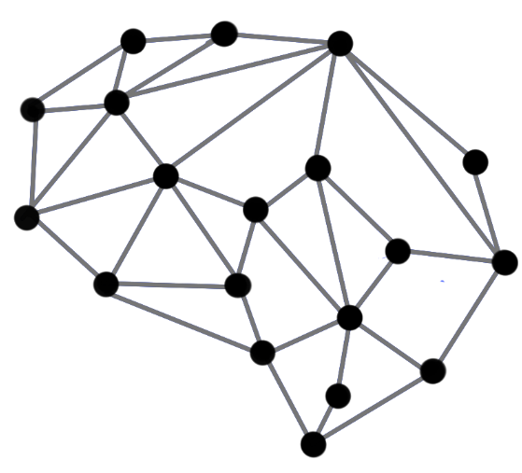
Recent Developments
In 2010: Blind Source Separation(BSS) using graph theory [Blöchl, 2010]
In 2020: First approaches to combine non-Gaussianity based BSS with graph based BSS (Jari Miettinen et al.) [Miettinen, 2020]
What is the idea?
Design a method that uses:
Non-Gaussianity measure (classic ICA)
Information about underlying graph structure
Combine those in a way that they complement each other
Notes:
In 2010 a research team from Helmholtz Research Center came up with a method to use graph theory based Signal Separation
10 years later - > Aalto research group around Esa Ollila and Jari Miettinen came up with an approach to combine this graph based Method with non-Gaussianity based ICA by:
Using some Non-Gaussianity measure and information about some network topology
At first this sounds very appealing, but one might ask: What are graphs?

Slide 5
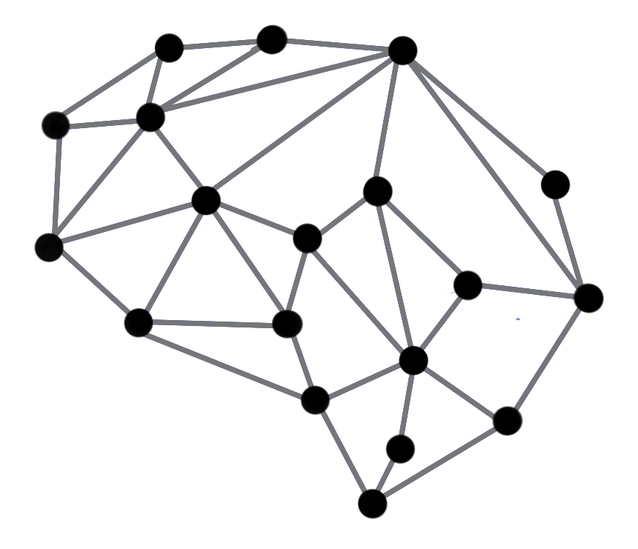

Graph Blind Source Separation What are Graphs?
Notes:
In following: A short introduction to the concepts we used

Slide 6
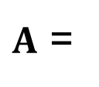
Graph Blind Source Separation What are Graphs?
Graphs are structures build by vertices that are connected by edges
Edges represent proximity between two vertices
Graph structure can be stored in a matrix ⇒ The adjacency matrix A
Examples: Social networks, sensor networks, brain networks, etc. [Djuric, 2018]
0 1 1 1 1 1 1
7
2
1 0 0 0 0 0 0
1 0 0 0 0 0 0
$A$ =
1 0 0 0 0 0 0
6
1
3
1 0 0 0 0 0 0
1 0 0 0 0 0 0
4
1 0 0 0 0 0 0
5
Undirected unweighted graph
Notes:
Firs of all: A set of vertices/nodes that is connected by some edges is called a Graph
The edges represent some kind of proximity ore closeness of the nodes
Example Facebook/Instagram: Each member is a vertex, each friendship or follower is an edge
Edges may be directed or undirected
Undirected: If I am friends with Korbinian or Felix on Facebook, it means they are also friends with me => the friendship is mutual)
Directed: If I follow someone on Instagram it doesn’t mean they necessarily follow me to
This information about the topology of the graph can be stored compactly in an adjacency matrix

Slide 7

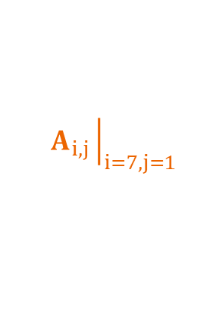

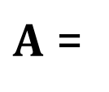
Graph Blind Source Separation What are Graphs?
Graphs are structures build by vertices that are connected by edges
The Entry $A_{i,j}$represents the edge between node i and j
$$A_{i,j}{\left.​\right|}_{i=1,j=7}$$
0 1 1 1 1 1 1
7
2
1 0 0 0 0 0 0
1 0 0 0 0 0 0
$A$ =
1 0 0 0 0 0 0
6
1
3
1 0 0 0 0 0 0
1 0 0 0 0 0 0
4
1 0 0 0 0 0 0
5
Undirected unweighted graph
$$A_{i,j}{\left.​\right|}_{i=7,j=1}$$
Notes:
each i,jth entry of the Adjacency matrix represents the edge between nodes i and j and A_ji the edge between j and i
If node 1 is representing me and node 7 is representing Korbinian it would mean that we are friends, or that we are both following each other or some other kind of mutual connection

Slide 8
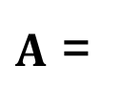
Graph Blind Source Separation Graph Signals
Analogy to discrete time signals
Simplest case: Recursive Line Graph
Each node represents a sample point
Directed graph ⇒ unsymmetric adjacency [Djuric, 2018]
0
1
2
3
…
N
n ∈ ℕ, n ≤ N
0 1 0 0 0 0 … 0
0 0 1 0 0 0 … 0
0 0 0 1 0 0 … 0
$A$ =
0 0 0 0 1 0 … 0
. . . . . . … 0
. . . . . . … 1
1 0 0 0 0 0 … 0
Notes:
Now that we know Graphs, we can introduce the concept of Signals on this graph
Actually we already know one => the time axis in discrete time signals can be represented as Line graph, in the case of periodic signals it woul be a recursive or cyclic line graph as shown here
This graph is directed (because flow of time is directed) => leads to A unsymmetric
In this representation each node of the Graph represents a time instance of the Signal

Slide 9
Graph Blind Source Separation What are Graph Signals?
Analogy to discrete time signals
Simplest case: Recursive Line Graph
Multiple Signals can share the same graph
In this case: The class of all periodic signals with period N [Djuric, 2018]
0
1
2
3
…
N
n ∈ ℕ, n ≤ N
0 1 0 0 0 0 … 0
0 0 1 0 0 0 … 0
0 0 0 1 0 0 … 0
$A$ =
0 0 0 0 1 0 … 0
. . . . . . … 0
. . . . . . … 1
1 0 0 0 0 0 … 0
Notes:
Examples of corresponding edges in the Adjacency matrix are depicted in colors ( green to last node, orange to first node)
It is important to note, that there can be various signals that share the same graph structure
In this case that would be : all periodic signals with Period of length N
Now that we have established what graph signals are, we can go ahead and define the Graph Shift

Slide 10

Graph Blind Source Separation What are Graph Signals?
Analogy to discrete time signals
Simplest case: Recursive Line Graph
We call ${XA}^{k}=X^{(k)}$ a graph shift by k
For Line Graph ⇔ Shift operator as known from Digital Signal Processing
When a graph shift is applied, the signal will shift along every connected path made up of the k nearest edges. [Djuric, 2018]
k = 1 shift
0
1
2
3
…
N
n ∈ ℕ, n ≤ N
Notes:
Graph Shift analog to the Shift Operator known from Digital Signal Processing:
In fact it is the same, for this type of Line Graph
This Propagation of the Signal through the graph, can be achieved by multiplication of the Signals X with the Adjacency Matrix A^k , where k is the length of the shift
So we can state that graph shift by k will propagate the signal along every connected path along the k nearest outgoing edges
Let‘s see what would happen, if we had an edge going from node 0 to node 3

Slide 11
Graph Blind Source Separation What are Graph Signals?
Analogy to discrete time signals
Simplest case: Recursive Line Graph
We call ${XA}^{k}=X^{(k)}$ a graph shift by k
For Line Graph ⇔ Shift operator as known from Digital Signal Processing
When a graph shift is applied, the signal will shift along every connected path made up of the k nearest edges. [Djuric, 2018]
k = 1 shift
0
1
2
3
…
N
n ∈ ℕ, n ≤ N
Notes:
As you can see, having additional connections between nodes will lead to a linear combination of the values of the signal that have been propagated through the incident edges into a node
In this case we have added up the values shifted from node 0 and node 2 into node 3
With all of this we are now able to define the Graph autocorrelation

Slide 12
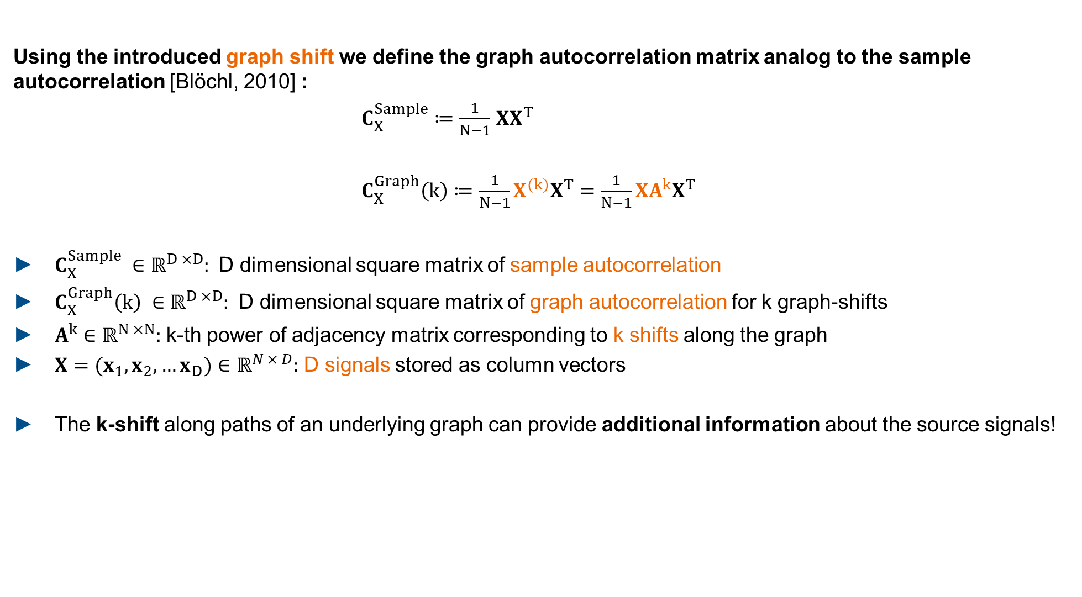

Graph Blind Source Separation Graph Autocorrelation
Using the introduced graph shift we define the graph autocorrelation matrix analog to the sample autocorrelation [Blöchl, 2010] :
$C_{X}^{Sample}≔\frac{1}{N−1}$ $XX^{T}$
$C_{X}^{Graph}\left(k\right)≔\frac{1}{N−1}X^{(k)}X^{T}=\frac{1}{N−1}XA^{k}X^{T}$
$C_{X}^{Sample} ∈{\text{ℝ}}^{D ×D}:$ D dimensional square matrix of sample autocorrelation
$C_{X}^{Graph}\left(k\right) ∈{\text{ℝ}}^{D ×D}:$ D dimensional square matrix of graph autocorrelation for k graph-shifts
$A^{k}∈{\text{ℝ}}^{N ×N}:$ k-th power of adjacency matrix corresponding to k shifts along the graph
$X=(x_{1}, x_{2},…x_{D})∈{\text{ℝ}}^{N × D}:$ D signals stored as column vectors
The k-shift along paths of an underlying graph can provide additional information about the source signals!
$=\frac{1}{N−1}$ $XIX^{T}$
$A^{k}{\left.​\right|}_{k=0}=I$ ,
$I$ $∈{\text{ℝ}}^{N ×N}$: Identity Matrix
Notes:
Analog to the sample autocorrelation matrix, which equals the sample covariance matrix because we have centered our data beforehand to have zero mean
We can define the graph autocorrelation as the correlation between the Signals X and the signals X at a lag k, meaning that it has been shifted by k through the graph
With that in mind it is easy to see that for k = 0 our Shift Operator will be equal to the Identity matrix and we end up with the sample autocorrelation matrix ,
This shift through the Graph, provides us with additional information about our sources, if they follow some other order than just the line-graph
Having this additional Information, we can use a decorrelation method to seperate our signals

Slide 13


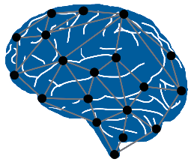

Graph Blind Source Seperation Graph Decorrelation
Find a matrix $W$ that diagonalizes $WC_{X}^{Graph}W^{T}$ as much as possible [Blöchl, 2010]
The solution for $W$ decorrelates the signals $X$ in the graph-sense
$W$ is an estimate for the solution of the BSS problem for graph-signals
Advantages | Disadvantages
Independent of data distribution | Graph structure not directly available
Works well with small sample sizes | Highly dependent on accurate graph
Graph structure in many real- world problems
N
Notes:
That, we do by finding a matrix W which diagonalizes our graph autocorrelation as much possible
In all of this we asssume whitened data
Then, W is an estimate for the Solution of the Source Separation Problem
This Method, has some noteworthy advantages:
Unlike ICA it does not presume any specific distribution of the signals, meaning it works with gaussian signals as well
The sample sizes can be much lower, (performs well with 1000 samples already)
There are numerous underlying network topologies in real world problems
However, these graph structures are most of the time not directly available and need to be inferred by some method
Therefore it is a major disadvantage, that the performance of the algorithm is highly dependent on accurate graph estimations

Slide 14
Graph Blind Source Seperation Graph Decorrelation
PowerICA shortcomings:
Significant performance loss for sample sizes with N << 5000
Unable to recover more than one Gaussian signal
Advantages | Disadvantages
Independent of data distribution | Graph structure not directly available
Works well with small sample sizes | Highly dependent on accurate graph
Graph structure in many real- world problems
N
Graph based BSS and non-Gaussianity based BSS seem to make up for each others weak points.
Notes:
Comparing this with the shortcomings of PowerICA adressed earlier it seems that they complement each other
So the Question is, how do we combine them?

Slide 15





Graph Blind Source Seperation Composite Objective
How can we combine them?
Approach from Jari Miettinen et al. (Aalto University) [Miettinen, 2020]
Define composite objective function $f_{composite}$:
PowerICA objective:
Maximize estimate of non-Gaussianity with the Lagrangian method.
$$\text{(1−}\text{λ}\text{)}$$
+
Composite objective function $f_{composite}$
Graph decorrelation objective:
Diagonalize graph autocorrelation matrix(matrices) as much as possible. For only one adjacency ⇒ eigenvalue problem.
$$\text{λ}$$
Balance Parameter
$$\text{0 < }\text{λ}\text{ < 1}$$
Notes:
The approach by Jari Miettinens group at Aalto considers first the two objective functions of
An ICA objective, which we chose to be PowerICA, that tries to separate the signals by maximizing non-Gaussianity
The Graph decorrelation objective, which is the diagonalization process of the graph autocorrelation
We cannot simply add them up as they are, but by introducing a new parameter lambda, that balances the two objective functions, we arrive at the composite objective function
And how this concept fared, you will hear by Christian

Slide 16
Literature
[Miettinen, 2020] Graph Signal Processing Meets Blind Source Separation, Jari Miettinen, Esa Ollila et al., 2020
[Blöchl, 2010] Second-Order Source Separation Based on Prior Knowledge Realized in a Graph Model, Florian Blöchl, Andreas Kowarsch, Fabian J. Theis, 2010
[Djuric, 2018] Cooperative and Graph Signal Processing Principles and Applications, Petar Djuric, Cédric Richard, 2018

