Slide 3
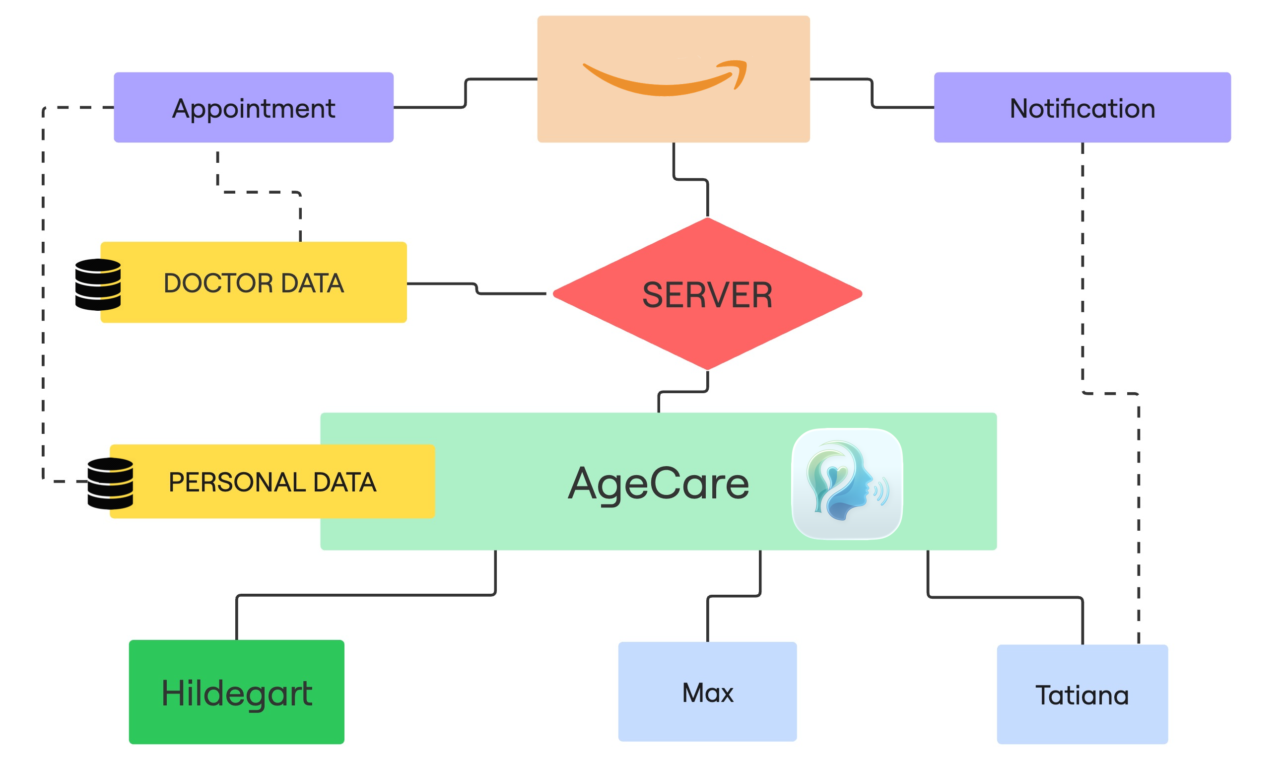
Notes:
Implementation

